Slide 1
Chapter 4
Partitioning
and Divide-and-Conquer Strategies

Slide 2
Partitioning
Partitioning simply divides the problem into parts.
Divide and Conquer
Characterized by dividing problem into sub-problems of same form as larger problem. Further divisions into still smaller sub-problems, usually done by recursion.
Recursive divide and conquer amenable to parallelization because separate processes can be used for divided parts. Also usually data is naturally localized.
4.1

Slide 3
Partitioning/Divide and Conquer
Examples
Many possibilities.
• Operations on sequences of number such as simply adding them together
• Several sorting algorithms can often be partitioned or constructed in a recursive fashion
• Numerical integration
• N-body problem
4.2

Slide 4
Partitioning Strategies
Partitioning can be applied to the program data (i.e., to dividing the data and operating upon the divided data concurrently). This is called data partitioning or domain decomposition.
Partitioning can also be applied to the functions of a program (i.e., dividing it into independent functions and executing them concurrently). This is functional decomposition.
data partitioning is a main strategy for parallel programming.

Slide 5
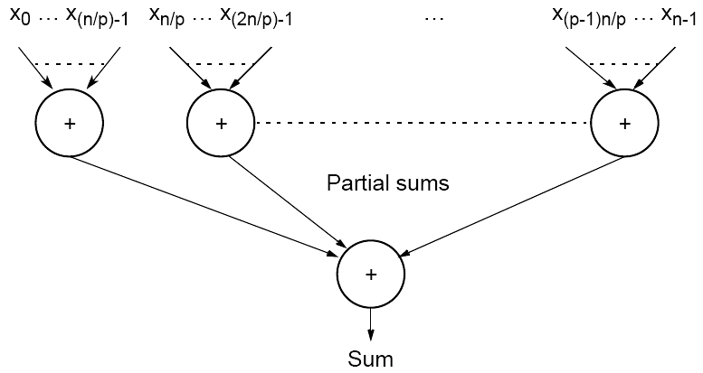
Partitioning a sequence of numbers into parts and adding the parts
For a simple master-slave approach, the numbers are sent from the master processor to the slave processors. They add their numbers, operating independently and concurrently, and send the partial sums to the master processor. The master processor adds the partial sums to form the result.

Slide 6
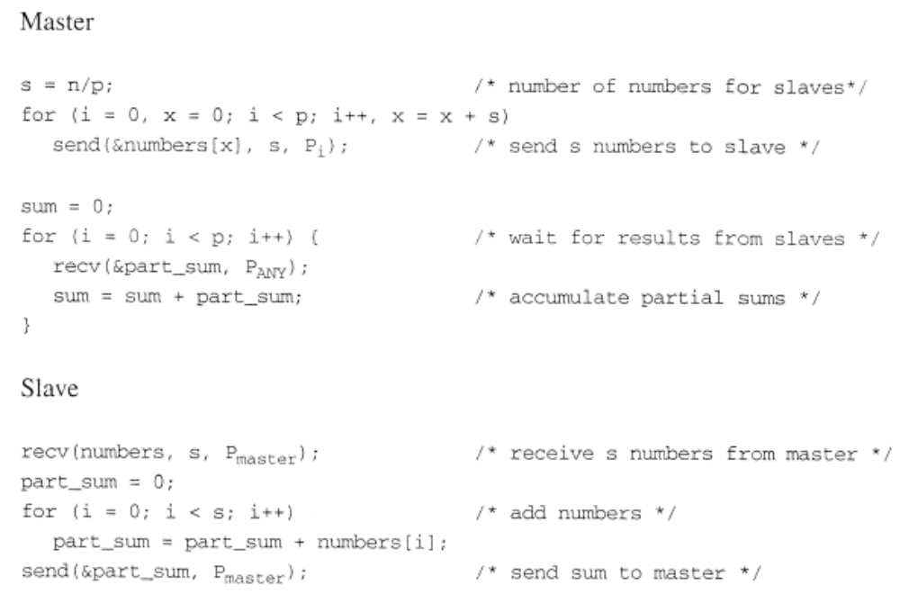
Send and Recv
4.3

Slide 7
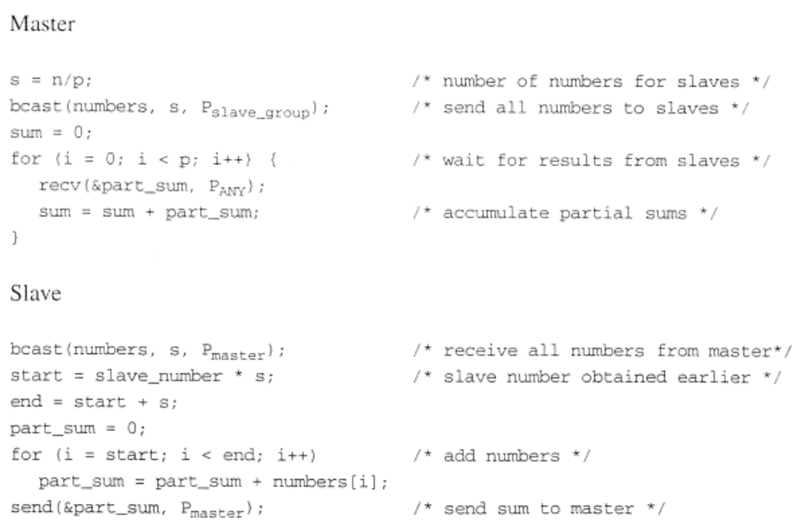
broadcast

Slide 8
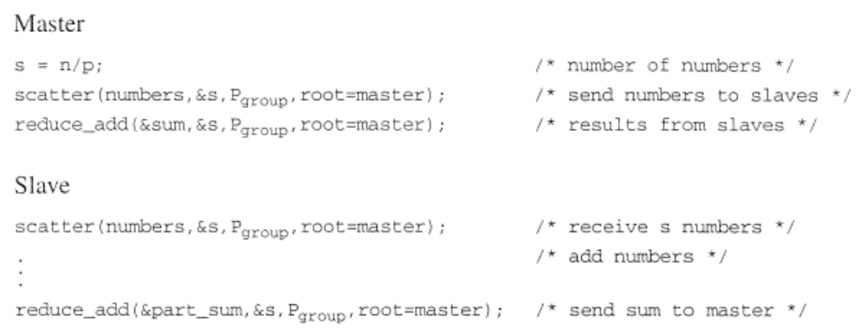
Scatter and Reduce
Can be used for other operations, as maximum number finding

Slide 9
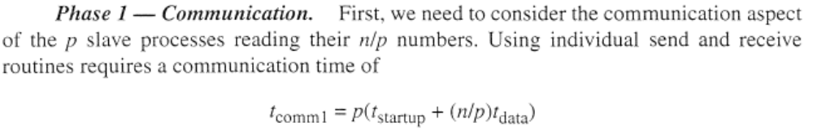
Analysis
The sequential computation requires n - 1 additions with a time complexity of O(n). In the parallel implementation, there are p slaves. the master process are included in one of the slaves in a SPMD model.

Slide 10
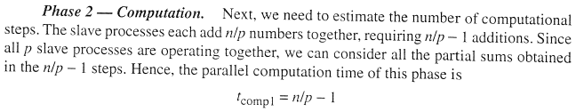
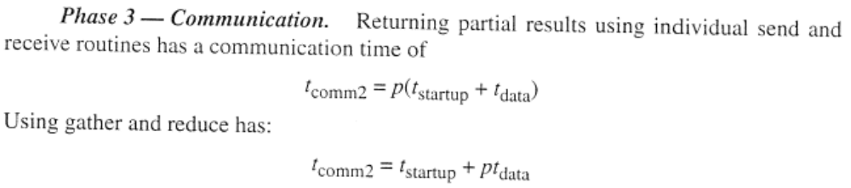
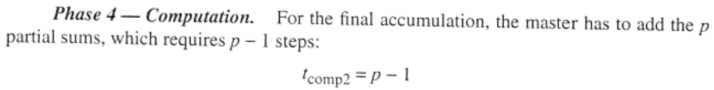

Slide 11
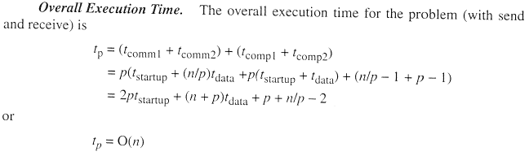
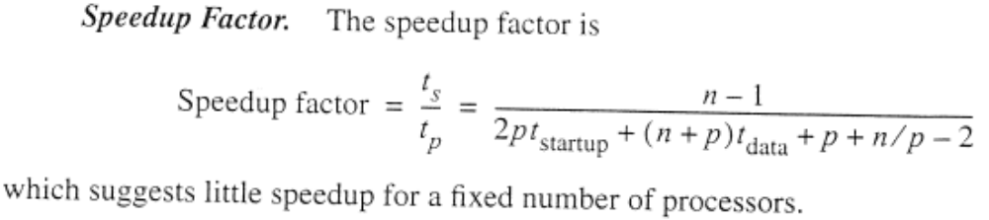

Slide 12
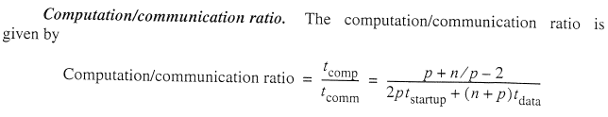
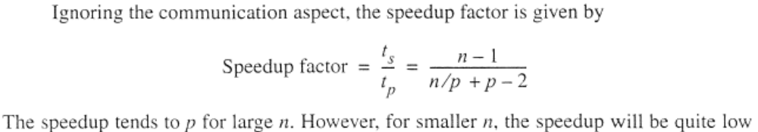

Slide 13
Divide and Conquer
The divide-and-conquer approach is characterized by dividing a problem into subproblems that are of the same form as the larger problem.
Further divisions into still smaller subproblems are usually done by recursion, a method well known to sequential programmers.
The recursive method will continually divide a problem until the tasks cannot be broken down into smaller parts.
Then the very simple tasks are performed and results combined.

Slide 14
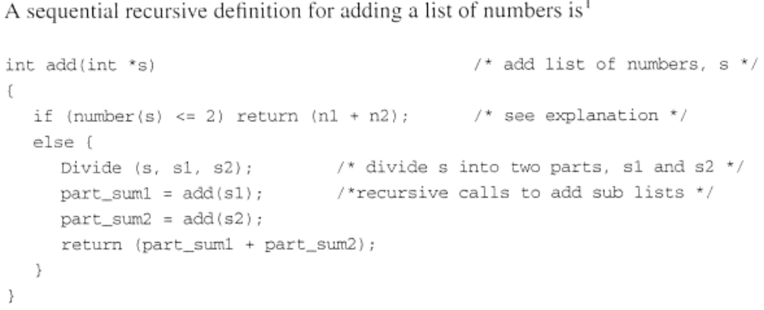

Slide 15
This method can be used for other global operations on a list, such as finding the maximum number. It can also be used for sorting a list by dividing it into smaller and smaller lists to sort. (Mergesort and quicksort sorting algorithms)
When each division creates two parts, a recursive divide-and-conquer formulation forms a binary tree. The tree is traversed downward as calls are made and upward when the calls return (a preorder traversal given the recursive definition).

Slide 16
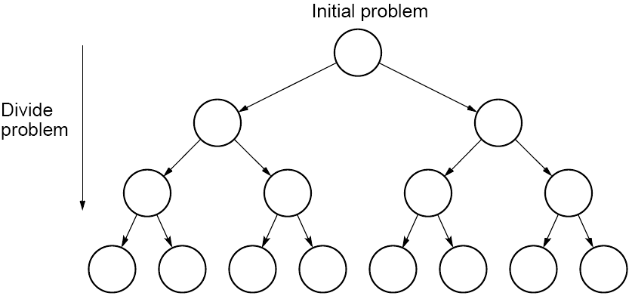
Tree construction
4.4

Slide 17
Parallel Implementation
In a sequential implementation, only one node of the tree can be visited at a time.
A parallel solution offers the prospect of traversing several parts of the tree simultaneously. Once a division is made into two parts. both parts can be processed simultaneously.
One could simply assign one processor to each node in the tree. (inefficient solution, too many processors)
A more efficient solution is to reuse processors at each level of the tree.

Slide 18
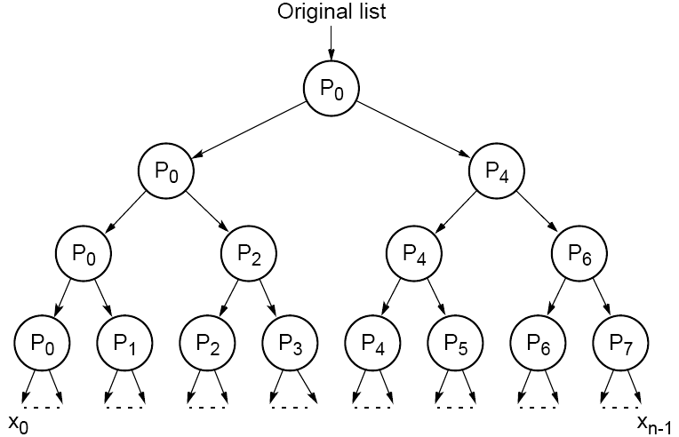
Dividing a list into parts
4.5

Slide 19
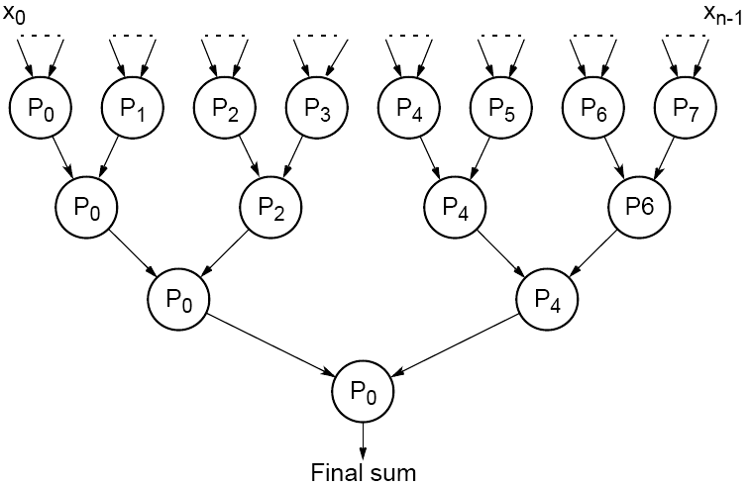
Partial summation
4.6

Slide 20
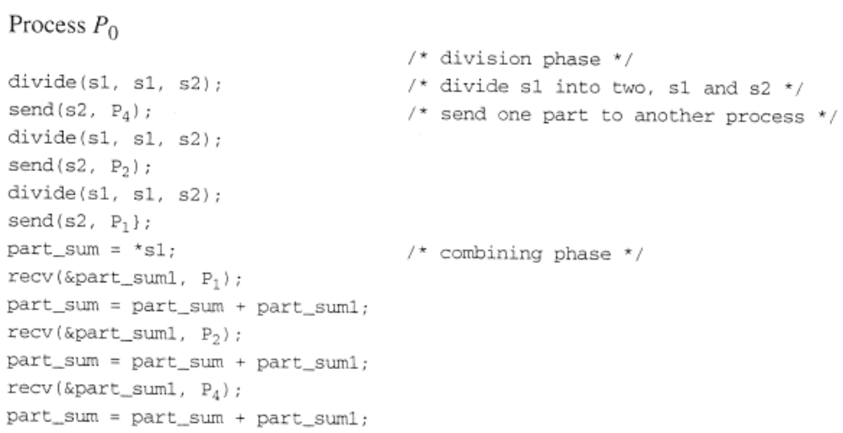
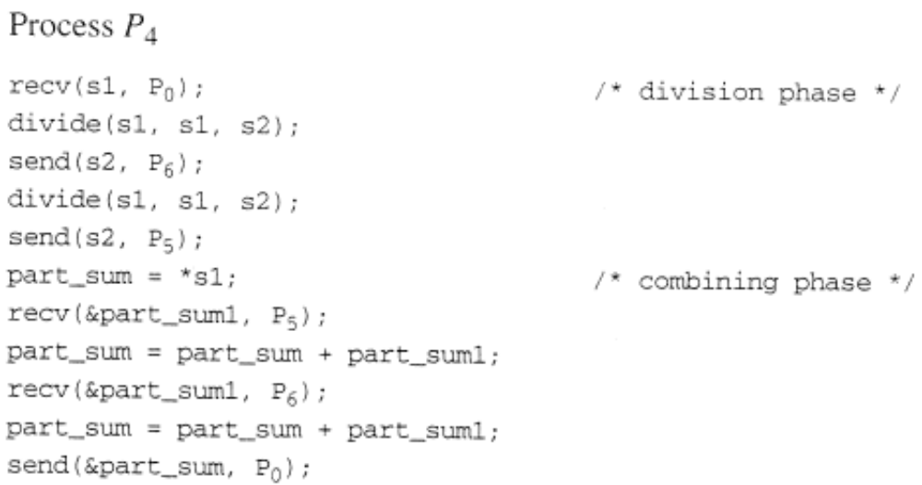

Slide 21
Analysis
We shall assume that n is a power of 2. The communication setup time, t_{startup}, is not included in the following for simplicity.
The division phase essentially consists only of communication if we assume that dividing the list into two parts requires minimal computation. The combining phase requires both computation and communication to add the partial sums received and pass on the result.

Slide 22
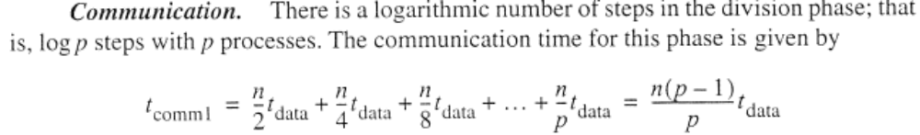



Slide 23
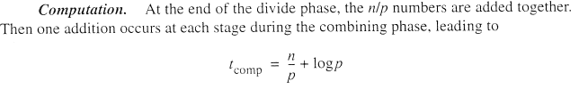
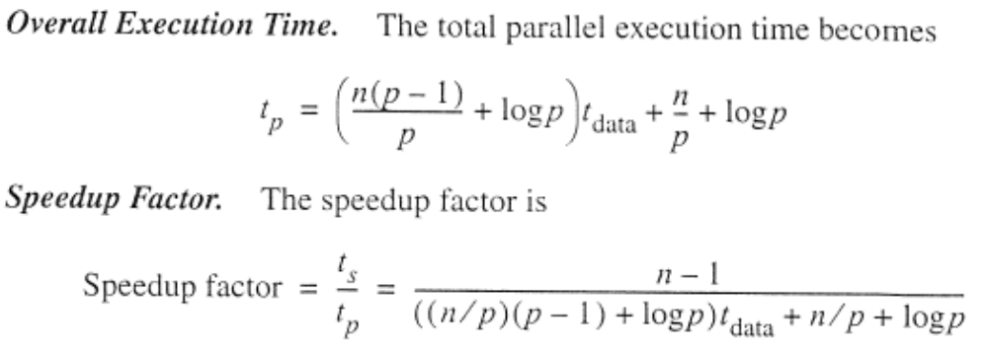

Slide 24
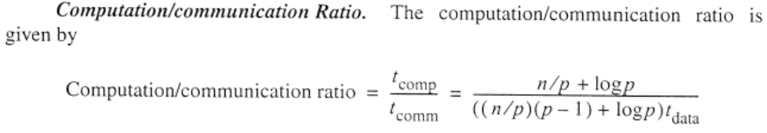

Slide 25
M-ary Divide and Conquer
Divide and conquer can also be applied where a task is divided into more than two parts at each stage.
A tree in which each node has four children is called a quadtree.
An octtree is a tree in which each node has eight children.
An m-ary tree would be formed if the division is into m parts.

Slide 26
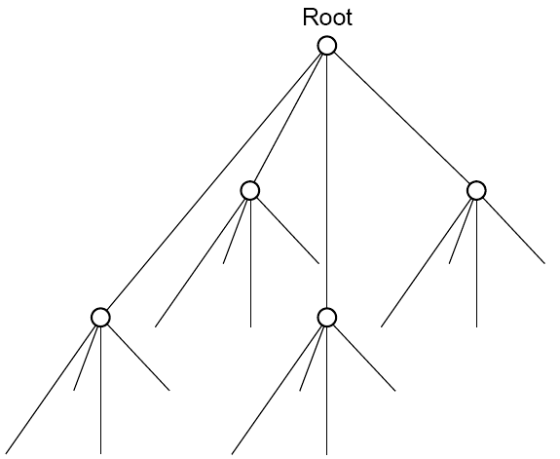
Quadtree
4.7

Slide 27
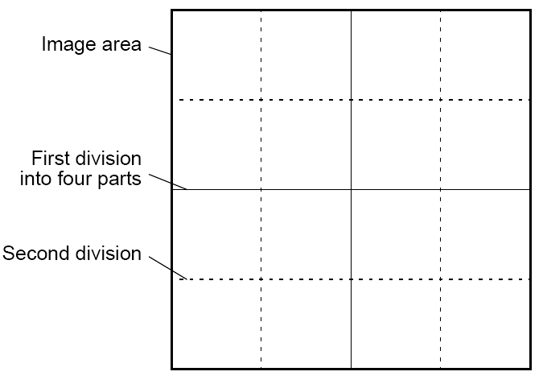
Dividing an image
4.8

Slide 28
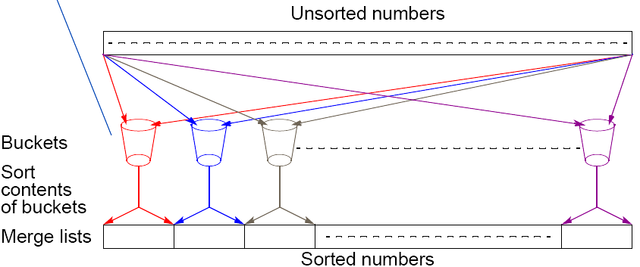
Bucket sort
One “bucket” assigned to hold numbers that fall within each region.
Numbers in each bucket sorted using a sequential sorting algorithm.
Sequential sorting time complexity: ty = n + m((n/m)log(n/m» = n + nlog(n/m) = O(nlog(n/m)) (traditional sorting: nlogn)
Works well if the original numbers uniformly distributed across a known interval, say 0 to a - 1.
4.9

Slide 29
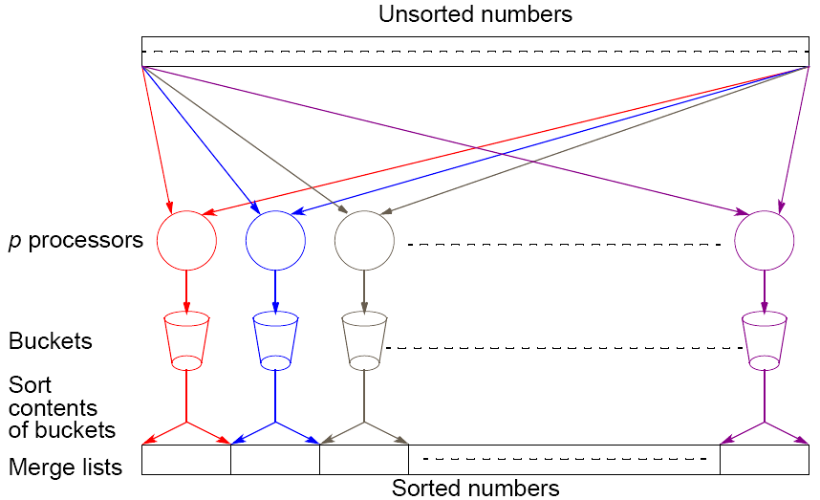
Parallel version of bucket sort
Simple approach
Assign one processor for each bucket.
4.10

Slide 30
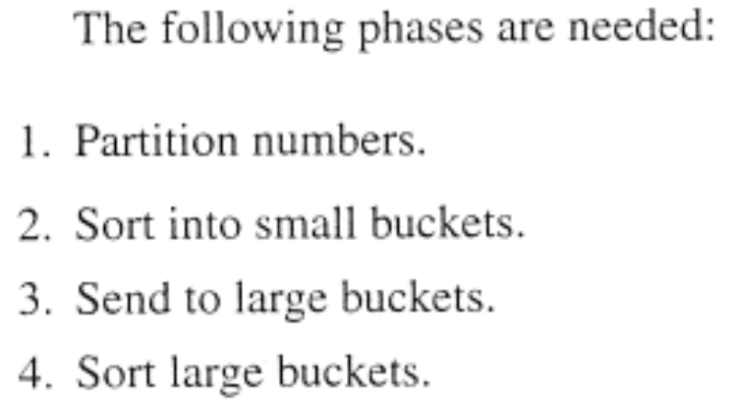
Further Parallelization
Partition sequence into m regions, one region for each processor.
Each processor maintains p “small” buckets and separates numbers in its region into its own small buckets.
Small buckets then emptied into p final buckets for sorting, which requires each processor to send one small bucket to each of the other processors (bucket i to processor i).
4.11

Slide 31
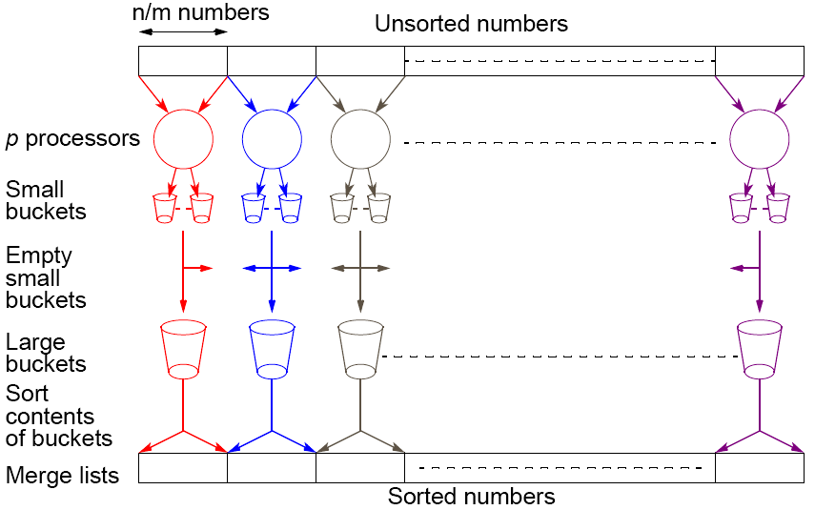
Another parallel version of bucket sort
Introduces new message-passing operation - all-to-all broadcast.
4.12

Slide 32
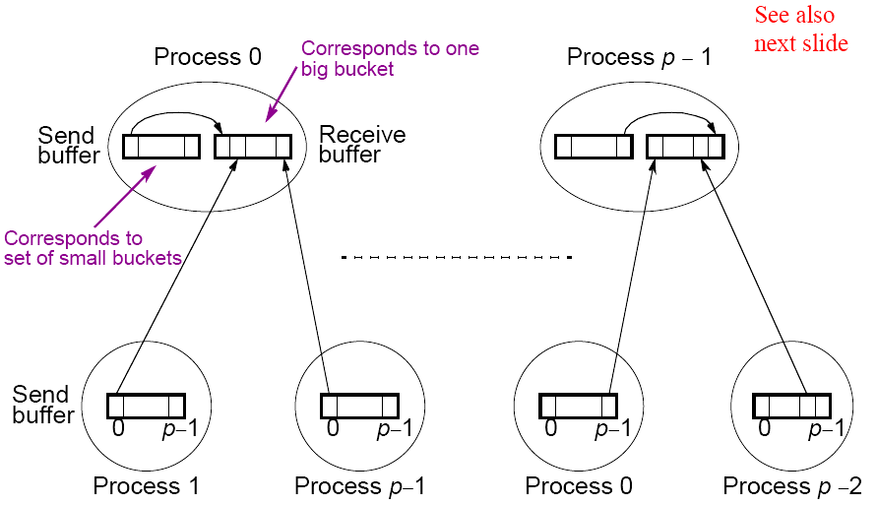
“all-to-all” broadcast routine
Sends data from each process to every other process
4.13

Slide 33
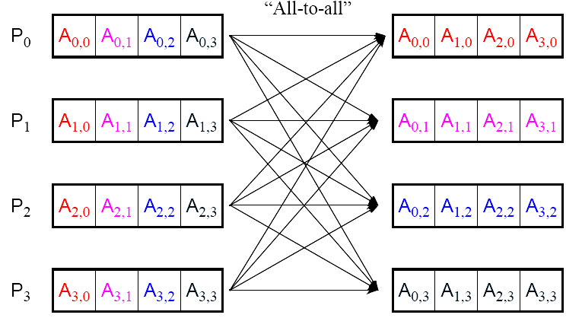
“all-to-all” routine actually transfers rows of an array to columns:
Transposes a matrix.
4.14

Slide 34






Analysis
upper
lower

Slide 35
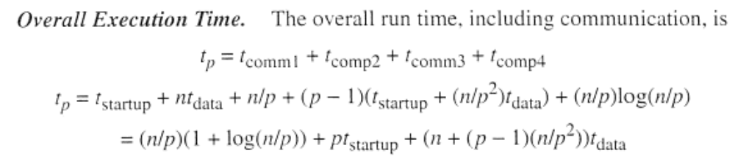
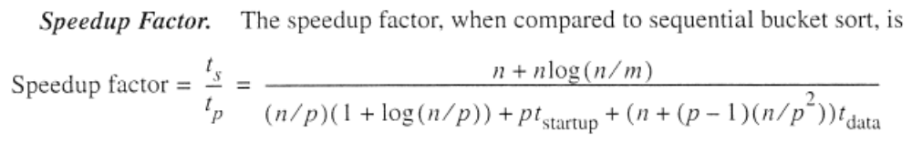
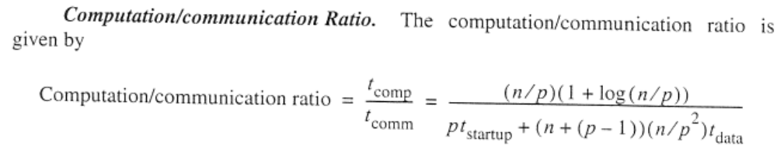
*No result collection.

Slide 36

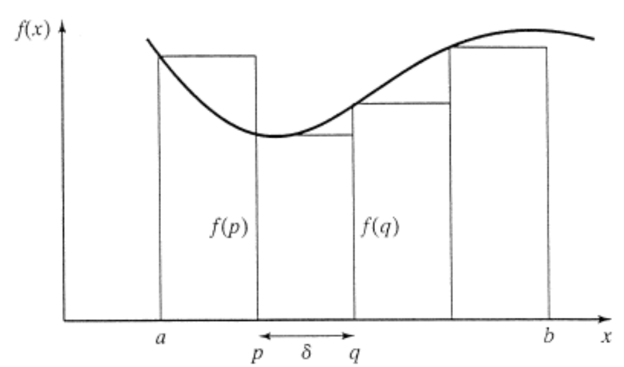
Numerical integration using rectangles
Each region calculated using an approximation given by rectangles:
Aligning the rectangles:
4.15

Slide 37
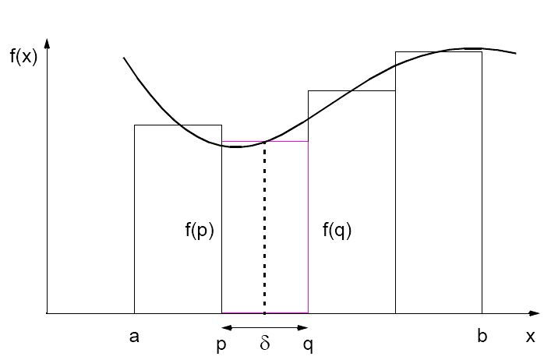

Slide 38
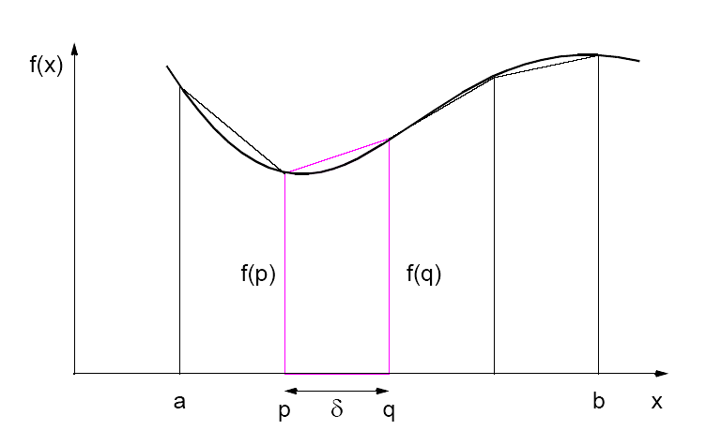
Numerical integration using trapezoidal method
May not be better!
4.16

Slide 39
Static Assignment
Prior to the start of the computation, one process is statically assigned to be responsible for computing each region.
The SPMD (single-program multiple-data) model is appropriate.

Slide 40
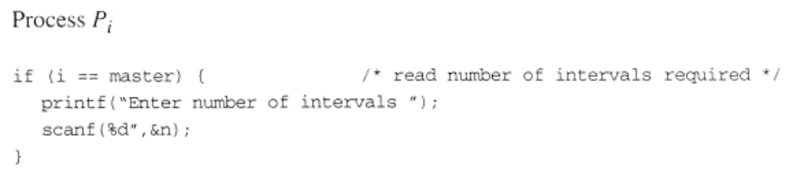
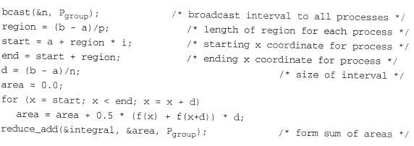

Slide 41
Gravitational N-Body Problem
Finding positions and movements of bodies in space subject to gravitational forces from other bodies, using Newtonian laws of physics.
4.25

Slide 42

Gravitational N-Body Problem Equations
Gravitational force between two bodies of masses m_{a} and m_{b} is:
G is the gravitational constant and r the distance between the bodies. Subject to forces, body accelerates according to Newton’s 2nd law:
F = ma
m is mass of the body, F is force it experiences, and a the resultant acceleration.
4.26

Slide 43
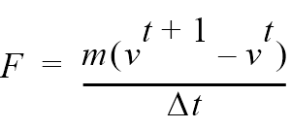
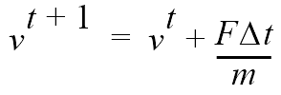

Details
Let the time interval be t. For a body of mass m, the force is:
New velocity is:
where v^{t+1} is the velocity at time t + 1 and v^{t} is the velocity at time t.
Over time interval Δt, position changes by
where x^{t} is its position at time t.
Once bodies move to new positions, forces change. Computation has to be repeated.
4.27

Slide 44
Sequential Code
Overall gravitational N-body computation can be described by:
for (t = 0; t < tmax; t++) /* for each time period */
for (i = 0; i < N; i++) { /* for each body */
F = Force_routine(i); /* compute force on ith body */
v[i]new = v[i] + F * dt / m; /* compute new velocity */
x[i]new = x[i] + v[i]new * dt; /* and new position */
}
for (i = 0; i < nmax; i++) { /* for each body */
x[i] = x[i]new; /* update velocity & position*/
v[i] = v[i]new;
}
3.28

Slide 45
Parallel Code
The sequential algorithm is an O(N²) algorithm (for one iteration) as each of the N bodies is influenced by each of the other N - 1 bodies.
Not feasible to use this direct algorithm for most interesting N-body problems where N is very large.
4.29

Slide 46
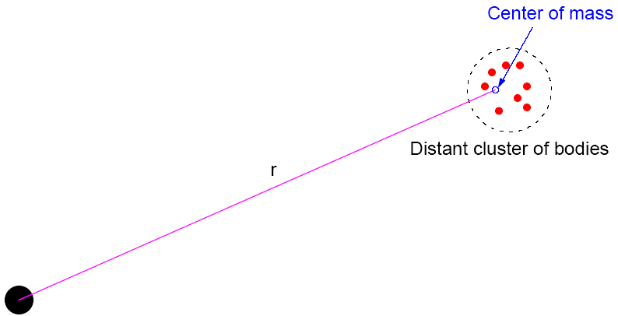
Time complexity can be reduced approximating a cluster of distant bodies as a single distant body with mass sited at the center of mass of the cluster:
4.30

Slide 47
Barnes-Hut Algorithm
Start with whole space in which one cube contains the bodies (or particles).
• First, this cube is divided into eight subcubes.
• If a subcube contains no particles, subcube deleted from further consideration.
• If a subcube contains one body, subcube retained.
• If a subcube contains more than one body, it is recursively divided until every subcube contains one body.
4.31

Slide 48
Creates an octtree - a tree with up to eight edges from each node.
The leaves represent cells each containing one body.
After the tree has been constructed, the total mass and center of mass of the subcube is stored at each node.
4.32

Slide 49

Force on each body obtained by traversing tree starting at root, stopping at a node when the clustering approximation can be used, e.g. when:
where is a constant typically 1.0 or less.
Constructing tree requires a time of O(nlogn), and so does computing all the forces, so that overall time complexity of method is O(nlogn).
4.33

Slide 50
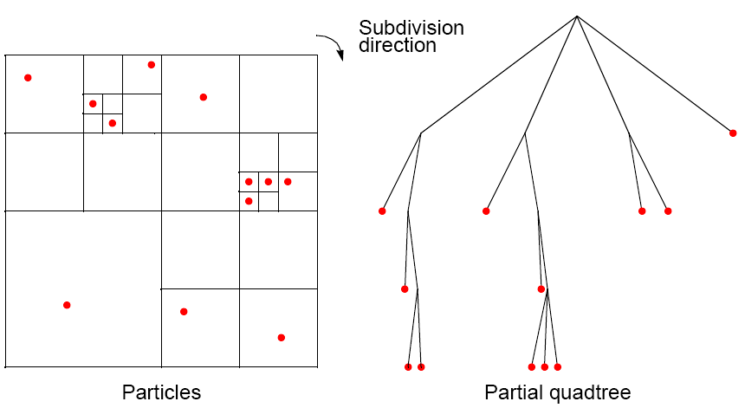
Recursive division of 2-dimensional space
4.34

Slide 51
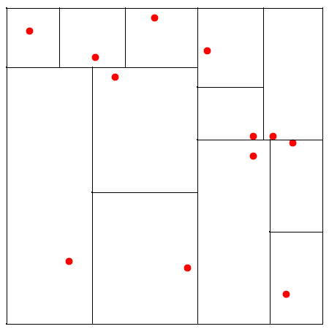
Orthogonal Recursive Bisection
(For 2-dimensional area) First, a vertical line found that divides area into two areas each with equal number of bodies. For each area, a horizontal line found that divides it into two areas each with equal number of bodies. Repeated as required.
4.35

Slide 52
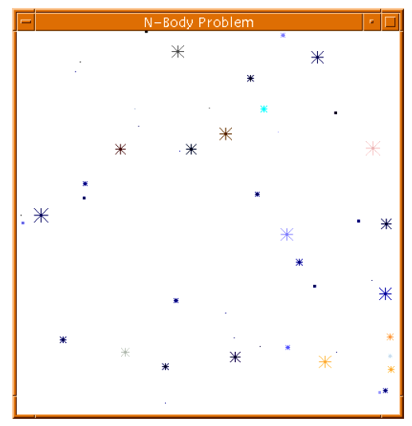
Astrophysical N-body simulation
By Scott Linssen (UNCC student, 1997) using O(N²) algorithm.
4.36

Slide 53
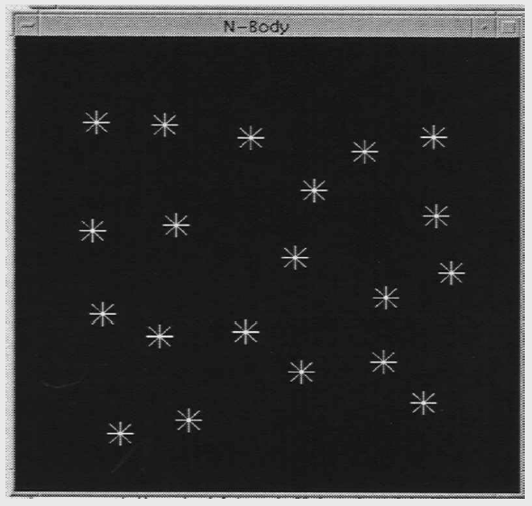
Astrophysical N-body simulation
By David Messager (UNCC student 1998) using Barnes-Hut algorithm.
4.37

