Slide 1
Chapter 5
Pipelined Computations
5.1

Slide 2
In this chapter, we present a parallel processing technique called pipelining, which is applicable to a wide range of problems that are partially sequential in nature.

Slide 3
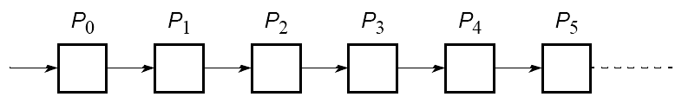
Pipelined Computations
Problem divided into a series of tasks that have to be completed one after the other (the basis of sequential programming). Each task executed by a separate process or processor. We sometimes refer to each pipeline process as a pipeline stage. This parallelism can be viewed as a form functional decomposition.
5.2

Slide 4
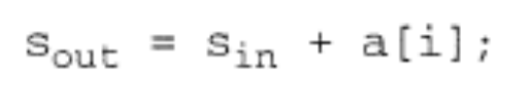
Example
Add all the elements of array a to an accumulating sum:
for (i = 0; i < n; i++)
sum = sum + a[i];
The loop could be “unfolded” to yield
sum = sum + a[0];
sum = sum + a[1];
sum = sum + a[2];
sum = sum + a[3];
sum = sum + a[4];
.
.
.
5.3

Slide 5
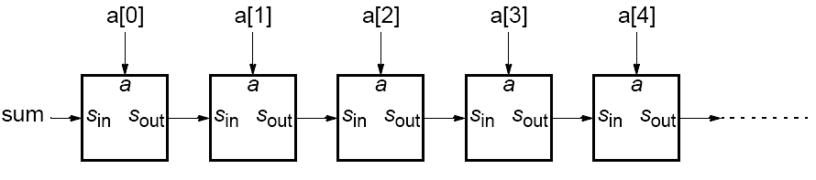
Pipeline for an unfolded loop
5.4

Slide 6
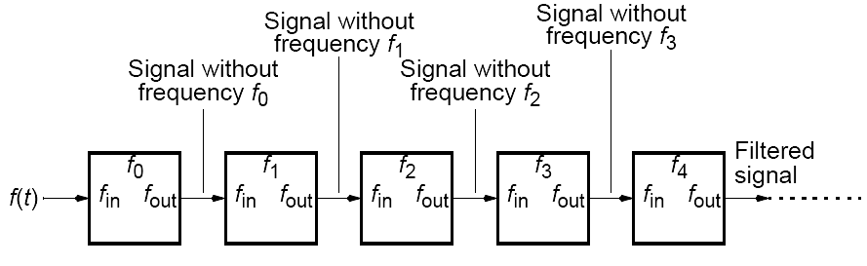
Another Example
Frequency filter - Objective to remove specific frequencies (f₀, f₁, f₂,f₃, etc.) from a digitized signal, f(t).
Signal enters pipeline from left:
Sound system is also an application.
5.5

Slide 7
Where pipelining can be used to good effect
Assuming problem can be divided into a series of sequential tasks, pipelined approach can provide increased execution speed under the following three types of computations:
1. If more than one instance of the complete problem is to be
Executed
2. If a series of data items must be processed, each requiring
multiple operations
3. If information to start next process can be passed forward
before process has completed all its internal operations
5.6

Slide 8
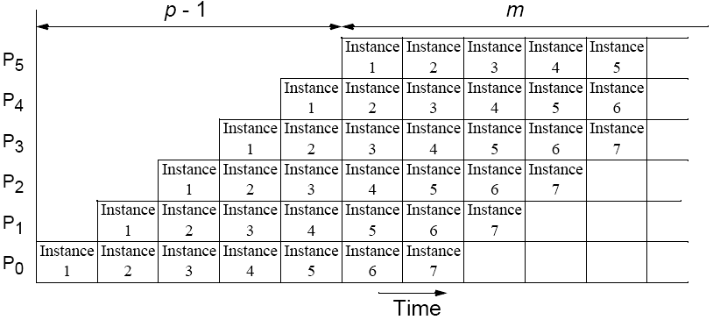
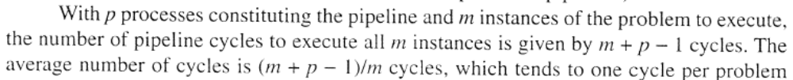
“Type 1” Pipeline Space-Time Diagram
5.7

Slide 9
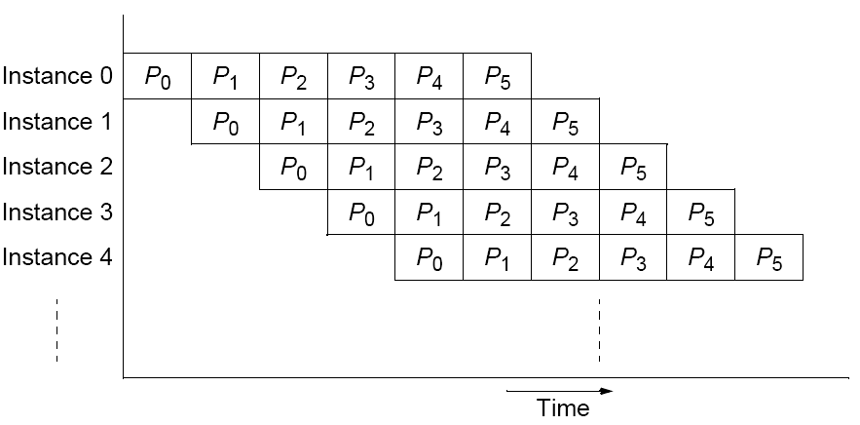
Alternative space-time diagram
5.8

Slide 10
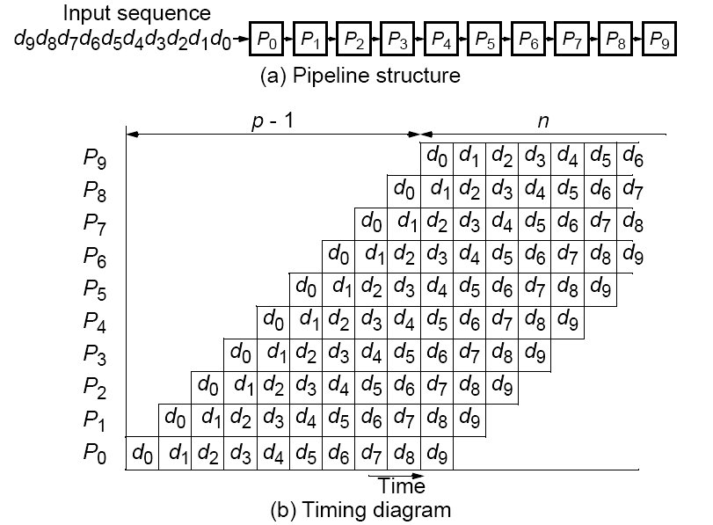
“Type 2” Pipeline Space-Time Diagram
5.9

Slide 11
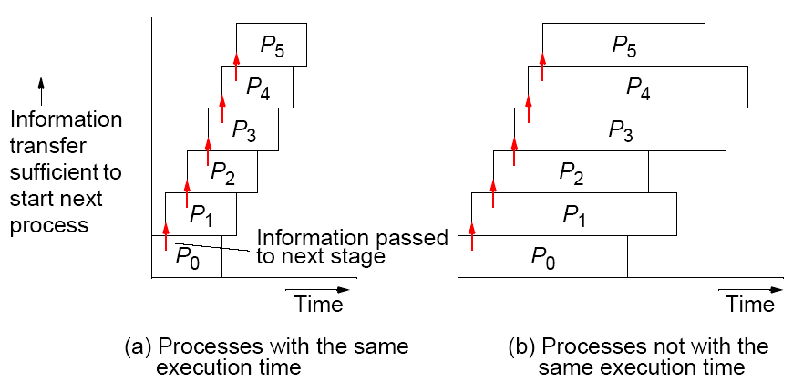
“Type 3” Pipeline Space-Time Diagram
Pipeline processing where information passes to next stage before previous state completed.
5.10

Slide 12
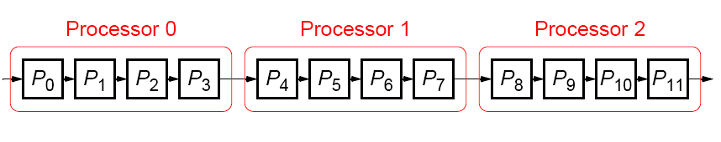
If the number of stages is larger than the number of processors in any pipeline, a group of stages can be assigned to each processor:
5.11

Slide 13
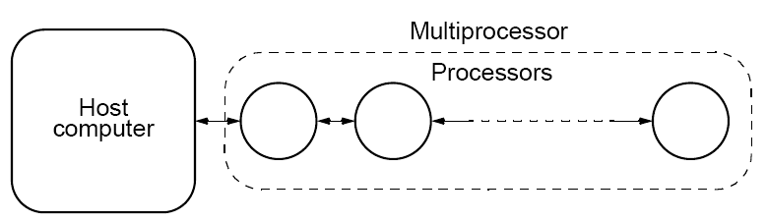
Computing Platform for Pipelined Applications
Multiprocessor system with a line configuration
A key requirement for pipelining is the ability to send messages between
adjacent processes in the pipeline. An ideal interconnection structure is a line or ring structure.
Strictly speaking pipeline may not be the best structure for a cluster - however a cluster with switched direct connections, as most have, can support simultaneous message passing.
5. 12

Slide 14
Example Pipelined Solutions
(Examples of each type of computation)
5.13

Slide 15
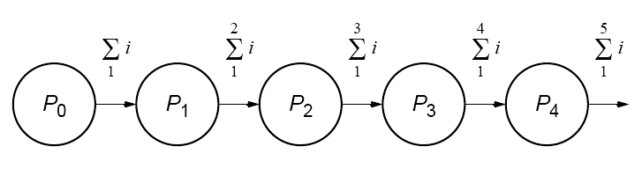
Pipeline Program Examples
Adding Numbers
Type 1 pipeline computation
5.14

Slide 16
Basic code for process Pi :
recv(&accumulation, Pi-1);
accumulation = accumulation + number;
send(&accumulation, Pi+1);
except for the first process, P0, which is
send(&number, P1);
and the last process, Pn-1, which is
recv(&number, Pn-2);
accumulation = accumulation + number;
5.15

Slide 17
SPMD program
if (process > 0) {
recv(&accumulation, Pi-1);
accumulation = accumulation + number;
}
if (process < n-1)
send(&accumulation, P i+1);
The final result is in the last process.
Instead of addition, other arithmetic operations could be done.
5.16

Slide 18
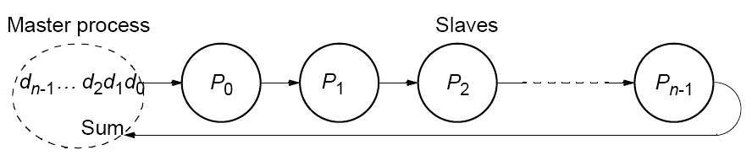
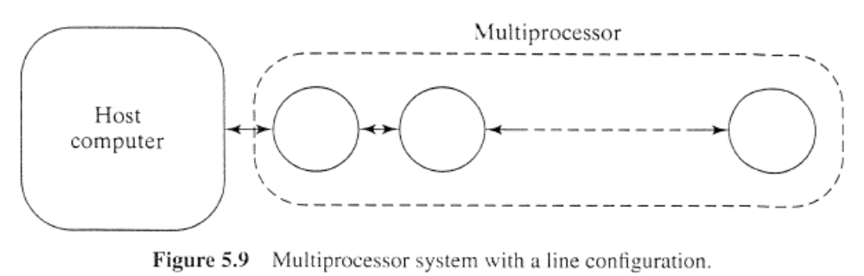
Pipelined addition numbers
Master process and ring configuration
5.17

Slide 19



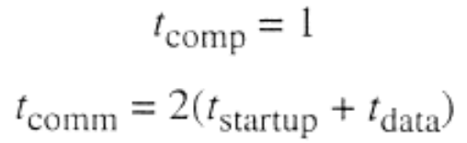
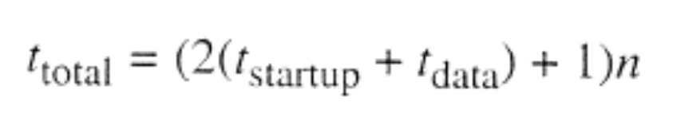

Analysis
n process

Slide 20

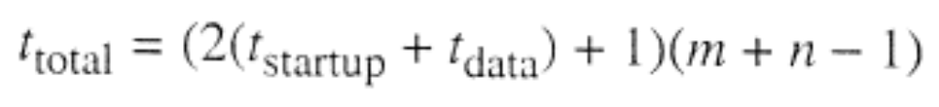
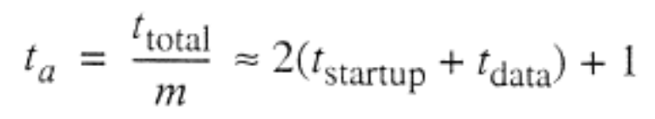

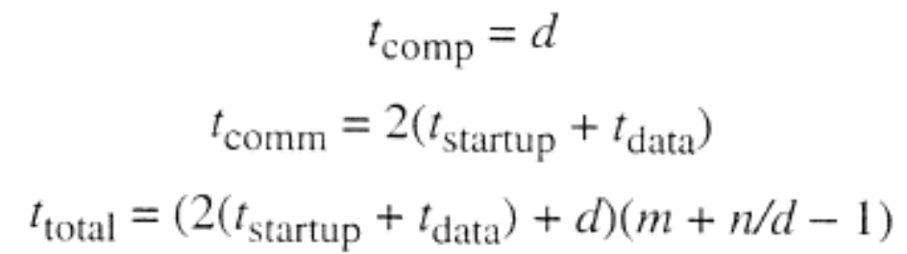
Increase the execution time

Slide 21
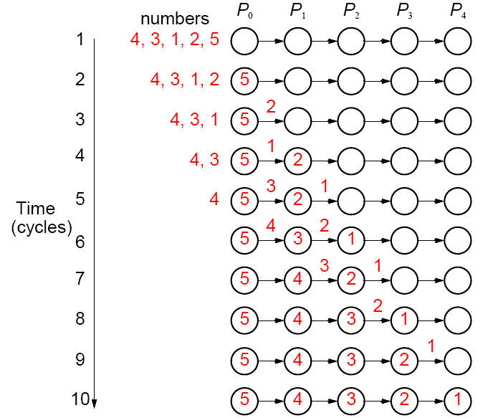
Sorting Numbers
A parallel version of insertion sort.
5.18

Slide 22
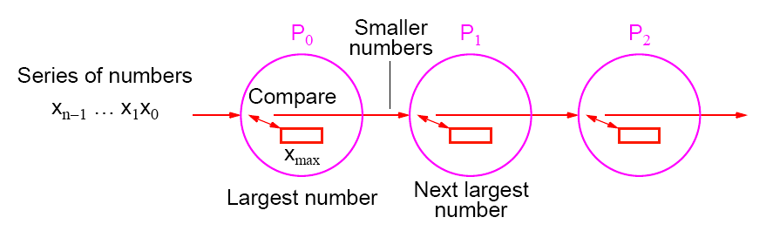
Pipeline for sorting using insertion sort
Type 2 pipeline computation
5.19

Slide 23
The basic algorithm for process Pi is
recv(&number, Pi-1);
if (number > x) {
send(&x, Pi+1);
x = number;
} else send(&number, Pi+1);
With n numbers, number ith process is to accept = n - i.
Number of passes onward = n - i - 1
Hence, a simple loop could be used.
5.20

Slide 24
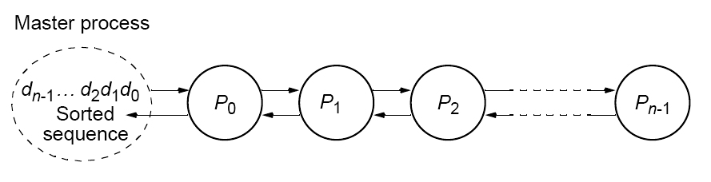
Insertion sort with results returned to master process using bidirectional line configuration
5.21

Slide 25
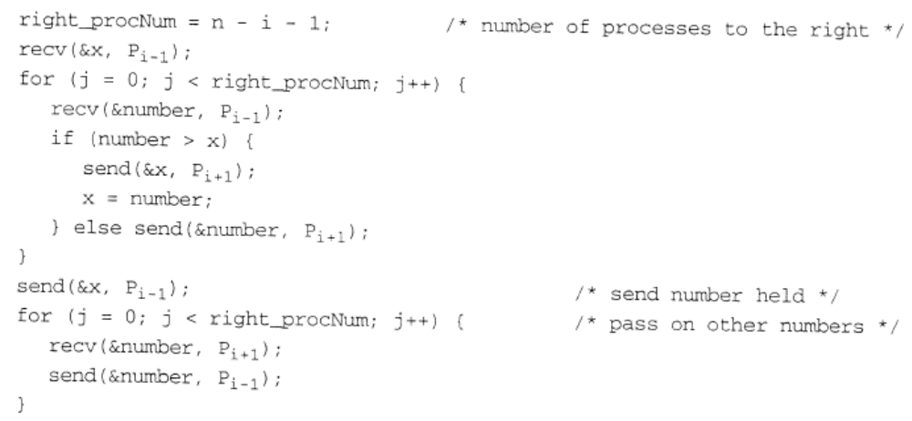

Slide 26
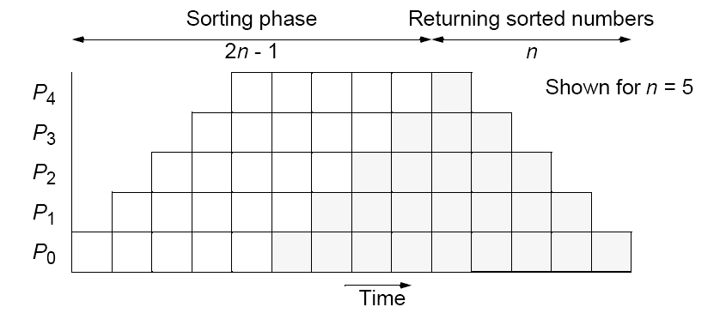
Insertion sort with results returned
5.22

Slide 27

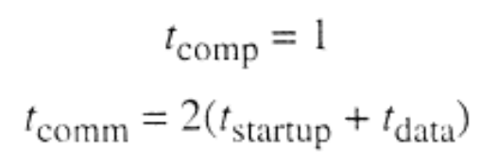
Analysis

Slide 28
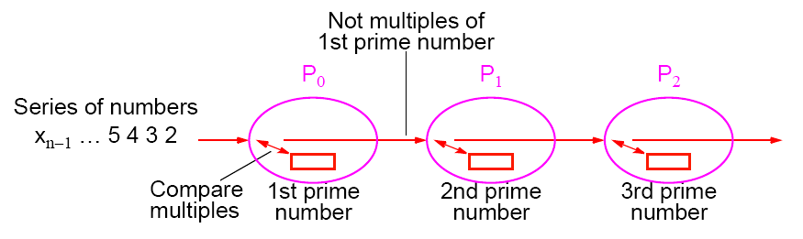
Prime Number Generation
Sieve of Eratosthenes
Series of all integers generated from 2.
First number, 2, is prime and kept.
All multiples of this number deleted as they cannot be prime.
Process repeated with each remaining number.
The algorithm removes non-primes, leaving only primes.
Type 2 pipeline computation
5.23

Slide 29
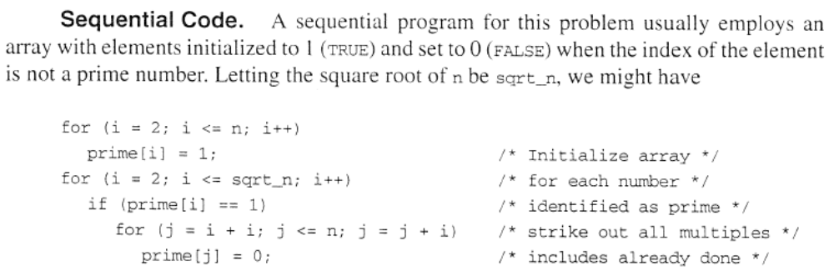

Slide 30
The code for a process, Pi, could be based upon
recv(&x, Pi-1);
/* repeat following for each number */
recv(&number, Pi-1);
if ((number % x) != 0) send(&number, P i+1);
Each process will not receive the same number of numbers and is not known beforehand. Use a “terminator” message, which is sent at the end of the sequence:
recv(&x, Pi-1);
for (i = 0; i < n; i++) {
recv(&number, Pi-1);
If (number == terminator) break;
(number % x) != 0) send(&number, P i+1);
}
5.24

Slide 31
Analysis
Similar to the sorting algorithm

Slide 32
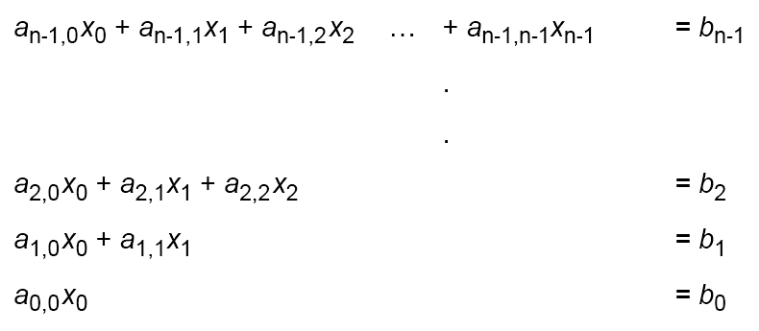
Solving a System of Linear Equations
Upper-triangular form
where a’s and b’s are constants and x’s are unknowns to be found.
5.25

Slide 33



Back Substitution
First, unknown x₀ is found from last equation; i.e.,
Value obtained for x₀ substituted into next equation to obtain x₁; i.e.,
Values obtained for x₁ and x₀ substituted into next equation to obtain x₂:
and so on until all the unknowns are found.
5.26

Slide 34
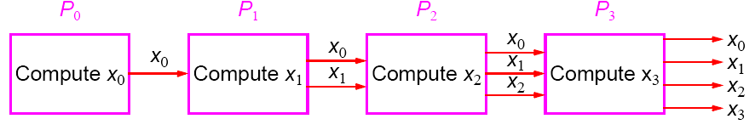
Pipeline Solution
First pipeline stage computes x₀ and passes x₀ onto the second stage, which computes x₁ from x₀ and passes both x₀ and x₁ onto the next stage, which computes x₂ from x₀ and x₁, and so on.
Type 3 pipeline computation
5.27

Slide 35
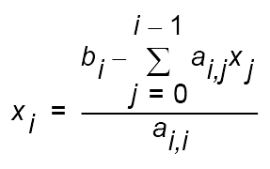
The ith process (0 < i < n) receives the values x₀, x₁, x₂, …, x_{i-1} and computes x_{i} from the equation:
5.28

Slide 36
Sequential Code
Given constants a_{i,j} and b_{k} stored in arrays a[ ][ ] and b[ ], respectively, and values for unknowns to be stored in array, x[ ], sequential code could be
x[0] = b[0]/a[0][0]; /* computed separately */
for (i = 1; i < n; i++) { /*for remaining unknowns*/
sum = 0;
For (j = 0; j < i; j++
sum = sum + a[i][j]*x[j];
x[i] = (b[i] - sum)/a[i][i];
}
5.29

Slide 37
Parallel Code
Pseudocode of process P_{i} (1 < i < n) of could be
for (j = 0; j < i; j++) {
recv(&x[j], Pi-1);
send(&x[j], Pi+1);
}
sum = 0;
for (j = 0; j < i; j++)
sum = sum + a[i][j]*x[j];
x[i] = (b[i] - sum)/a[i][i];
send(&x[i], Pi+1);
Now have additional computations to do after receiving and resending values.
5.30

Slide 38
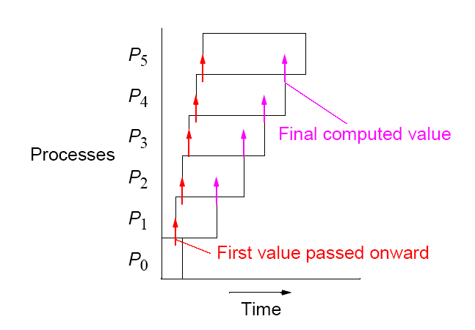
Pipeline processing using back substitution
5.31

Slide 39
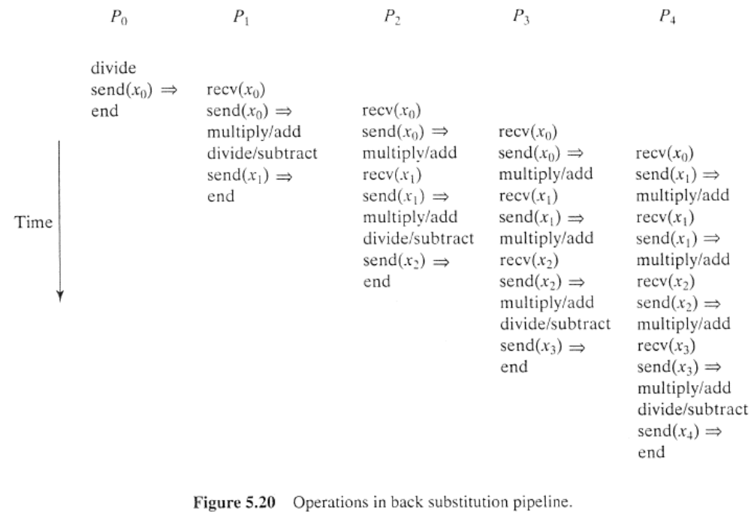

Slide 40
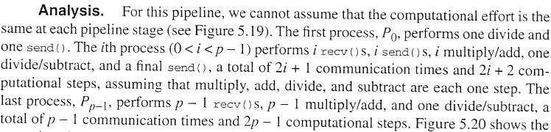
Analysis

