Slide 1
Chapter 6
Synchronous Computations
6.1

Slide 2
Synchronous Computations
In this chapter, we consider problems solved by a group of separate computations that must at times wait for each other before proceeding, thereby becoming synchronized.
A very important class of such applications is called fully synchronous applications. In a (fully) synchronous application, all the processes synchronized at regular points.
All the operations start at the same time in a lock-step manner analogous to SIMD computations.
we describe how to reduce the amount of synchronization needed in order to increase the computational speed, which we call partially synchronous methods.

Slide 3
Barrier
A basic mechanism for synchronizing processes - inserted at the point in each process where it must wait.
All processes can continue from this point when all the processes have reached it (or, in some implementations, when a stated number of processes have reached this point).
Barriers apply to both shared memory and message-passing systems.
MPI has the barrier routine, MPI_Barrier().
6.2

Slide 4
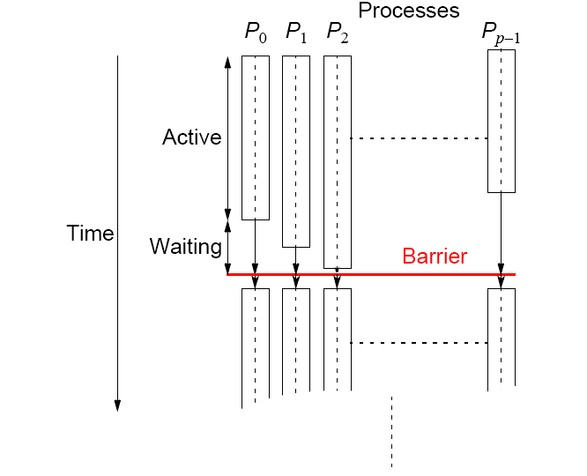
Processes reaching barrier
at different times
6.3

Slide 5
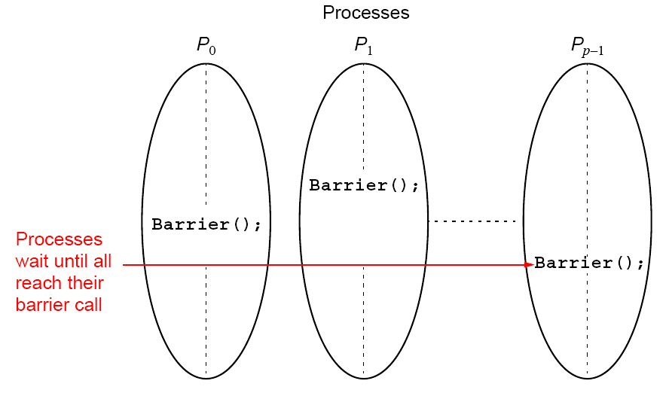
In message-passing systems, barriers provided with library
routines:
6.4

Slide 6
MPI
MPI_Barrier()
Barrier with a named communicator being the only parameter.
Called by each process in the group, blocking until all members of the group have reached the barrier call and only returning then.
6.5

Slide 7
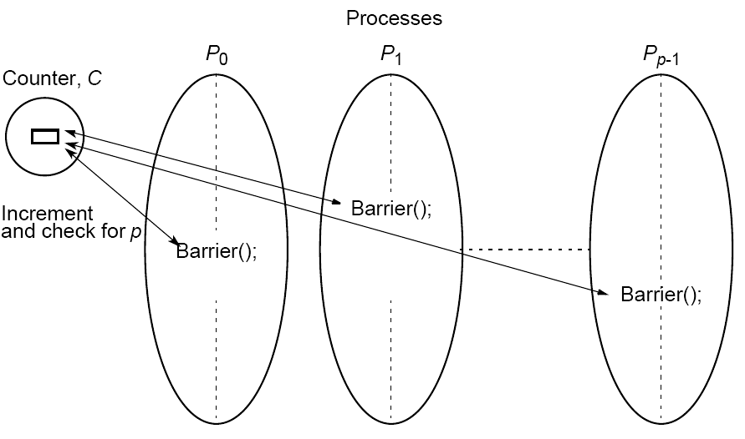
Barrier Implementation
Centralized counter implementation (a linear barrier):
6.6

Slide 8
Good barrier implementations must take into account that a barrier might be used more than once in a process.
Might be possible for a process to enter the barrier for a second time before previous processes have left the barrier for the first time.
6.7

Slide 9
Counter-based barriers often have two phases:
• A process enters arrival phase and does not leave this
phase until all processes have arrived in this phase.
• Then processes move to departure phase and are released.
Two-phase handles the reentrant scenario.
6.8

Slide 10
Example code:
Master:
for (i = 0; i < n; i++) /*count slaves as they reach barrier*/
recv(Pany);
for (i = 0; i < n; i++) /* release slaves */
send(Pi);
Slave processes:
send(Pmaster);
recv(Pmaster);
A simple NULL message could be sent.
6.9

Slide 11
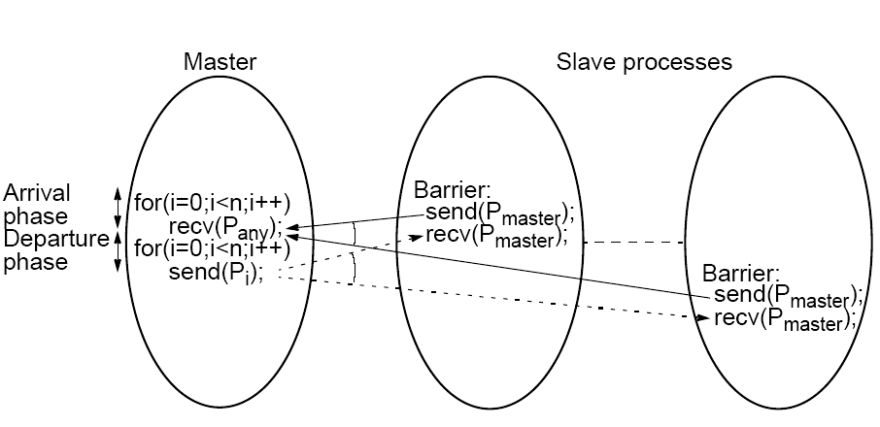
Barrier implementation in
a message-passing system
6.10

Slide 12
Tree Implementation
More efficient. O(log p) steps
Suppose 8 processes, P0, P1, P2, P3, P4, P5, P6, P7:
1st stage: P1 sends message to P0; (when P1 reaches its barrier)
P3 sends message to P2; (when P3 reaches its barrier)
P5 sends message to P4; (when P5 reaches its barrier)
P7 sends message to P6; (when P7 reaches its barrier)
2nd stage: P2 sends message to P0; (P2 & P3 reached their barrier)
P6 sends message to P4; (P6 & P7 reached their barrier)
3rd stage: P4 sends message to P0; (P4, P5, P6, & P7 reached barrier)
P0 terminates arrival phase;
(when P0 reaches barrier & received message from P4)
Release with a reverse tree construction.
6.11

Slide 13
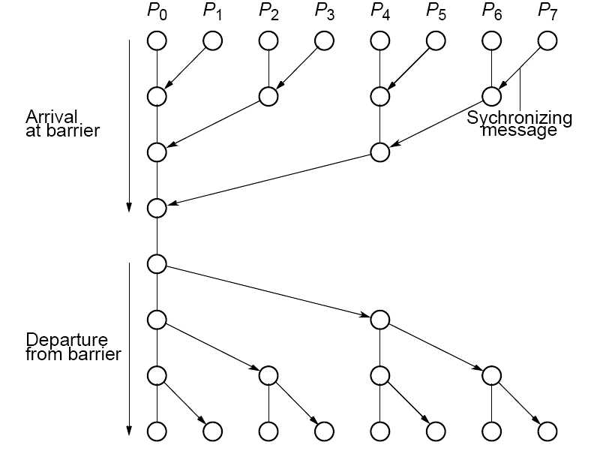
Tree barrier
6.12

Slide 14
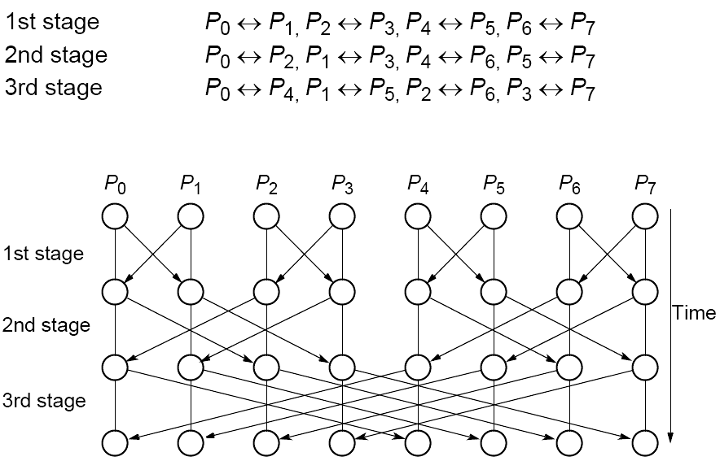
Butterfly Barrier
Barrier only a single pair of send()/recv()
6.13

Slide 15
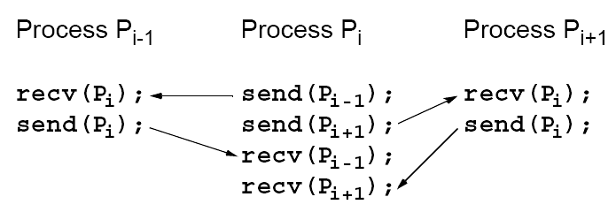
Local Synchronization
Suppose a process Pi needs to be synchronized and to exchange data with process Pi-1 and process Pi+1 before continuing:
Not a perfect three-process barrier because process Pi-1 will only synchronize with Pi and continue as soon as Pi allows. Similarly, process Pi+1 only synchronizes with Pi.
6.14

Slide 16
Deadlock
When a pair of processes each send and receive from each other, deadlock may occur.
Deadlock will occur if both processes perform the send, using synchronous routines first (or blocking routines without sufficient buffering). This is because neither will return; they will wait for matching receives that are never reached.
6.15

Slide 17
A Solution
Arrange for one process to receive first and then send and the other process to send first and then receive.
Example
Linear pipeline, deadlock can be avoided by arranging so the even-numbered processes perform their sends first and the odd-numbered processes perform their receives first.
6.16

Slide 18
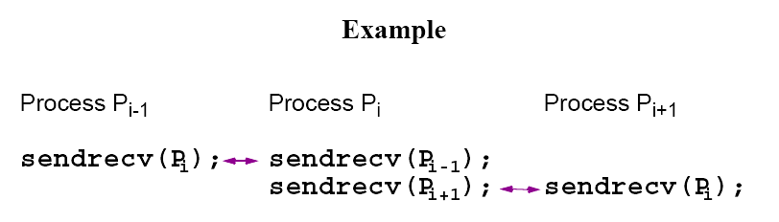
Combined deadlock-free blocking
sendrecv() routines
MPI provides MPI_Sendrecv() and MPI_Sendrecv_replace().
MPI sendrev()s actually has 12 parameters!
6.17

Slide 19
Synchronized Computations
Can be classififed as:
• Fully synchronous
or
• Locally synchronous
In fully synchronous, all processes involved in the computation must be synchronized.
In locally synchronous, processes only need to synchronize with a set of logically nearby processes, not all processes involved in the computation
6.18

Slide 20
Fully Synchronized Computation Examples
Data Parallel Computations
Same operation performed on different data elements
simultaneously; i.e., in parallel.
Particularly convenient because:
• Ease of programming (essentially only one program).
• Can scale easily to larger problem sizes.
• Many numeric and some non-numeric problems can be
cast in a data parallel form.
6.19

Slide 21
Example
To add the same constant to each element of an array:
for (i = 0; i < n; i++)
a[i] = a[i] + k;
The statement:
a[i] = a[i] + k;
could be executed simultaneously by multiple processors, each using a different index i (0 < i <= n).
6.20

Slide 22
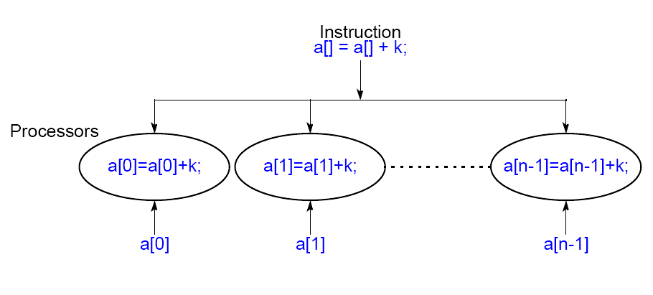
Data Parallel Computation
6.21

Slide 23
forall construct
Special “parallel” construct in parallel programming languages to specify data parallel operations
Example
forall (i = 0; i < n; i++) {
body
}
states that n instances of the statements of the body can be
executed simultaneously.
One value of the loop variable i is valid in each instance of the
body, the first instance has i = 0, the next i = 1, and so on.
6.22

Slide 24
To add k to each element of an array, a, we can write
forall (i = 0; i < n; i++)
a[i] = a[i] + k;
6.23

Slide 25
Data parallel technique applied to multiprocessors and multicomputers
Example
To add k to the elements of an array:
i = myrank;
a[i] = a[i] + k; /* body */
barrier(mygroup);
where myrank is a process rank between 0 and n - 1.
6.24

Slide 26
Data Parallel Example Prefix Sum Problem
Given a list of numbers, x₀, …, x_{n-1}, compute all the partial summations, i.e.:
x₀ + x₁; x₀ + x₁ + x₂; x₀ + x₁ + x₂ + x₃; … ).
Can also be defined with associative operations other than addition.
Widely studied. Practical applications in areas such as processor allocation, data compaction, sorting, and polynomial evaluation.
6.25

Slide 27
Data parallel method of adding all partial sums of 16 numbers
6.26

Slide 28
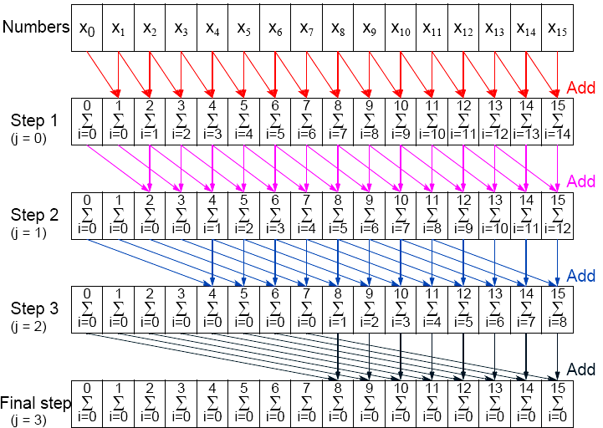
Data parallel prefix sum operation
6.27

Slide 29
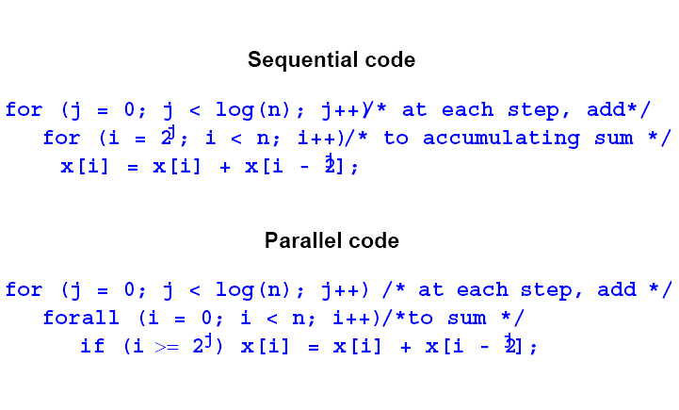
6.28

Slide 30
Synchronous Iteration
(Synchronous Parallelism)
Each iteration composed of several processes that start together at beginning of iteration. Next iteration cannot begin until all processes have finished previous iteration.
Using forall construct:
for (j = 0; j < n; j++) /*for each synch. iteration */
forall (i = 0; i < N; i++) { /*N procs each using*/
body(i); /* specific value of i */
}
6.29

Slide 31
Using message passing barrier:
for (j = 0; j < n; j++) { /*for each synchr.iteration */
i = myrank; /*find value of i to be used */
body(i);
barrier(mygroup);
}
6.30

Slide 32
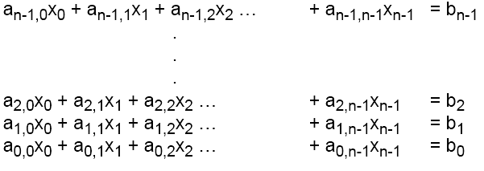
Another fully synchronous computation example
Solving a General System of Linear Equations by Iteration
Suppose the equations are of a general form with n equations and n unknowns
where the unknowns are x₀, x₁, x₂, … x_{n-1} (0 <= i < n).
6.31

Slide 33
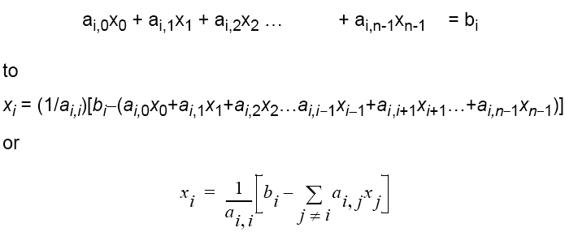
By rearranging the ith equation:
This equation gives x_{i} in terms of the other unknowns.
Can be be used as an iteration formula for each of the unknowns to obtain better approximations.
6.32

Slide 34

Jacobi Iteration
All values of x are updated together.
Can be proven that Jacobi method will converge if diagonal values of a have an absolute value greater than sum of the absolute values of the other a’s on the row (the array of a’s is diagonally dominant) i.e. if
This condition is a sufficient but not a necessary condition.
6.33

Slide 35
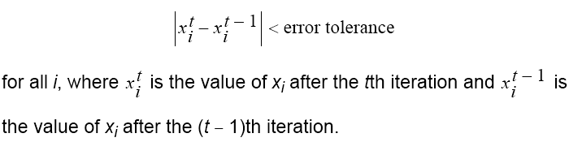
Termination
A simple, common approach. Compare values computed in one iteration to values obtained from the previous iteration. Terminate computation when all values are within given tolerance; i.e., when
However, this does not guarantee the solution to that accuracy.
6.34

Slide 36
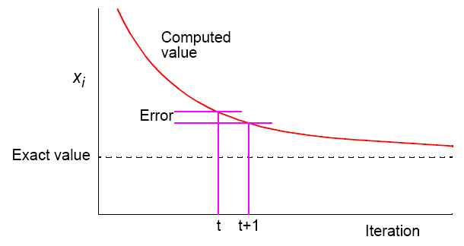
Convergence Rate
6.35

Slide 37
Parallel Code
Process Pi could be of the form
x[i] = b[i]; /*initialize unknown*/
for (iteration = 0; iteration < limit; iteration++) {
sum = -a[i][i] * x[i];
for (j = 0; j < n; j++) /* compute summation */
sum = sum + a[i][j] * x[j];
new_x[i] = (b[i] - sum) / a[i][i]; /* compute unknown */
allgather(&new_x[i]); /*bcast/rec values */
global_barrier(); /* wait for all procs */
}
allgather() sends the newly computed value of x[i] from process i to every other process and collects data broadcast from the other processes.
6.36

Slide 38
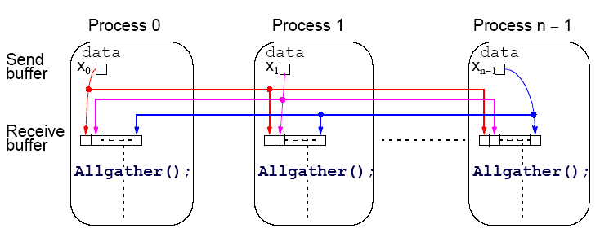
Introduce a new message-passing operation - Allgather.
Allgather
Broadcast and gather values in one composite construction.
6.37

Slide 39
Partitioning
Usually number of processors much fewer than number of data items to be processed. Partition the problem so that processors take on more than one data item.
6.38

Slide 40
block allocation – allocate groups of consecutive unknowns to processors in increasing order.
cyclic allocation – processors are allocated one unknown in order; i.e., processor P₀ is allocated x₀, x_{p}, x_{2p}, …, x_{((n/p)-1)p}, processor P₁ is allocated x₁, x_{p+1}, x_{2p+1}, …, x_{((n/p)-1)p+1}, and so on.
Cyclic allocation no particular advantage here (Indeed, may be disadvantageous because the indices of unknowns have to be computed in a more complex way).
6.39

Slide 41
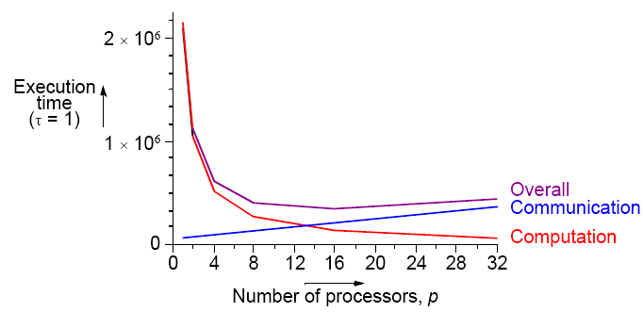
Effects of computation and communication in Jacobi iteration
Consequences of different numbers of processors done in textbook.
Get:
6.40

Slide 42
Locally Synchronous Computation
Heat Distribution Problem
An area has known temperatures along each of its edges.
Find the temperature distribution within.
6.41

Slide 43

Divide area into fine mesh of points, h_{i,j}.
Temperature at an inside point taken to be average of temperatures of four neighboring points. Convenient to describe edges by points.
Temperature of each point by iterating the equation:
(0 < i < n, 0 < j < n) for a fixed number of iterations or until the difference between iterations less than some very small amount.
6.42

Slide 44
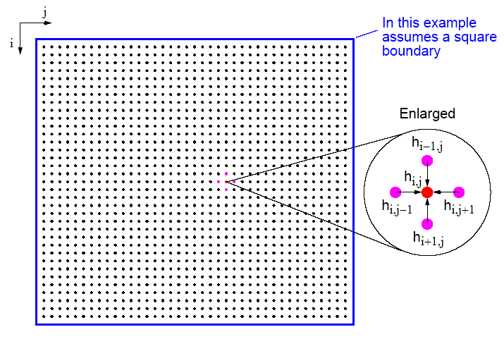
Heat Distribution Problem
Many similar problems
6.43

Slide 45
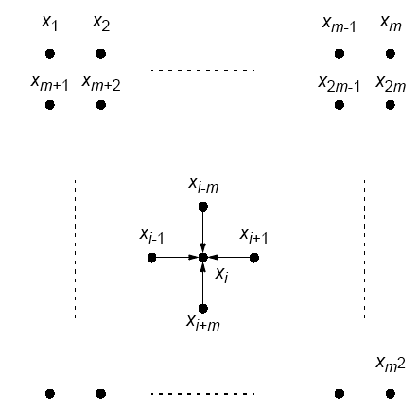
Natural ordering of heat distribution problem
6.44

Slide 46


Number points from 1 for convenience and include those representing the edges. Each point will then use the equation
Could be written as a linear equation containing the unknowns xi-m, xi-1, xi+1, and xi+m:
6.45

Slide 47
Sequential Code
Using a fixed number of iterations
for (iteration = 0; iteration < limit; iteration++) {
for (i = 1; i < n; i++)
for (j = 1; j < n; j++)
g[i][j] = 0.25*(h[i-1][j]+h[i+1][j]+h[i][j-1]+h[i][j+1]);
for (i = 1; i < n; i++) /* update points */
for (j = 1; j < n; j++)
h[i][j] = g[i][j];
}
using original numbering system (n x n array).
6.46

Slide 48
To stop at some precision:
do {
for (i = 1; i < n; i++)
for (j = 1; j < n; j++)
g[i][j] = 0.25*(h[i-1][j]+h[i+1][j]+h[i][j-1]+h[i][j+1]);
for (i = 1; i < n; i++) /* update points */
for (j = 1; j < n; j++)
h[i][j] = g[i][j];
continue = FALSE; /* indicates whether to continue */
for (i = 1; i < n; i++)/* check each pt for convergence */
for (j = 1; j < n; j++)
if (!converged(i,j) {/* point found not converged */
continue = TRUE;
break;
}
} while (continue == TRUE);
6.47

Slide 49
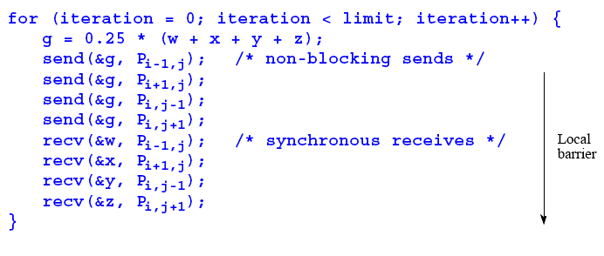
Parallel Code
With fixed number of iterations, P_{i,j}
(except for the boundary points):
Important to use send()s that do not block while waiting for recv()s; otherwise processes would deadlock, each waiting for a recv() before moving on - recv()s must be synchronous and wait for send()s.
6.48

Slide 50
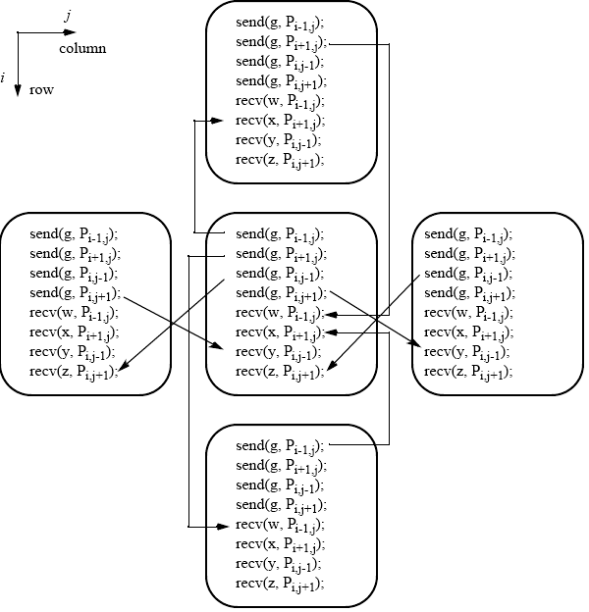
Message passing for heat distribution problem
Local synchronous
6.49

Slide 51
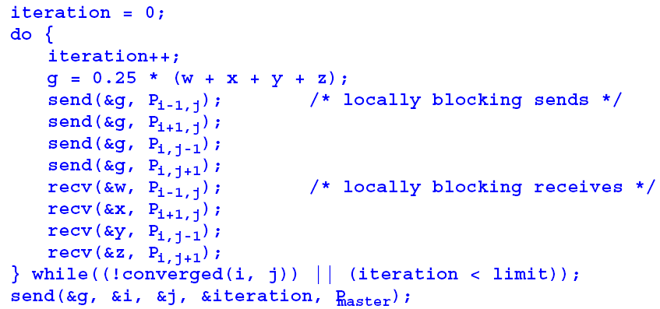
Version where processes stop when they reach their required precision:
6.50

Slide 52
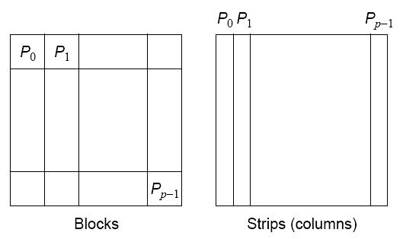
Partitioning
Normally allocate more than one point to each processor, because many more points than processors.
Points could be partitioned into square blocks or strips:
6.54

Slide 53
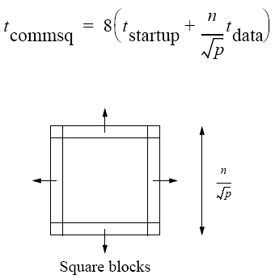
Block partition
Four edges where data points exchanged.
Communication time given by
6.55

Slide 54
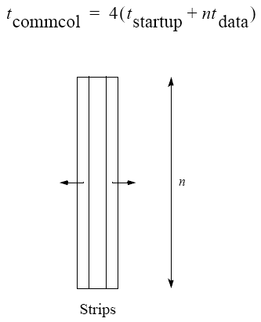
Strip partition
Two edges where data points are exchanged.
Communication time is given by
6.56

Slide 55

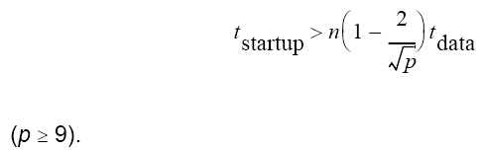
Optimum
In general, strip partition best for large startup time, and block
partition best for small startup time.
With the previous equations, block partition has a larger communication time than strip partition if
6.57

Slide 56
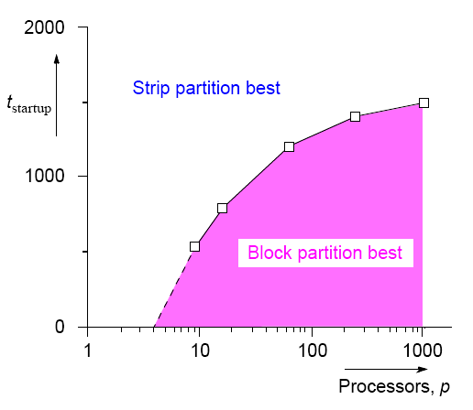
Startup times for block and
strip partitions
6.58

Slide 57
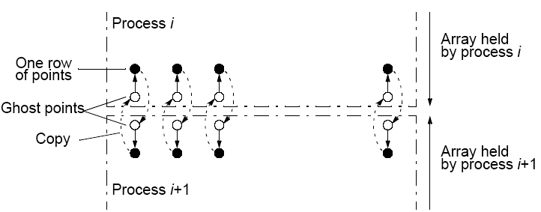
Ghost Points
Additional row of points at each edge that hold values from adjacent edge. Each array of points increased to accommodate ghost rows.
6.59

Slide 58
Safety and Deadlock
When all processes send their messages first and then receive all of their messages is “unsafe” because it relies upon buffering in the send()s. The amount of buffering is not specified in MPI.
If insufficient storage available, send routine may be delayed from returning until storage becomes available or until the message can be sent without buffering.
Then, a locally blocking send() could behave as a synchronous send(), only returning when the matching recv() is executed. Since a matching recv() would never be executed if all the send()s are synchronous, deadlock would occur.
6.60

Slide 59
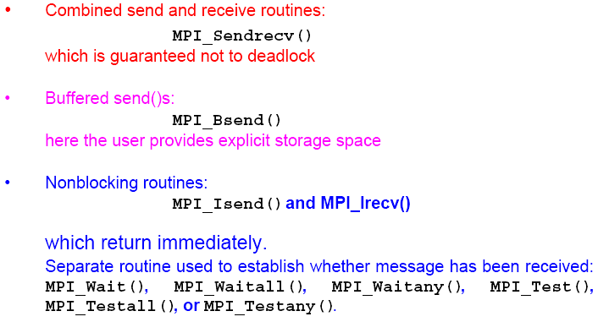
MPI Safe Message Passing Routines
MPI offers several methods for safe communication:
6.62

