Slide 1
Autonomous Aerobatics on Commanded Paths
Cyber-Physical Systems
Project Work Youlin Gao, Anthony Blanc, Andreas Bruckmeier

Slide 2
Outline
…
Control Structure
…

Slide 3
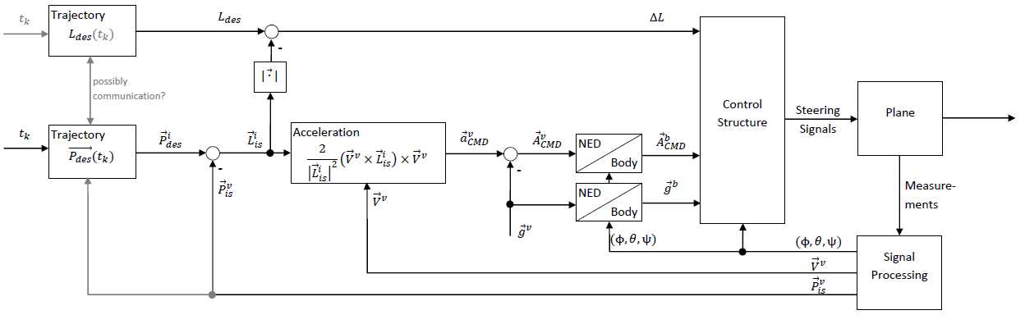
Control Structure
Overview
It is thought, that the trajectory P_{des} (t_{k} ) is a function of time, containing position and implicitely speed.
The desired look-ahead distance L_{des} can be a constant but also a function of time or even a function of the trajectory P_{des} (t_{k} ) so that L can always be optimal.
The speed of the plane is controlled by minimising the error of the look-ahead distance ΔL with a PID-Controller which steers the throttle.
Aileron, elevator, and rudder is also steered with PID-Controllers. The control variables therefore are calculated with the Acceleration Equation [(1) in the paper].

Slide 4
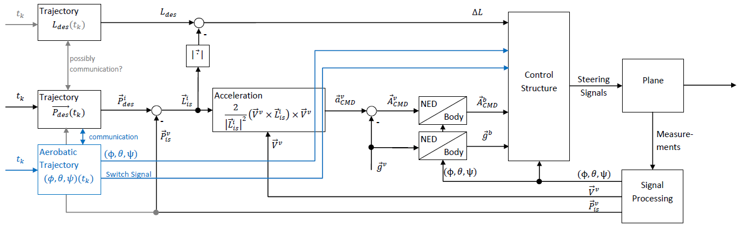
Control Structure
Extended Design
For some aerobatic figures, which can not be depicted with a trajectory (looping, slow-roll,…), an extended temporary simple control structure is presented.
Now, Euler Angles can be adjusted directly.
The control is a simple PID-Control-Structure where the error of the Euler Angles are the control variables.

Slide 5
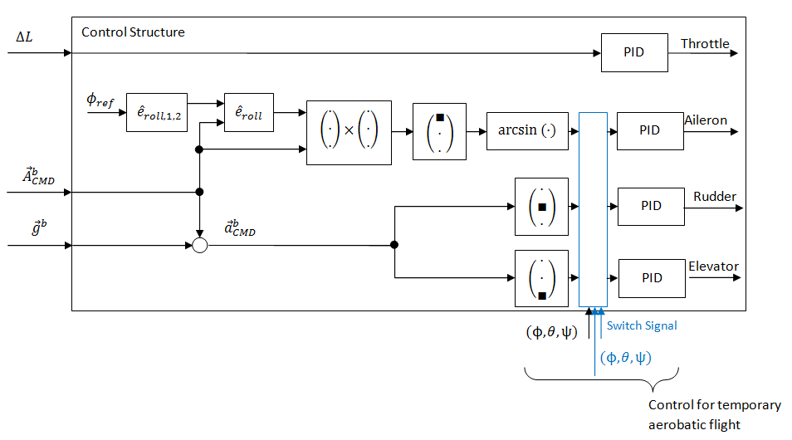
Control Structure
Controller Design
Controller Design is a simplified version of the approach in the paper.
Also included is the switch for temporary aerobatic flight with the Euler Angles.

Slide 6
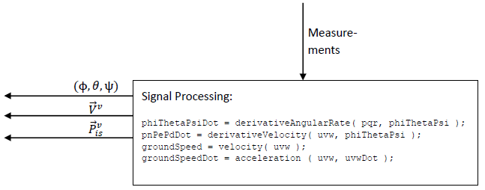
Control Structure
Signal Processing
The Signal Processing is already finished and implemented in the current project.

Slide 7
Control Structure
Work Partitioning + State of the Project
Work to be done by Youlin, Anthony, Andreas. Finished work, given parts.

Slide 8
References
Park, Sanghyuk: Autonomous aerobatics on commanded path. Aerospace Science and Technology 22 (2012), p. 64-74.

