Slide 1

Developing Tools for Indie Games
Marc Flury
Co-Founder
Notes:
PREPARTION
Open command prompt
안녕하십니까? 저는 DROOL의 마크 프루리입니다. 3년 동안 서울에 살았습니다. 한국말 조금 할 수 있는데 이 오늘의 주제가 복잡하니까 영어로 말합니다. 통역사께 감사드립니다!
Hi, I’m Marc Flury from the independent developer Drool.
I’m a game programmer and designer.
Today I’ll talk about developing tools and engine tech for independent games.

Slide 2




My Background
Game programmer for ten years
Worked at Harmonix for seven years
Notes:
Worked at AAA developer Harmonix for seven years
Harmonix was my first job in the industry
Started as a junior programmer doing UI programming
Moved to a more senior position as a lead programmer
Some games…

Slide 3

Now
Moved to Seoul three years ago
Founded Drool with Brian Gibson (artist, musician)
Notes:
Three years ago, I moved here to Seoul
At that time I became an independent developer and started my own company with my partner Brian Gibson
We’re currently developing our first game, Thumper.

Slide 4
About Thumper
Two developers (one programmer)
Years of development time
Plan to release within a year
Using a custom engine
Notes:
Two developers.
I do all the programming.
Brian does the art and music.
We both do the game design.
We’ve been working on the game for over 5 years.
A long time, but the first three years were not full-time, been developing full-time for 2.5 years
Our goal is to release the game in about a year
We’re using an entirely custom engine that I’ve built (audio middle ware, some external libraries).

Slide 5
Why a custom engine?
Fun (most of the time)
Get better at making games
New tools create new design possibilities
Notes:
If you’re developing our own game, you have a lot of choices when it comes to choosing the engine and technology you use.
Unity, Unreal might make the most sense for you
My personal reasons are…
When developing an engine and tools and understanding them at a deep level, you will have game design insights that you wouldn’t have otherwise

Slide 6
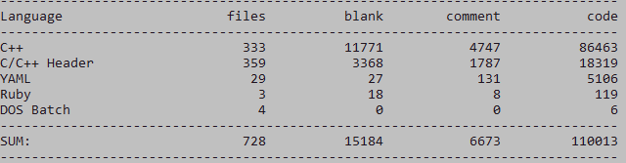
Thumper Codebase
Hundreds of data files
Thousands of game objects
Hundreds of visual script nodes
Notes:
So this talk is about the lessons I’ve learned while building my own engine.
This talk will be most relevant to programmers working on small-to-midsized games, but hopefully it’s mostly relevant to all game programmers.
This is a lot of work for one person, so…

Slide 7
The Challenge
Develop tools efficiently - spend time on your game, not tools
Develop the right tools, so you can create content efficiently
As much about production as programming
Notes:
The challenge is to work very efficiently and effectively.
This is obvious…

Slide 8
My Experience
90% of code I write is not exciting/innovative, it’s nuts and bolts
My technical skill has improved, but my most important skill is maximizing productivity
Notes:
In my experience, and in most typical game engines, most of the code is not that innovative or cutting-edge. Most of it just about getting things to work. Most of the effort I spend is on realizing my game designs.
I’m learned a lot about fairly advanced topics, like rendering, memory management, etc. but being able to code technically complex systems is ultimately not as important as staying productive and getting things done.

Slide 9
Be your own producer
Wait, isn’t this a programming talk?
Who needs a producer anyway?
Notes:
So part of this talk is about being your own producer.
If you’re an independent developer no one tells you what you should be working on.
That freedom is great in many ways and it’s a big reason why many people want to be indie developers.
It’s great to be free of management overhead.
But of course it means you have to be good at managing your time or you’ll never finish your game.
So this talk is about programming today, but from a production perspective.
Everyone knows that time-management is important, but not many people talk about it in the specific context of programming independent games, so that’s what I’ll try to do today.

Slide 10
Personal Production Techniques
Track your time and effort
Look at the big picture
Stay focused
Notes:
I decided to call my approach to this “personal production,” and these are three very general, very high-level techniques I’ll talk about.
Looking at this slide, I’m a little embarrassed, because these are so obvious and so high-level. But I want to back each one up with some specific examples based on my experience developing my game.

Slide 11
Why track your time and effort?
Your intuition of what’s important is probably wrong
You can easily waste time
Be a good engineer!
Notes:
It’s not a waste of time to track your work.
Just like any resource, as a programmer, as an engineer, you should be optimizing for your time, which is really the most valuable resource you have.

Slide 12
1. Track your time and effort
Maintain a “work log”
  Text file, spreadsheet, whatever
Track how you spend your time, especially:
  Bug fixing
  Tasks that take longer than expected
  Mistakes/bugs made by other developers, including non-programmers
  Time spent not programming (chatting, e-mail, etc.)
Use this actual data to decide when to refactor, improve tools, etc.

Slide 13
What’s helpful to me
Test-driven development
  Immediate, visual feedback
  Helps catch common mistakes (ones I actually make!)
  Useful up to a point, don’t take it too far
Debug visualizations
  Tasks, animations
  Audio
  Memory
  Timers
  Rendering

Slide 14
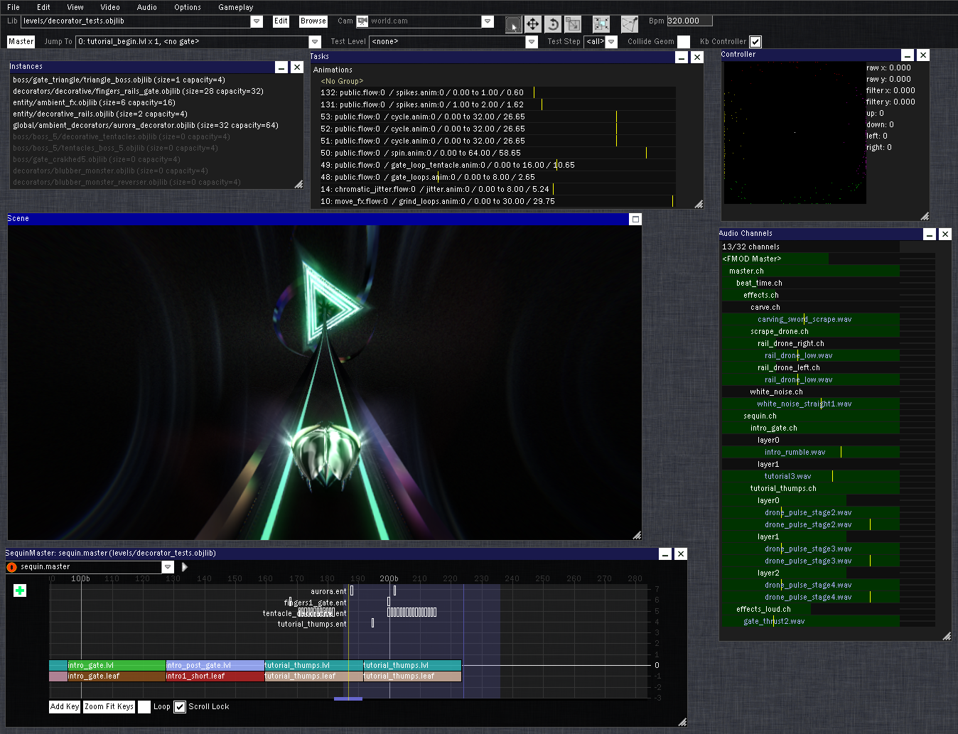

Slide 15
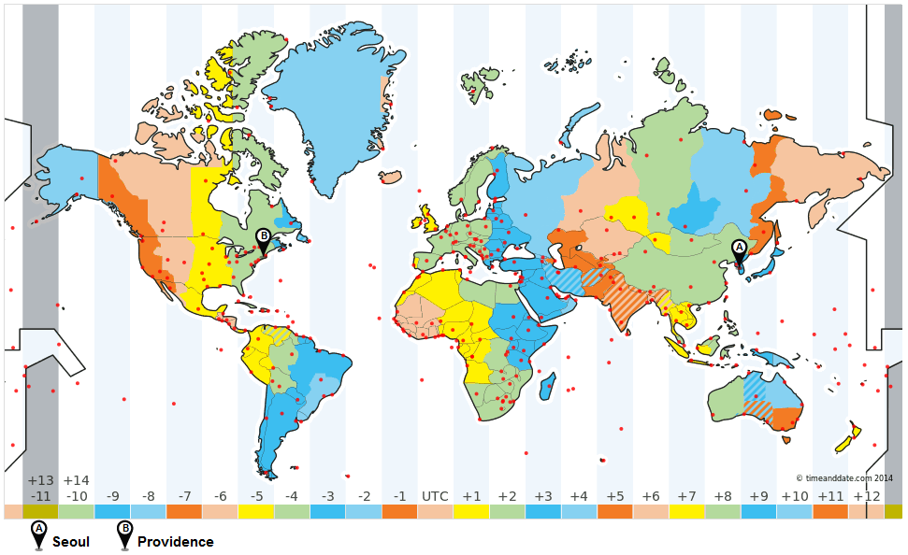
Long Distance Collaboration

Slide 16
Typical E-mail
From: brian@drool.ws
To: marc@drool.ws
Subject: Rendering bug
There is a rendering problem with shadow.mat in thump/run/decorators/blubber_monster.objlib. I’m not sure if there’s a problem with material settings or a code issue?
Notes:
DEMO… open command prompt

Slide 17
E-mail with Object URL
From: brian@drool.ws
To: marc@drool.ws
Subject: Rendering bug
There is a rendering problem with drl://decorators/blubber_monster.objlib?obj=shadow.mat. I’m not sure if there’s a problem with material settings or a code issue?

Slide 18
Other applications
Data validation reports
Errors and warnings
Working with external teams
Notes:
DEMO: render frame report

Slide 19
Object URL Implementation
http://drool.ws/2013/10/29/engine-tech-easy-collaboration-with-object-urls/

Slide 20
Editor vs. Game
I was spending lots of time writing editor-only code
Editor case is usually more complex
  Objects can be created, deleted anytime
  Maintain and display references
  Cut, copy, paste
  Undo, redo
  Robust serialization (backwards-compatible, inter-file dependencies)
Game requirements are totally different
  Fast loading
  Efficient memory usage
  Cache-coherent
Notes:
So that was a small feature that I added because I noticed we were spending a lot of time writing tedious e-mails to each other.
Next, I’ll talk about a larger refactor I did to our engine that was informed by my work log.

Slide 21
Editor vs. Game
“Thumper is a small game, so I can just use the same file format and serialization code for the game and editor.”
My intuition said:
It will be less code to maintain (only one save/load)
It will be simpler
The editor is integrated into the game app, so the data should be the same

Slide 22
Editor vs. Game
Reality said:
Work log: a lot of time fixing editor-only bugs
Difficult to make game data performant
Packed binary formats are not ideal for robust save/load
Binary file formats are not merge-able and lead to workflow problems
Code was littered with #ifdefs

Slide 23
Editor vs. Game
Use a human-readable, text-based format for editor
Use packed, high performance binary for the game
Doesn’t matter if you have separate editor/game apps or not
The data is what matters

Slide 24
Text-based object format
name: approach.sample
id: 4002
path: samples/swish/short_whip.wave
mode: kOneOff
volume: 0.5
pitch: 1.0
pan: 0.0
channel_group: 3021

Slide 25
Benefits
Separate formats reduce overall complexity
Only need to maintain latest version of game data
Cheap “concurrent” editing
  cf: dev blog for The Witness
Easy to search your “database” of objects (just grep)

Slide 26
What’s not helpful (to me)
C++ const correctness
Object orientated programming
  Thinking in terms of classes/objects
  Thinking about public vs. protected vs. private
  Planning inheritance hierarchies

Slide 27
Mesh
Material
Camera
ParticleSystem
Notes:
When I started building our engine, I didn’t have a lot of experience with graphics programming.
I had never written a line of shader code before and my 3D math was a little rusty.
But I knew the basics and I started to start designing the system using OOP principles.

Slide 28
Object
Mesh
Material
Camera
ParticleSystem

Slide 29
TransformObject
Object
DrawObject
Mesh
Material
Camera
ParticleSystem

Slide 30
TransformObject
Object
DrawObject
Mesh
Material
Camera
ParticleSystem

Slide 31
Component
Object
Mesh
Material
Camera
ParticleSystem

Slide 32
Compnent
Component
Object
DrawComp
TransformComp
Mesh
Material
Camera
ParticleSystem

Slide 33
Component
Object
DrawComp
TransformComp
Mesh
DrawComp
TransformComp
Material
Camera
TransformComp
ParticleSystem
DrawComp
TransformComp

Slide 34
Component
Object
DrawComp
TransformComp
Mesh
DrawComp
TransformComp
Material
Camera
TransformComp
ParticleSystem
DrawComp
TransformComp
DX9Mesh
DX9Material
DX9Camera
DX9ParticleSystem

Slide 35
Component
Object
DrawComp
TransformComp
Mesh
DrawComp
TransformComp
Material
Camera
TransformComp
ParticleSystem
DrawComp
TransformComp
DX9Mesh
DX9Material
DX9Camera
DX9ParticleSystem
Notes:
Now you may think that you’ll want an Abstract Factory pattern to create your platform-specific objects and you can start on that…
Wait, STOP. Is this actually solving your problems?
OOP is especially cumbersome in C++
The biggest drawback is that you are solving problems, but not the most important ones
Rather than helping solve hard problems, it can obscure them

Slide 36
Mesh
Material
Camera
ParticleSystem

Slide 37
Mesh
Material
Camera
ParticleSystem
Real problems
Sort draw calls
Batch/instance draw calls
Minimize cache misses
Minimize DX9 CPU overhead

Slide 38
Mesh
Material
Camera
ParticleSystem
Key
64-bit key

Slide 39
Mesh
Material
Camera
ParticleSystem
Key
64-bit key
Data
Transform, vertices, particles, etc.

Slide 40
Mesh
Material
Camera
ParticleSystem
Draw()
Unsorted
Key
Offset
Key
Offset
Key
Offset
Key
Offset
…
Draw Data
Data
Data
Data
Data
…

Slide 41
Mesh
Material
Camera
ParticleSystem
Draw()
Unsorted
Key
Offset
Key
Offset
Key
Offset
Key
Offset
…
Draw Data
Data
Data
Data
Data
…
Sort()
Sorted
Key
Offset
Key
Offset
Key
Offset
Key
Offset
…
Draw Data
Data
Data
Data
Data
…

Slide 42
Mesh
Material
Camera
ParticleSystem
Draw()
Unsorted
Key
Offset
Key
Offset
Key
Offset
Key
Offset
…
Draw Data
Data
Data
Data
Data
…
Sort()
Sorted
Key
Offset
Key
Offset
Key
Offset
Key
Offset
…
Draw Data
Data
Data
Data
Data
…
RenderDX9()

Slide 43
Mesh
Material
Camera
ParticleSystem
Draw()
Unsorted
Key
Offset
Key
Offset
Key
Offset
Key
Offset
…
Draw Data
Data
Data
Data
Data
…
Sort()
Sorted
Key
Offset
Key
Offset
Key
Offset
Key
Offset
…
Draw Data
Data
Data
Data
Data
…
RenderDX9()

Slide 44
Component
Object
DrawComp
TransformComp
Mesh
DrawComp
TransformComp
Material
Camera
TransformComp
ParticleSystem
DrawComp
TransformComp
DX9Mesh
DX9Material
DX9Camera
DX9ParticleSystem

Slide 45
Data-orientated programming
Understand your real problem
Strive for a single point of enumeration, avoid mess of classes/objects
Make your problem easier to visualize, debug, profile

Slide 46
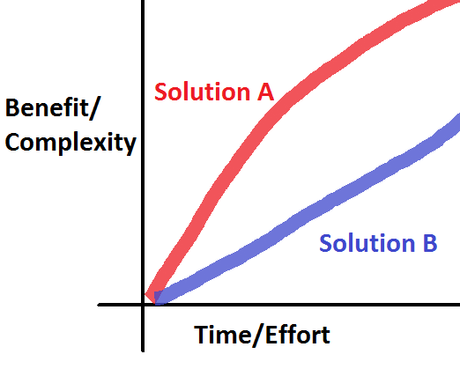
2. See the Big Picture

Slide 47
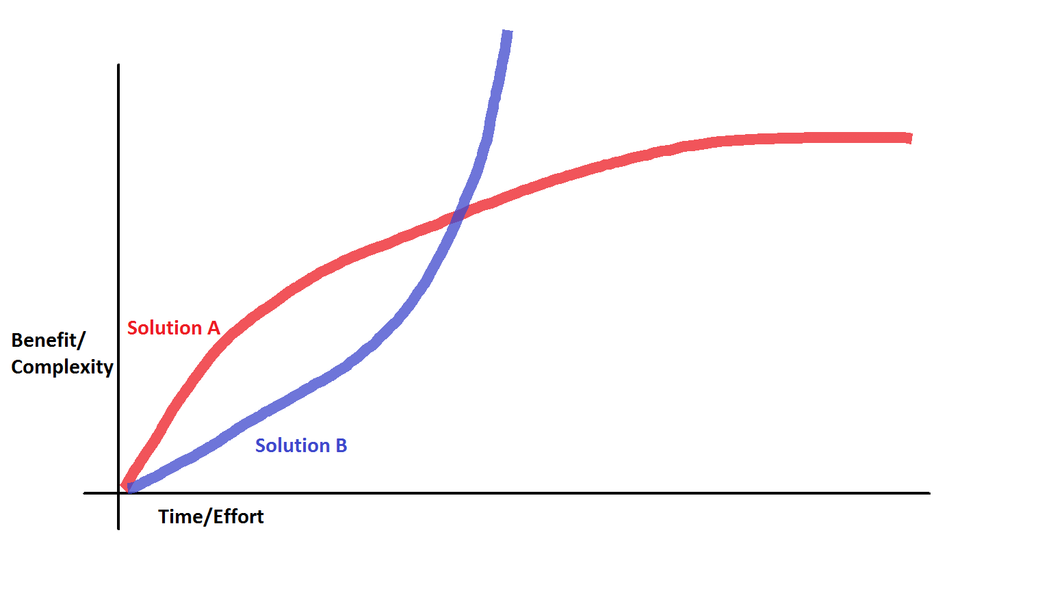
2. See the Big Picture

Slide 48
Property-grid vs. Visual Scripting
FxTrigger
Flow

Slide 49
Every feature introduces risk

Slide 50
3. Stay Focused
Don’t compete on feature set
Do focused, high-quality work
Explore one core tech feature fully
Use constraints to limit scope

Slide 51
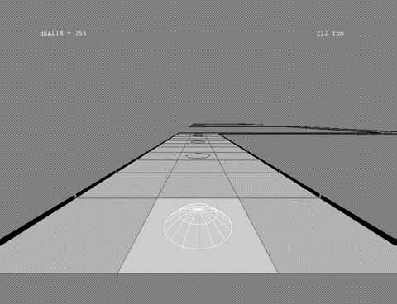
Prototype

Slide 52
----------------------------------------------------------------
-----------------------------------b-bb-b-b-bb--b--.....................
--------------------------------------------------b....................
---------------------------------------------------...-...-..............
--------------------------------------------------b--...................
....................................................b...-.................
................................................... -....................
...............................................--...b--..-..................
...............................................--.....b....................
......................................................-....-................
...............................................--.....b--.....-..............
...............................................--.......b....................
........................................................-..............-..............................-bb--bb--
........................................................b-b.........................--................b.......b
..........................................................-.........................--................b..-....b
..........................................................b.....-.....-...............................-.......-
..........................................................b..-............................--..........-.......-
......................................................--..-................-........-.....--.....-....b..-....b
......................................................--..b...........................................b.......b
..........................................................-....-bb--bb--bb--bb--bb--bb--bb--bb--bb--bb-....-.--
....................................................--....b....b.........................................-....-
....................................................--....-....b...-.......-..........-................-......b
..........................................................b--bb-..............................................b
..........................................................bbb-b-b-bb-b-bb--bb--bb--bb--bb--bb--bb--bb--bb--bb--.
-----------------------------------------------------------......
-----------------------------------------------------------.........
----------------------------------------------------------b..........
-----------------------------------------------------------..............
-------------------------------------------------------b-b-.........
--------------------------------------------------------------
----------------------------------------------------b-b------------
-----------------------------------------------------------------
-------------------------------------------------b-b----------------
-----------------------------------------------------------------
----------------------------------------------b-b-------------------
-------------------------------------------------------------
---------------------------------b--bb-b-b-bb-b------------------------
...............................b.......................................
...........................-...-.....-...................................
.............................--b........................................
.................-...........b...........-......-.......................
.............................-........................................
...........................--b......-..................................
...........................b..........-..............................
...........................-........................................

Slide 53
Thumper’s Sequencer Tool
A linear stream of data used for level design, animation, characters, etc.

Slide 54
Gameplay Creation
Level Editor Demo

Slide 55
Obstacles, enemies
Tentacle Finger
Zillapede
Notes:
Unique aesthetic from our simple tool

Slide 56
Gameplay and “Physics”
Controller
JumpAnim

Slide 57
What we don’t have
Animation package import/export and playback
Physics
Sophisticated 3D editor

Slide 58
Gameplay…

