Slide 1
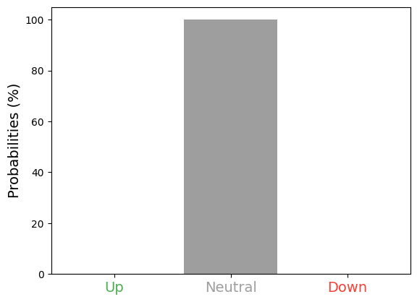
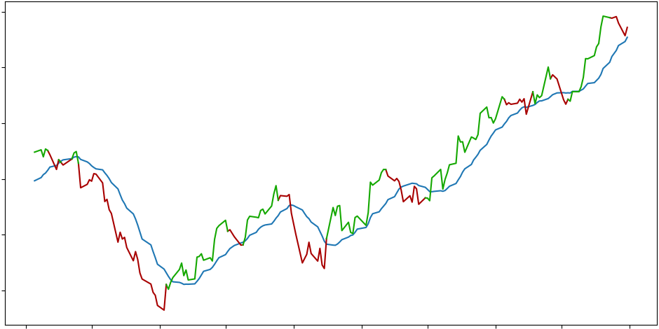
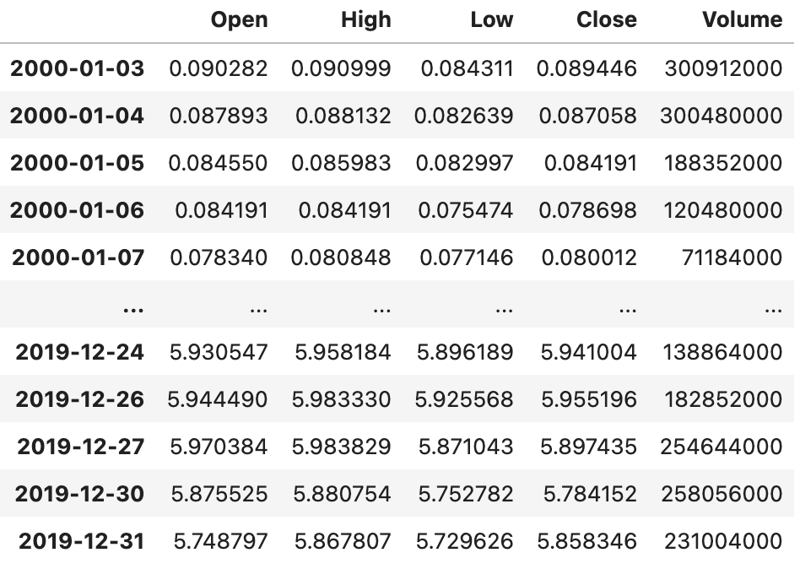
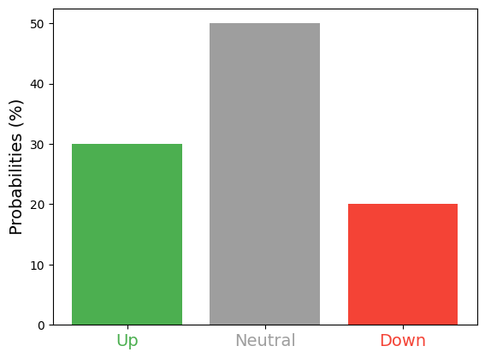
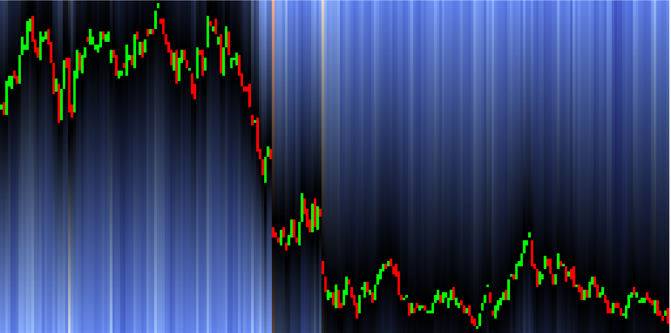








Last timepoint
$a$: Transformation function TS to annotation
$y_{t−T:t}$: Segmented time series
$y_{t}$: Ground truth
$g$: Transformation function TS to image
$x_{t−T:t}$: chart (OHLCV)
DNN
$z_{t}$: visual representation of time series
$\hat{y_{t}}$: Conditional estimated probability distribution
$f$: Deep neural network

