Slide 1
Popcorn & Code
Programming for Data Scientists: Python
The Smart Seat Reservation
Group: Anthonella Alessandra Frutos Lara, Emily Sophie Aust & Cordula Maier
Tutor: Corinna Elena Wegner

Slide 2
Introduction & Motivation
Challenge our knowledge
Full Web Development
SQL Database
Improving Changes
Default Project
Our Project
Be more creative, but still with orientation
Learn JavaScript
React Skills

Slide 3
Objective
The goal of this project is to implement a seat reservation system for a cinema consisting of:
SQLite Database for data storage
Backend based on Flask
Frontend based on React and React Router
Statistical analysis of reservations

Slide 4
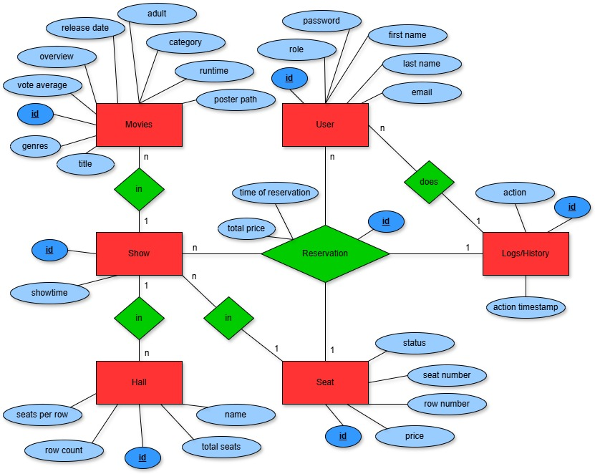
SQLite Database Design

Slide 5
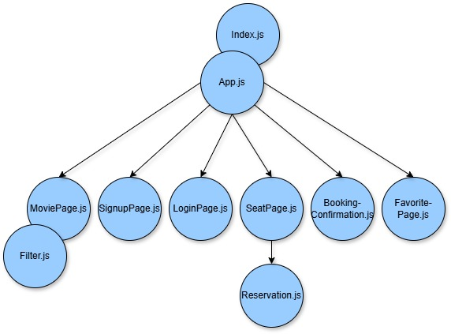
Frontend
Main component, administrates navigation
Entry point for React-App
Add screenshots from our App!
Add screenshots from our App!

Slide 6
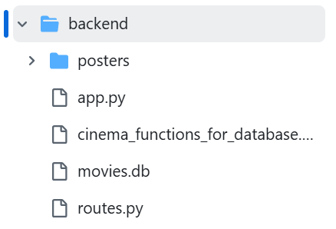
Backend
Main Application
- Starts Flask-Server and connects modules
- Flask & CORS allows API requests from frontend
- Uses SQLite for data handling
Functions for administration of database
API routes
- Defines endpoints for login, reservation, etc.

Slide 7
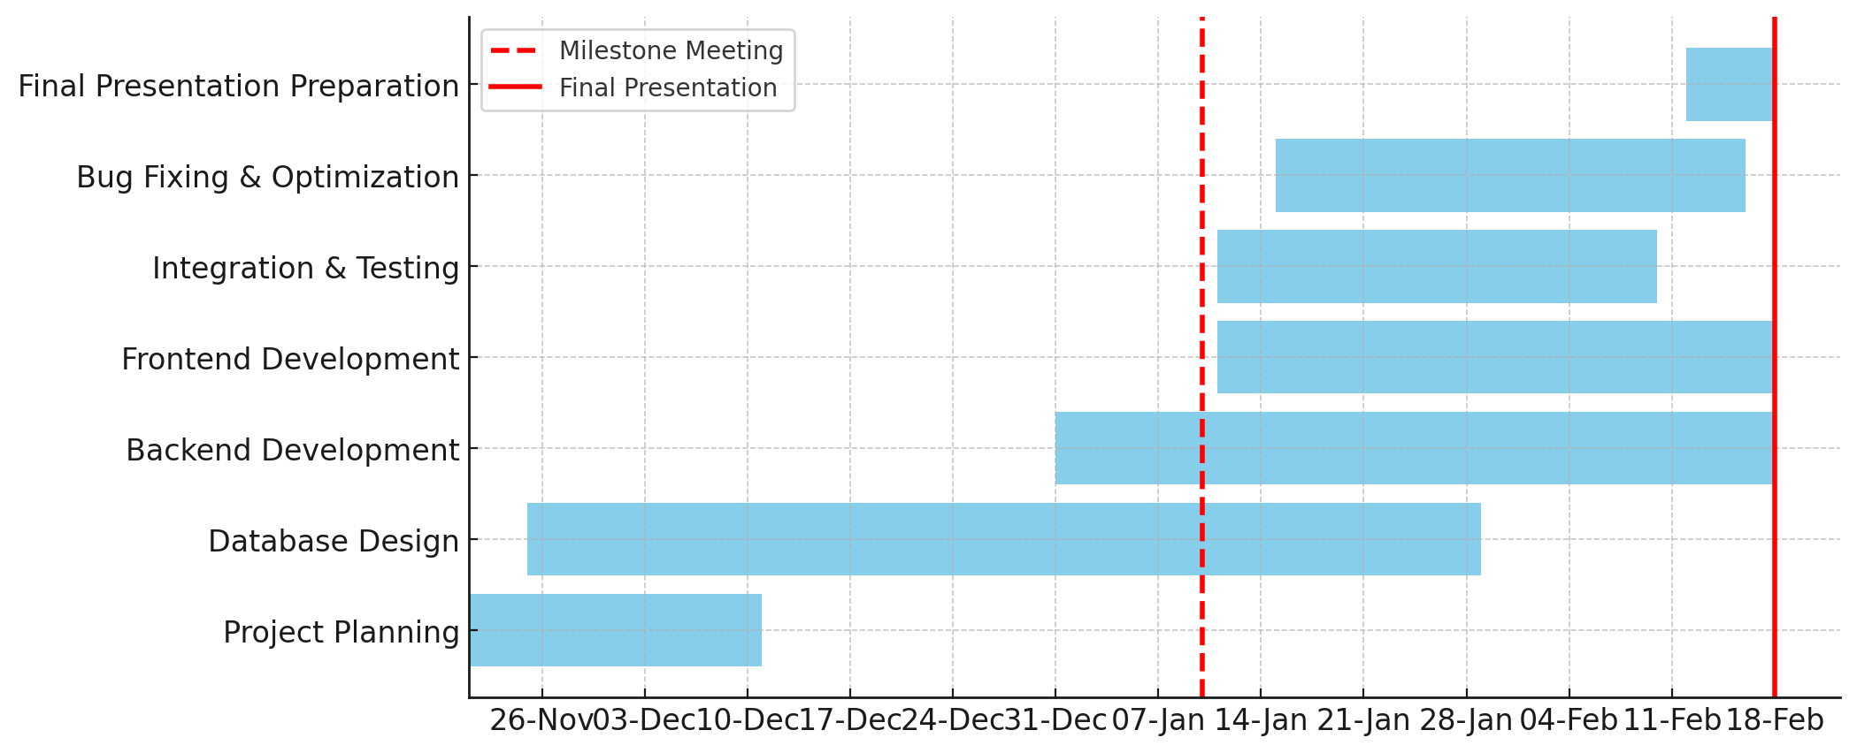
Project Timeline

Slide 8
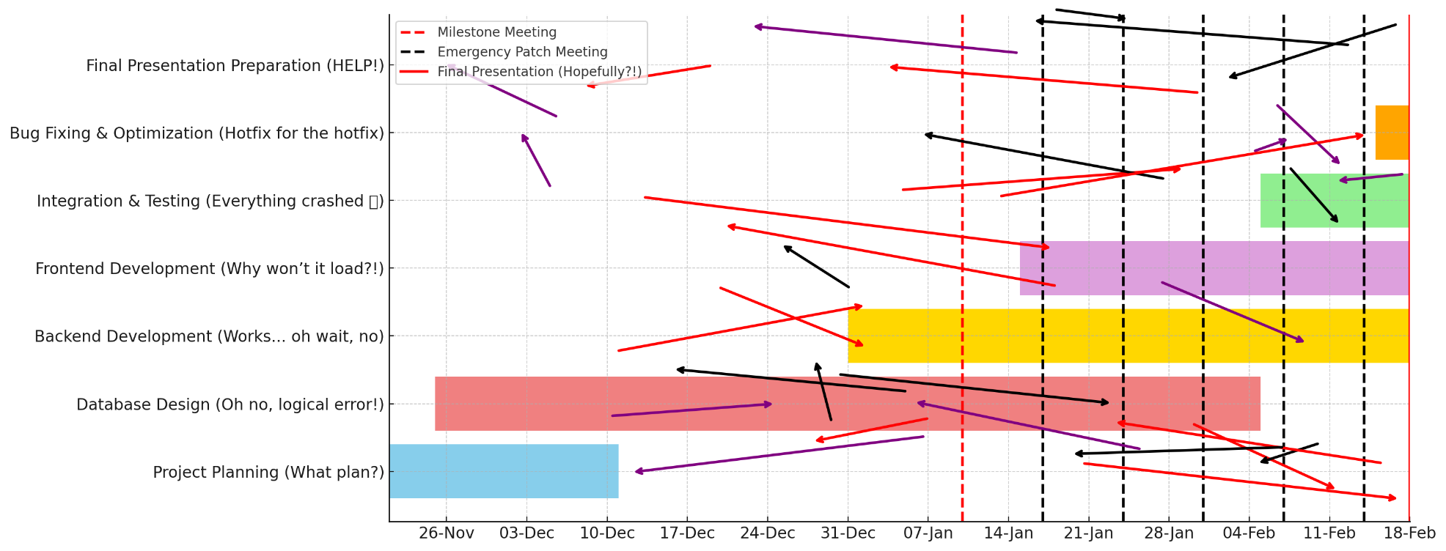

Project Timeline - Reality

Slide 9
Contributions
Anthonella
Emily
Cinema Seat Reservation
Cordula
Database design
Functions for database
Statistical analysis

Slide 10
References
The movie API: https://www.themoviedb.org/ See AI Usage Cards in GitHub.

Slide 11
Let‘s reserve some seats!

