Slide 1
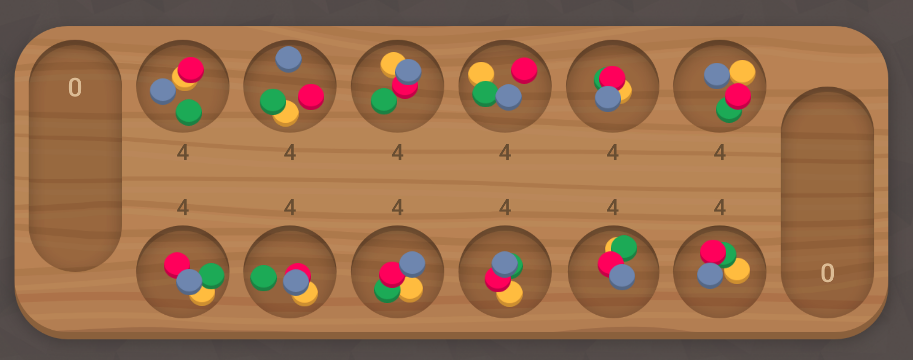
STMH Brainstorming

Slide 2
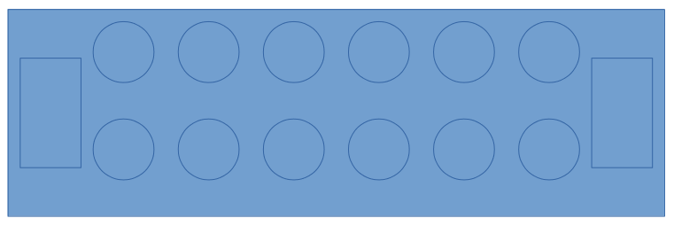
Rules
6 lubang + 1 lumbung @pemain
@lubang 4 rock TOTAL 48
Player 2 orang
Random play first
Mengacu ke https://mancala.playdrift.com/

Slide 3
Representasi GA+?
Populasi = jumlah lubang
Koromosom
H1 – H6 (Rule Based)
KETERANGAN
H1 = …..
H2 = …..
Hn = ...
H1*W1
H2*W2
H3*W3
H4*W4
H5*W5
H6*W6

Slide 4
For each move
Do GA First
Start
Initialize popsize
Random W1-Wn
Individu = lubang
Hitung H1-Hn untuk setiap individu → GA → Move → Repeat
Hitung nilai H1-Hn
Fitness Value
Selection
Mutation (W)
Crossover (W)
Iterasi = x
Move Rock
Game = selesai
Selesai
Selesai

Slide 5
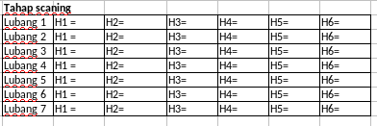
scanning

Slide 6
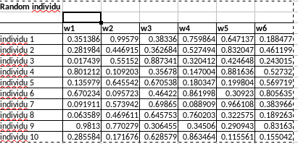
Generate populasi

Slide 7
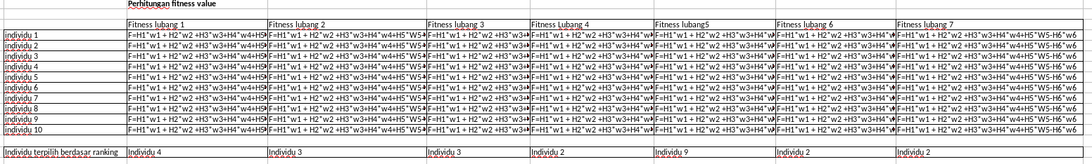
Perhitungan fitness value

Slide 8

Roulete wheel

Slide 9
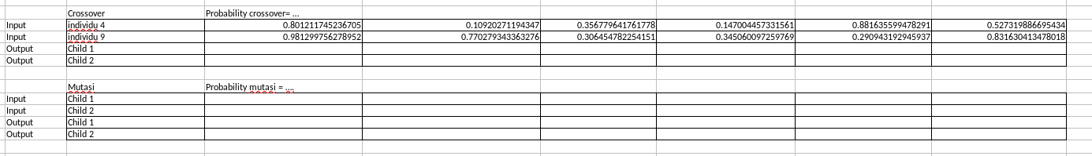
Crossover Mutasi

Slide 10
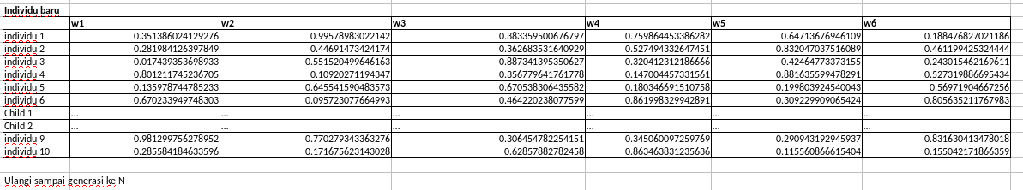
Perbaruan populasi + Repeat GA

Slide 11
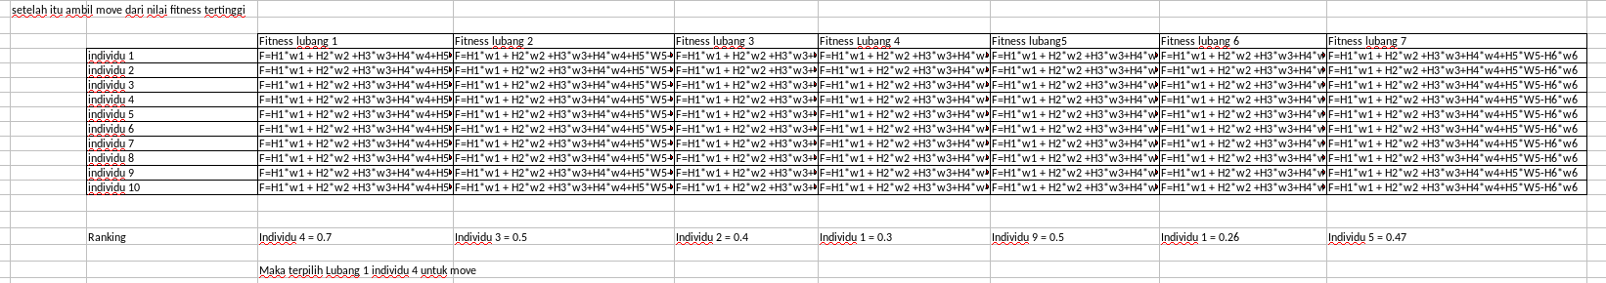
Hasil setelah 5 generasi

Slide 12
Fungsi yang harus dibuat
H=[H1,H2,H3,H4,H5,H6]
Def scanning(lubang, H):
return lubang, H
1. Scanning + normalisasi H
2. Fitness value
3. Generate populasi
4. Roulette wheel
5. Crossover
6. Mutasi
7. Replace individu
8. Pengambilan Move(terakhir)
Individu = [ ]
Def generate_pop(n):
return individu
Def fitnes(lubang,individu)
return nilai_individu_tiap_lubang

