Slide 1
Honeypots
Jordan Anthony

Slide 2
Summary
What is a Honeypot?
What types are there?
The 2 Honeypots I deployed (Pentbox and Cowrie)
Attacking the Honeypots
Other common Honeypots
Conclusion

Slide 3
What is a Honeypot?
A honeypot is a server or machine used to lure in and track attackers
The point of a honeypot is to gather data from attackers
The data collected can be used to create signatures
Honeypots are made supposed to look enticing to attackers

Slide 4
Types of honeypots
Scalability is the ability to deploy many honeypots
Fidelity is the ability to look like a real machine
The are low, medium and high interaction honeypots
Low interaction honeypots have higher scalability and lower fidelity
Medium interaction honeypots have some scalability and some fidelity
High interaction honeypots have low scalability and high fidelity.

Slide 5
Why use honeypots?
They collect real data from real hackers and don’t just simulate attacks
They reduce false positives significantly because all traffic is not legitimate
They do not require expensive resources because they are often VM’s
You can still log attackers using encryption because all traffic gets logged

Slide 6
My deployed honeypots
I deployed a honeypot from a package called Pentbox
I also deployed a honeypot called cowrie

Slide 7
Pentbox
Pentbox is a package that contains cryptography and network tools
It is open source and available on git-hub
It contains a low interaction and highly scalable honeypot
It works by opening a port of your choice and logging attempted intrusions
It denies every intrusion and just simply logs some important information
The pentbox honeypot displays a message of your choice for the intruder

Slide 8
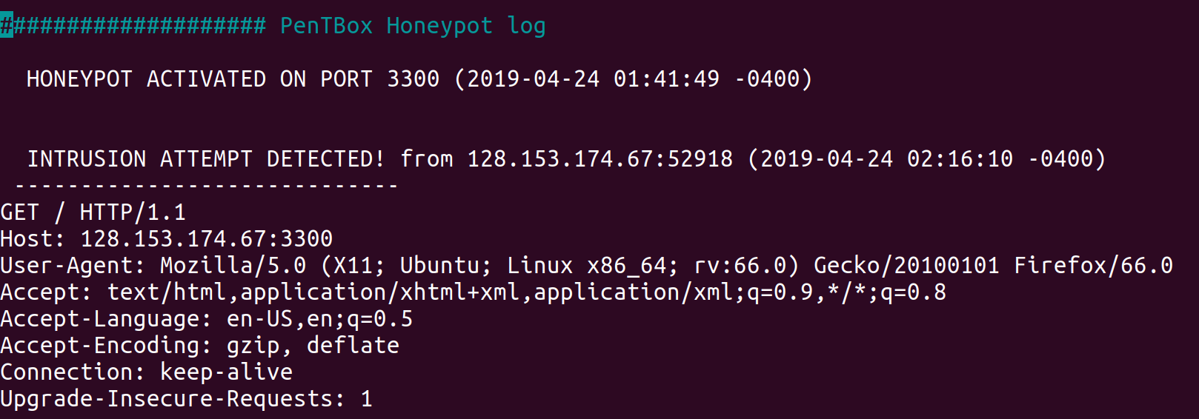
Pentbox
Pentbox logs the I.P., O.S., browser if used, language used and the connection

Slide 9
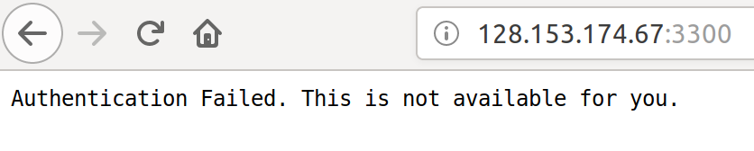
Pentbox
Pentbox will also show a message for the attacker

Slide 10
Cowrie
Cowrie is a package built solely for being a honeypot
Cowrie is also open source and available on git-hub
It is a medium interaction honeypot meaning the intruder can use a shell
It is an SSH and telnet honeypot
It looks like a real linux shell when an attacker “gets in”

Slide 11
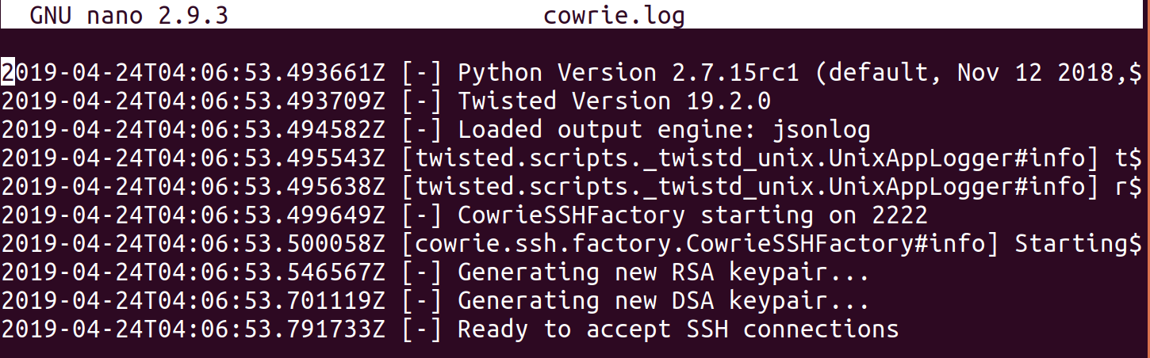
Cowrie
Cowrie logs when you start, what port, and when it is ready

Slide 12
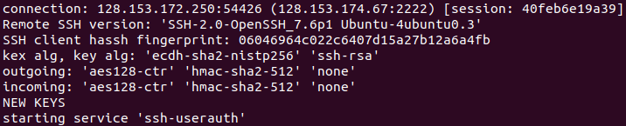
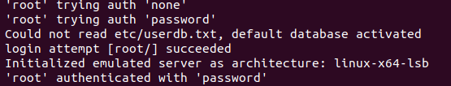
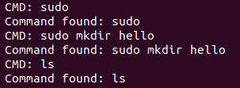
Cowrie
Cowrie also logs user information and everything the user tries to do

Slide 13
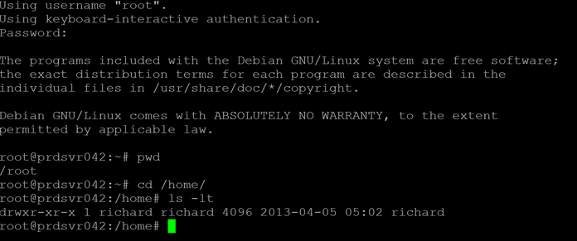
What does Cowrie look like for the attacker?
The cowrie shell shows a fake user named Richard when the attacker logs in. It lets any password log in as root.

Slide 14
Other Honeypots
HoneyDrive is a OVA that contains many different types of honeypots
Honeyd is a popular honeypot that simulate networks like http
Snare is a popular web application honeypot
Kippo is an popular alternative ssh honeypot like cowrie

Slide 15
Conclusion
Honeypots are useful for creating signatures
Low interaction honeypots like Pentbox give the attacker little to no access which makes it harder to make exact signatures
Medium interaction honeypots like Cowrie let attackers do more, thus increasing the accuracy of the signature created.
It is a good idea to deploy low to medium interaction honeypots inside a VM

Slide 16
Sources
https://github.com/royaflash/pentbox
https://github.com/cowrie/cowrie
https://www.thewindowsclub.com/what-are-honeypots
https://www.blackmoreops.com/2016/05/06/setup-honeypot-in-kali-linux/

