Slide 1
Country-Level Exploration from World Health Organization (WHO)
Anthony Cunningham
DATA 824

Slide 2
Table of Contents
Data Background
Data Source + How to Acquire
Contents
Purpose + Research Questions
Shiny App Demo + Interesting Findings

Slide 3
Life Expectancy Data: Kaggle

Slide 4
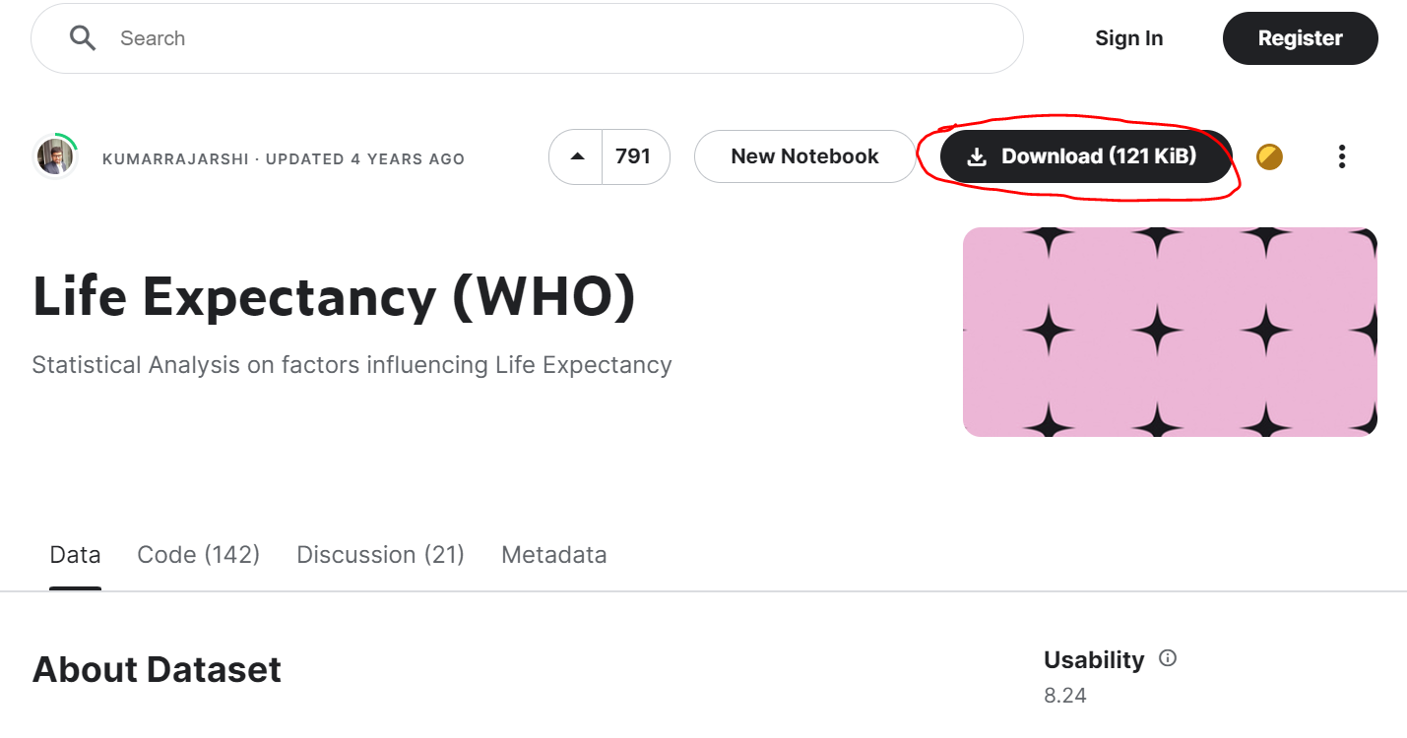
Data Acquisition
Found on Kaggle, by user KUMARRAJARSHI (link)
To download the data, create a free Kaggle account, sign in, and click “Download”:

Slide 5
Data Acquisition (Cont.)
Once downloaded, move it to a directory accessible by an R session
See GitHub for full dataset.
A bit of cleaning was applied to this dataset (format column headers, add continent of each country) – see data_cleaning.R
Dataset used for analysis: life_expectancy_clean.csv

Slide 6
Data Contents
Health data sourced from the Global Health Observatory under WHO
Socioeconomic data sourced from the United Nation
Health and socioeconomic-related measures (20 in total) for 193 countries, from 2000-2015, including life expectancy, adult mortality, infant death count, alcohol consumption per capita, government health expenditure, hepatitis B immunization coverage and average years of schooling
See data_dictionary.xlsx for more info about each measure

Slide 7
Purpose

Slide 8
Purpose
As the dataset author notes, this dataset was intended for use in a multiple linear regression context, where life expectancy for a given country is to be evaluated and predicted, given a host of country-level measures.
I intend to make use of data visualization techniques and technologies to make the initial exploration for this effort easier and more accessible.
In linear regression problems, it is often useful to study bivariate correlations between measures and the outcome variable, or with other measures (to detect potential multicollinearity).
Additionally, this dataset can be used to incorporate a time-based element (such as autoregression) in solving the intended problem. For exploratory purposes, it is often useful to track these measures across time to help inform modeling decisions.

Slide 9
Research Questions
Are there factors (either health-related, economic-related or both) that are highly correlated with country-level life expectancy?
Has life expectancy changed across time? Is this change different for some countries or regions, but not others?
What is the relationship between life expectancy and government healthcare expenditure, access to education and immunization coverage?
What impacts do lifestyle habits (diet, alcohol consumption, exercise) have on country-level life expectancy?

Slide 10
Findings
Demonstration of Shiny App

Slide 11
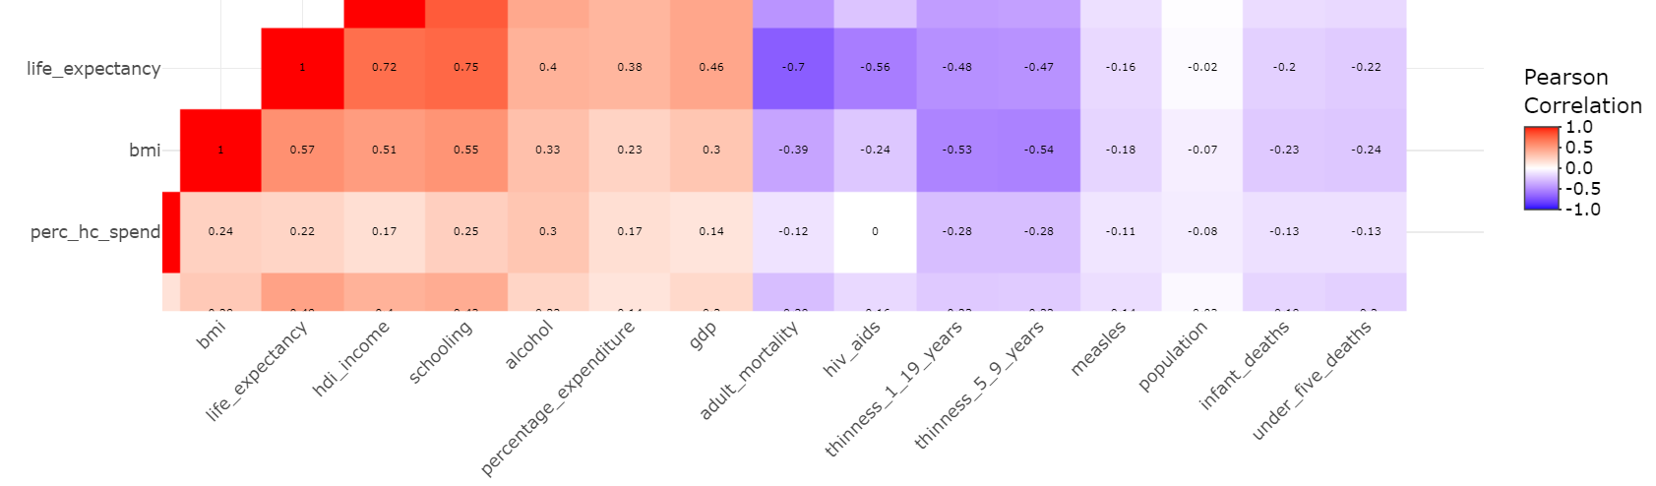
1: Factors Correlated with Life Expectancy
Using a heatmap of the correlation matrix among all numeric measures, it is shown that average schooling, HDI income and adult mortality all are highly correlated with life expectancy (|r| >= 0.7).

Slide 12
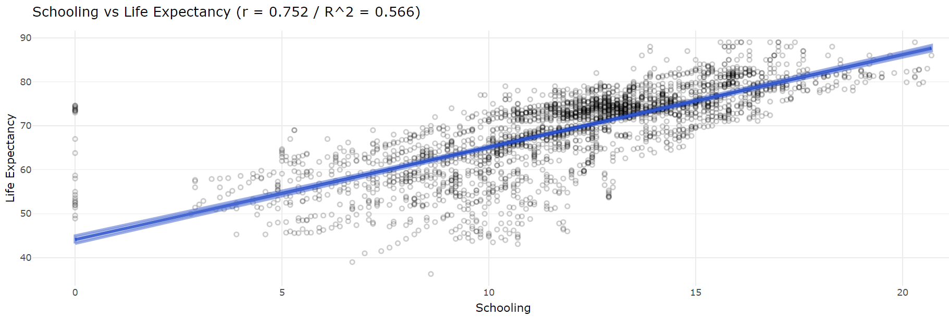
1: Factors Correlated with Life Expectancy
Schooling was found to be positively correlated with life expectancy; additionally, 57% of variation in life expectancy can be explained from average years of education alone, across all countries and years. This was also part of RQ #3.

Slide 13
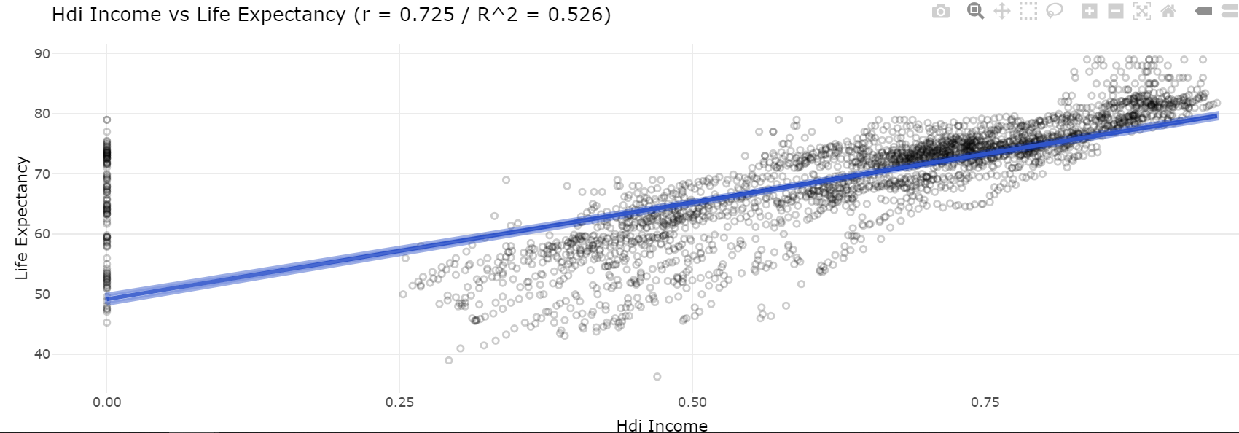
1: Factors Correlated with Life Expectancy
The income measure from the Human Development Index was also found to be positively correlated with life expectancy. Interestingly, it is also seen that a handful of country-year pairings have HDI Income of 0. After inspection using plotly’s interactive feature, most of these observations occur before 2002. This likely dulls the observed correlation, as most countries with non-zero HDI income tend to have higher life expectancy. This may indicate some additional cleaning may need to be performed on this measure as well.

Slide 14
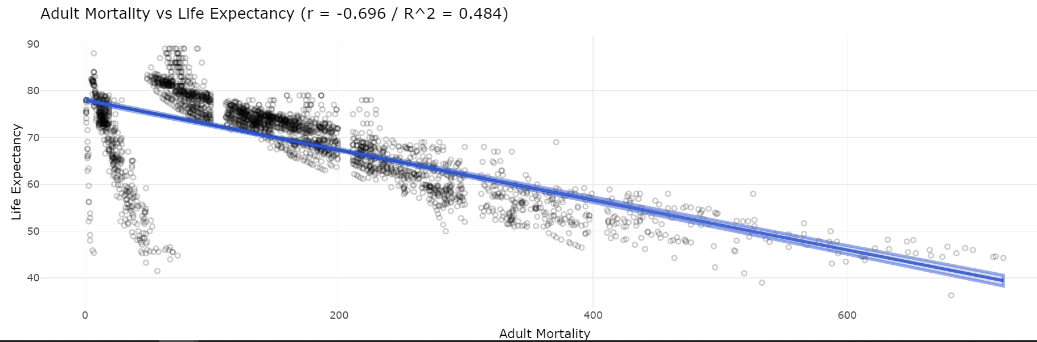
1: Factors Correlated with Life Expectancy
Lastly, adult mortalities were found to be negatively correlated with life expectancy. However, what’s interesting here is the noticeable separation from the general trend for country-year pairings with very low estimated mortality rates. This could indicate that mortality would be a good candidate for regression splining.

Slide 15
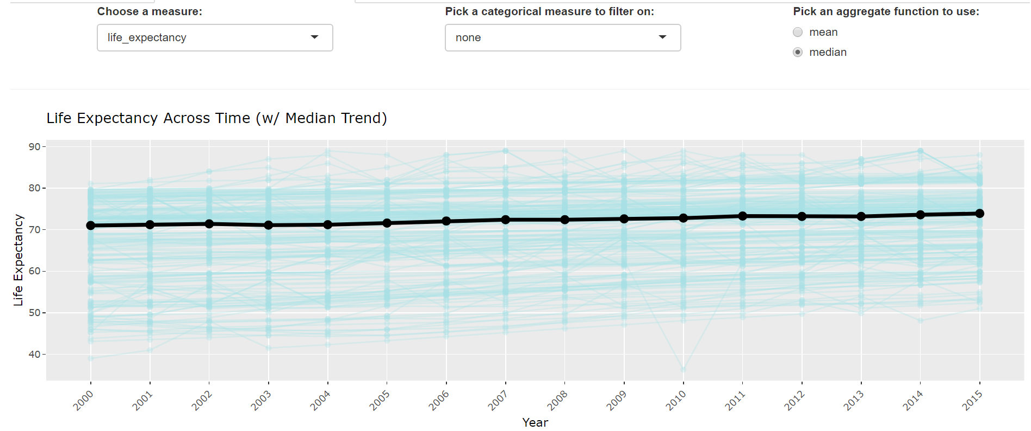
2: Life Expectancy Across Time
The median country-level life expectancy has slowly increased across the years of this dataset. In 2000, the median life expectancy was 71.0. In 2015, it was 73.9. Underlying this trend, what’s more interesting is that the floor of lower-expectant countries appears to be significantly higher in recent years. The worst country (Sierra Leone, 51.0) is still above 50.

Slide 16
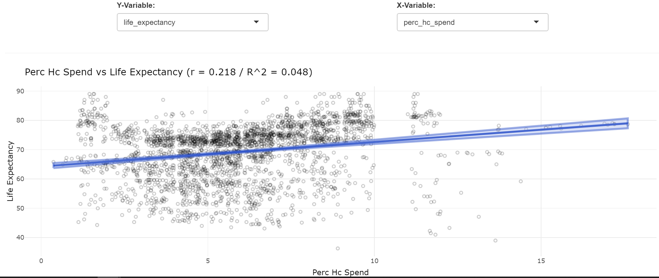
3: Life Expectancy vs Government Health Expenditures
The linear relationship between government healthcare spend and life expectancy doesn’t look to be strong, although slightly positive.

Slide 17
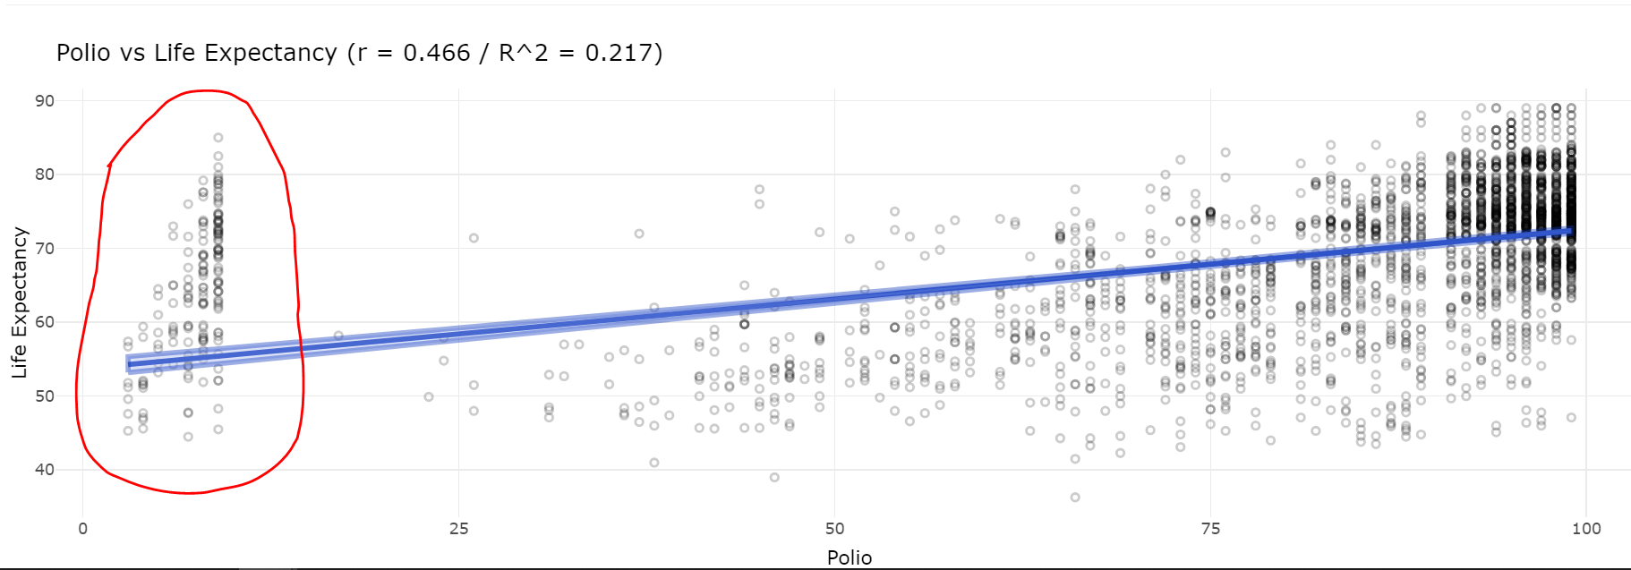
3: Life Expectancy vs Polio Immunizations
The linear relationship between polio inoculation among 1 year olds and life expectancy is positive and pretty strong. What’s interesting to see is the large variance of country-year pairs with very low polio immunization rates, and the noticeable gap between that and the rest of the cohort.

Slide 18
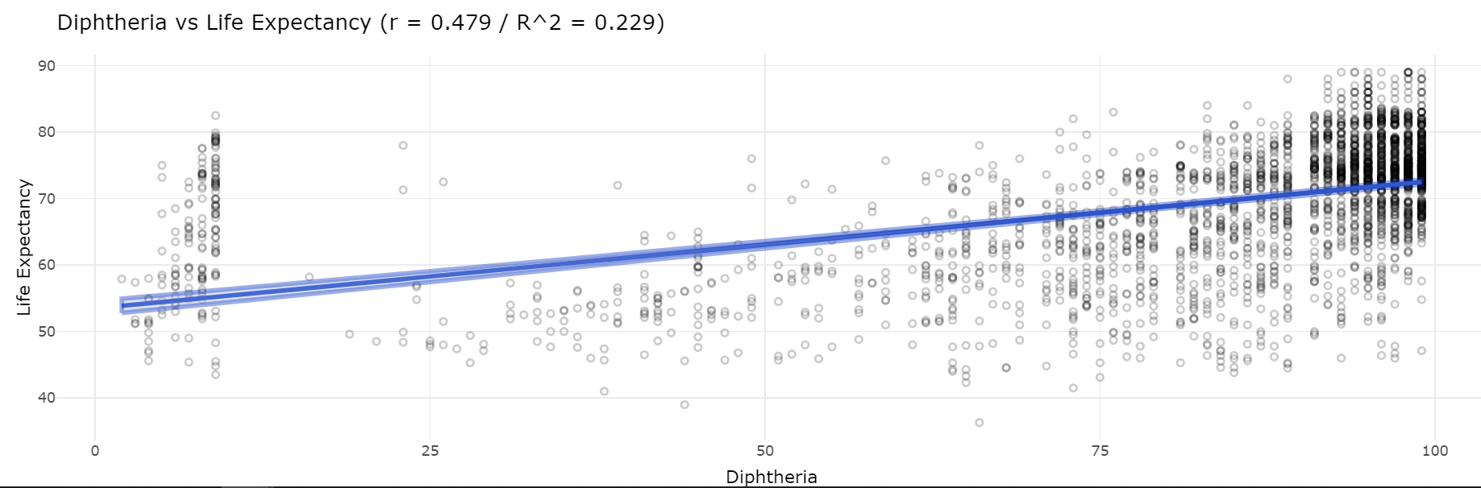
3: Life Expectancy vs Tetanus Immunization
We see a very similar relationship between life expectancy and tetanus inoculation as we did with polio, including the high-variance among very low immunization rates. As expected, correlation between polio and tetanus immunization rates one one-year-olds was positive and large (r = 0.674).

Slide 19
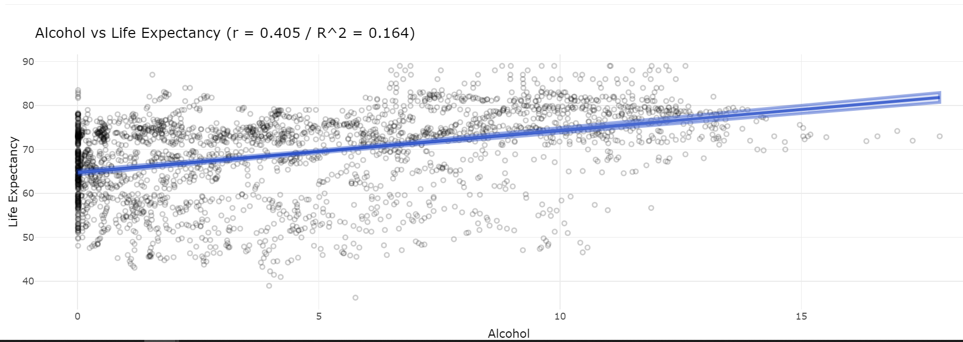
4: Life Expectancy vs Alcohol Consumption
There is a decently large positive relationship between life expectancy and alcohol consumption. This measure does look to be a bit right-skewed, indicating that we should consider transforming it into a more normally-distributed variable before building a model for predicting life expectancy.

Slide 20
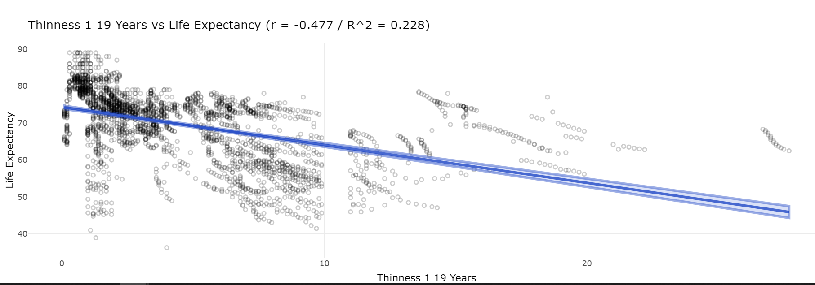
4: Life Expectancy vs Thinness Rate (10-19 y.o.)
Lack of access to a basic nutritious diet among pre-teens and teens is negatively associated with life expectancy. This measure would also be a good candidate for transformation, as well as exploring non-linear relationships, as the change in impact on life expectancy appears to be diminished for higher thinness rates.

Slide 21
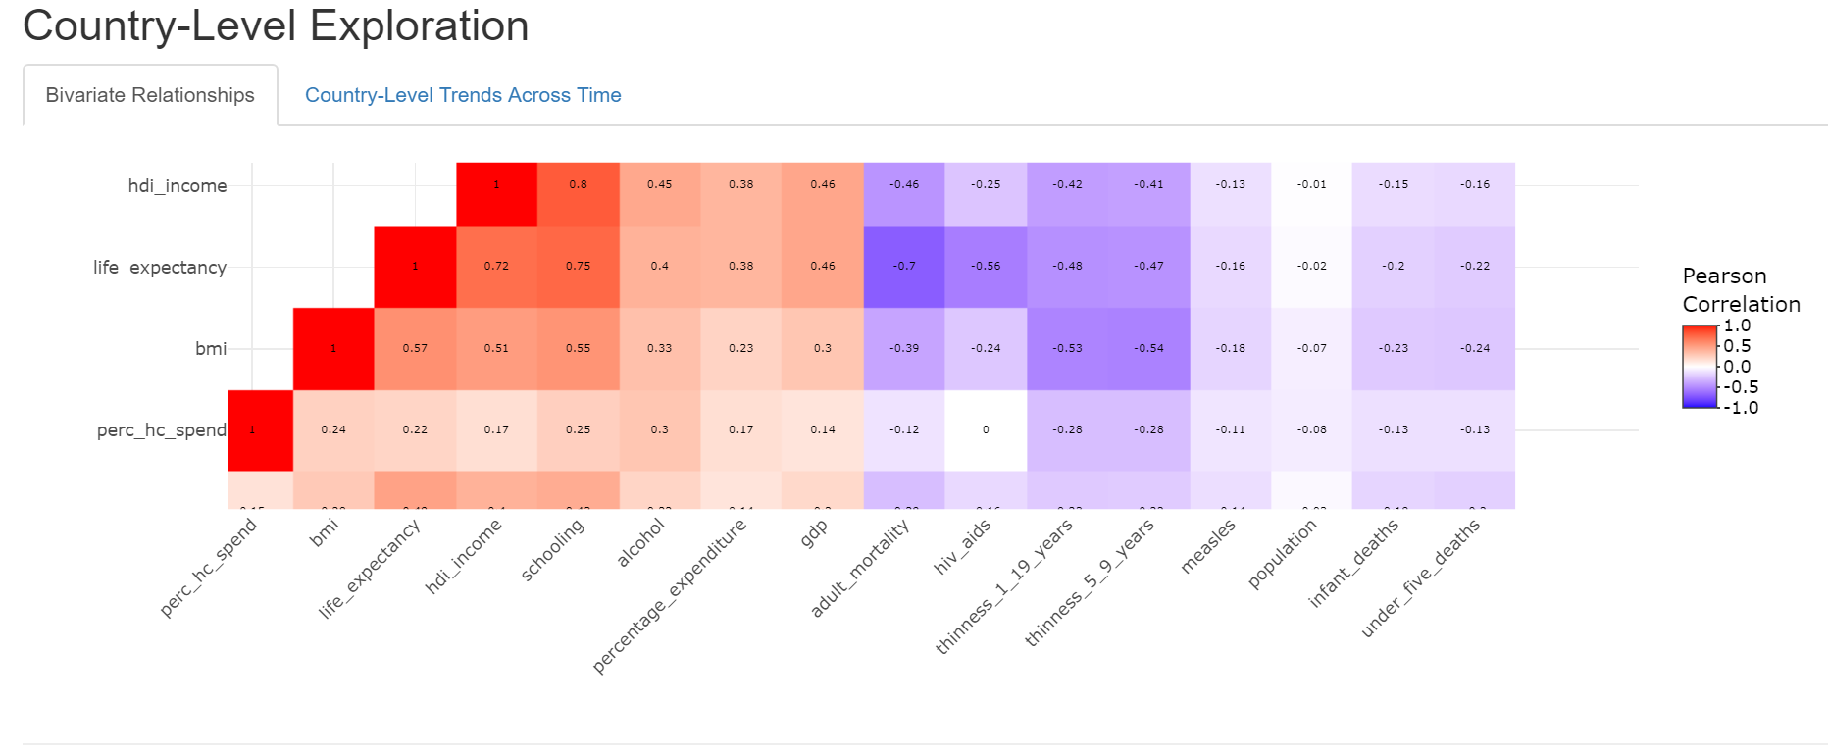
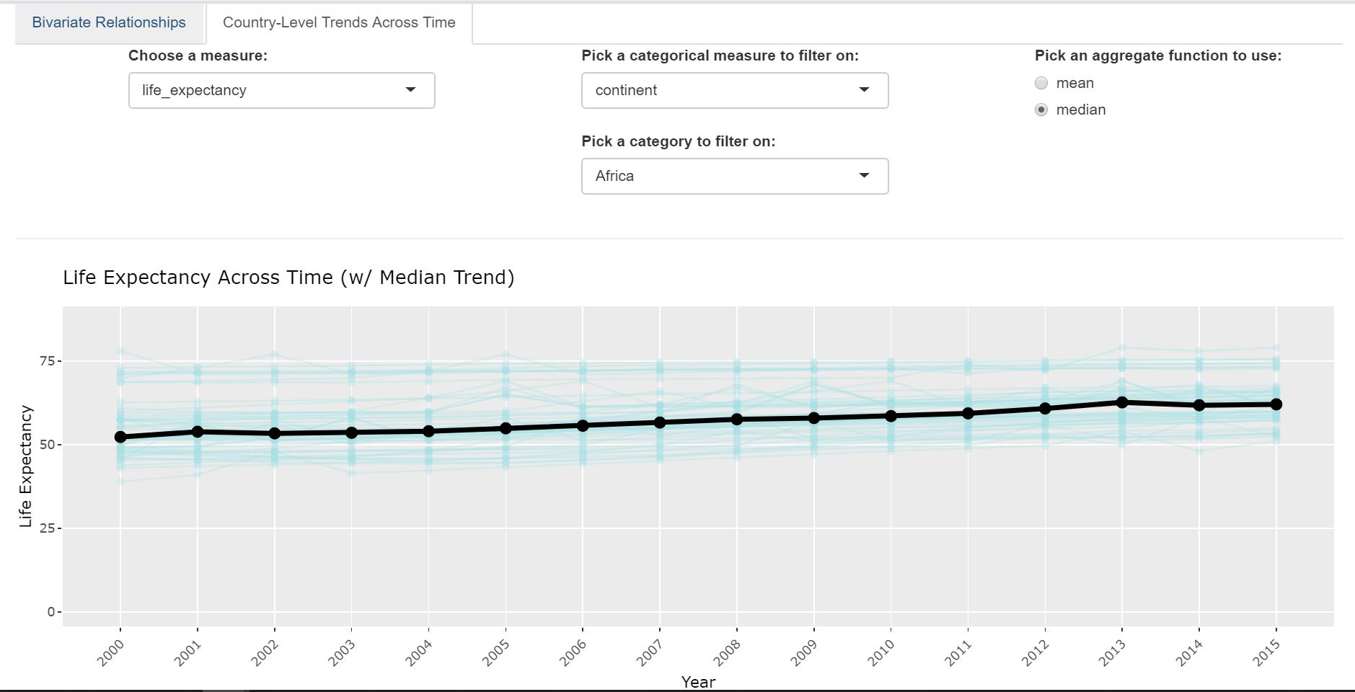
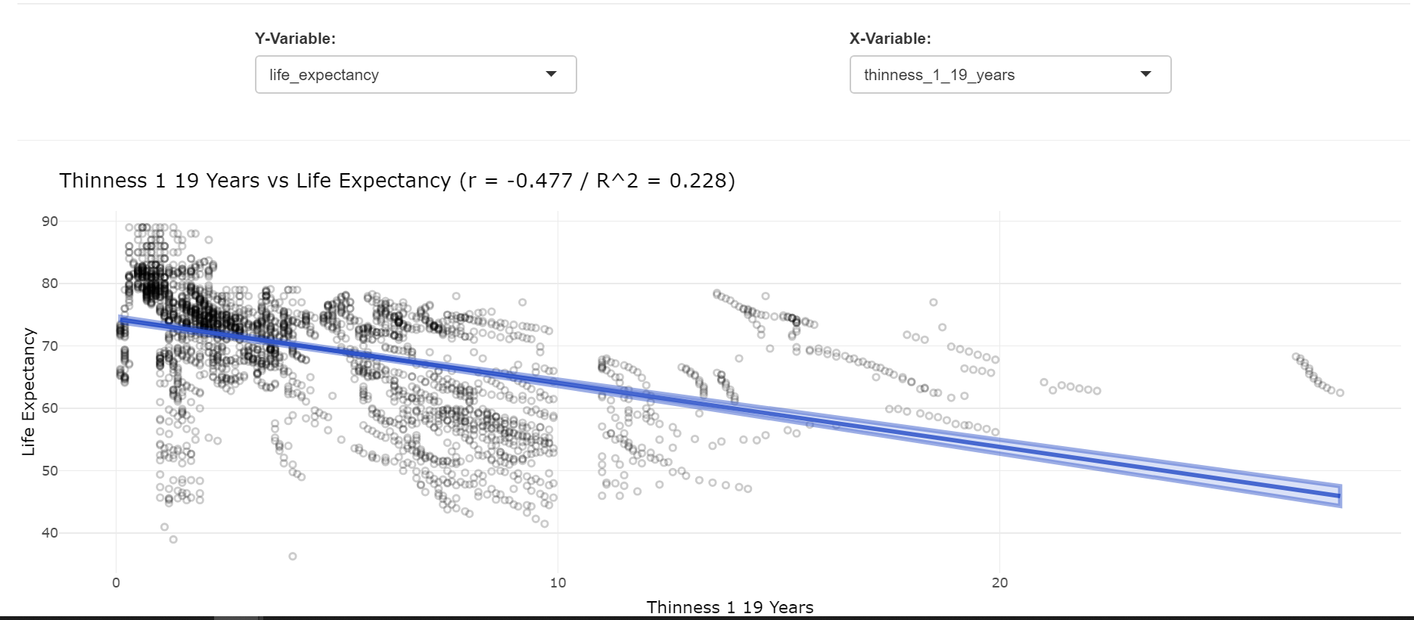
Shiny App Overview
Access on GitHub with this link. Download it and the dataset life_expectancy_clean.csv (make sure to change the location here on your local directory), open an Rstudio session and select “Run App” in the upper-right corner.
Bivariate Exploration
Trend across Time
This app helps in initial exploration for multiple linear regression and time series problems: it can summarize bivariate relationships via heatmap and scatter plots, as well as show aggregated trends across time, all with the convenient interactivity of plotly.

