Slide 1
Lunar Meteoroid Ejecta Model
Anthony M. DeStefano
NASA/MSFC/EV44 Natural Environments
10/23/2020

Slide 2
Overview
DSNE Rev H Lunar Ejecta Model – NASA SP-8013 (1969)
Based on Zook 1967
Brief (non-exhaustive) Review of Impact-Ejecta Scaling Models
Zook 1967
Krivov et al. 2003
Housen & Holsapple 2011
Proposed New DSNE Model -- Lunar Meteoroid Ejecta Model (LuMEM)
Sporadic meteoroid flux (Grun et al 1985)
Near Earth Object (NEO) flux (Brown et al 2002)
Impact-ejecta scaling model (Housen & Holsapple 2011)
Ejecta particle size distribution (Carrier 2003)
Ejecta zenith angle distribution (empirically from Gault & Wedekind 1978)
Ejecta azimuth angle distribution (modified from Rival & Mandeville 1999)
Analytic model of lunar ejecta
Speed distribution as a function of distance
Secondary flux as a function of distance
Secondary flux in terms of primary flux
Results of LuMEM
Igloo number flux distribution (based on MEM3, see Moorhead et al 2019)
Ejecta size scaling (derived from Carrier 2003)
Ejecta speed scaling (Housen & Holsapple 2011)

Slide 3
Overview
DSNE Rev H Lunar Ejecta Model – NASA SP-8013 (1969)
Based on Zook 1967
Brief (non-exhaustive) Review of Impact-Ejecta Scaling Models
Zook 1967
Krivov et al. 2003
Housen & Holsapple 2011
Proposed New DSNE Model -- Lunar Meteoroid Ejecta Model (LuMEM)
Sporadic meteoroid flux (Grun et al 1985)
Near Earth Object (NEO) flux (Brown et al 2002)
Impact-ejecta scaling model (Housen & Holsapple 2011)
Ejecta particle size distribution (Carrier 2003)
Ejecta zenith angle distribution (empirically from Gault & Wedekind 1978)
Ejecta azimuth angle distribution (modified from Rival & Mandeville 1999)
Analytic model of lunar ejecta
Speed distribution as a function of distance
Secondary flux as a function of distance
Secondary flux in terms of primary flux
Results of LuMEM
Igloo number flux distribution (based on MEM3, see Moorhead et al 2019)
Ejecta size scaling (derived from Carrier 2003)
Ejecta speed scaling (Housen & Holsapple 2011)

Slide 4
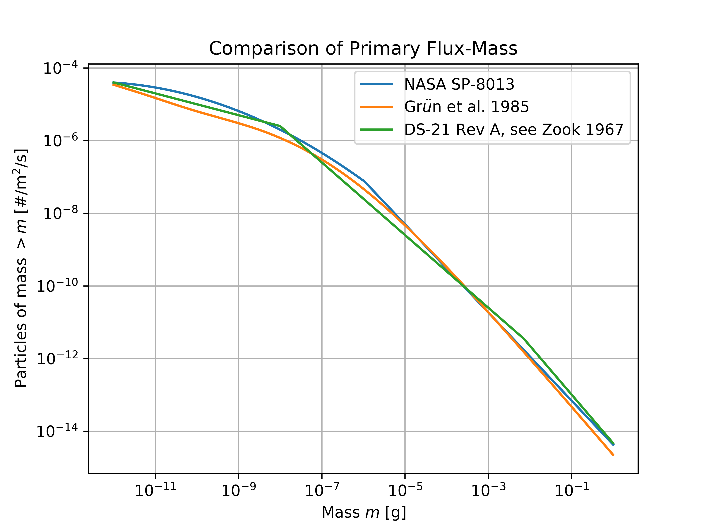
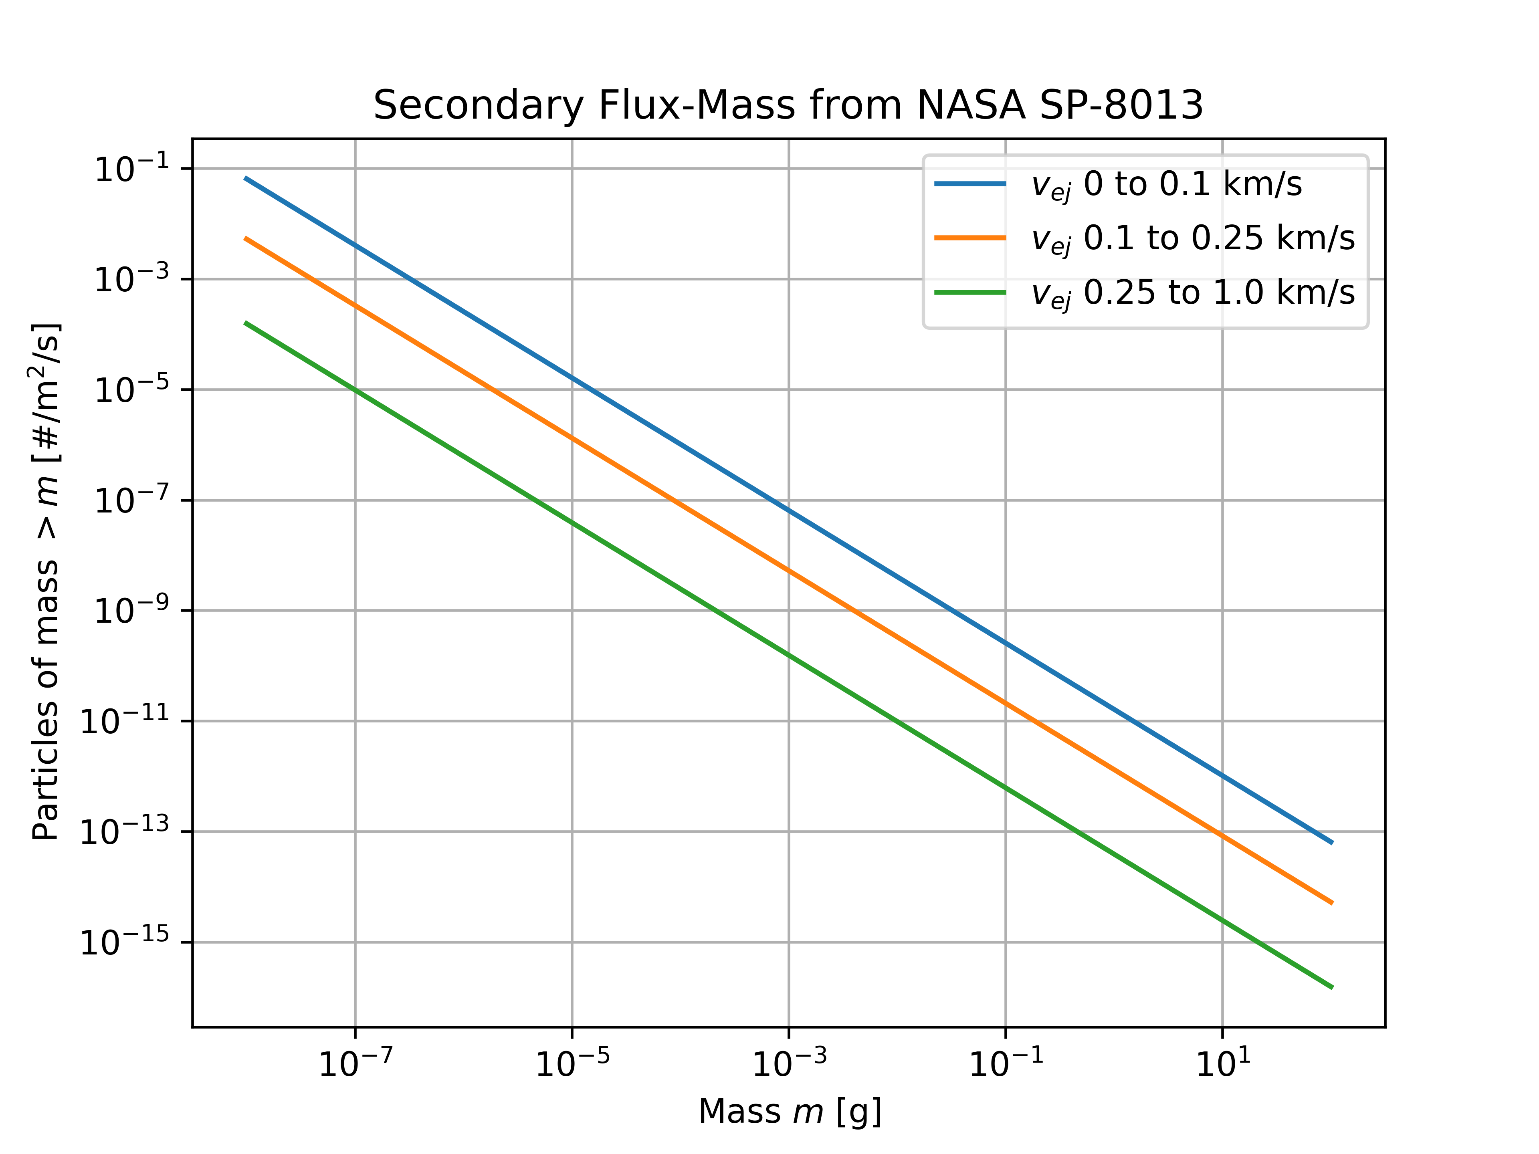
DSNE Rev H Lunar Ejecta Model NASA SP-8013 (1969)
Average speed [both] = 20 km/s
Density [NASA SP-8013] = 0.5 g/cm^3
Density [Grun et al 1985] = 2.5 g/cm^3
Density = 2.5 g/cm^3

Slide 5
Overview
DSNE Rev H Lunar Ejecta Model – NASA SP-8013 (1969)
Based on Zook 1967
Brief (non-exhaustive) Review of Impact-Ejecta Scaling Models
Zook 1967
Krivov et al. 2003
Housen & Holsapple 2011
Proposed New DSNE Model -- Lunar Meteoroid Ejecta Model (LuMEM)
Sporadic meteoroid flux (Grun et al 1985)
Near Earth Object (NEO) flux (Brown et al 2002)
Impact-ejecta scaling model (Housen & Holsapple 2011)
Ejecta particle size distribution (Carrier 2003)
Ejecta zenith angle distribution (empirically from Gault & Wedekind 1978)
Ejecta azimuth angle distribution (modified from Rival & Mandeville 1999)
Analytic model of lunar ejecta
Speed distribution as a function of distance
Secondary flux as a function of distance
Secondary flux in terms of primary flux
Results of LuMEM
Igloo number flux distribution (based on MEM3, see Moorhead et al 2019)
Ejecta size scaling (derived from Carrier 2003)
Ejecta speed scaling (Housen & Holsapple 2011)

Slide 6
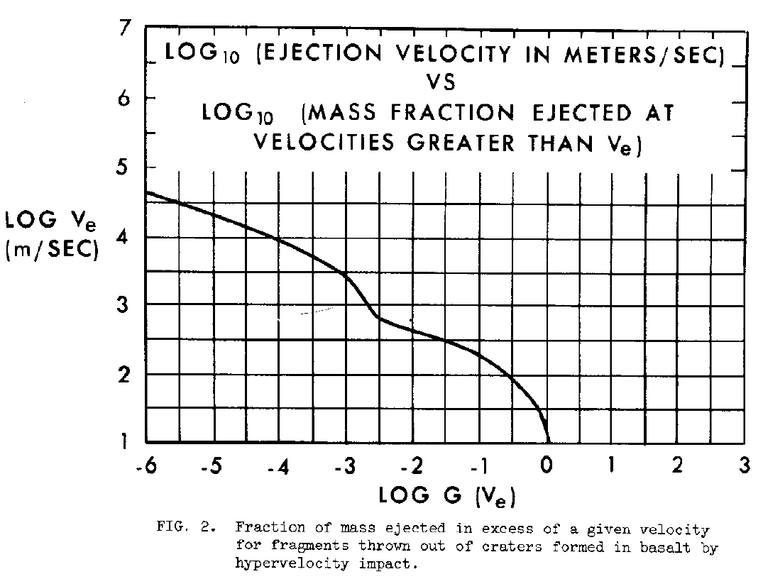

Impact-Ejecta Scaling Models Zook 1967
$f\left(>m_{e}, >v_{e}\right)=k_{1}^{−γ}k_{2}k_{3}^{−(γ+1)}\left(\frac{−1}{1−\frac{3}{α}−\frac{3γ}{α}}\right)m_{e}^{γ}{\left(\frac{1}{2}v_{p}^{2}\right)}^{−γ}{\left[G\left(v_{e}\right)\right]}^{1−\frac{3}{α}\left(1+γ\right)}$
Where $G\left(v_{e}\right)\sim v_{e}^{−1.92}$ for $v_{e}>0.1$km/s
The index $γ=γ(m_{p})$ is the power-law index of
the primary flux curve (see previous slide)
The parameter $α$ ranges from 0.3-0.7 (Zook ‘67)
In general, $α<1$ (Gault et al. 1963), property of
the target material
Implicitly, $m_{p}= \frac{m_{e}}{k_{1}k_{3}\left(\frac{1}{2}v_{p}^{2}\right){\left[G\left(v_{e}\right)\right]}^{\frac{3}{α}}}$, which defines $γ$
as a function of $m_{e}, v_{p},$and $v_{e}$

Slide 7
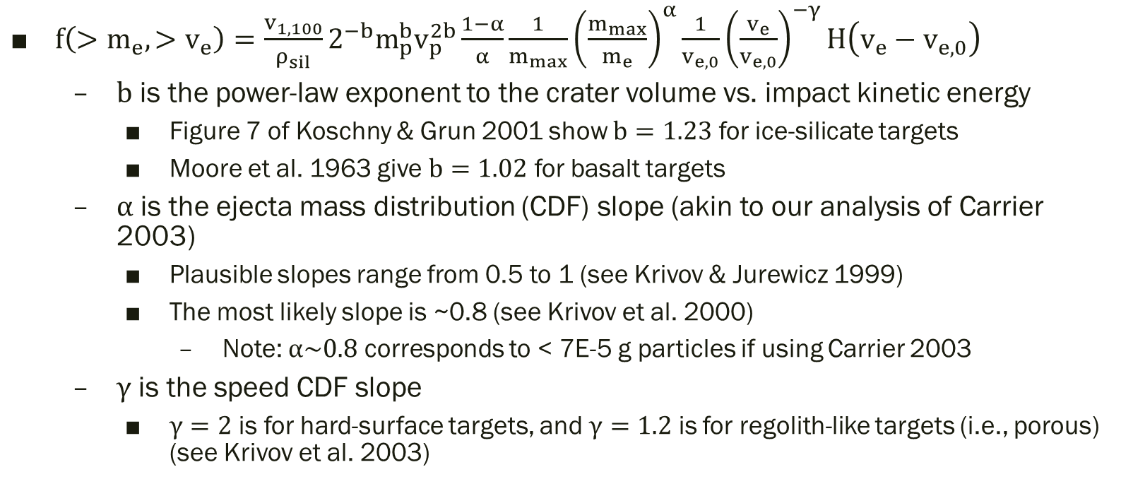
Impact-Ejecta Scaling Models Krivov et al. 2003
$f\left(>m_{e}, >v_{e}\right)=\frac{v_{1,100}}{ρ_{sil}}2^{−b}m_{p}^{b}v_{p}^{2b}\frac{1−α}{α}\frac{1}{m_{max}}{\left(\frac{m_{max}}{m_{e}}\right)}^{α}\frac{1}{v_{e,0}}{\left(\frac{v_{e}}{v_{e,0}}\right)}^{−γ}H\left(v_{e}−v_{e,0}\right)$
$b$ is the power-law exponent to the crater volume vs. impact kinetic energy
Figure 7 of Koschny & Grun 2001 show $b=1.23$ for ice-silicate targets
Moore et al. 1963 give $b=1.02$ for basalt targets
$α$ is the ejecta mass distribution (CDF) slope (akin to our analysis of Carrier 2003)
Plausible slopes range from 0.5 to 1 (see Krivov & Jurewicz 1999)
The most likely slope is ~0.8 (see Krivov et al. 2000)
Note: $α\sim 0.8$ corresponds to < 7E-5 g particles if using Carrier 2003
$γ$ is the speed CDF slope
$γ=2$ is for hard-surface targets, and $γ=1.2$ is for regolith-like targets (i.e., porous) (see Krivov et al. 2003)

Slide 8
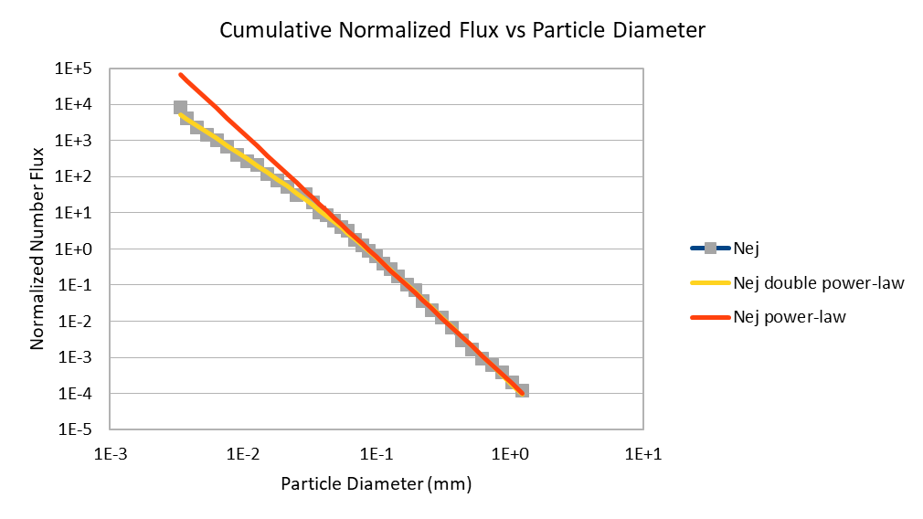
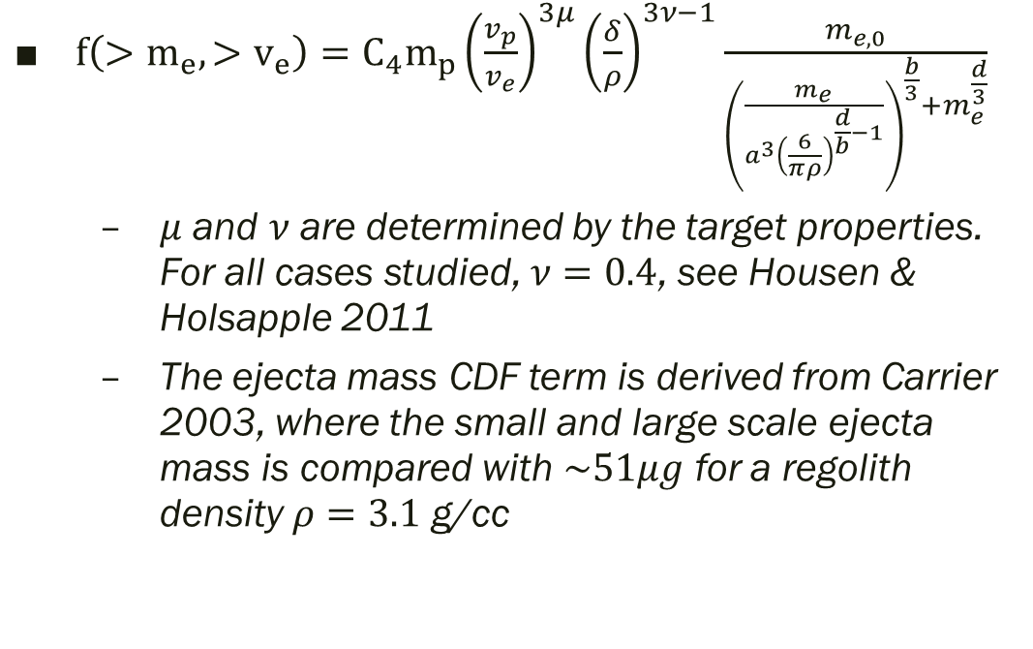
Impact-Ejecta Scaling Models Housen & Holsapple 2011
$f\left(>m_{e}, >v_{e}\right)=C_{4}m_{p}{\left(\frac{v_{p}}{v_{e}}\right)}^{3μ}{\left(\frac{δ}{ρ}\right)}^{3ν−1}\frac{m_{e,0}}{{\left(\frac{m_{e}}{a^{3}{\left(\frac{6}{πρ}\right)}^{\frac{d}{b}−1}}\right)}^{\frac{b}{3}}+m_{e}^{\frac{d}{3}}}$
$μ$ and $ν$ are determined by the target properties. For all cases studied, $ν=0.4$, see Housen & Holsapple 2011
The ejecta mass CDF term is derived from Carrier 2003, where the small and large scale ejecta mass is compared with $\sim 51μg$ for a regolith density $ρ=3.1$ g/cc

Slide 9
Overview
DSNE Rev H Lunar Ejecta Model – NASA SP-8013 (1969)
Based on Zook 1967
Brief (non-exhaustive) Review of Impact-Ejecta Scaling Models
Zook 1967
Krivov et al. 2003
Housen & Holsapple 2011
Proposed New DSNE Model -- Lunar Meteoroid Ejecta Model (LuMEM)
Sporadic meteoroid flux (Grun et al 1985)
Near Earth Object (NEO) flux (Brown et al 2002)
Impact-ejecta scaling model (Housen & Holsapple 2011)
Ejecta particle size distribution (Carrier 2003)
Ejecta zenith angle distribution (empirically from Gault & Wedekind 1978)
Ejecta azimuth angle distribution (modified from Rival & Mandeville 1999)
Analytic model of lunar ejecta
Speed distribution as a function of distance
Secondary flux as a function of distance
Secondary flux in terms of primary flux
Results of LuMEM
Igloo number flux distribution (based on MEM3, see Moorhead et al 2019)
Ejecta size scaling (derived from Carrier 2003)
Ejecta speed scaling (Housen & Holsapple 2011)

Slide 10
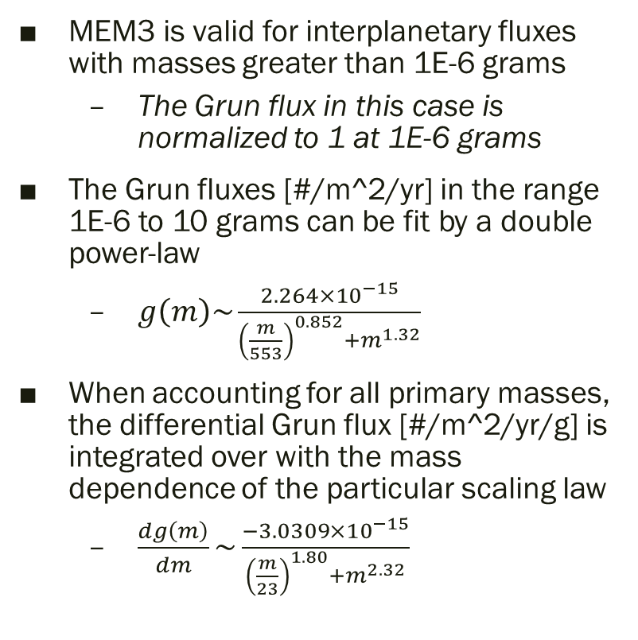
Sporadic meteoroid flux (Grun et al. 1985)
MEM3 is valid for interplanetary fluxes with masses greater than 1E-6 grams
The Grun flux in this case is normalized to 1 at 1E-6 grams
The Grun fluxes [#/m^2/yr] in the range 1E-6 to 10 grams can be fit by a double power-law
$g\left(m\right)\sim \frac{2.264×{10}^{−15}}{{\left(\frac{m}{553}\right)}^{0.852}+m^{1.32}}$
When accounting for all primary masses, the differential Grun flux [#/m^2/yr/g] is integrated over with the mass dependence of the particular scaling law
$\frac{dg\left(m\right)}{dm}\sim \frac{−3.0309×{10}^{−15}}{{\left(\frac{m}{23}\right)}^{1.80}+m^{2.32}}$

Slide 11
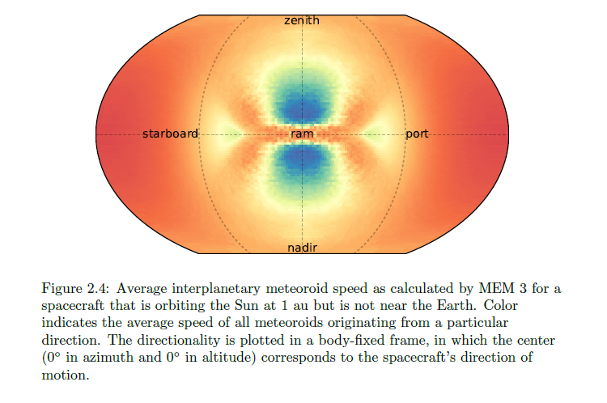
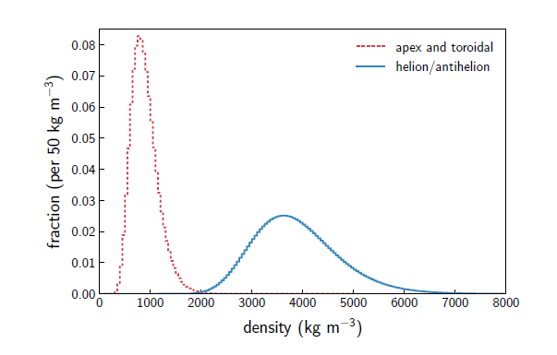
Sporadic meteoroid flux (low and high density populations in MEM)
Apex & toroidal
Helion/antihelion
Log-normal distributions
Moorhead 2019

Slide 12
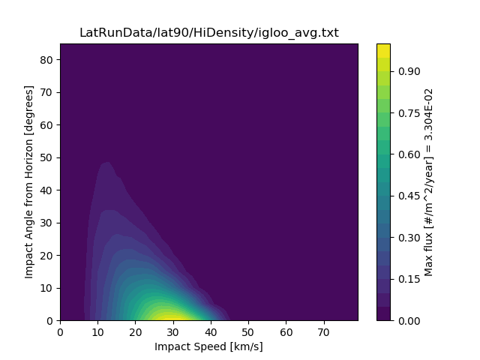
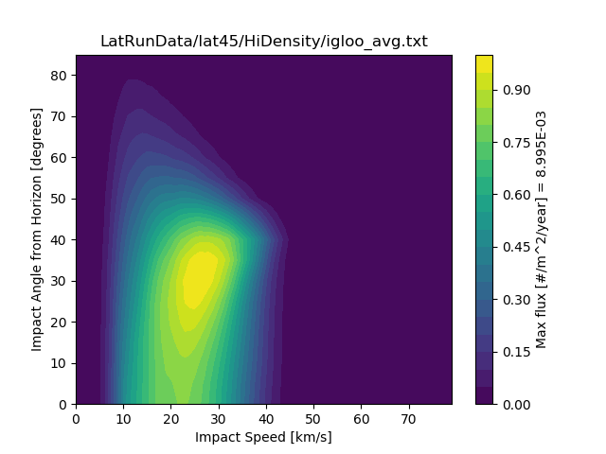
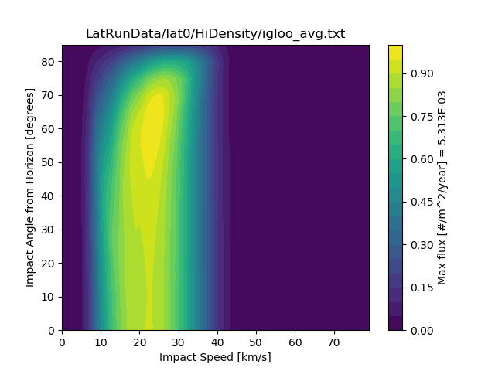
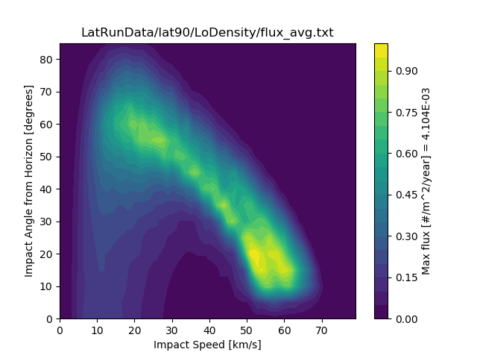
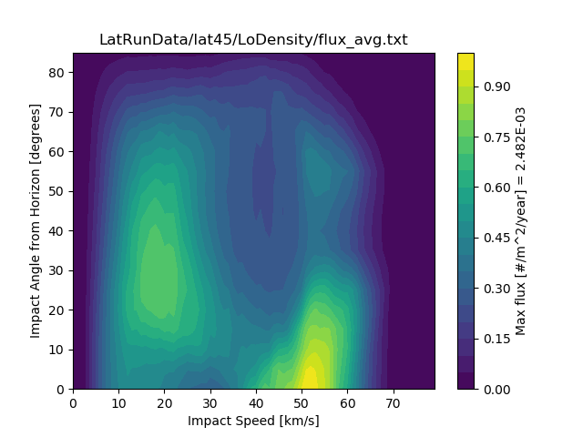
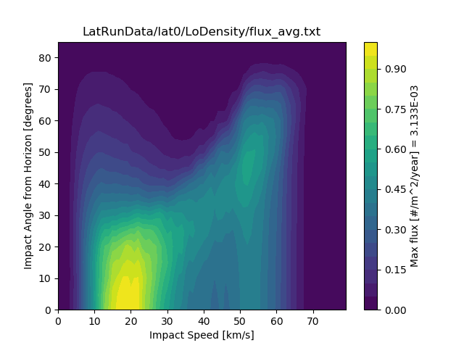
Sporadic meteoroid flux and latitudinal dependence on the lunar surface

Slide 13

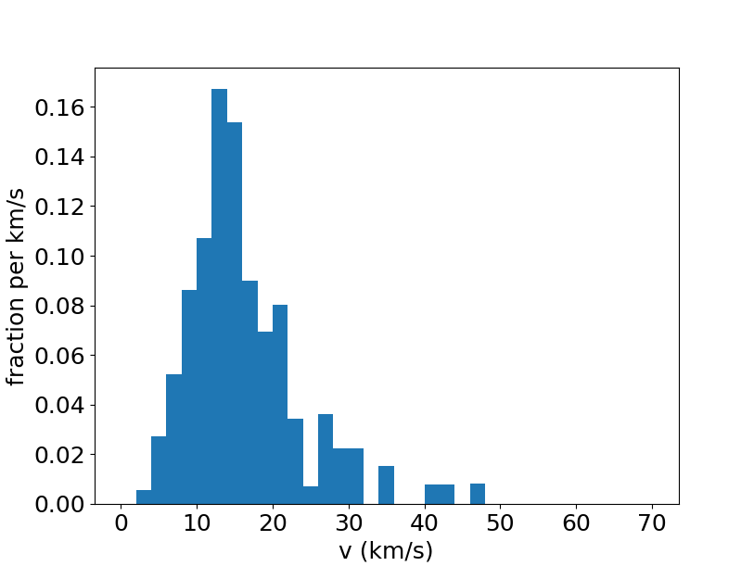
Near Earth Object (NEO) flux (Brown et al. 2002) at the lunar surface
Althea Moorhead (see memo OSMA/MEO/Lunar-001) computed the NEO flux at the lunar surface based on Brown et al. 2002 and velocity distribution of bolides reported by the Center for Near Earth Object Studies (CNEOS)
In LuMEM, we approximate the angular distribution of fluxes at the lunar surface by the high density population of MEM
The high density population in MEM comes from the equatorial plane, similar to the NEOs

Slide 14
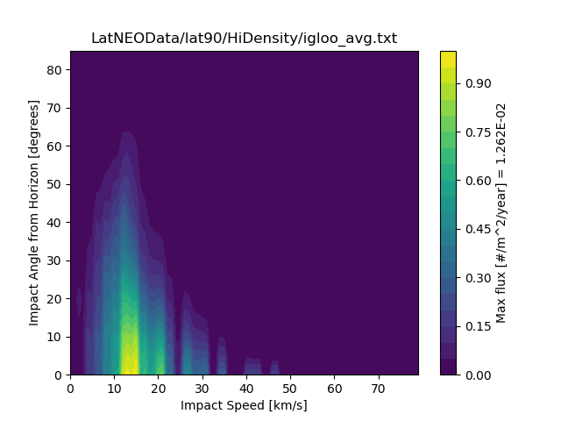
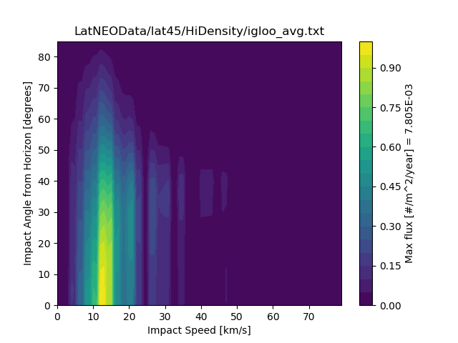
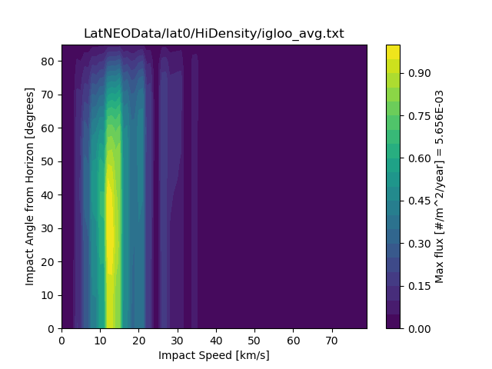
NEO flux and latitudinal dependence on the lunar surface

Slide 15
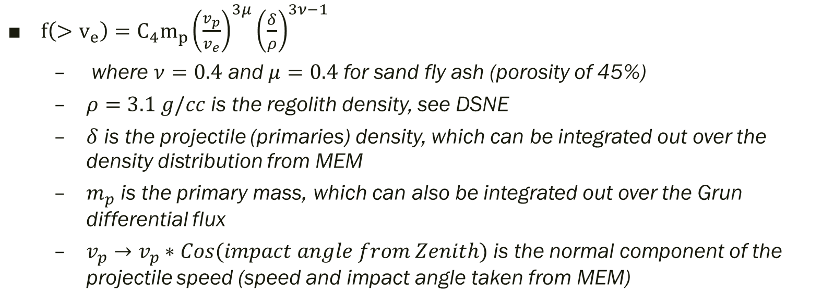
Impact-ejecta scaling model (Housen & Holsapple 2011)
$f\left(>v_{e}\right)=C_{4}m_{p}{\left(\frac{v_{p}}{v_{e}}\right)}^{3μ}{\left(\frac{δ}{ρ}\right)}^{3ν−1}$
where $ν=0.4$ and $μ=0.4$ for sand fly ash (porosity of 45%)
$ρ=3.1 g/cc$ is the regolith density, see DSNE
$δ$ is the projectile (primaries) density, which can be integrated out over the density distribution from MEM
$m_{p}$ is the primary mass, which can also be integrated out over the Grun differential flux
$v_{p}→v_{p}∗Cos(impact angle from Zenith)$ is the normal component of the projectile speed (speed and impact angle taken from MEM)

Slide 16
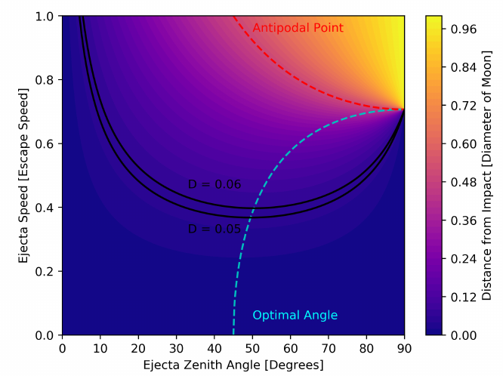





Trajectory and spherical geometry of secondary ejecta

Slide 17
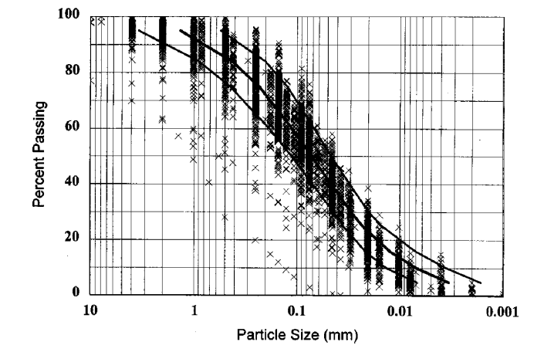


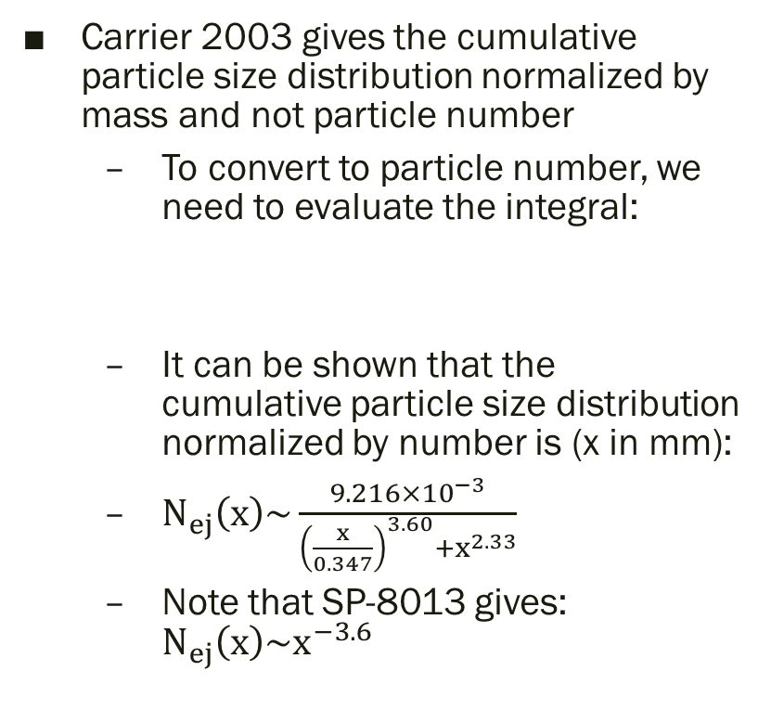
Ejecta particle size distribution (Carrier 2003)
Carrier 2003 gives the cumulative particle size distribution normalized by mass and not particle number
To convert to particle number, we need to evaluate the integral:
It can be shown that the cumulative particle size distribution normalized by number is (x in mm):
$N_{ej}\left(x\right)\sim \frac{9.216×{10}^{−3}}{{\left(\frac{x}{0.347}\right)}^{3.60}+x^{2.33}}$
Note that SP-8013 gives: $N_{ej}\left(x\right)\sim x^{−3.6}$

Slide 18
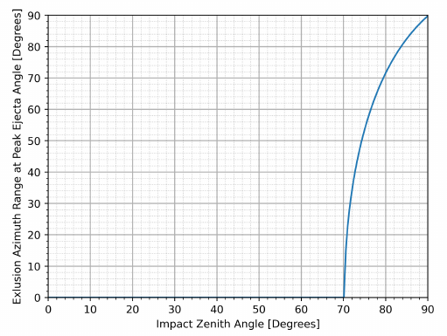
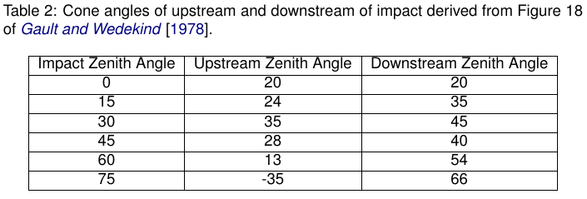

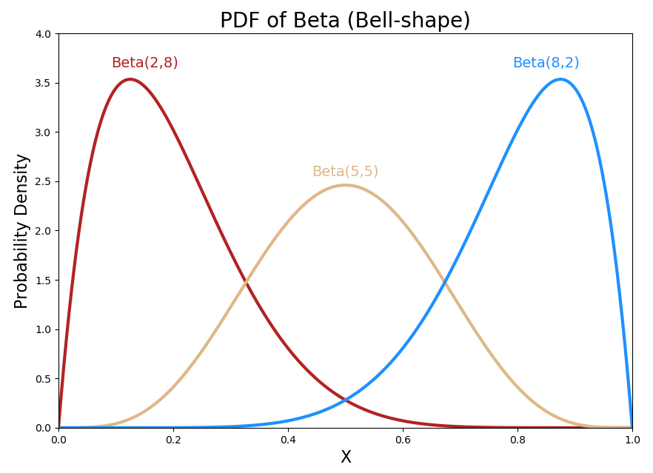


Ejecta zenith angle distribution (empirically from Gault & Wedekind 1978)
Zenith angle distribution (formally, a beta distribution in cosine of the zenith angle):
The maximum ejecta zenith angle as a function of ejecta azimuth from the down stream direction of the primary impact:
Defined so that α_max is the peak of the distribution

Slide 19
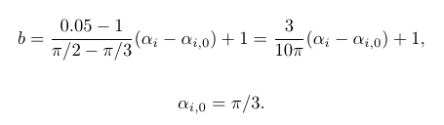



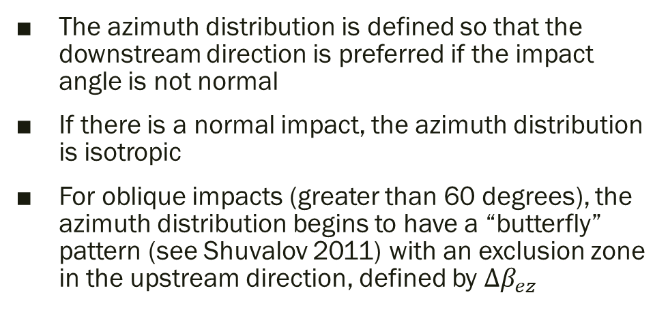
Ejecta azimuth angle distribution (modified from Rival & Mandeville 1999)
The azimuth distribution is defined so that the downstream direction is preferred if the impact angle is not normal
If there is a normal impact, the azimuth distribution is isotropic
For oblique impacts (greater than 60 degrees), the azimuth distribution begins to have a “butterfly” pattern (see Shuvalov 2011) with an exclusion zone in the upstream direction, defined by $Δβ_{ez}$

Slide 20
Overview
DSNE Rev H Lunar Ejecta Model – NASA SP-8013 (1969)
Based on Zook 1967
Brief (non-exhaustive) Review of Impact-Ejecta Scaling Models
Zook 1967
Krivov et al. 2003
Housen & Holsapple 2011
Proposed New DSNE Model -- Lunar Meteoroid Ejecta Model (LuMEM)
Sporadic meteoroid flux (Grun et al 1985)
Near Earth Object (NEO) flux (Brown et al 2002)
Impact-ejecta scaling model (Housen & Holsapple 2011)
Ejecta particle size distribution (Carrier 2003)
Ejecta zenith angle distribution (empirically from Gault & Wedekind 1978)
Ejecta azimuth angle distribution (modified from Rival & Mandeville 1999)
Analytic model of lunar ejecta
Speed distribution as a function of distance
Secondary flux as a function of distance
Secondary flux in terms of primary flux
Results of LuMEM
Igloo number flux distribution (based on MEM3, see Moorhead et al 2019)
Ejecta size scaling (derived from Carrier 2003)
Ejecta speed scaling (Housen & Holsapple 2011)

Slide 21






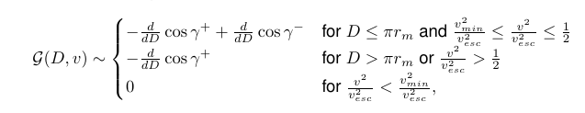
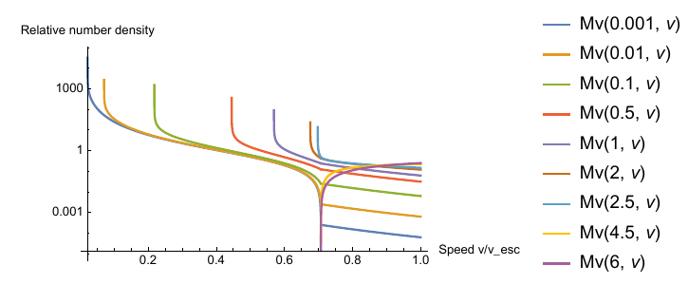


Speed distribution as a function of distance
Differential area
Azimuthal field-of-view
Ejecta speed distribution
Geometric factor

Slide 22
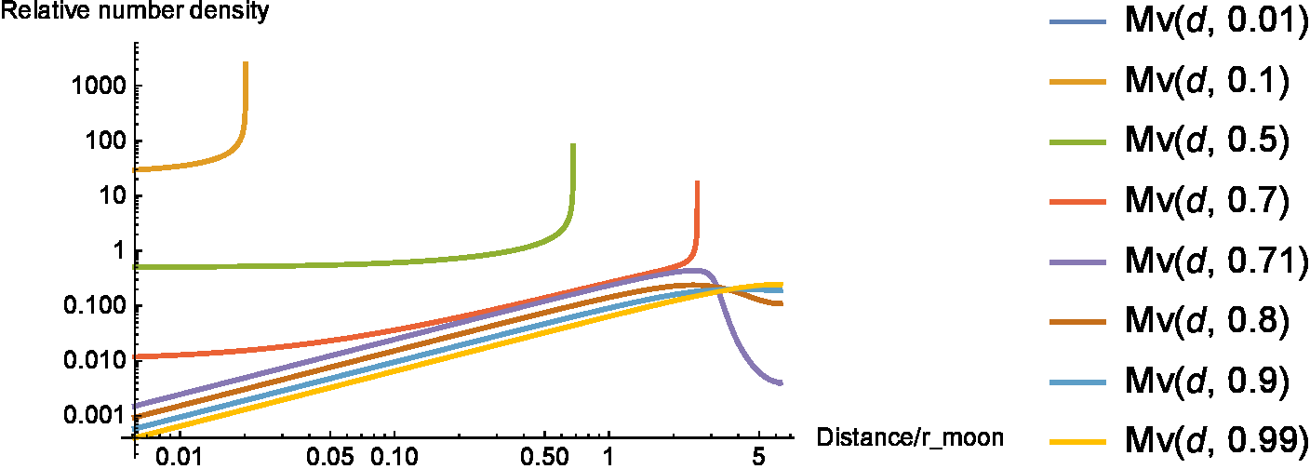
Distance distribution as a function of speed
Each integral over the distance for each speed gives a weight of 1
For speeds less than sqrt(2)/2 (or < 0.7071 * v_esc)
A very specific distance (a ring around the ROI) contributes to a given ejecta speed
For speeds greater than 0.7071 * v_esc and less than ~0.9 * v_esc
A range of distances from ~0.35 to 0.6 * circumference of Moon (like a hemispherical cap centered at the antipode) contribute to a given ejecta speed
For speeds greater than ~0.9 * v_esc
Distances greater than ~0.4 * circumference of Moon, which is the entire Moon contributes to a given speed

Slide 23
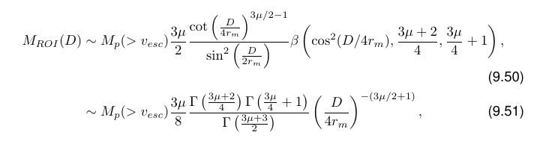
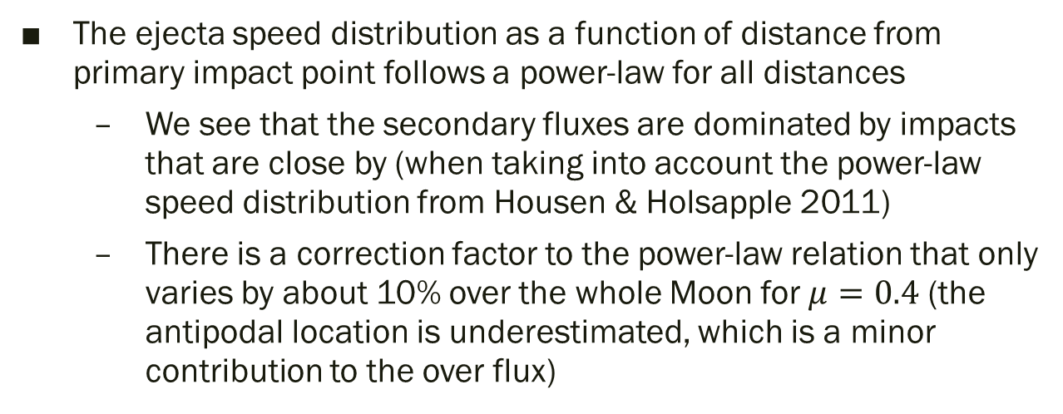
Secondary flux as a function of distance
The ejecta speed distribution as a function of distance from primary impact point follows a power-law for all distances
We see that the secondary fluxes are dominated by impacts that are close by (when taking into account the power-law speed distribution from Housen & Holsapple 2011)
There is a correction factor to the power-law relation that only varies by about 10% over the whole Moon for $μ=0.4$ (the antipodal location is underestimated, which is a minor contribution to the over flux)

Slide 24



Secondary flux from impacts over the whole Moon in terms of secondary flux from a single impact on the Moon
Secondary flux as a function of ejected angle from zenith
Secondary flux if all ejecta is ejected at 45 degrees
Secondary flux assuming isotopically ejected ejecta, shown to be comparable to ejecta only at 45 degrees
E.g., if v_min = 100 m/s, then the size of the ROI must be << 5.2 meters, otherwise higher terms come into play
From HH11 scaling laws

Slide 25
Overview
DSNE Rev H Lunar Ejecta Model – NASA SP-8013 (1969)
Based on Zook 1967
Brief (non-exhaustive) Review of Impact-Ejecta Scaling Models
Zook 1967
Krivov et al. 2003
Housen & Holsapple 2011
Proposed New DSNE Model -- Lunar Meteoroid Ejecta Model (LuMEM)
Sporadic meteoroid flux (Grun et al 1985)
Near Earth Object (NEO) flux (Brown et al 2002)
Impact-ejecta scaling model (Housen & Holsapple 2011)
Ejecta particle size distribution (Carrier 2003)
Ejecta zenith angle distribution (empirically from Gault & Wedekind 1978)
Ejecta azimuth angle distribution (modified from Rival & Mandeville 1999)
Analytic model of lunar ejecta
Speed distribution as a function of distance
Secondary flux as a function of distance
Secondary flux in terms of primary flux
Results of LuMEM
Igloo number flux distribution (based on MEM3, see Moorhead et al 2019)
Ejecta size scaling (derived from Carrier 2003)
Ejecta speed scaling (Housen & Holsapple 2011)

Slide 26
Results from the Lunar Meteoroid Ejecta Model (LuMEM)

