Slide 1
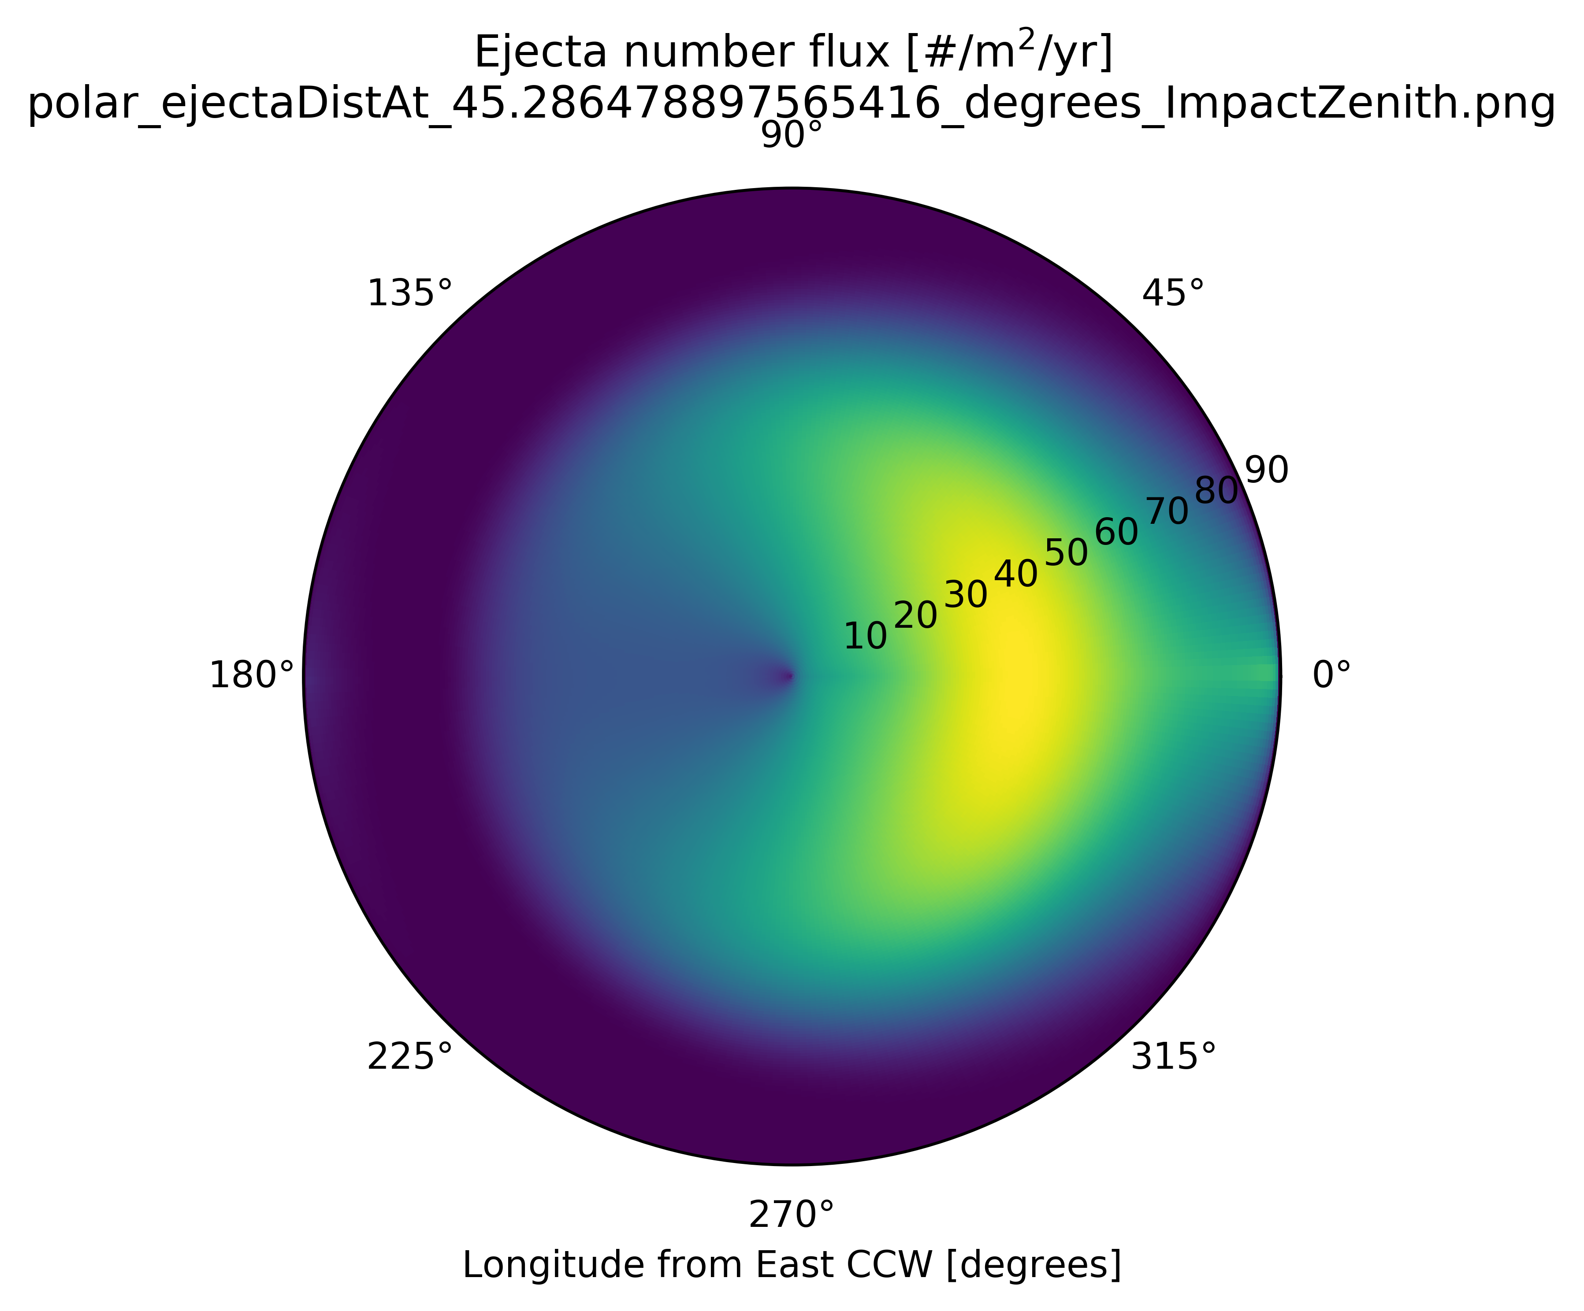
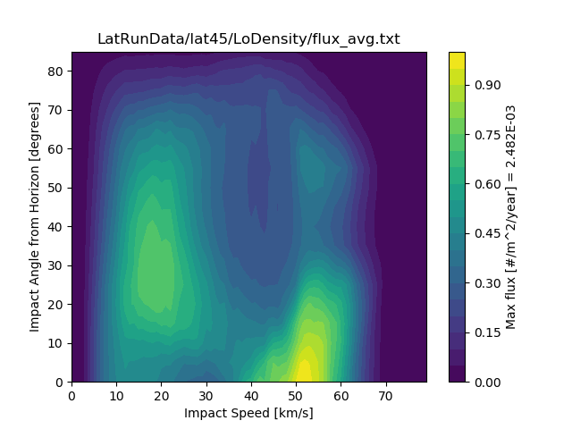
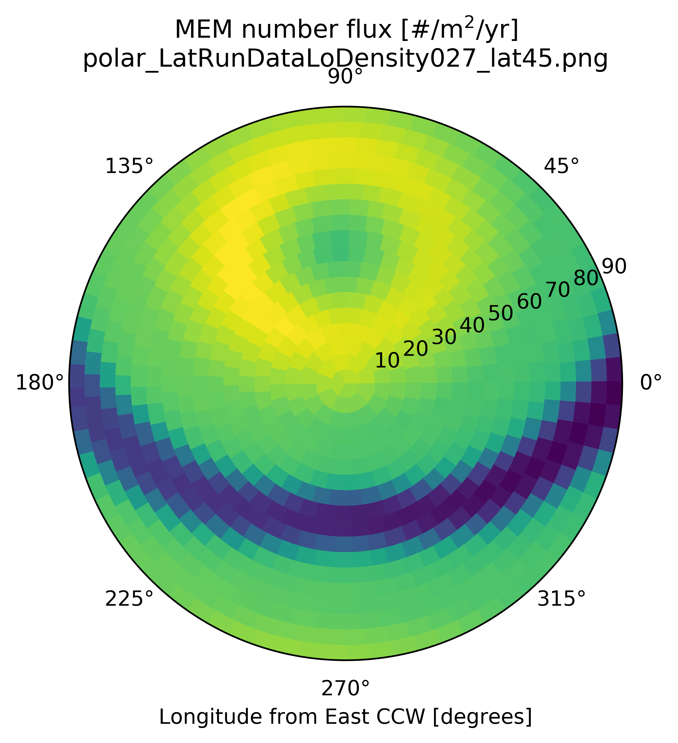
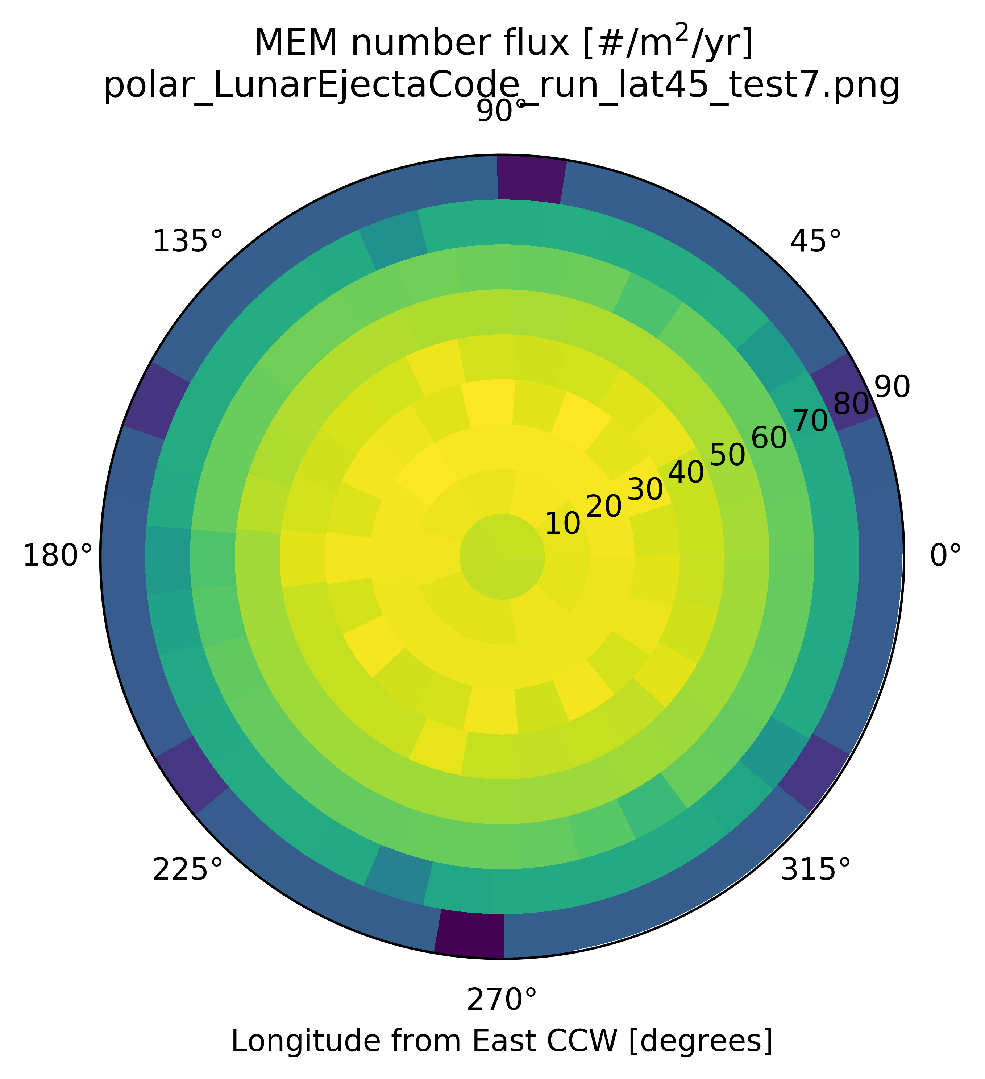

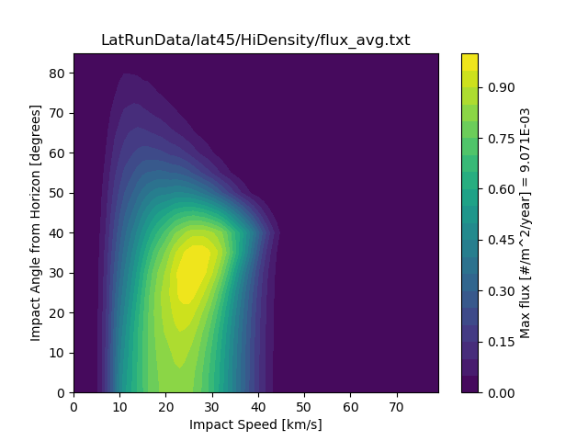
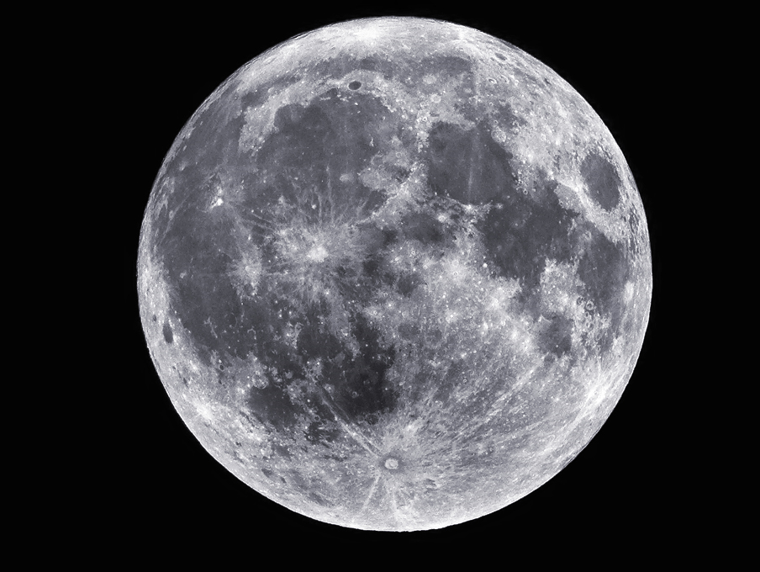

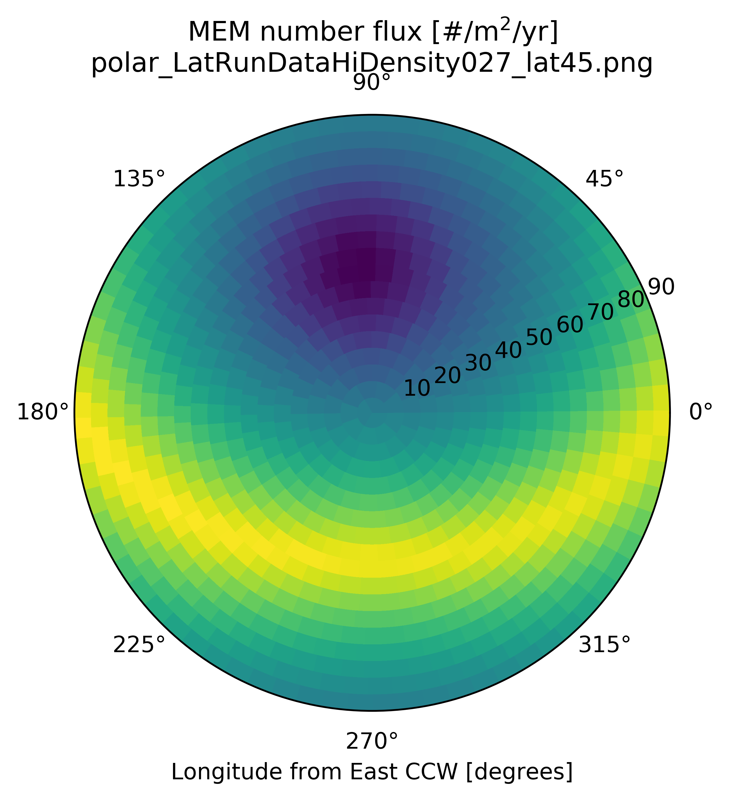
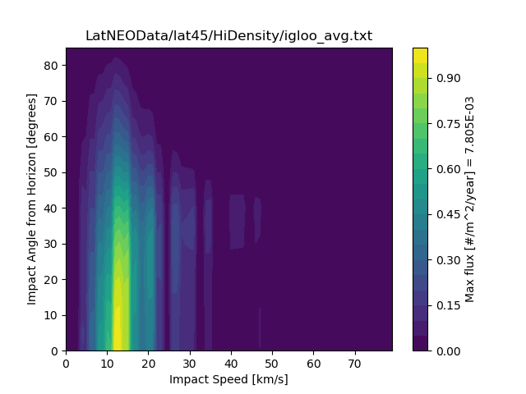





Total Ejecta Angular Distribution (at 45 degrees latitude)
Ejecta Angular Distribution (for 45 degree impact)
MEM Low Density Population
Downstream
$$α_{ejecta, ROI}$$
MEM High Density Population
$$α_{ejecta, site}$$
$$α_{impact}$$
$$φ_{ROI}$$
$$φ_{impact}$$
Near Earth Object Population

