Slide 1
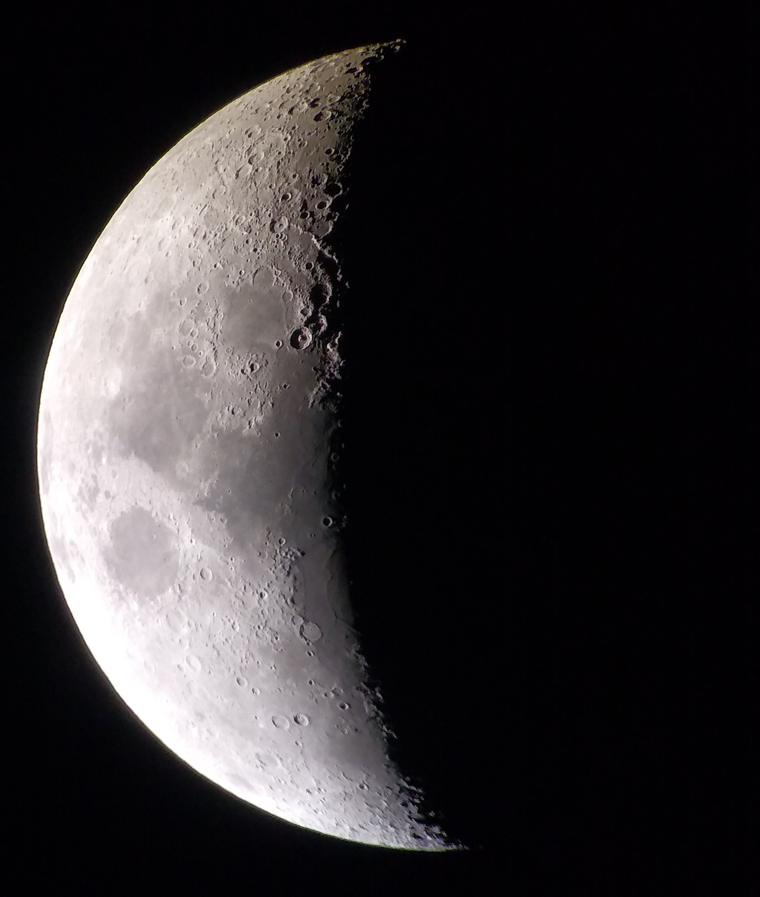
Meeting over MeMoSeE: Near-field and tall structures
Anthony M. DeStefano
NASA/MSFC/EV44 Natural Environments
6/29/2021

Slide 2
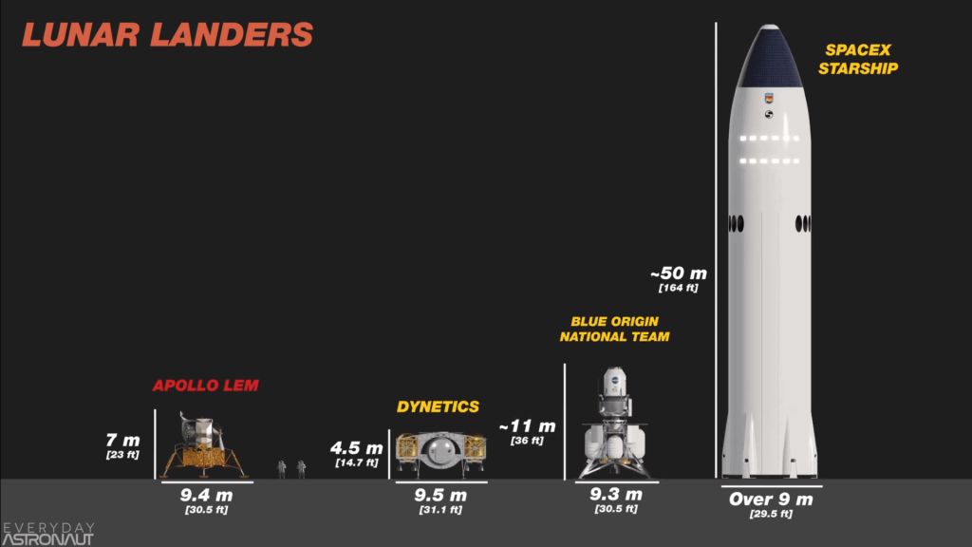
Tall Structures
Original assumption:
Primary impact radius = secondary impact radius (from lunar center)
Question: How will the secondary ejecta environment be modified for structures that are sufficiently tall?
Corollary: How tall is sufficiently tall?
https://everydayastronaut.com/artemis-vs-apollo/

Slide 3
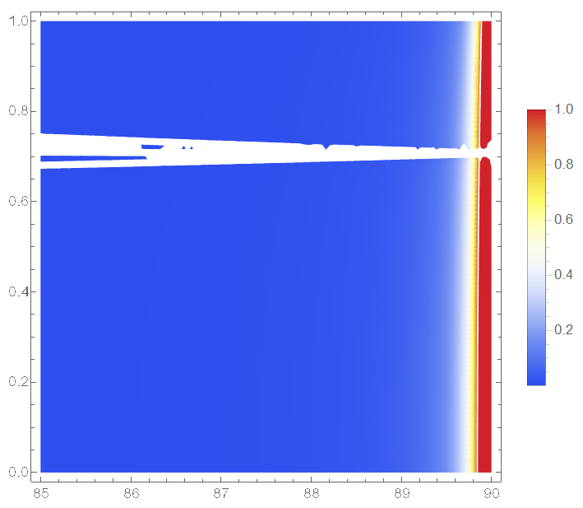
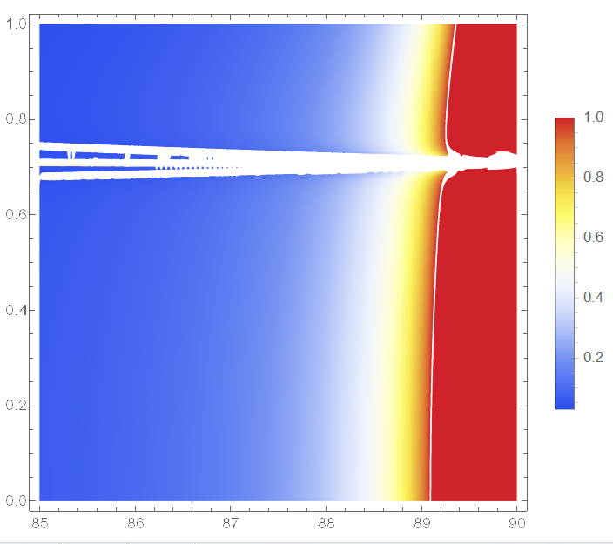
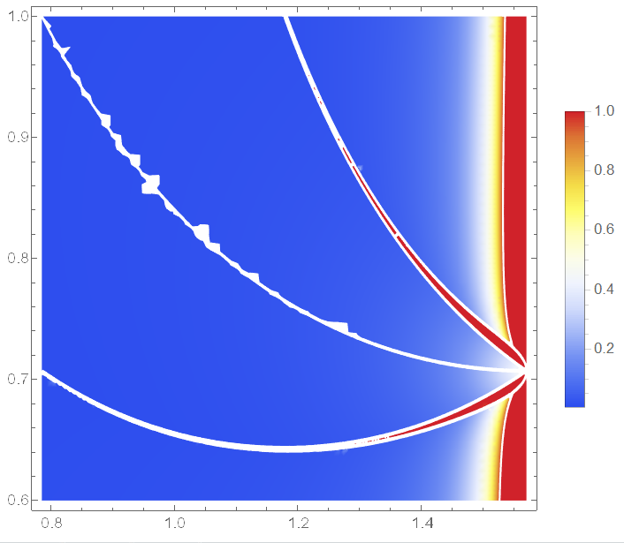
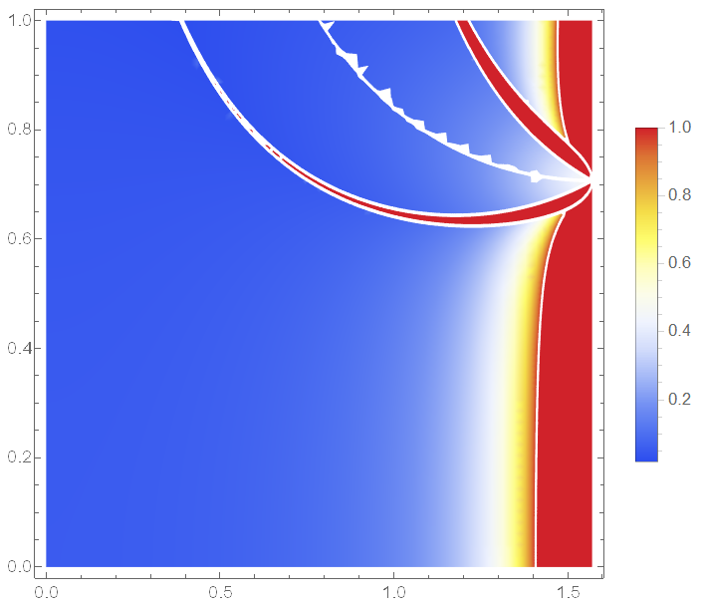
Tall Structures Ejecta speed vs ejecta zenith angle
52m
1.7km
The tallest lander ~50m
Comparing the ejected distance, the error stays below 10% for zenith angles < ~89 degrees, for all ejecta speeds
The error term ~ height/lunar radius
Going from a 7m to 50m lander doesn’t make a difference, only for very shallow ejecta angles
At an ejecta angle of 45 degrees:
The maximum relative error is bounded by height/lunar radius
17km
173km

