Slide 1
Lunar Meteoroid Ejecta Model
Anthony M. DeStefano
NASA/MSFC/EV44 Natural Environments
10/20/2020

Slide 2
Overview
DSNE Rev H Lunar Ejecta Model – NASA SP-8013 (1969)
Based on Zook 1967
Brief (non-exhaustive) Review of Impact-Ejecta Scaling Models
Zook 1967
Krivov et al. 2003
Housen & Holsapple 2011
Proposed New DSNE Model -- Lunar Meteoroid Ejecta Model (LuMEM)
Sporadic meteoroid flux (Grun et al 1985)
Near Earth Object (NEO) flux (Brown et al 2002)
Impact-ejecta scaling model (Housen & Holsapple 2011)
Ejecta particle size distribution (Carrier 2003)
Ejecta zenith angle distribution (empirically from Gault & Wedekind 1978)
Ejecta azimuth angle distribution (modified from Rival & Mandeville 1999)
Analytic model of lunar ejecta
Speed distribution as a function of distance
Secondary flux as a function of distance
Secondary flux in terms of primary flux
Results of LuMEM
Igloo number flux distribution (based on MEM3, see Moorhead et al 2019)
Ejecta size scaling (derived from Carrier 2003)
Ejecta speed scaling (Housen & Holsapple 2011)

Slide 3
Overview
DSNE Rev H Lunar Ejecta Model – NASA SP-8013 (1969)
Based on Zook 1967
Brief (non-exhaustive) Review of Impact-Ejecta Scaling Models
Zook 1967
Krivov et al. 2003
Housen & Holsapple 2011
Proposed New DSNE Model -- Lunar Meteoroid Ejecta Model (LuMEM)
Sporadic meteoroid flux (Grun et al 1985)
Near Earth Object (NEO) flux (Brown et al 2002)
Impact-ejecta scaling model (Housen & Holsapple 2011)
Ejecta particle size distribution (Carrier 2003)
Ejecta zenith angle distribution (empirically from Gault & Wedekind 1978)
Ejecta azimuth angle distribution (modified from Rival & Mandeville 1999)
Analytic model of lunar ejecta
Speed distribution as a function of distance
Secondary flux as a function of distance
Secondary flux in terms of primary flux
Results of LuMEM
Igloo number flux distribution (based on MEM3, see Moorhead et al 2019)
Ejecta size scaling (derived from Carrier 2003)
Ejecta speed scaling (Housen & Holsapple 2011)

Slide 4
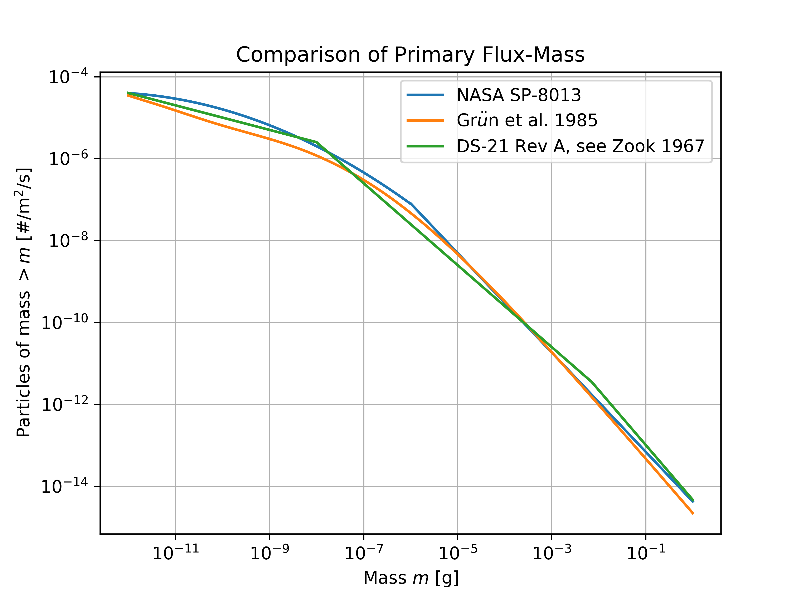
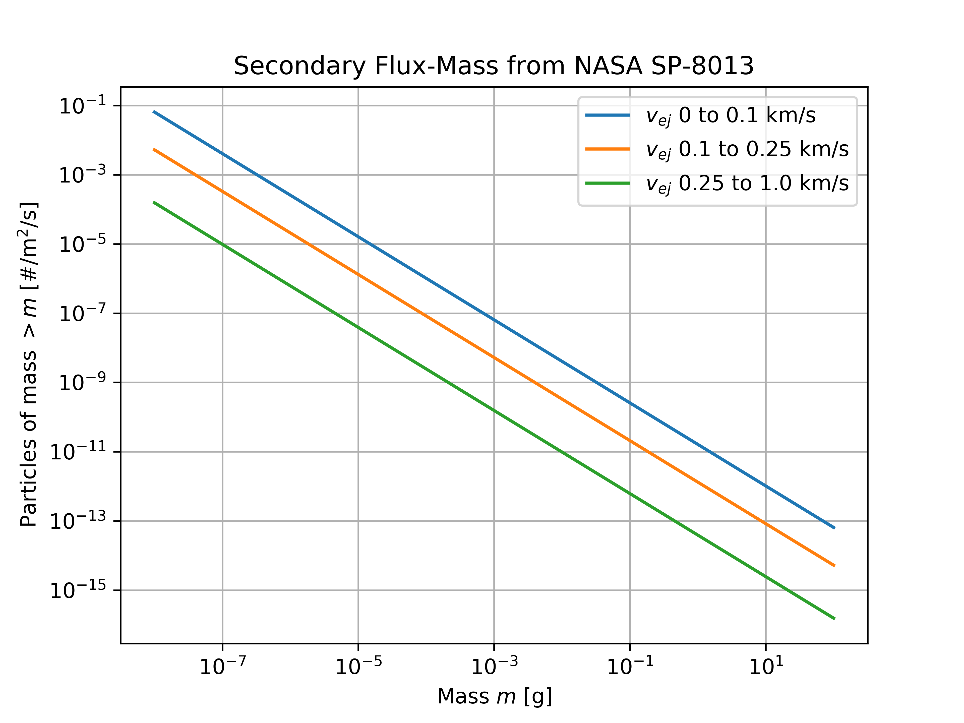
DSNE Rev H Lunar Ejecta Model NASA SP-8013 (1969)
Average speed [both] = 20 km/s
Density [NASA SP-8013] = 0.5 g/cm^3
Density [Grun et al 1985] = 2.5 g/cm^3
Density = 2.5 g/cm^3

Slide 5
Overview
DSNE Rev H Lunar Ejecta Model – NASA SP-8013 (1969)
Based on Zook 1967
Brief (non-exhaustive) Review of Impact-Ejecta Scaling Models
Zook 1967
Krivov et al. 2003
Housen & Holsapple 2011
Proposed New DSNE Model -- Lunar Meteoroid Ejecta Model (LuMEM)
Sporadic meteoroid flux (Grun et al 1985)
Near Earth Object (NEO) flux (Brown et al 2002)
Impact-ejecta scaling model (Housen & Holsapple 2011)
Ejecta particle size distribution (Carrier 2003)
Ejecta zenith angle distribution (empirically from Gault & Wedekind 1978)
Ejecta azimuth angle distribution (modified from Rival & Mandeville 1999)
Analytic model of lunar ejecta
Speed distribution as a function of distance
Secondary flux as a function of distance
Secondary flux in terms of primary flux
Results of LuMEM
Igloo number flux distribution (based on MEM3, see Moorhead et al 2019)
Ejecta size scaling (derived from Carrier 2003)
Ejecta speed scaling (Housen & Holsapple 2011)

Slide 6
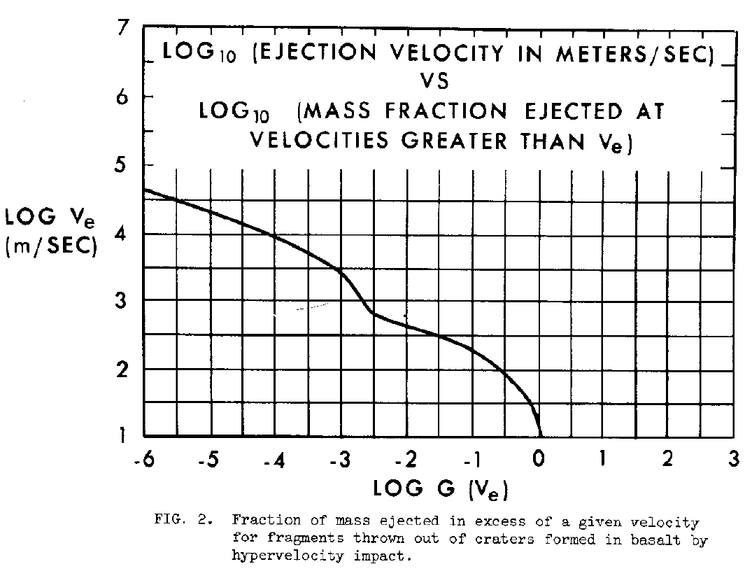

Impact-Ejecta Scaling Models Zook 1967
$f\left(>m_{e}, >v_{e}\right)=k_{1}^{−γ}k_{2}k_{3}^{−(γ+1)}\left(\frac{−1}{1−\frac{3}{α}−\frac{3γ}{α}}\right)m_{e}^{γ}{\left(\frac{1}{2}v_{p}^{2}\right)}^{−γ}{\left[G\left(v_{e}\right)\right]}^{1−\frac{3}{α}\left(1+γ\right)}$
Where $G\left(v_{e}\right)\sim v_{e}^{−1.92}$ for $v_{e}>0.1$km/s
The index $γ=γ(m_{p})$ is the power-law index of
the primary flux curve (see previous slide)
The parameter $α$ ranges from 0.3-0.7 (Zook ‘67)
In general, $α<1$ (Gault et al. 1963), property of
the target material
Implicitly, $m_{p}= \frac{m_{e}}{k_{1}k_{3}\left(\frac{1}{2}v_{p}^{2}\right){\left[G\left(v_{e}\right)\right]}^{\frac{3}{α}}}$, which defines $γ$
as a function of $m_{e}, v_{p},$and $v_{e}$

Slide 7
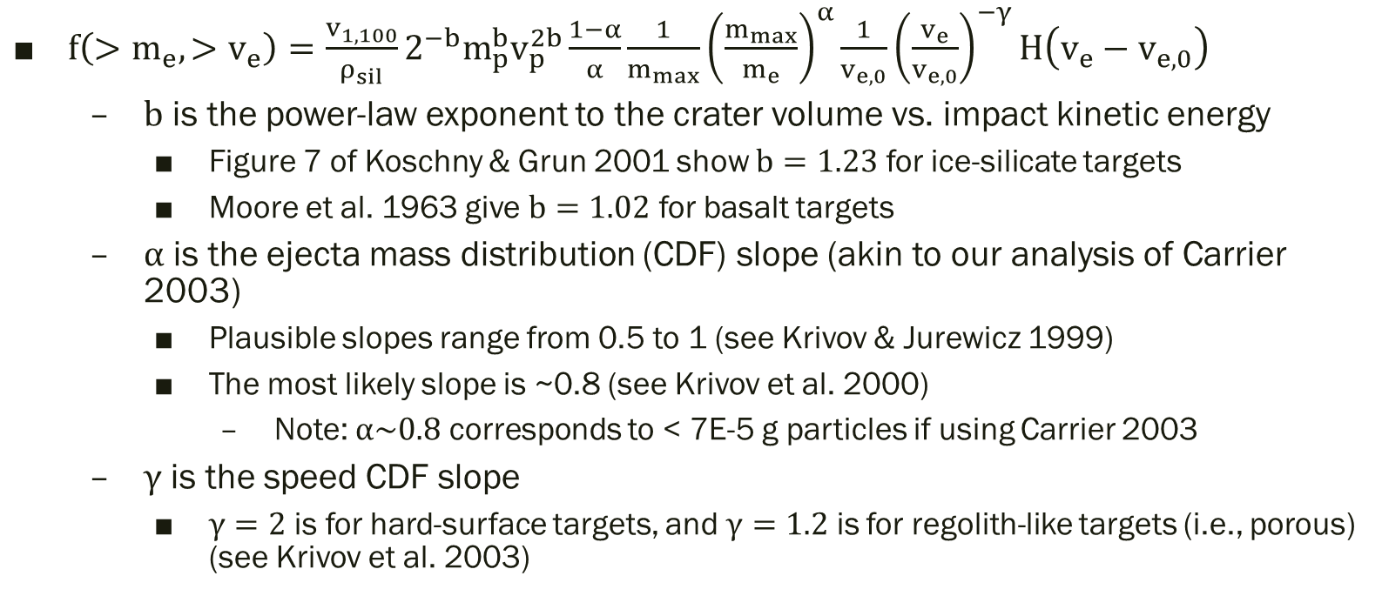
Impact-Ejecta Scaling Models Krivov et al. 2003
$f\left(>m_{e}, >v_{e}\right)=\frac{v_{1,100}}{ρ_{sil}}2^{−b}m_{p}^{b}v_{p}^{2b}\frac{1−α}{α}\frac{1}{m_{max}}{\left(\frac{m_{max}}{m_{e}}\right)}^{α}\frac{1}{v_{e,0}}{\left(\frac{v_{e}}{v_{e,0}}\right)}^{−γ}H\left(v_{e}−v_{e,0}\right)$
$b$ is the power-law exponent to the crater volume vs. impact kinetic energy
Figure 7 of Koschny & Grun 2001 show $b=1.23$ for ice-silicate targets
Moore et al. 1963 give $b=1.02$ for basalt targets
$α$ is the ejecta mass distribution (CDF) slope (akin to our analysis of Carrier 2003)
Plausible slopes range from 0.5 to 1 (see Krivov & Jurewicz 1999)
The most likely slope is ~0.8 (see Krivov et al. 2000)
Note: $α\sim 0.8$ corresponds to < 7E-5 g particles if using Carrier 2003
$γ$ is the speed CDF slope
$γ=2$ is for hard-surface targets, and $γ=1.2$ is for regolith-like targets (i.e., porous) (see Krivov et al. 2003)

Slide 8
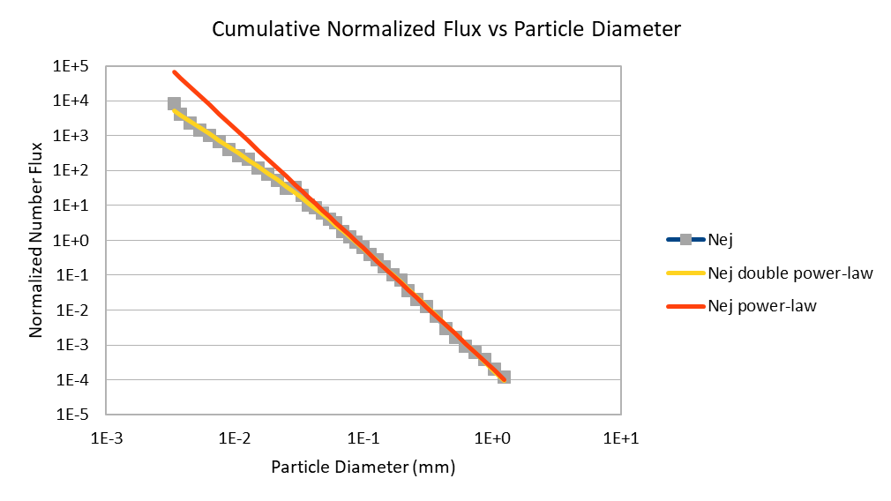
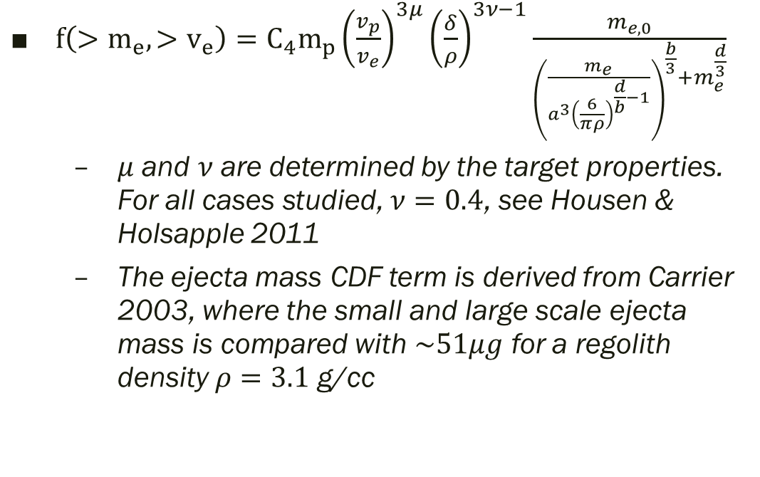
Impact-Ejecta Scaling Models Housen & Holsapple 2011
$f\left(>m_{e}, >v_{e}\right)=C_{4}m_{p}{\left(\frac{v_{p}}{v_{e}}\right)}^{3μ}{\left(\frac{δ}{ρ}\right)}^{3ν−1}\frac{m_{e,0}}{{\left(\frac{m_{e}}{a^{3}{\left(\frac{6}{πρ}\right)}^{\frac{d}{b}−1}}\right)}^{\frac{b}{3}}+m_{e}^{\frac{d}{3}}}$
$μ$ and $ν$ are determined by the target properties. For all cases studied, $ν=0.4$, see Housen & Holsapple 2011
The ejecta mass CDF term is derived from Carrier 2003, where the small and large scale ejecta mass is compared with $\sim 51μg$ for a regolith density $ρ=3.1$ g/cc

Slide 10
Overview
DSNE Rev H Lunar Ejecta Model – NASA SP-8013 (1969)
Based on Zook 1967
Brief (non-exhaustive) Review of Impact-Ejecta Scaling Models
Zook 1967
Krivov et al. 2003
Housen & Holsapple 2011
Proposed New DSNE Model -- Lunar Meteoroid Ejecta Model (LuMEM)
Sporadic meteoroid flux (Grun et al 1985)
Near Earth Object (NEO) flux (Brown et al 2002)
Impact-ejecta scaling model (Housen & Holsapple 2011)
Ejecta particle size distribution (Carrier 2003)
Ejecta zenith angle distribution (empirically from Gault & Wedekind 1978)
Ejecta azimuth angle distribution (modified from Rival & Mandeville 1999)
Analytic model of lunar ejecta
Speed distribution as a function of distance
Secondary flux as a function of distance
Secondary flux in terms of primary flux
Results of LuMEM
Igloo number flux distribution (based on MEM3, see Moorhead et al 2019)
Ejecta size scaling (derived from Carrier 2003)
Ejecta speed scaling (Housen & Holsapple 2011)

Slide 11
Sporadic meteoroid flux (Grun et al 1985)

Slide 12
Overview
DSNE Rev H Lunar Ejecta Model – NASA SP-8013 (1969)
Based on Zook 1967
Brief (non-exhaustive) Review of Impact-Ejecta Scaling Models
Zook 1967
Krivov et al. 2003
Housen & Holsapple 2011
Proposed New DSNE Model -- Lunar Meteoroid Ejecta Model (LuMEM)
Sporadic meteoroid flux (Grun et al 1985)
Near Earth Object (NEO) flux (Brown et al 2002)
Impact-ejecta scaling model (Housen & Holsapple 2011)
Ejecta particle size distribution (Carrier 2003)
Ejecta zenith angle distribution (empirically from Gault & Wedekind 1978)
Ejecta azimuth angle distribution (modified from Rival & Mandeville 1999)
Analytic model of lunar ejecta
Speed distribution as a function of distance
Secondary flux as a function of distance
Secondary flux in terms of primary flux
Results of LuMEM
Igloo number flux distribution (based on MEM3, see Moorhead et al 2019)
Ejecta size scaling (derived from Carrier 2003)
Ejecta speed scaling (Housen & Holsapple 2011)

Slide 13
Overview
DSNE Rev H Lunar Ejecta Model – NASA SP-8013 (1969)
Based on Zook 1967
Brief (non-exhaustive) Review of Impact-Ejecta Scaling Models
Zook 1967
Krivov et al. 2003
Housen & Holsapple 2011
Proposed New DSNE Model -- Lunar Meteoroid Ejecta Model (LuMEM)
Sporadic meteoroid flux (Grun et al 1985)
Near Earth Object (NEO) flux (Brown et al 2002)
Impact-ejecta scaling model (Housen & Holsapple 2011)
Ejecta particle size distribution (Carrier 2003)
Ejecta zenith angle distribution (empirically from Gault & Wedekind 1978)
Ejecta azimuth angle distribution (modified from Rival & Mandeville 1999)
Analytic model of lunar ejecta
Speed distribution as a function of distance
Secondary flux as a function of distance
Secondary flux in terms of primary flux
Results of LuMEM
Igloo number flux distribution (based on MEM3, see Moorhead et al 2019)
Ejecta size scaling (derived from Carrier 2003)
Ejecta speed scaling (Housen & Holsapple 2011)

