Slide 1
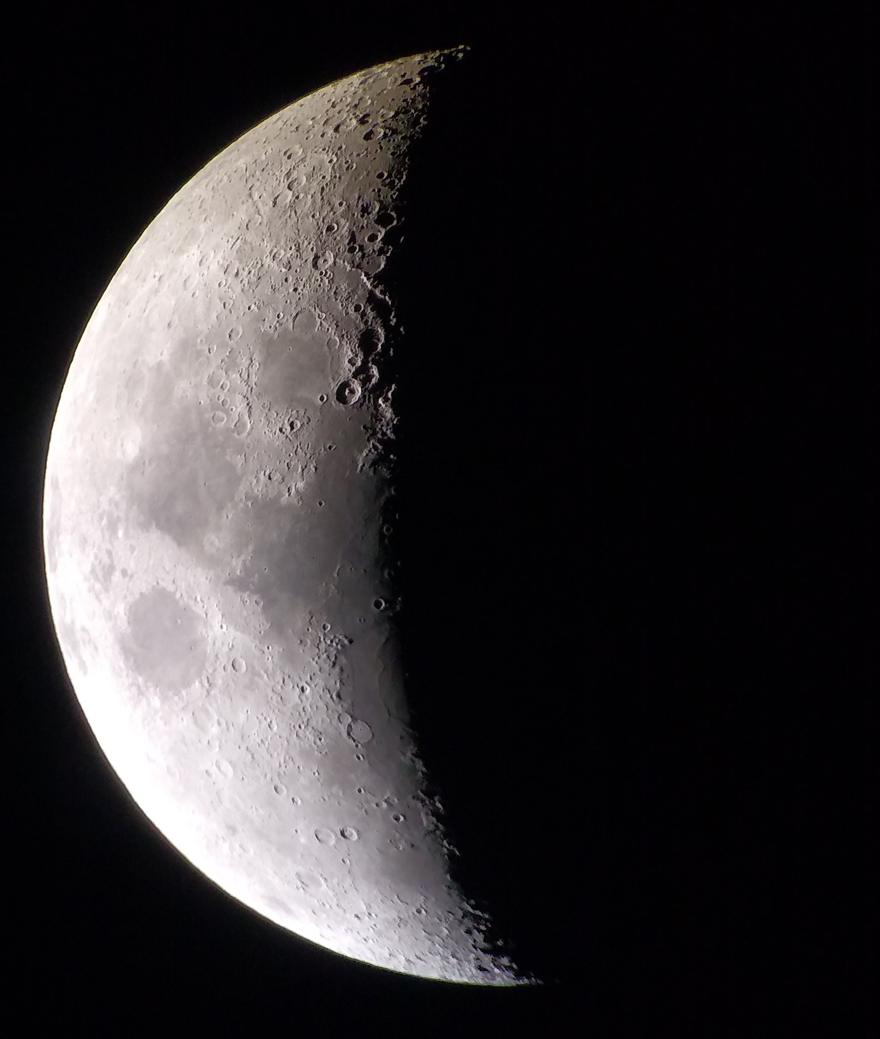
Meeting over MeMoSeE: Near-field and tall structures
Anthony M. DeStefano
NASA/MSFC/EV44 Natural Environments
6/29/2021

Slide 2
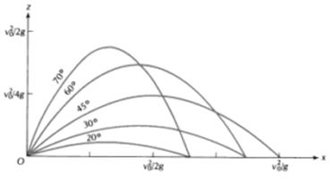

Near-field
${\left(\frac{v_{min}}{v_{esc}}\right)}^{2}=\frac{\tan\left(\frac{D}{2r_{m}}\right)}{\tan\left(\frac{π+ D/{r_{m}}}{4}\right)}$ , where $v_{esc}=\sqrt{2gr_{m}}$
This relates the minimum ejecta speed v_min to reach a distance D, assuming ejecta angles at the optimal angle
The optimal angle is given by, $γ_{opt}= \frac{π+ D/{r_{m}}}{4}$
For the near-field, D << r_m, $v_{min}∼$ $v_{esc}\sqrt{\frac{D}{2r_{m}}}=\sqrt{gD}$ (as expected)
For any zenith angle, $v_{min}∼$ $v_{esc}\sqrt{\frac{D}{2r_{m}\sin{(2γ)}}}$
https://thefactfactor.com/facts/pure_science/physics/projectile-motion/10299/

Slide 3
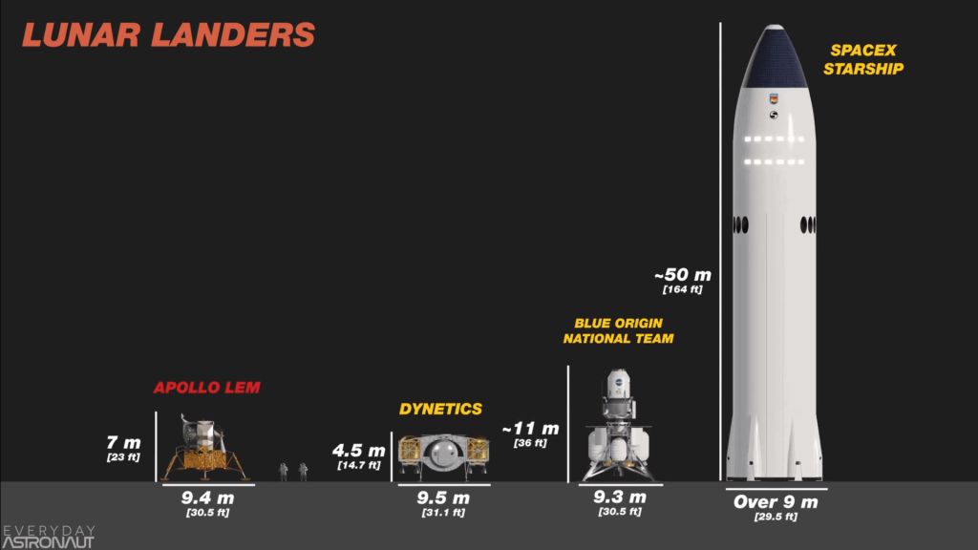
Tall Structures
Original assumption:
Primary impact radius = secondary impact radius (from lunar center)
Question: How will the secondary ejecta environment be modified for structures that are sufficiently tall?
Corollary: How tall is sufficiently tall?
https://everydayastronaut.com/artemis-vs-apollo/

Slide 4
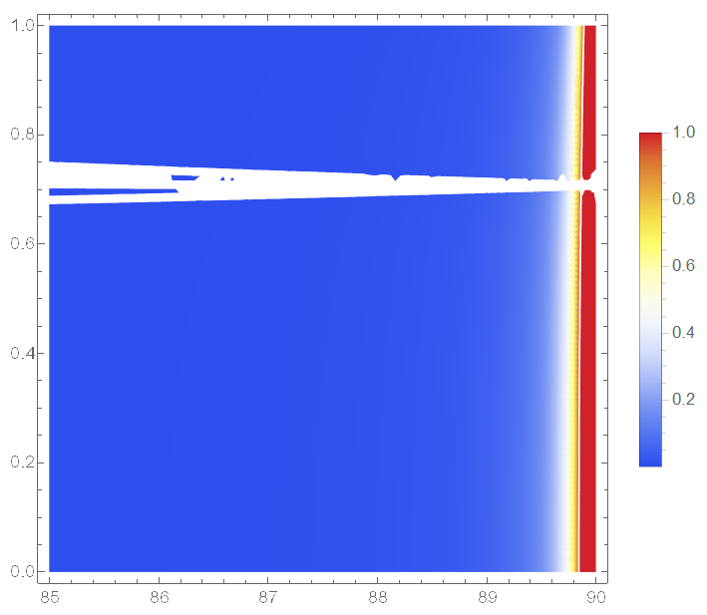
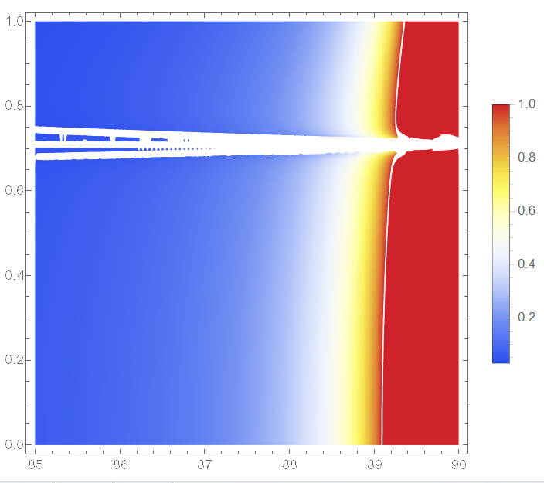

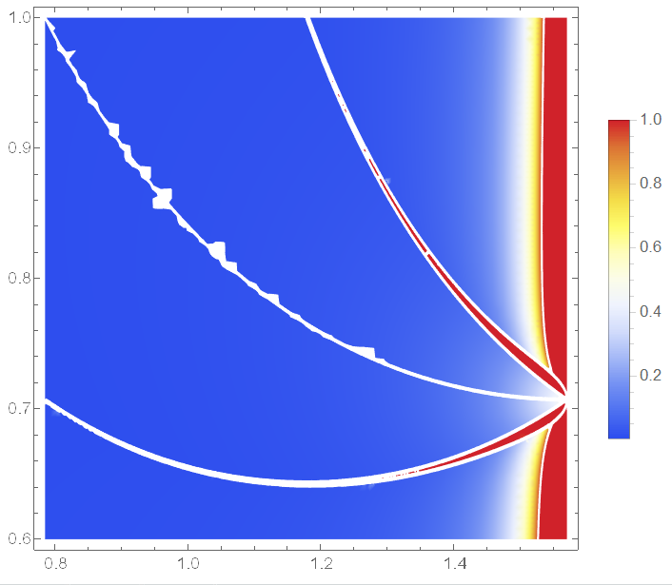
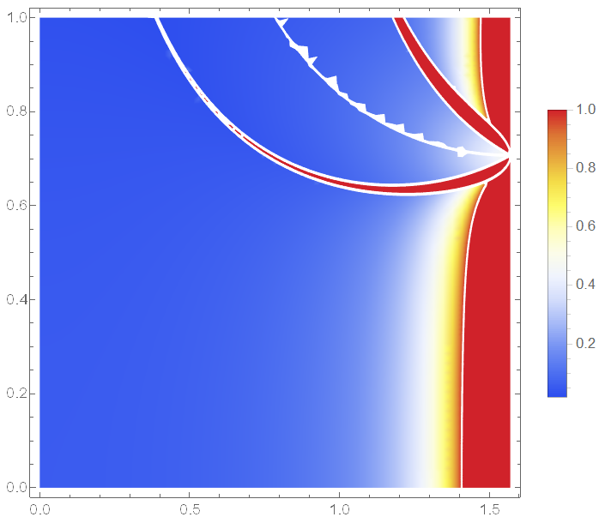
Tall Structures Ejecta speed vs ejecta zenith angle
52m
1.7km
The tallest lander ~50m
Comparing the ejected distance, the error stays below 10% for zenith angles < ~89 degrees, for all ejecta speeds
The error term ~ height/lunar radius
Going from a 7m to 50m lander doesn’t make a difference, only for very shallow ejecta angles
At an ejecta angle of 45 degrees:
The maximum relative error is bounded by 1 x height/lunar radius
E.g., 52m / 1737km = 3E-5
17km
173km

