Slide 1
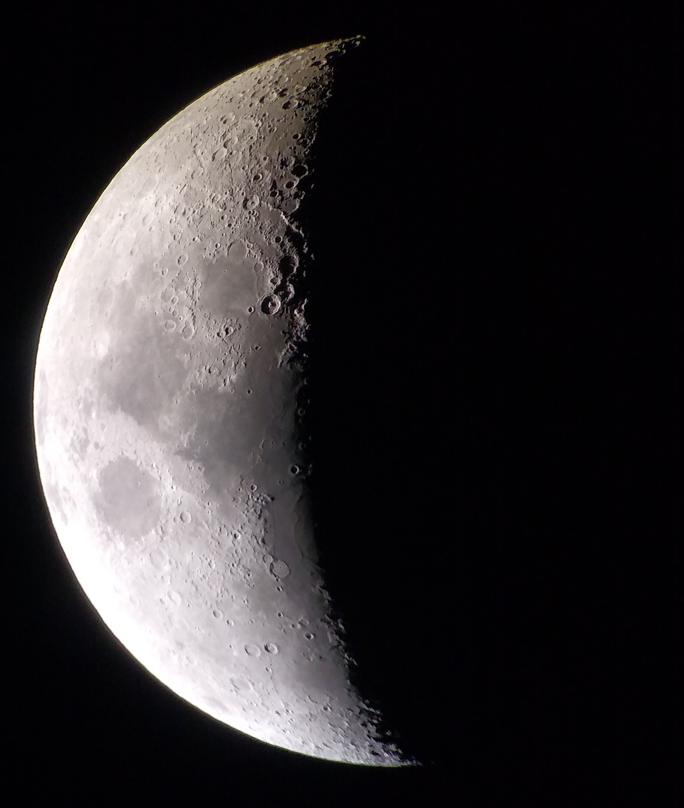
Meeting over MeMoSeE: Near-field and tall structures
Anthony M. DeStefano
NASA/MSFC/EV44 Natural Environments
6/29/2021

Slide 2
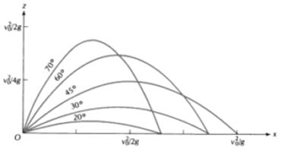

Near-field
${\left(\frac{v_{min}}{v_{esc}}\right)}^{2}=\frac{\tan\left(\frac{D}{2r_{m}}\right)}{\tan\left(\frac{π+ D/{r_{m}}}{4}\right)}$ , where $v_{esc}=\sqrt{2gr_{m}}$
This relates the minimum ejecta speed v_min to reach a distance D, assuming ejecta angles at the optimal angle
The optimal angle is given by, $γ_{opt}= \frac{π+ D/{r_{m}}}{4}$
For the near-field, D << r_m, $v_{min}∼$ $v_{esc}\sqrt{\frac{D}{2r_{m}}}=\sqrt{gD}$ (as expected)
For any zenith angle, $v_{min}∼$ $v_{esc}\sqrt{\frac{D}{2r_{m}\sin{(2γ)}}}$
https://thefactfactor.com/facts/pure_science/physics/projectile-motion/10299/

Slide 3
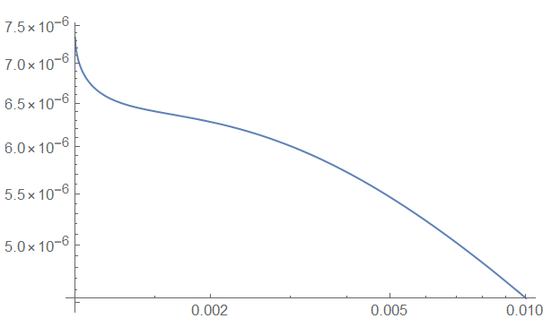

Near-field
Differential ejecta flux [mass flux per distance]
Assumes power-law scaling at lowest speeds (this is not entirely true!)
In fact, we expect the peak at low distances to be flattened
The fraction of azimuth FOV from the impact to the observer perfectly cancels the sin term in the spherical integral
to leading order related to the observer size over the distance from the observer
???
~ constant !!!
Distance [units of lunar radii]
Size of observer

Slide 4
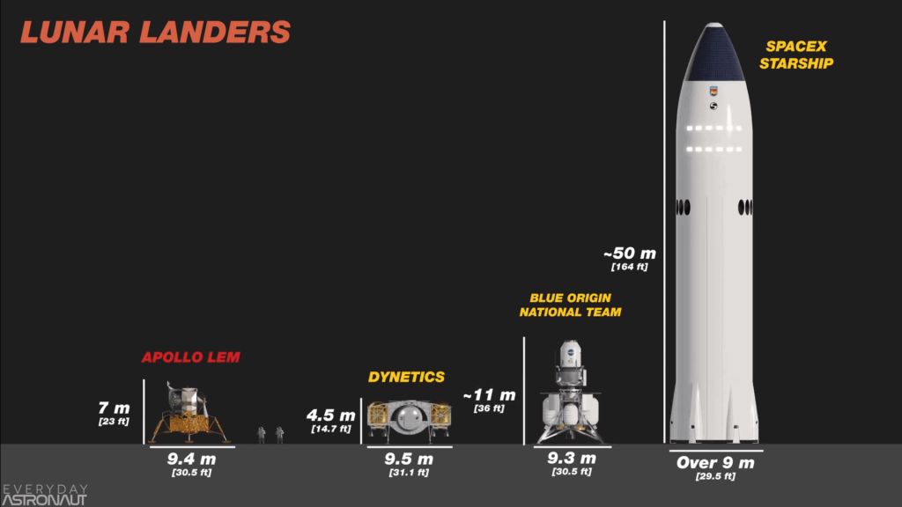
Tall Structures
Original assumption:
Primary impact radius = secondary impact radius (from lunar center)
Question: How will the secondary ejecta environment be modified for structures that are sufficiently tall?
Corollary: How tall is sufficiently tall?
https://everydayastronaut.com/artemis-vs-apollo/

Slide 5
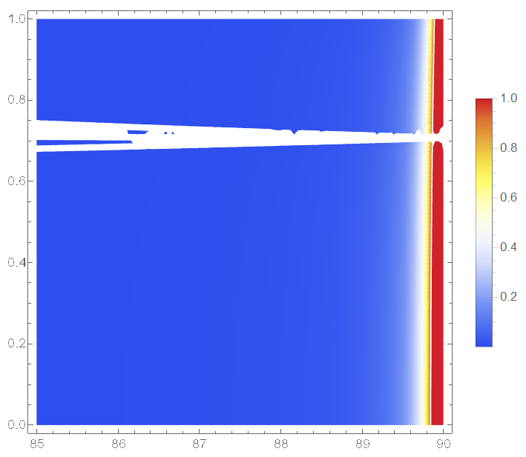
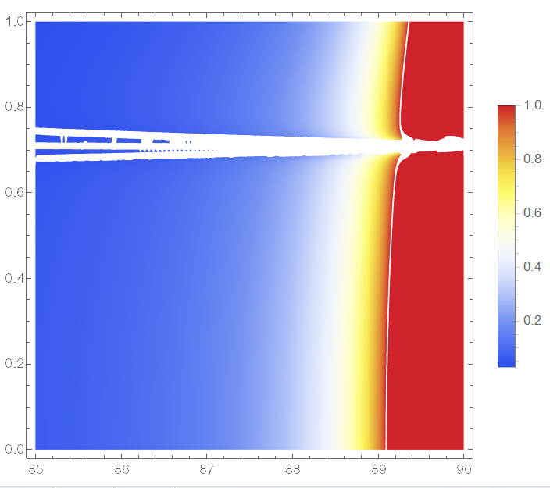

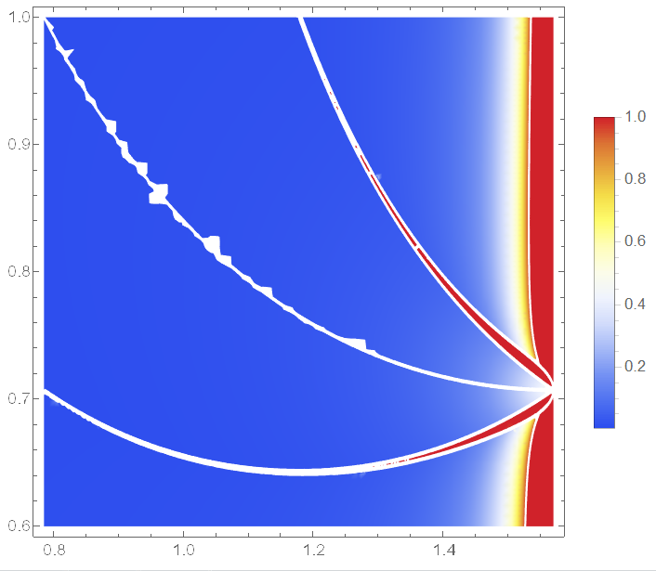
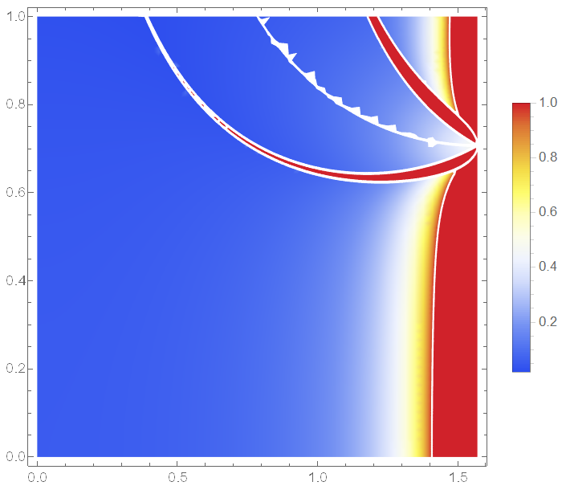
Tall Structures Ejecta speed vs ejecta zenith angle
52m
1.7km
The tallest lander ~50m
Comparing the ejected distance, the error stays below 10% for zenith angles < ~89 degrees, for all ejecta speeds
The error term ~ height/lunar radius
Going from a 7m to 50m lander doesn’t make a difference, only for very shallow ejecta angles
At an ejecta angle of 45 degrees:
The maximum relative error is bounded by 1 x height/lunar radius
E.g., 52m / 1737km = 3E-5
17km
173km

