Slide 1
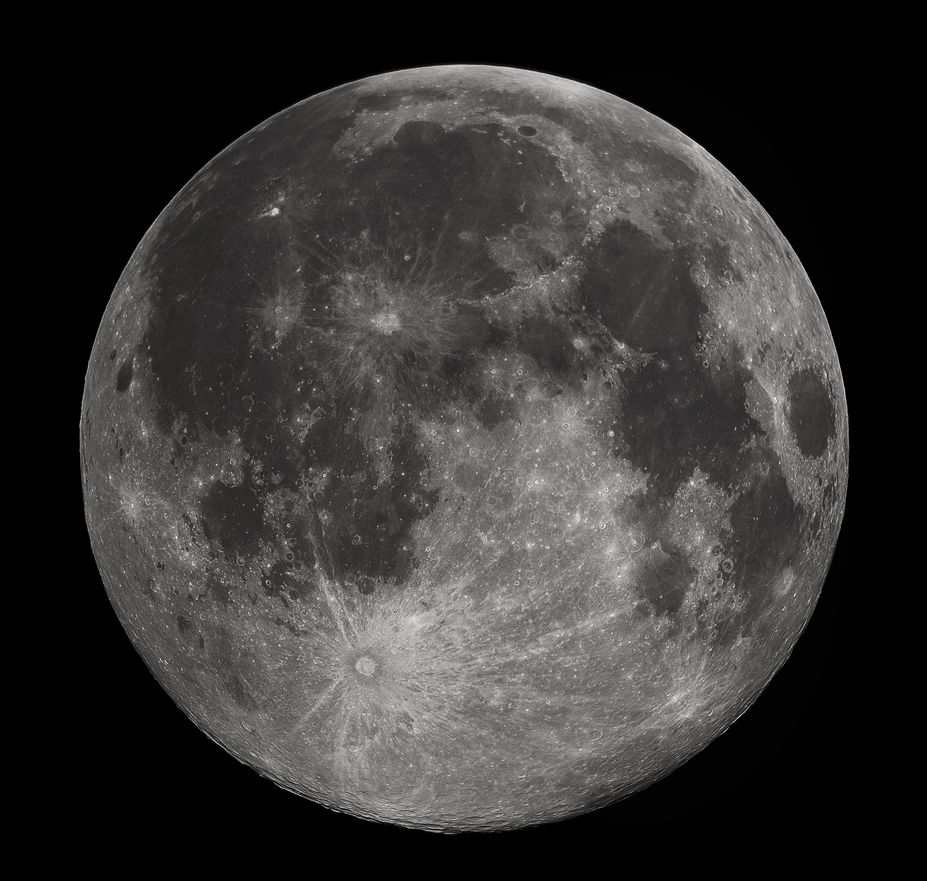
Lunar Secondary Ejecta Model Overview
Anthony M. DeStefano
NASA/MSFC/EV44 Natural Environments

Slide 2
Outline
Primary flux sources
Converting to secondary fluxes
Secondary Ejecta from Primary Impact Location to a Region-of-Interest (ROI)
Angular Distributions of Secondary EJecta
Preliminary Secondary Ejecta Flux

Slide 3
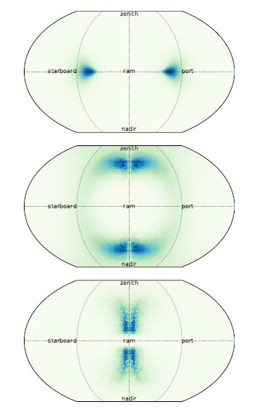
Primary Flux Sources
Meteoroid Engineering Model (MEM) – DSNE Rev. G Section 3.3.6
Sporadic meteoroid complex (1E-6 to 10 grams) (background meteoroid, no meteoroid showers)
1) High density population (peak ~3800 kg/m^3) – helion and anti-helion
2) Low density population (peak ~1000 kg/m^3) – toroidal and apex
Full angular (altitude and azimuth) and speed distribution + density, and mass distributions (Grun et al. 1985)
Near Earth Objects (NEO) – Brown et al. 2002 and CNEOS
Small asteroids and comets (0.1 to 1000 meters in diameter)
Single density of 3000 kg/m^3
Speed distribution from analysis of CNEOS data
Full angular distribution is adapted from the MEM high density population, (roughly similar orbital origin) renormalizing the speed distribution

Slide 4
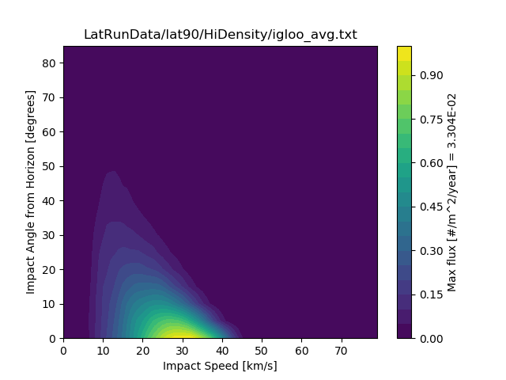
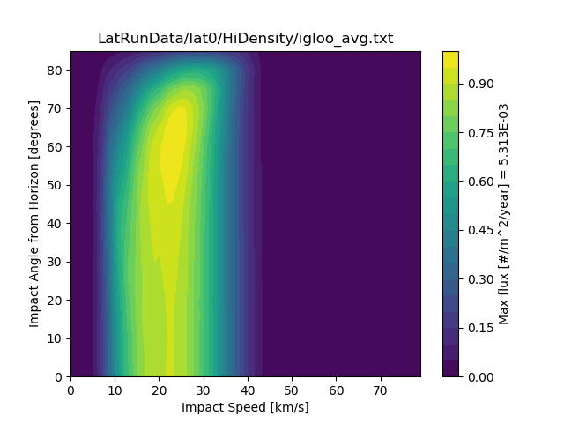
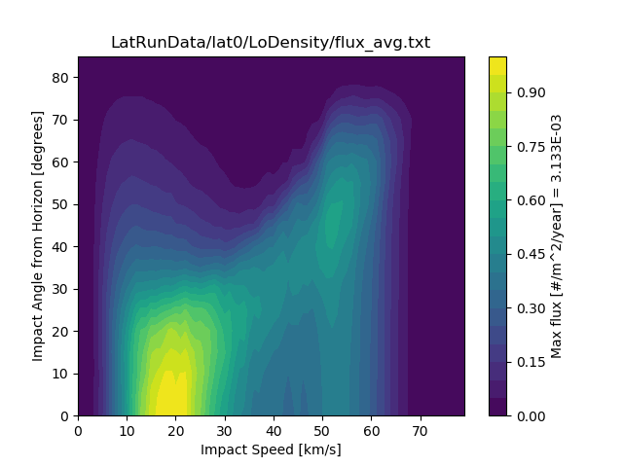
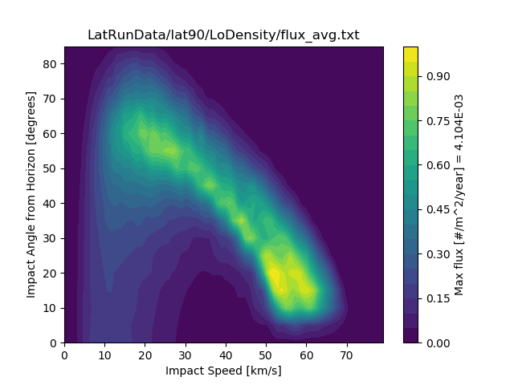
Primary Flux Sources
We compute the primary fluxes for a range of latitudes on the Moon
The impact angle-speed flux distribution is highly dependent on impact latitude

Slide 5
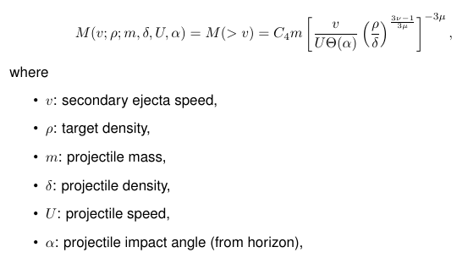
Converting to Secondary Fluxes
Housen and Holsapple 2011 scaling laws
M(>v) is the secondary mass ejected faster than v as a function of projectile and target properties
Technical detail: We can integrate out:
Projectile mass m
Projectile density delta

Slide 6
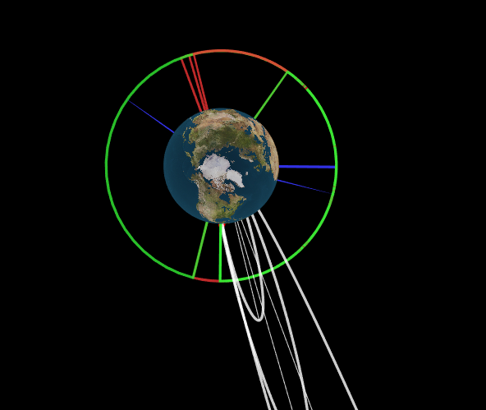
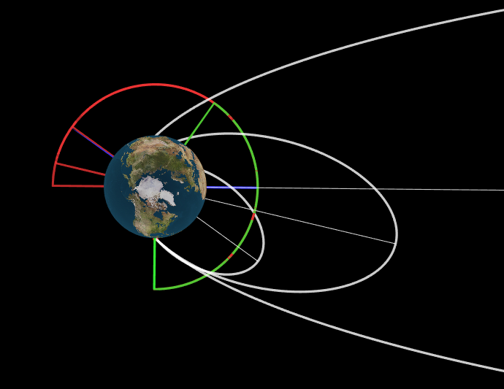
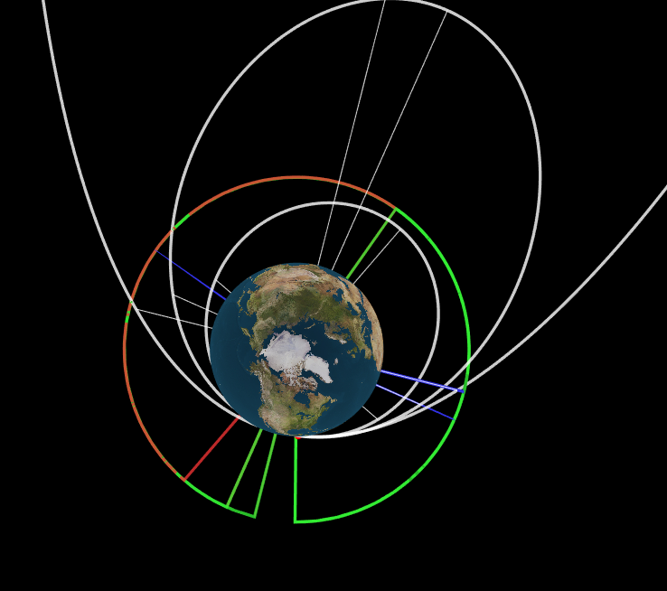
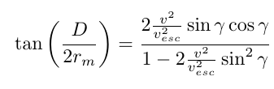
Secondary Ejecta from Primary Impact Location to a Region-of-Interest (ROI)
For a given impact, only a small fraction of the ejecta reaches a ROI
D: distance from impact to ROI
rm: radius of Moon
v: ejecta speed
v_esc = lunar escape speed
gamma = ejecta zenith angle

Slide 7
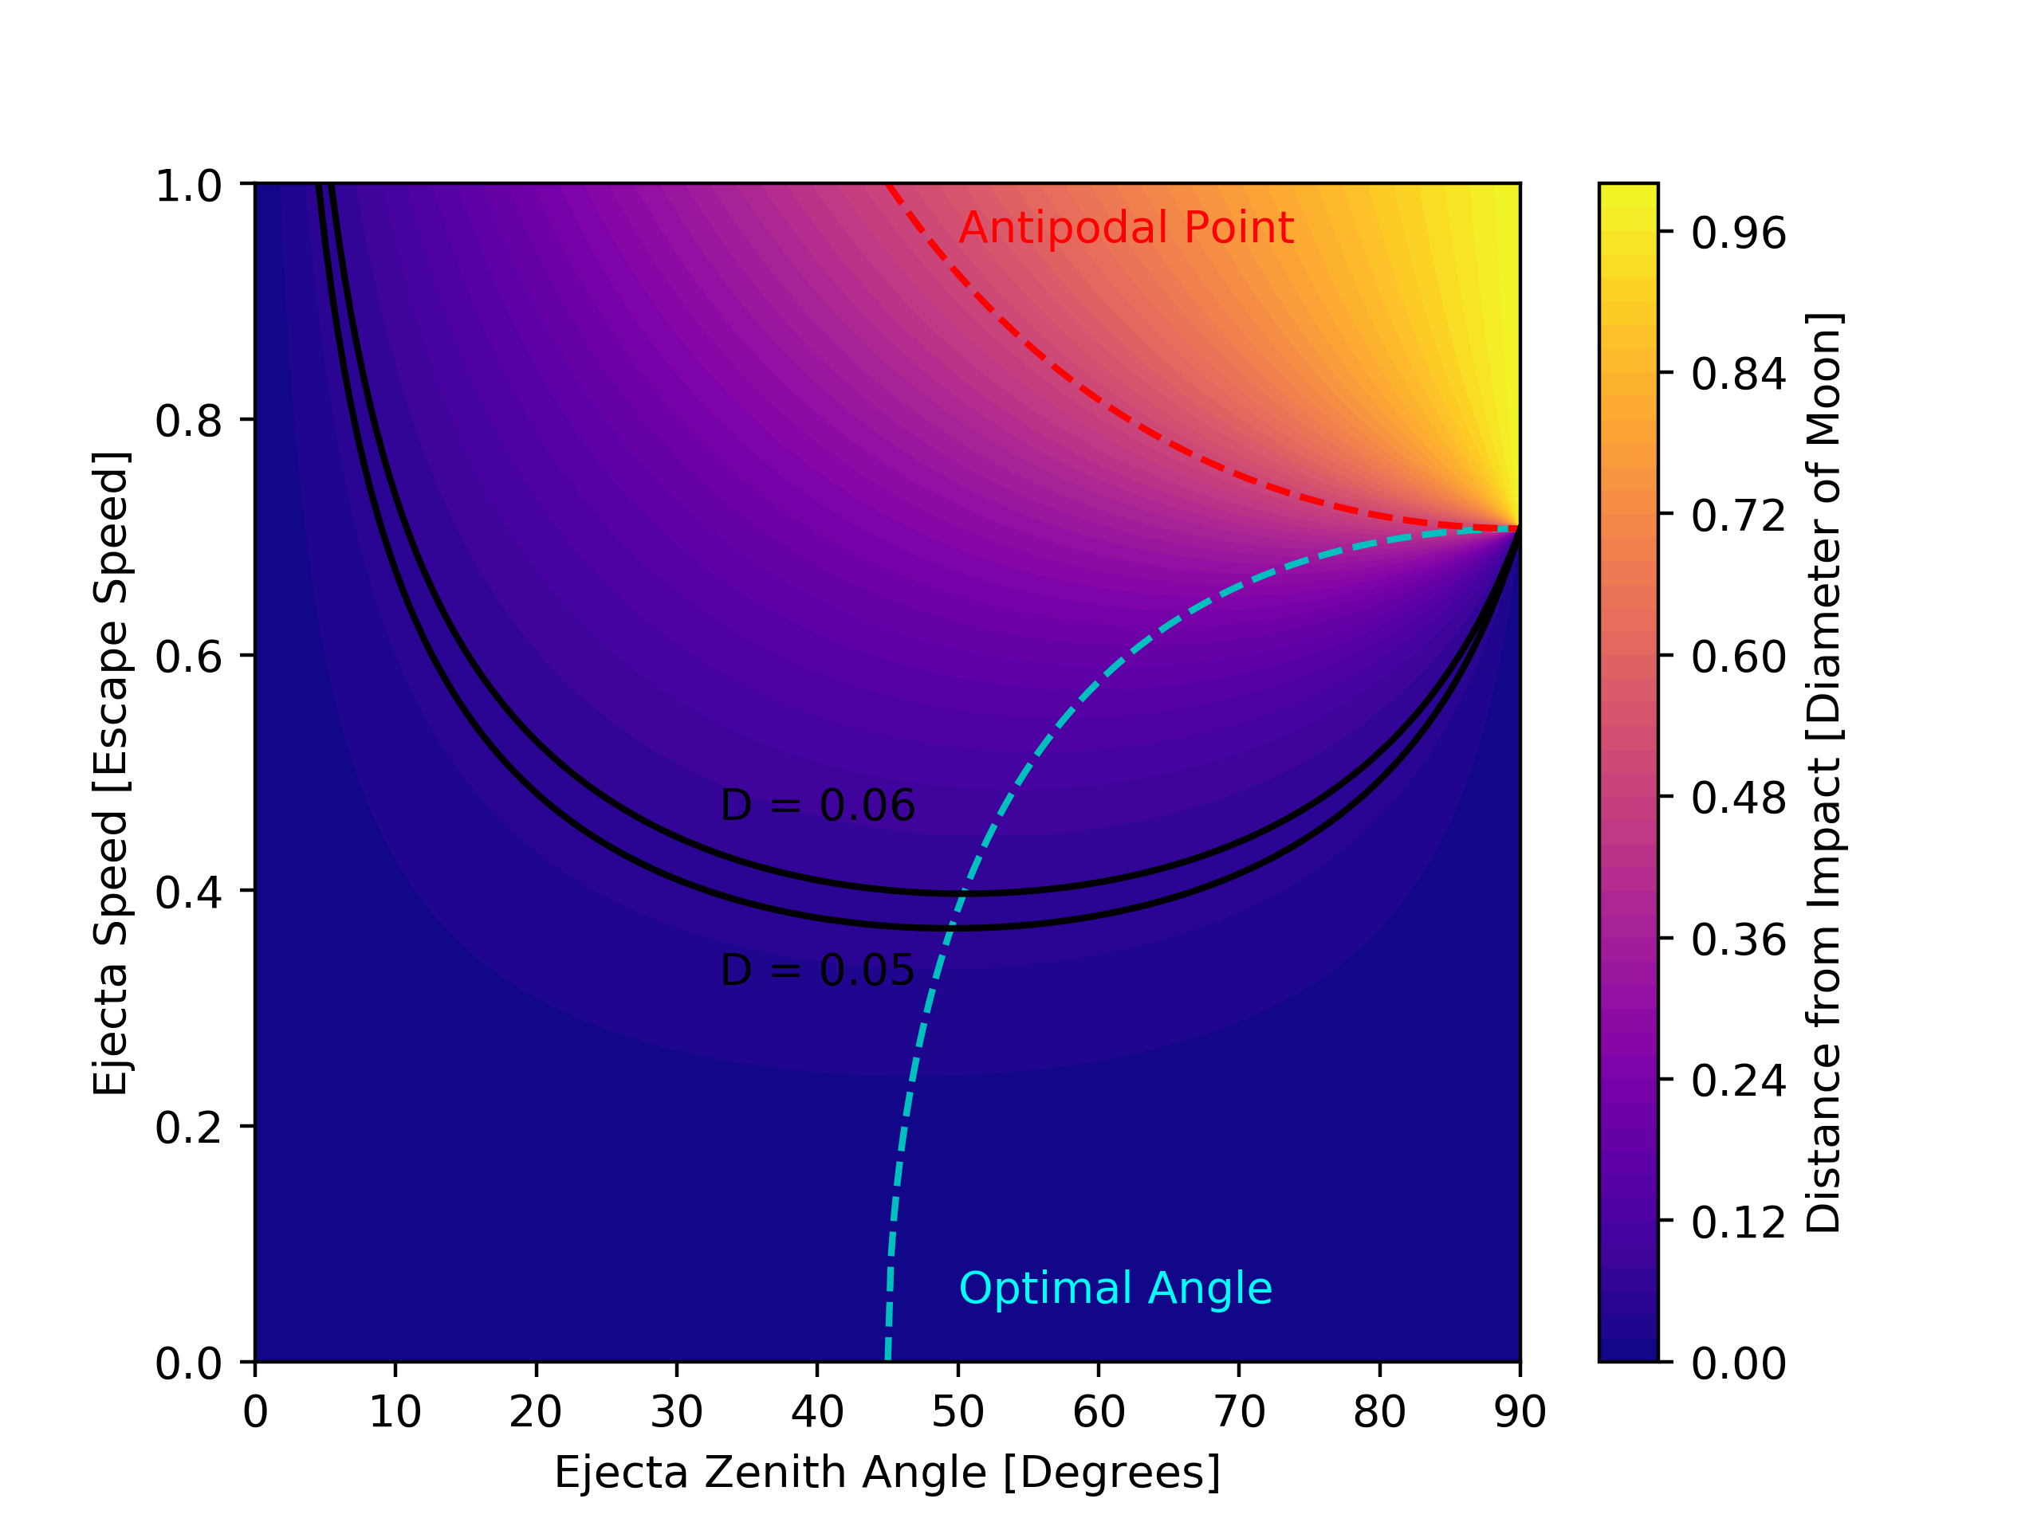
Secondary Ejecta from Primary Impact Location to a Region-of-Interest (ROI)
The ejecta speeds and zenith angles between the two black curves are valid speed-angle combinations that will reach a particular ROI

Slide 8
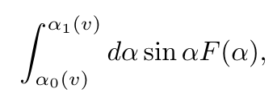

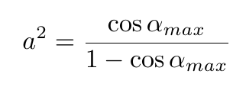
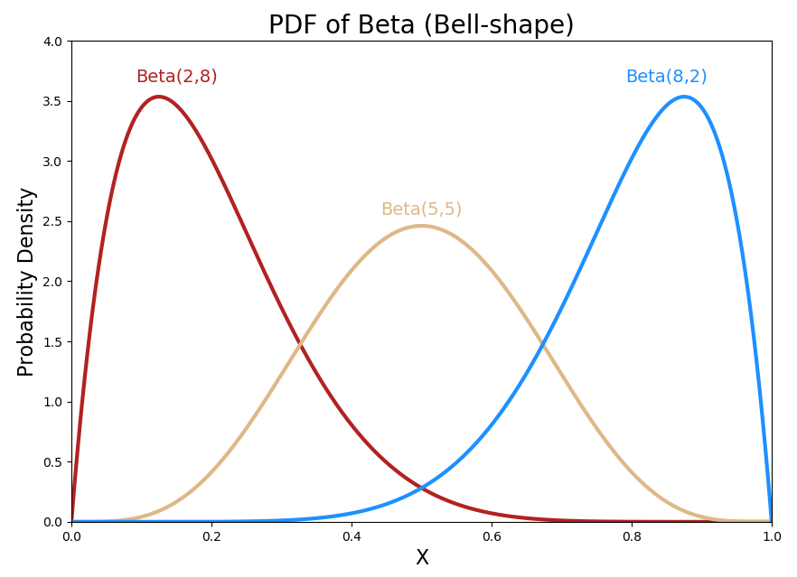
Angular Distributions of Secondary EJecta
Using a Beta distribution for the ejecta zenith angle allows for fine-tuning of the peak in addition to analytic solutions via integration
Most often a delta function at 45 degrees or a gaussian distribution centered on 45 degrees is used
Different impact angles will produce ejecta distributions with a different peak-angle (Gault and Wedekind 1978)
https://towardsdatascience.com/beta-distribution-intuition-examples-and-derivation-cf00f4db57af

Slide 9
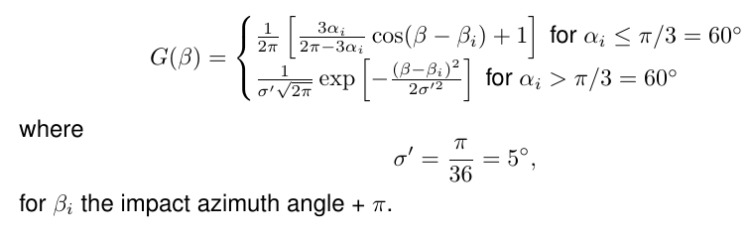
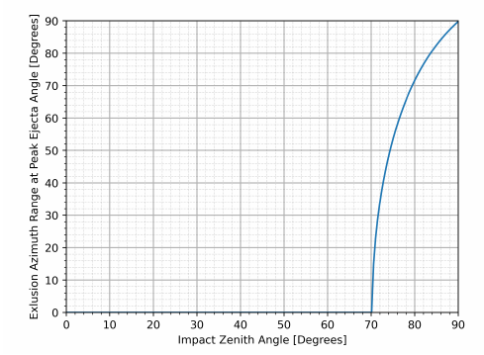
Angular Distributions of Secondary EJecta
Shown to the left an example of an azimuth distribution for the ejecta taken from Rival and Mandeville 1999.
As the impact angle departs from the zenith, the azimuth distribution becomes more asymmetric, favoring the downstream direction
For oblique impacts, there is an exclusion zone where very little ejecta is seen upstream

Slide 10
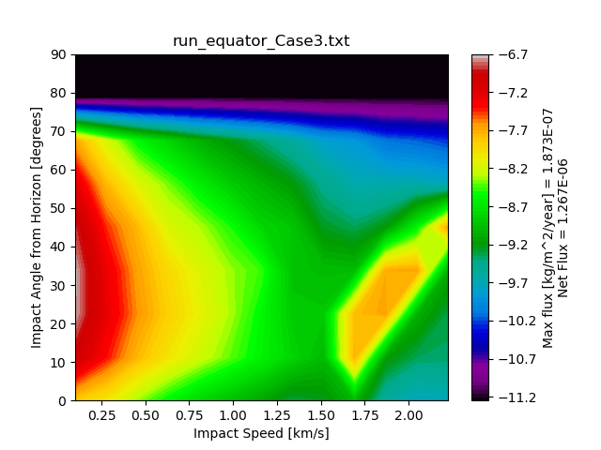
Preliminary Secondary Ejecta Flux
PRELIMINARY RESULTS
Comparing with the 1969 Model
For a limiting mass of 10E-6 grams for speeds between 0.1 and 0.25 km/s:
1969 Model = 2.5E-5 #/m^2/yr
Our model = 3.5E-7 #/m^2/yr
We predict a decrease in secondary fluxes by a few orders of magnitude
In agreement with Caleb Fassett’s and Bjorman’s analysis

