Slide 1
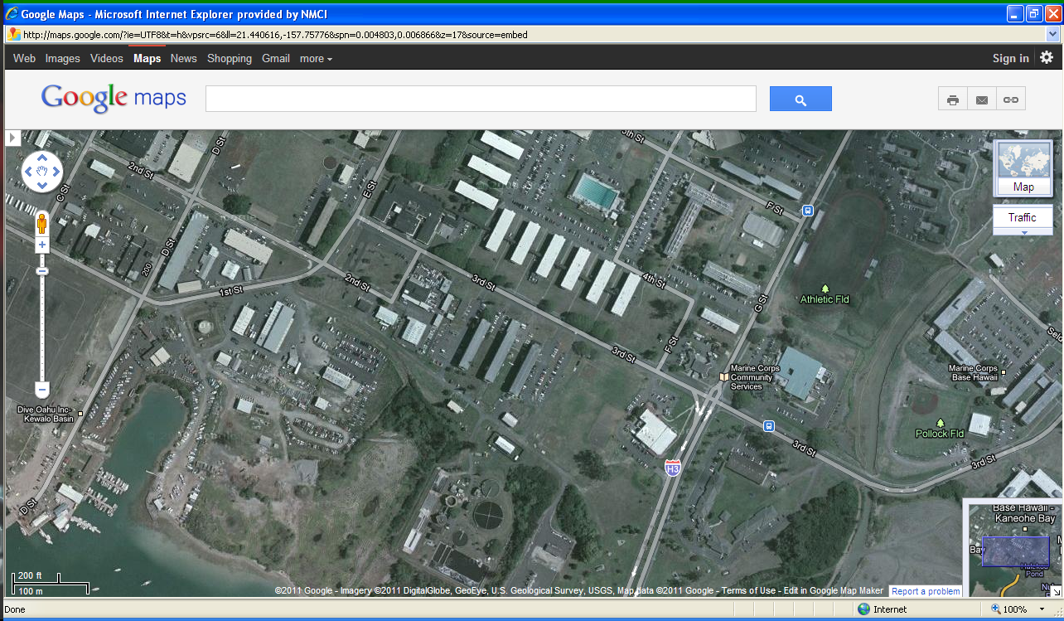
Base Safety Directorate Bldg 279
AMMO 51 Marine Corps Base Hawaii
Bldg 279, Base Safety Directorate Class Room
Phone: (808) 257-1830
I-H3 to Main Gate, go to light and turn left onto 3rd street to E street. At “T” intersection turn left then immediate right. Turn right again into parking lot.
Kaneohe Bay Lodge: (808)254-2806
I-H3 to Main Gate, continue straight, Lodge is located on the right before Traffic light.
Kaneohe Bay Lodge

Slide 2
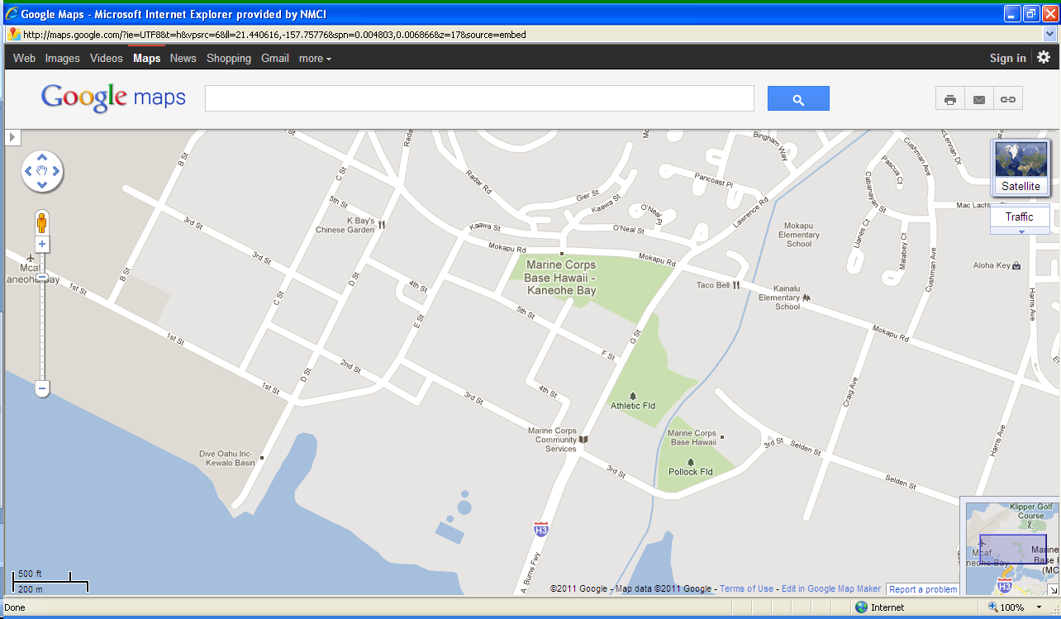
AMMO 51 Marine Corps Base Hawaii
Bldg 279, Base Safety Directorate Class Room
Phone: (808) 257-1830
I-H3 to Main Gate, go to light and turn left onto 3rd street to E street. At “T” intersection turn left then immediate right. Turn right again into parking lot.
Kaneohe Bay Lodge: (808)254-2806
I-H3 to Main Gate, continue straight, Lodge is located on the right before Traffic light.
Base Safety Center Bldg 279
Kaneohe Bay Lodge

