Slide 1
Object Recognition in Self Driving
Anthony Testa

Slide 2
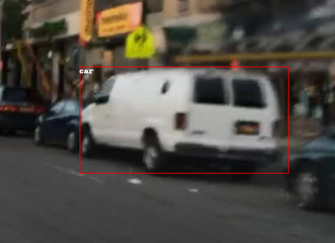
Object Detection
Detection (location)
Classification (identification)

Slide 3
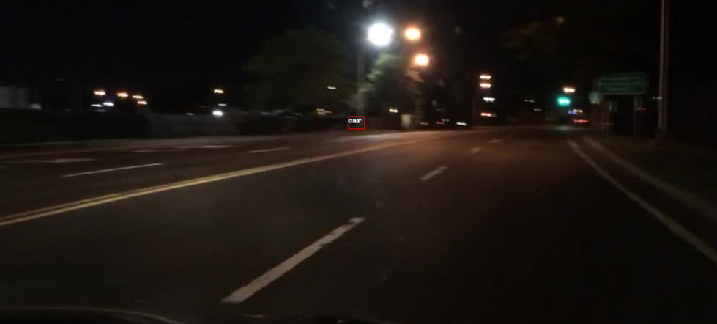
SSD: Single Shot MultiBox Detector
Single network
Fast, not as accurate

Slide 4
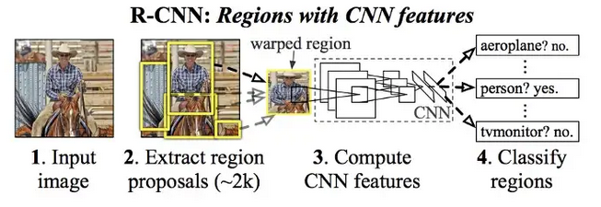
Faster R-CNN
- Regions with convolutional neural network
- Combine region proposal and object recognition
- Reduced training time
- Highly effective

Slide 5
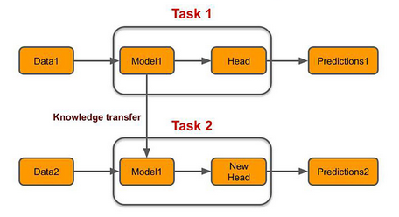
Transfer Learning
Pre-trained model (COCO)
Retrain last layer
Save training time, better accuracy

Slide 6
Dataset
BDD100K
UCBerkeley
720p (high res!)
Video source
Labels / bounding boxes

Slide 7
Training Times
Faster R-CNN (no transfer): 0 mins
SSD: 36 mins
Faster R-CNN: 1 hr 38 mins

Slide 8
