Slide 1
UCU Innovators Hub
Group Three Project Presentation

Slide 2
Problem Statement
No centralized repository for student innovations.
Hard to access past projects.
Limited visibility for innovators.

Slide 3
Project Objectives
Centralize innovations.
Enable submission, approval & browsing.
Provide analytics dashboards.
Foster collaboration.

Slide 4
System Architecture
React Frontend
Node.js Backend
MySQL Database
JWT Authentication

Slide 5
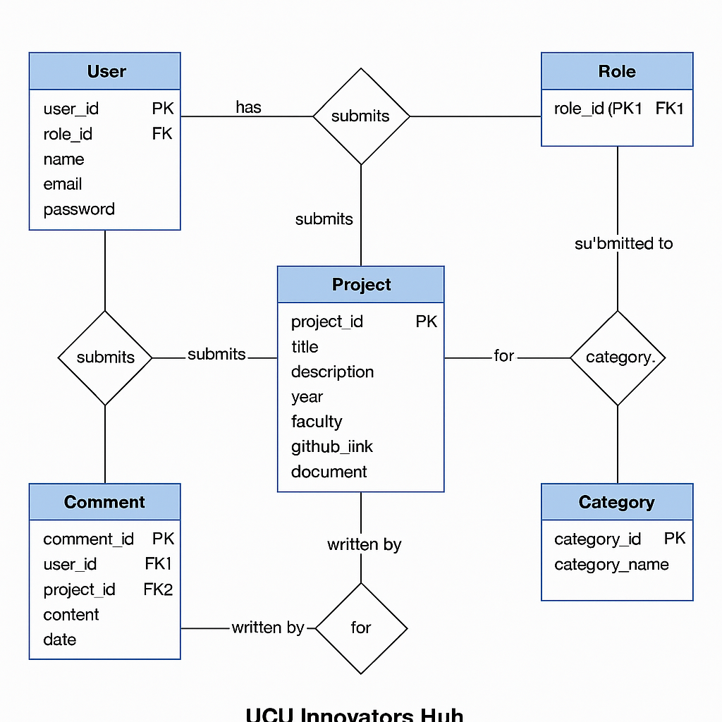
ER Diagram

Slide 6
Key Features
User authentication
Project submission workflow
Supervisor approval system
Public project gallery
Admin analytics dashboard

Slide 7
Analytics Dashboard
Project counts per faculty
Approval statistics
Trending technologies
Most active innovators

Slide 8
Conclusion
The UCU Innovators Hub provides a scalable, centralized platform for showcasing and managing student innovations while promoting collaboration and academic excellence.

Slide 9
Group Members Names
Terma Aryouma Bahtokpah--------- M25B13/061
Bukenya Elijah Kirabo-----------------M25B13/057
Mukisa Joel------------------------------M25B13/008
Opolot Jonathan-----------------------M25B13/022
Ruzira Anthony-------------------------M25B13/009

