Slide 1
Employment during COVID-19
By: Anthony Ali

Slide 2
Table of Contents
COVID-19 impact on employment
Which locations have a need for employment
Which companies are looking to hire
Which positions are in demand
What are the salary expectations
Future Analysis: If I had more time
Q and A
References

Slide 3
1. COVID-19 Background
Impact of COVID-19 on the Employment rate

Slide 4
Impact of COVID-19 on the employment rate
Key Points:
As of March the unemployment rate has rose to 4.4 percent.
This is up 0.9 percent from February and is the largest over-the month increase in the unemployment rate since January 1975
Number of people who reported being on temporary layoff more than doubled to 1.8 Million

Slide 5

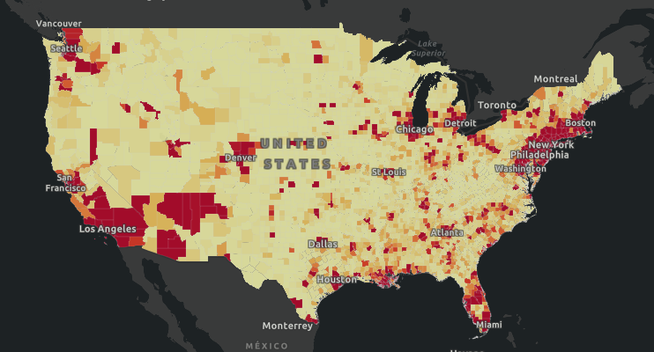
A picture is worth a thousand words
Heat Map of confirmed COVID-19 cases as of 4/25/20
Reference: https://coronavirus.jhu.edu/us-map

Slide 6
2. Which locations have a need for employment
Locations with the most job postings

Slide 7
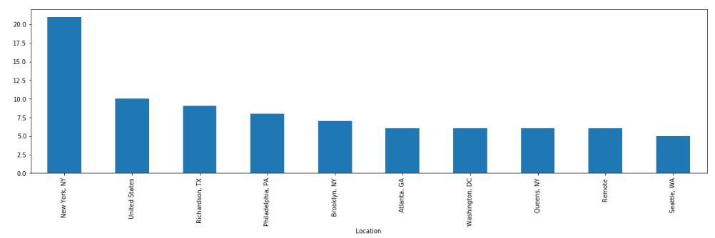
Which locations have a need for employment
The locations with a need for employment correspond with the heat map of confirmed COVID-19 cases.

Slide 8
3. Which companies are looking to hire
Companies with the most job postings

Slide 9
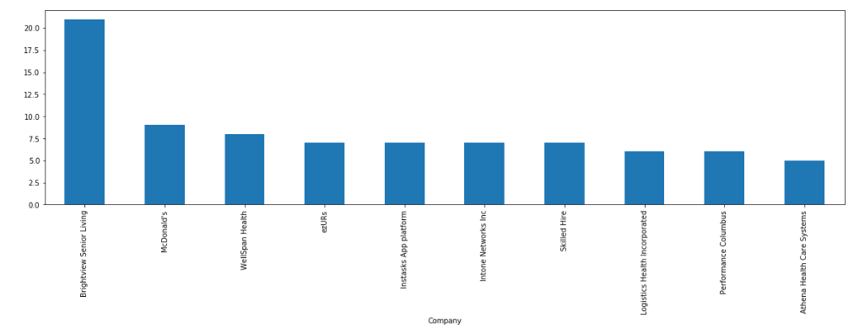
Which companies are looking to hire
The companies with the most job postings were medical facilities and surprisingly fast food.

Slide 10
4. Which positions are in demand
Job-titles with the most job postings

Slide 11
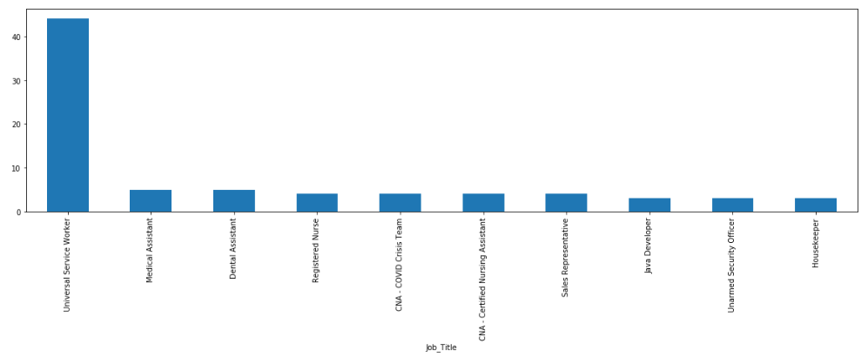
Which positions are in demand
The positions with the most job postings were medical positions or people working in medical facilities.

Slide 12
5. What are the salary expectations
Salary expectations for jobs during COVID-19

Slide 13
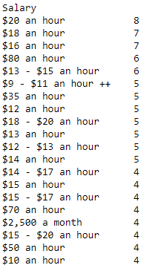
Salary expectations for jobs during COVID-19
There was extreme variance in the salaries, but the following conclusions were determined.
Minimum Salary - $17,680
Maximum Salary - $176,800
Average Minimum Salary - $39,564
Average Maximum Salary - $42,377

Slide 14
6. Future Analysis
What additional analysis could be done

Slide 15
Future Analysis
COVID-19 job postings by date
Specific requirements for job postings

Slide 16
Q and A
What questions do you have?

Slide 17
References
https://coronavirus.jhu.edu/us-map
https://www.bls.gov/bls/effects-of-covid-19-pandemic-on-employment-and-unemployment-statistics.htm
https://www.indeed.com/jobs?q=Covid+Jobs&start=

