Slide 1
Module 1--F# Basics
Syntax
Functions
Tuples
Records
Immutability
File Ordering

Slide 2
Value Bindings
// The "let" keyword defines an (immutable) value
let myInt = 5
let myFloat = 3.14
let myString = "hello" //note that no types needed
// ======== Lists ============
let twoToFive = [2;3;4;5] // Square brackets create a list with
// semicolon delimiters.
let oneToFive = 1 :: twoToFive // :: creates list with new 1st element
// The result is [1;2;3;4;5]
let zeroToFive = [0;1] @ twoToFive // @ concats two lists

Slide 3
Function Bindings
// ======== Functions ========
// The "let" keyword also defines a named function.
let square x = x * x // Note that no parens are used.
square 3 // Now run the function. Again, no parens.
let add x y = x + y // don't use add (x,y)! It means something
// completely different.
add 2 3 // Now run the function.

Slide 4
Multiline Function Bindings
// to define a multiline function, just use indents. No semicolons needed.
let evens list =
let isEven x = x%2 = 0 // Define "isEven" as an inner ("nested") function
List.filter isEven list // List.filter is a library function
// with two parameters: a boolean function
// and a list to work on
evens oneToFive // Now run the function

Slide 5
Explicit Function Arguments
// Sometimes the type inference system cannot determine your argument types.
// You may need to explicitly define the types
let divide (x: double) (y: double) =
x / y

Slide 6
If Else Control Flow
// Prefer using match over if else
let condition = true
let decision = if condition then
“Yes”
else // Always need an else branch that will return the same type
“No”

Slide 7
Precedence & Lambdas
// You can use parens to clarify precedence. In this example,
// do "map" first, with two args, then do "sum" on the result.
// Without the parens, "List.map" would be passed as an arg to List.sum
List.sum (List.map square [1..100] )
// you can define lambdas (anonymous functions) using the "fun" keyword
List.sum (List.map (fun x->x*x) [1..100])
// In F# returns are implicit -- no "return" needed. A function always
// returns the value of the last expression used.

Slide 8
Tuples & Records
// Tuple types are pairs, triples, etc. Tuples use commas.
let twoTuple = 1,2
let threeTuple = "a",2,true
// Get items out of a tuple with fst, snd
let firstItem = fst twoTuple
let secondItem = snd twoTuple
// Deconstruct a tuple into 3 variables
let (first,second,third) = threeTuple
// Record types have named fields. Semicolons are separators.
type Person = {First:string; Last:string}
let person1 = {First="john"; Last="Doe"}

Slide 9
Printing
// ========= Printing =========
// The printf/printfn functions are similar to the
// Console.Write/WriteLine functions in C#.
printfn "Printing an int %i, a float %f, a bool %b" 1 2.0 true
printfn "A string %s, and something generic %A" "hello" [1;2;3;4]
// all complex types have pretty printing built in
printfn "twoTuple=%A,\nPerson=%A,\nTemp=%A,\nEmployee=%A"
twoTuple person1 temp worker
// There are also sprintf/sprintfn functions for formatting data
// into a string, similar to String.Format.

Slide 10
Immutability
let myInt = 5
myInt = 10 // this returns a bool for if myInt is 10
let mutable myInt = 5
myInt <- 10 // is valid but avoid if possible

Slide 11





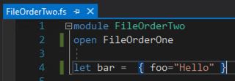
File Ordering
File order matters
Arrange your files top to bottom order in the IDE
A file can only use bindings from another file if it is below it

Slide 12
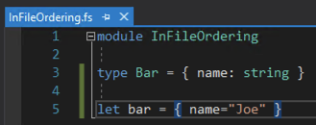
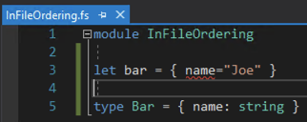
In File Ordering
Declaration order matters
Types, Functions, and Values must be declared before they are used

Slide 13
Module 2 – Lists & Sequences
Creating and Initializing lists
Properties of Lists
Operators for working with lists
Operating on List elements
Sequence
Sequence or List?

Slide 14
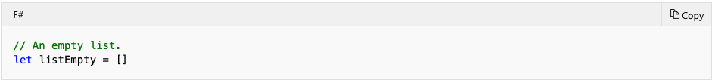
Creating and Initializing Lists
You can define a list by explicitly listing out the elements, separated by semicolons and enclosed in square brackets, as shown in the following line of code.
You can also define list elements by using a range indicated by integers separated by the range operator (..), as shown in the following code.
An empty list is specified by a pair of square brackets with nothing in between them.

Slide 15
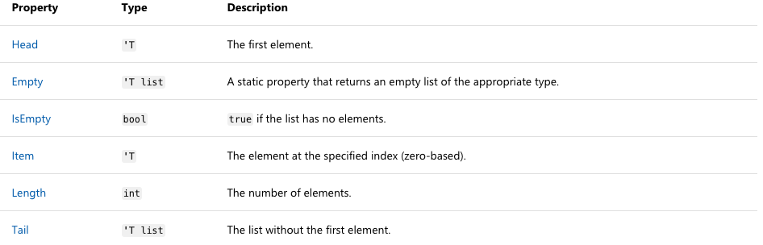
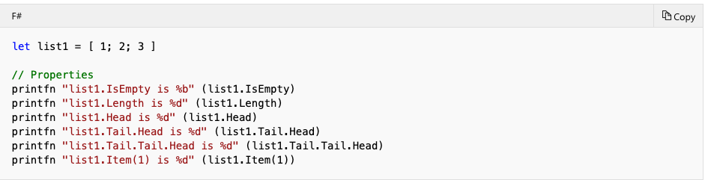
Properties of Lists

Slide 16
Operators for Working with Lists
You can attach elements to a list by using the :: (cons) operator. If list1 is [2; 3; 4], the following code creates list2 as [100; 2; 3; 4].
You can concatenate lists that have compatible types by using the @ operator, as in the following code. If list1 is [2; 3; 4] and list2 is [100; 2; 3; 4], this code creates list3 as [2; 3; 4; 100; 2; 3; 4].

Slide 17
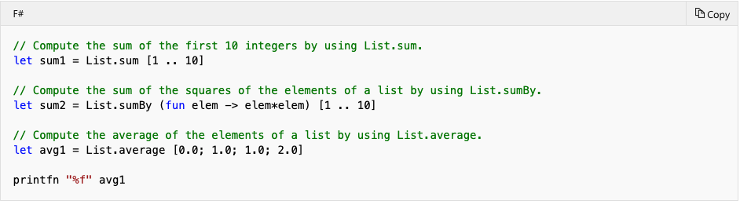
Arithmetic Operations on Lists

Slide 18
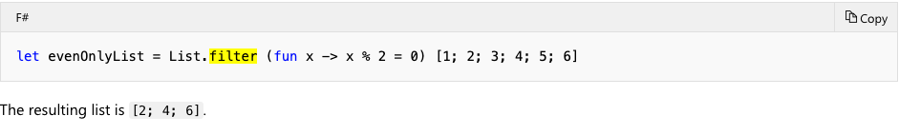
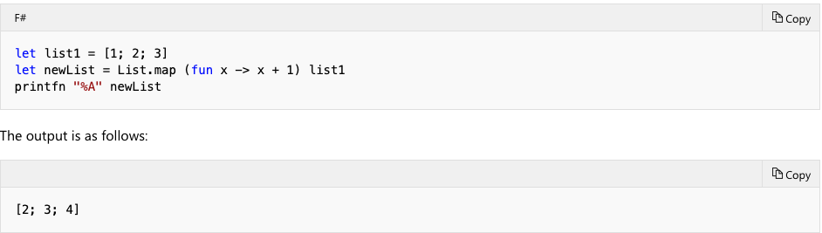
Operating on List Elements Filter & Map
You can use List.filter, which takes a Boolean condition and produces a new list that consists only of elements that satisfy the given condition.
Another frequently used function that transforms list elements is List.map, which enables you to apply a function to each element of a list and put all the results into a new list.

Slide 19
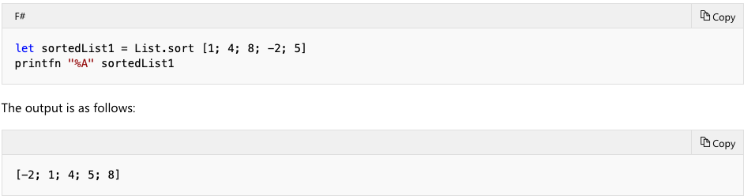
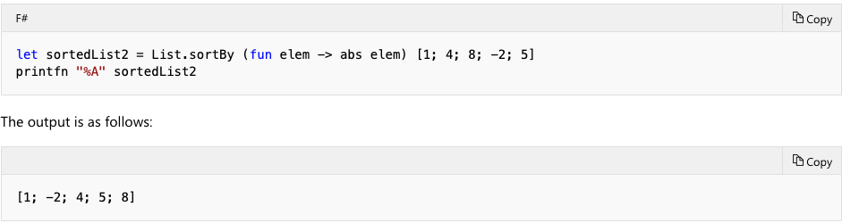
Operating on List Elements Sorting
The following example demonstrates the use of List.sort
The following example demonstrates the use of List.sortby.

Slide 20
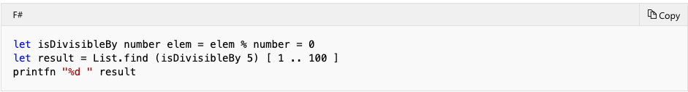
Operating on List Elements Searching
Search Operations on Lists
The following code example demonstrates the use of List.find to find the first number that is divisible by 5 in a list.
The result is 5

Slide 21
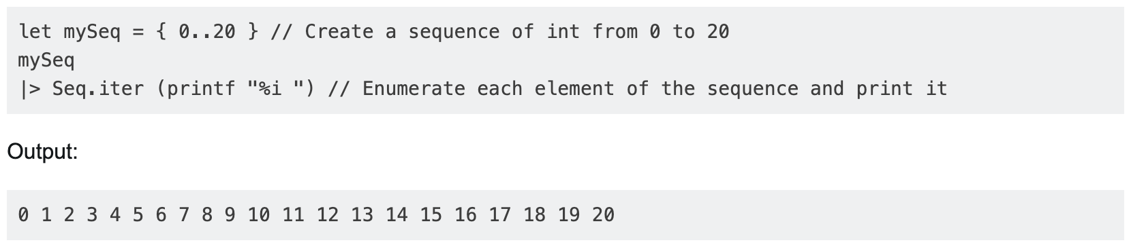
Sequences
A sequence is a series of elements that can be enumerated. It is an alias of System.Collections.Generic.IEnumerable and lazy. It stores a series of elements of the same type (can be any value or object, even another sequence). Functions from the Seq.module can be used to operate on it.
Here is a simple example of a sequence enumeration:

Slide 22
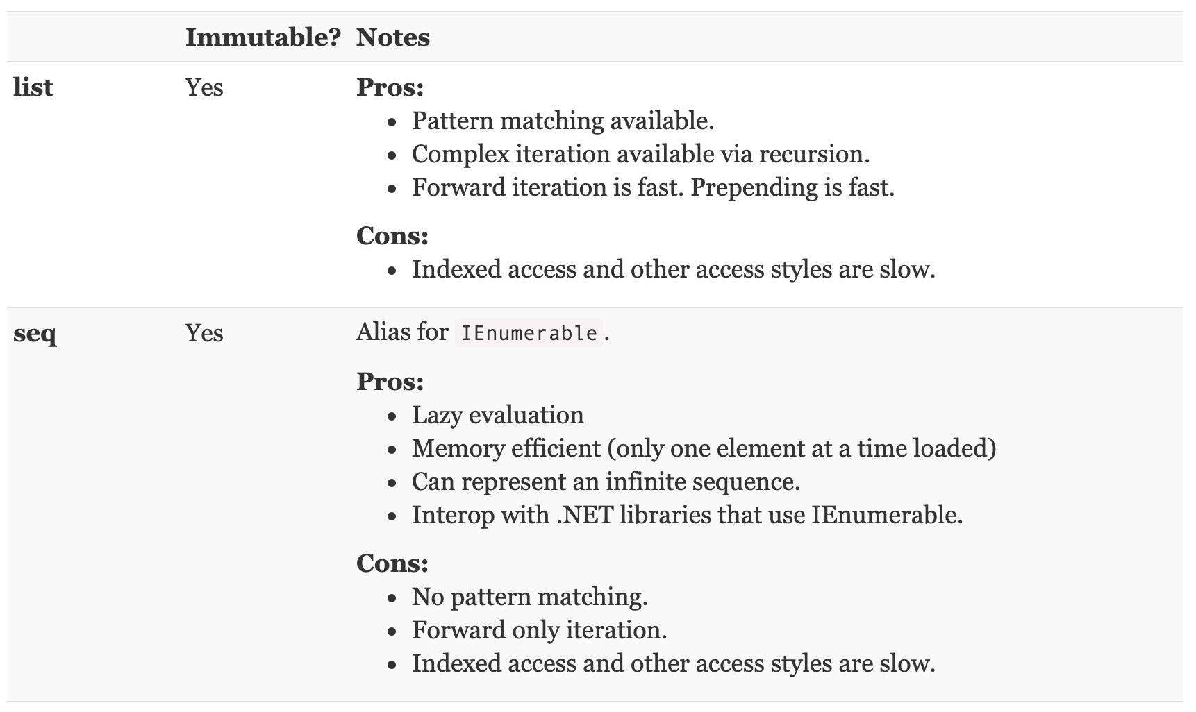
Sequences or Lists?

Slide 23
F# Discriminated Unions
Piping
Pattern Matching
Discriminated Union
Options
Result

Slide 24
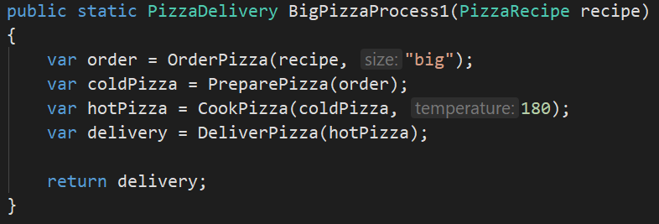
Forward Pipe

Slide 25
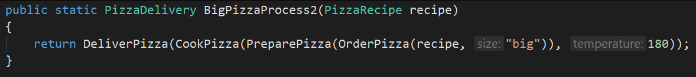
Forward Pipe

Slide 26
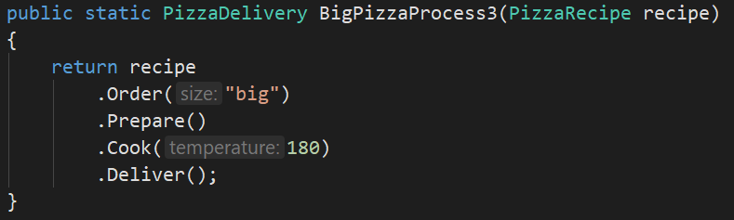
Forward Pipe

Slide 27
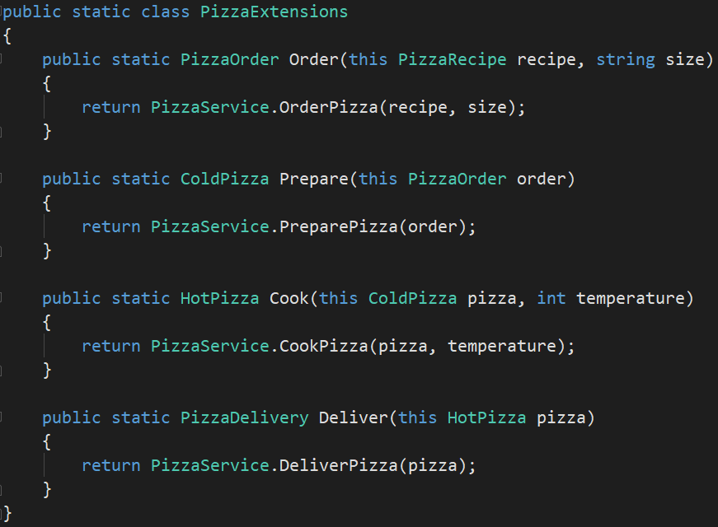
Forward Pipe

Slide 28
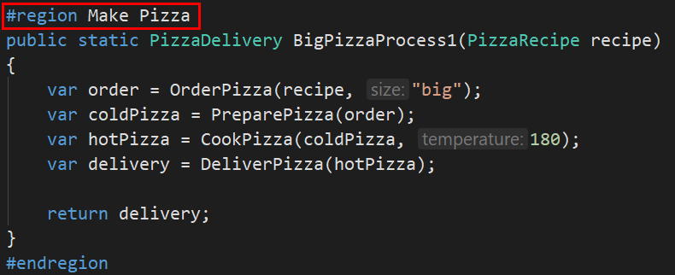
Forward Pipe

Slide 29

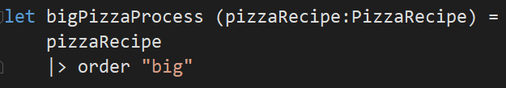
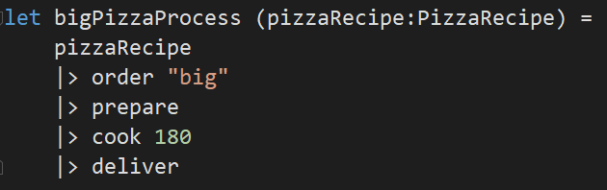

Forward Pipe

Slide 30
Forward Pipe
Easier to read
Less placeholder variables and/or parenthesis
Keeps code elegant
Passes data as last parameter

Slide 31


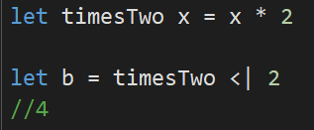
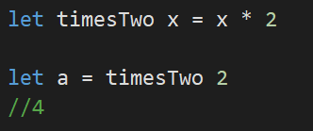
Backward Pipe

Slide 32
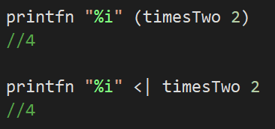
Backward Pipe
Change operator precedence without parentheses
Less placeholder variables

Slide 33
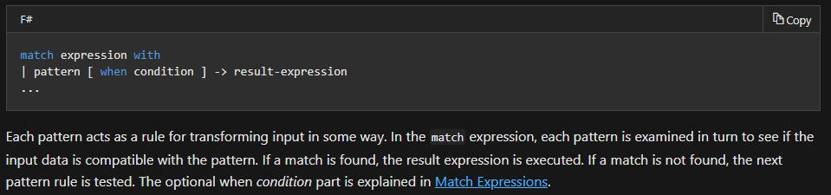
Pattern Matching
Constants (1.0, “test”, 30, Color.Red)
Identifier patterns (Discriminated Unions)
AND/OR patterns
List and Array Patterns
Tuple Patterns
And more!

Slide 34
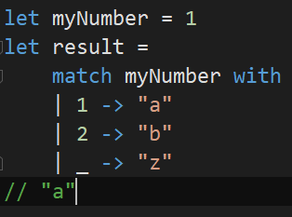
Pattern Matching
|'s must always be aligned with match statement
All statements must return the same type
Order matters
Compiler will give a warning if you don't match every possible case or have a default case
"_" is default

Slide 35
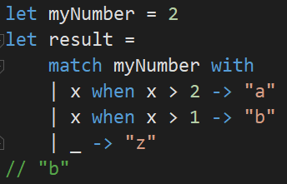
Pattern Matching (Guard)
Comparing the bound values
Testing object properties
Doing other kinds of matching, such as regular expressions

Slide 36
Discriminated Unions
Discriminated unions provide support for values that can be one of a number of named cases, possibly each with different values and types.
Discriminated unions are useful for heterogeneous data; data that can have special cases, including valid and error cases; data that varies in type from one instance to another; and as an alternative for small object hierarchies.

Slide 37
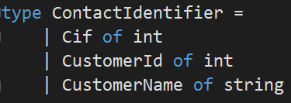
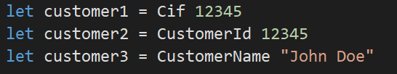
Discriminated Unions

Slide 38
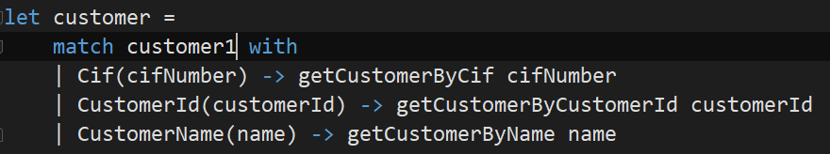
Discriminated Unions

Slide 39
Discriminated Unions
The labels must be uppercase (IE Cif, CustomerId)
Discriminated Unions can be composed of records, generics, or unions types
Lots of “free” magic (551 lines of it for ContactIdentifier)
HashCode
Equals

Slide 40
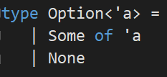

Option Type
Option is a discriminated union built into F#
Nullables in F# is highly discouraged
Option is one recommended approach

Slide 41
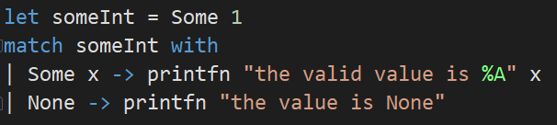
Option Type

Slide 42

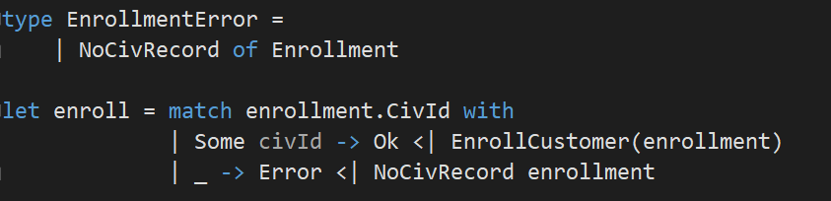
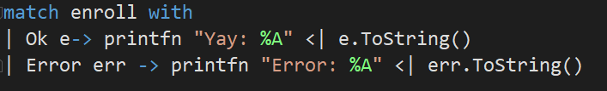
Result Type

Slide 43
Module 4
Advanced Bindings
Computation Expressions
Partial application
Type providers

Slide 44
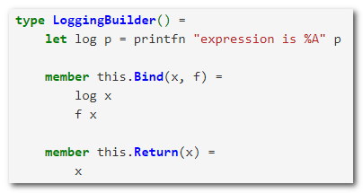
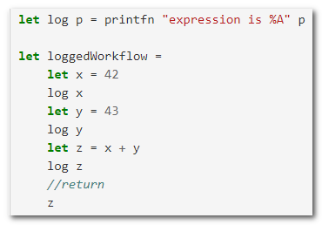
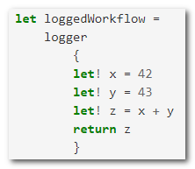
Advanced binding scenario
http://fsharpforfunandprofit.com sample
This is a Computation Expression!
Notes:
Jumping right in
Let's look at this example from the fsharpforfunandprofit.com website (which is an excellent source for learning the ins and outs using F# for practical purposes).
Notice that in between each value assignment there is a log statement. F# has a trick that can help us reduce this code. If we were to create this LoggingBuilder type that includes this this.Bind function then we can re-write the original code to look like this. When let! is called in the expression example then the data passes through LoggingBuilder.Bind before setting the x value. Notice that on each call to Bind the previous log statement is printed.
This is a Computation Expression and that is the topic of our next few slides.

Slide 45
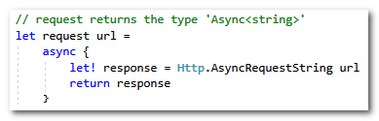
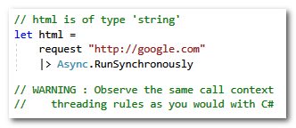
Async w/Computation Expressions
Notes:
Here is a sample using FSharp.Data’s Http type, which incidentally is a functional focused Http Library.
This call is surrounded by the async computation expression. Like Async/Await in C#, the result from this function is a generic, in F#’s case the generic is Async<string> instead of a C#'s Task<string>. F# can still create and execute Task based async/await constructs. This F# approach predates the introduction of async/await in C#, so this is the pattern you might expect to see in F# code.
We can then get the result from the async call immediately using Async.RunSynchronously. Be aware that F# has the same call context threading nuances that C# does, so this example is most applicable to console applications.

Slide 46
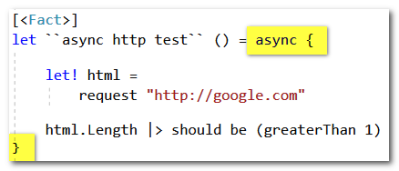
Testing Computation Expression functions
Notes:
When you test functions that have a Computation Expression then your test must also use the same Computation Expression.
This is how you would might create an XUnit integration test for an F# Async function.

Slide 47
Computation Expression Wrap-up
Other Computation Expressions
query – LINQ queries (not fluent version)
task – Nuget package for Task<a’>
Resources
F# For Fun and Profit – Computation Expression series
Microsoft Docs
Notes:
There are more Computation Expressions out there.

Slide 48
Detour – Pure Functions
Pure Function - A function’s output is determined purely by its input arguments. eg: Math Functions
Output is ALWAYS predictable
Only call other Pure Functions
NO side-effects
NO I/O
NO random operations
Why
Straight forward testing
Easier to reason about
Reproducible results
Parallelization
Notes:
Before we get onto our next topic, Partial Application, we need to take a quick detour and talk about a couple other important topics in functional programming. The first topic is Pure Functions.
A Pure function is a function whose output is determined solely on its input arguments. Because of that the output is ALWAYS predicatble.
Pure functions only call other pure functions.
Pure functions have NO side-effects, NO I/O, and NO Random operations. Random both in the case of calling a random function, and in the case of calling DateTime.Now or other non-deterministic functions in the framework.
Why is it important to bring up pure functions? They play an important part in Functional application. They are straight forward to test, easier to reason about, they have reproducible results and you can them in multi-threaded situations with having to worry about locks or other contention.
In short, write as many Pure functions as you can

Slide 49
Higher-order functions
Higher-order function
A function that takes another function as input
OR - A function that returns a function as output
You’ve seen this before
With C# + LINQ
The LINQ Select is a higher-order function users.Select(user => new { user.Name })
And with JavaScript – Callback functions, anyone?
Important for dependency inversion
Notes:
Next Detour, Higher Order Functions. I suspect that this is just a refresher.
A higher order function is a function that either takes a function as input or returns a function as output.
This pattern is important for things like functional dependency inversion.

Slide 50
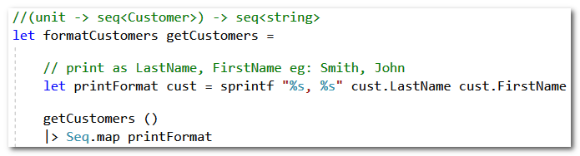
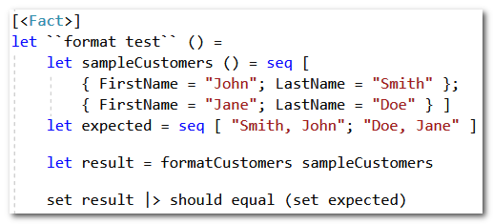
Sample H-O Function and Test
Notes:
Here is a sample function we are going to spend a little time with. This function takes a getCustomers argument, which happens to be a function.
For simplicity getCustomers does not take any inputs itself and it returns a sequence of the Customer type. Remember that Sequence is equivalent to IEnumerable.
The formatCustomers function executes getCustomers and then takes that sequence of customers, formats them in Last name comma First name and then returns it as a string sequence.
And then we have a basic test for this function. We are preparing a list of two customers and we have our expected result. Smith, John and Doe, Jane.
We then call our function under test, formatCustomers and we verify the results against expected using an FSUnit style assert.

Slide 51
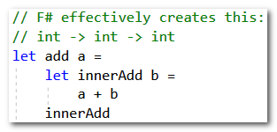





Partial Application
Same function signature
3
Notes:
Now onto partial application
Lets start off with an add function that adds two numbers together.
We can call this function to get the sum of 1 and 2. Of course 3 is printed.
In reality F# created the function to behave like this. It builds out the add function in a curryable format, if that's a word. And this alternate add has exactly the same signature as the original. How can that be? In our signature we can read that we have a function that takes an int, and another function that takes an int and finally we get an int return. So the signature demonstrates that we can call the function with currying.
So lets do that. We can call add with the extra parentheses but we will still get the same result as calling the add as above, because we already know that parentheses are not required in this kind of call.
So if we take the currying one step further we end up with an add that has the 1 partially applied. This creates a new function with the int -> int signature.
Then we can apply the second value of two in a separate call and still end up with our sum of 3.

Slide 52
formatCustomers Review
getCustomers is defined as unit -> seq<Customer> IEnumerable<Customer> GetCustomers() in C#
What getCustomers implementations are possible?
Notes:
Once again, lets review our formatCustomers HOF.
It takes a getCustomers function as input.
What other getCustomers implementations might be possible?
Perhaps a DB implementation

Slide 53
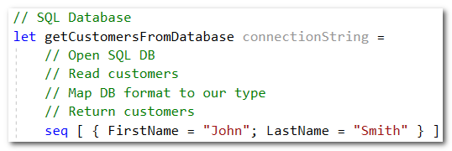
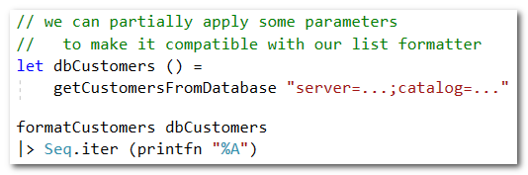
getCustomers DB

Slide 54
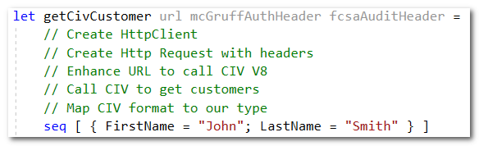
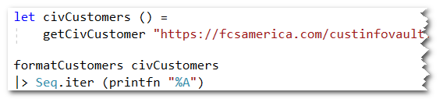
getCustomers CustInfoVault

Slide 55
Partial Application – Wrap-up
A technique we can use to re-shape a function to fit the signature of a Higher-Order Function
Leads us to put our most stable params first
EG: For GetCustomer
ConnectionString before CustomerID
let getCustomer connectionString customerId =
Partial Application is another one of the premier reasons why you would choose a functional language.

Slide 56
Type Providers
Type generation tool for external data sources
Property type inference – string, int, float, datetime
Many providers available...
FSharp.Data
CsvProvider
JsonProvider
XmlProvider
FSProjects on GitHub – nuget.org
SQLProvider
OpenApi (Swagger)
Azure Storage Type
GraphQL
Notes:
On to Type Providers
A Type Providers is a generation tool that can turn an external data source into a set of F# types
Type providers use type inference to generate a strongly typed types.

Slide 57
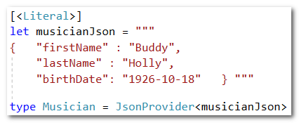
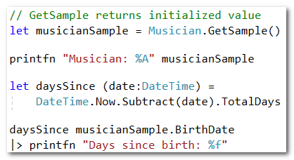
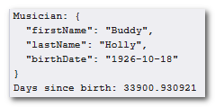
JsonProvider sample
Notes:
The Json Type Provider is fairly straight forward to setup compared to something like a SQL Database so I am going to use that as a sample.
I can create a Musician type using this string of Json Data.
I can then pull the sample data back out with a call to GetSample. Because I have type inference, the DateTime field was properly recognized so I can immediately perform date time calculations without any additional casting or parsing.
To the right is the two printfn statements. Buddy Holly was born roughly 33,900 days ago.

Slide 58


JsonProvider cont'd
Notes:
The JsonProvider type also generates several utility functions.
I can use the utility functions to create a new musician, parse additional json
Or load JSON from a variety of different input mediums.

Slide 59
Module 4 Wrap-up
We covered
Computation Expressions
Pure Functions
Higher order Functions
Partial Application
Type Providers
Lab order
Async
Partial Application
Type Providers

