Slide 1
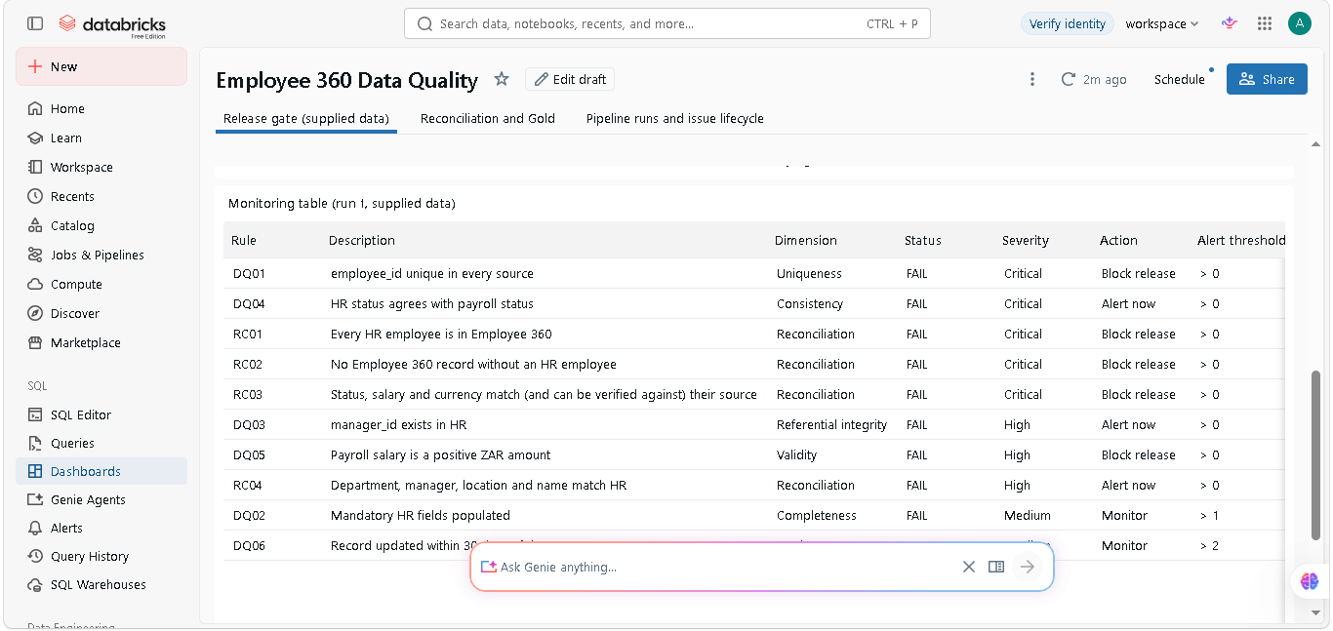
Employee 360
Data Quality
Technical Challenge Walkthrough
The supplied data is blocked for release because critical reconciliation controls fail.
Anthony Grant Apollis
8 slides | 5 to 10 minute recording
Notes:
Open by stating the purpose of the assignment. I assessed the quality of the HR, payroll and Employee 360 extracts, built repeatable controls, reconciled the sources and created operational monitoring. The supplied data is intentionally unsuitable for release: the checks identify real defects and show exactly where they begin. This walkthrough takes about seven minutes.

Slide 2
Business question and scope
Can Employee 360 be trusted for operational and management reporting?
Decision
Assessment coverage
BLOCK
HR, payroll and Employee 360 source files
Profiling, 10 data-quality controls and field-level reconciliation
Reason: source and reconciliation defects affect employee status, payroll values and completeness.
Incremental-load behaviour, monitoring and release decisions
Supplied-data result
Local validation: 17 findings across 12 employees. Release: BLOCK.
Employee 360 Data Quality | Anthony Grant Apollis
2 / 8
Notes:
The business question is whether the Employee 360 output is safe to publish. I evaluated all three supplied files, rather than only checking the target. Each source has 48 rows, but matching row counts do not prove trust. The supplied data creates 17 local rule findings across 12 employees. The release gate blocks publication because every defined control finds at least one issue. The important point is that a blocked release is a correct, useful outcome.

Slide 3
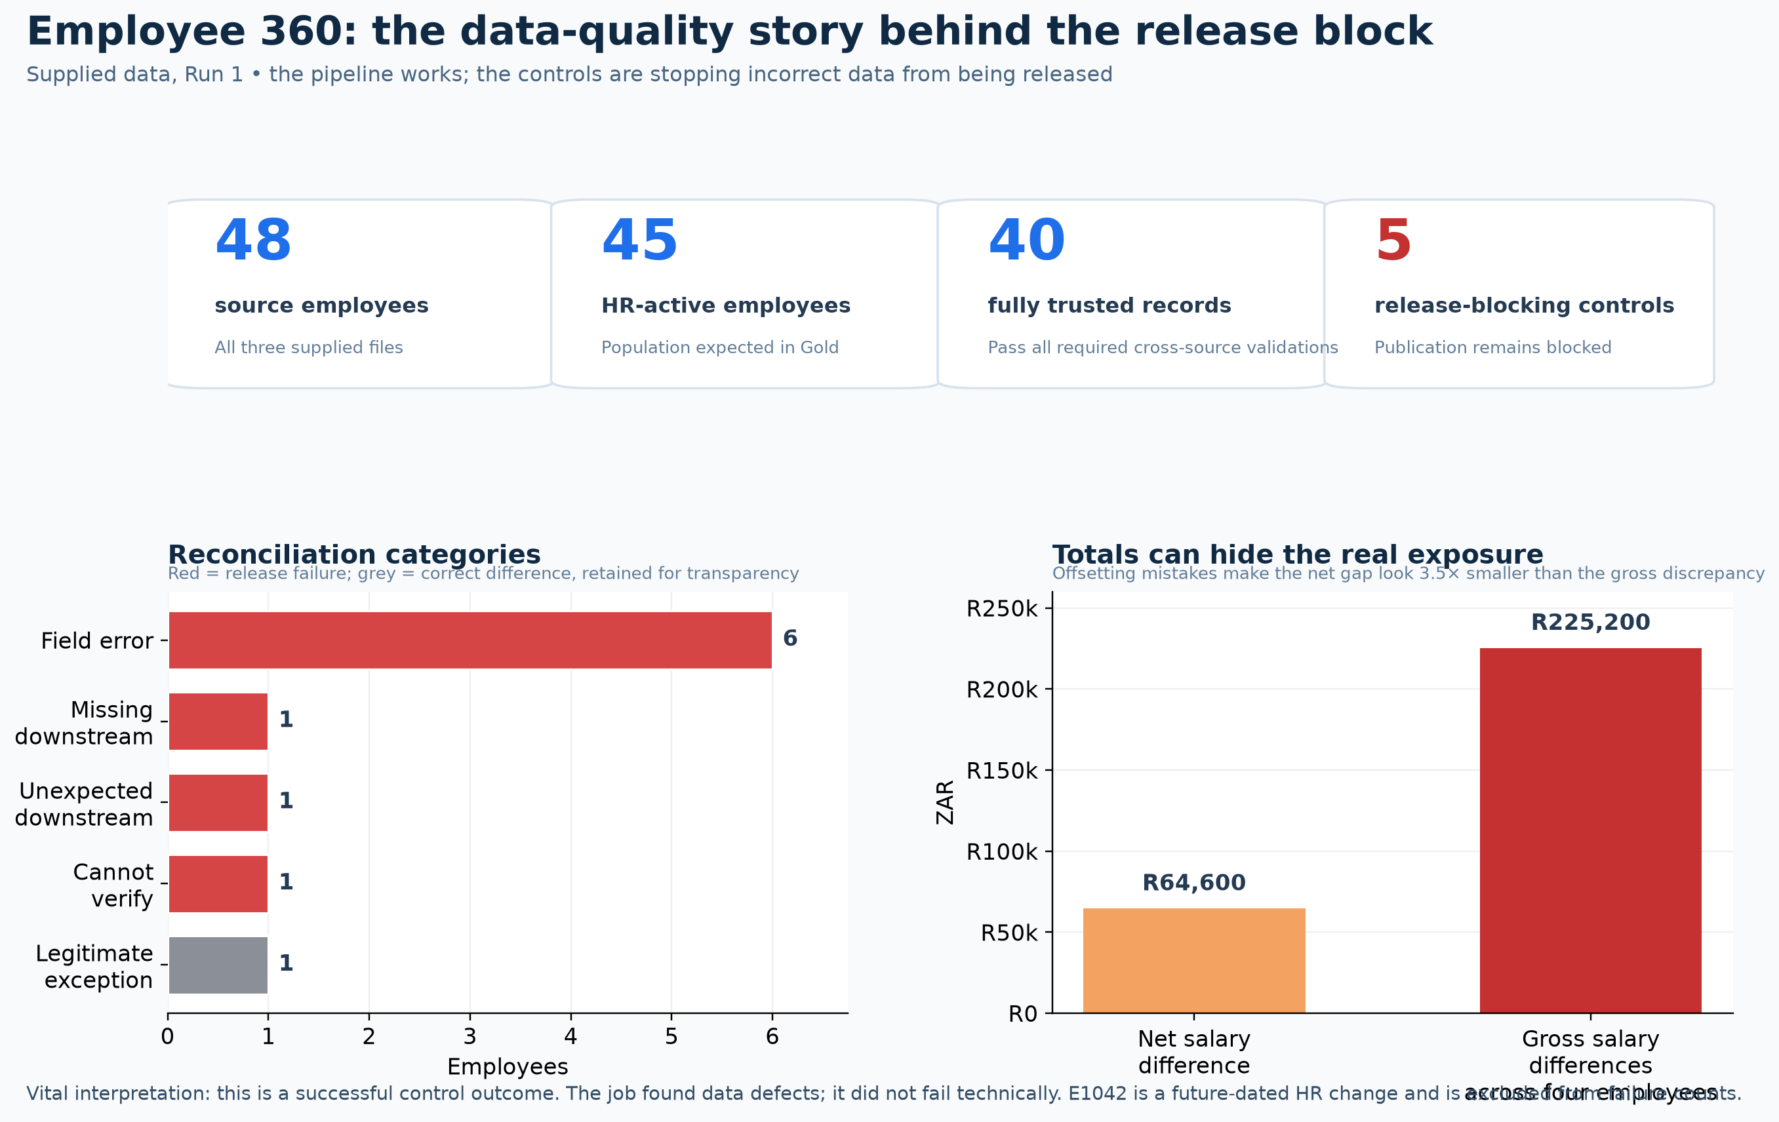
Profiling and quality controls
SQL produces clear table checks; PySpark runs the scalable pipeline controls.
10 controls across seven quality dimensions
Uniqueness and mandatory fields
Manager integrity and status consistency
Salary validity, freshness and payroll conflicts
Source-to-target reconciliation
Rules return affected employee IDs, severity and a release action. They do not simply return a row count.
Employee 360 Data Quality | Anthony Grant Apollis
3 / 8
Notes:
I used SQL for transparent profiling and reconciliation queries. I used PySpark for a repeatable Databricks job that reads the files, applies all ten controls and writes issue and monitoring tables. The controls span uniqueness, completeness, integrity, consistency, validity, timeliness and reconciliation. Each result retains employee IDs and a severity, so data owners can investigate an actual record rather than work from a vague aggregate.

Slide 4
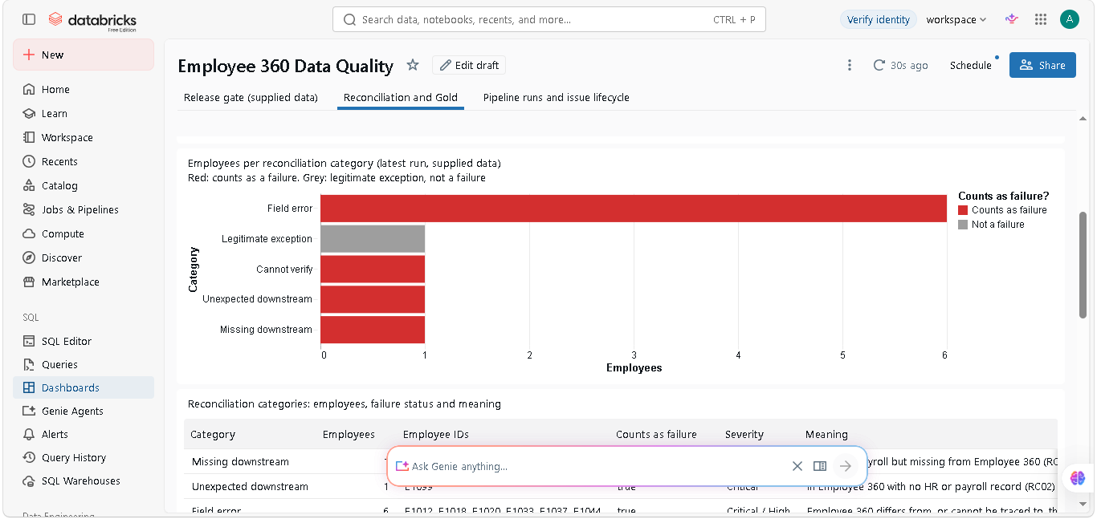
Field-level reconciliation and root cause
The comparison checks individual attributes, not only record totals.
What the comparison found
E1027 exists in HR but is missing downstream
E1099 exists downstream without an HR record
Six field errors affect status, salary or currency
E1015 has conflicting payroll values and remains Cannot verify
E1042 is a future-dated legitimate exception, not a failure
Root cause evidence: E1099 matches E1028 on all eight tested attributes, supporting a copied-record finding.
Employee 360 Data Quality | Anthony Grant Apollis
4 / 8
Notes:
This is the central reconciliation result. E1027 is missing from Employee 360. E1099 is an unexpected downstream record and matches E1028 across all eight tested attributes, which supports the root-cause finding that it was copied. Six employees have field-level errors. For E1015, payroll provides conflicting values, so the pipeline deliberately reports Cannot verify instead of choosing an arbitrary value. E1042 is a future-dated HR change; it is visible for transparency but does not block release.

Slide 5
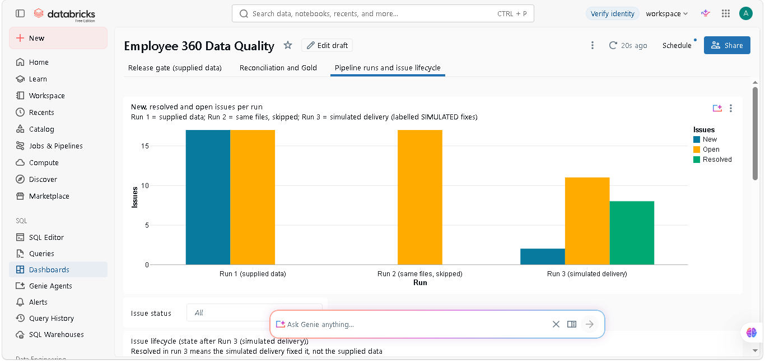
Incremental loading and issue lifecycle
The three-run sequence proves change handling without changing the supplied evidence.
Run 1
Supplied data full load. The pipeline detects the original issues.
Run 2
Same files. Hashes match, so the loader skips them and avoids duplicates.
Run 3
A separate simulated delivery tests changes: 8 resolved, 2 new, 11 still open.
Resolved on Run 3 means the simulated test data no longer triggers the rule. It does not claim the original files were fixed.
Employee 360 Data Quality | Anthony Grant Apollis
5 / 8
Notes:
The run sequence demonstrates incremental processing. Run one loads the supplied source files. Run two receives the same hashes and skips them, which prevents duplicate processing. Run three is deliberately simulated. It gives evidence that the pipeline detects changes, closes issues when later data no longer violates a rule, and flags new issues. Resolved never means the original challenge data changed. That distinction protects the integrity of the evidence.

Slide 6
Monitoring and release gate
The dashboard separates data-quality findings from technical job failures.
Release action
Block release for critical source and reconciliation errors
Alert now for high-severity operational risks
Monitor lower-severity conditions and trend them over time
Operational failure
A job error means engineering must restore the run.
Data-quality failure
A successful job can correctly report failed source-data controls.
Employee 360 Data Quality | Anthony Grant Apollis
6 / 8
Notes:
The monitoring dashboard has a release decision, rule outcomes, severity, actions and affected counts. Critical reconciliation defects block release. High severity controls alert data owners. Lower severity defects are monitored and trended. I also distinguish technical failure from data-quality failure. The earlier SQL subquery problem was an operational job error. The current blocked release is different: the job ran successfully and found data defects.

Slide 7
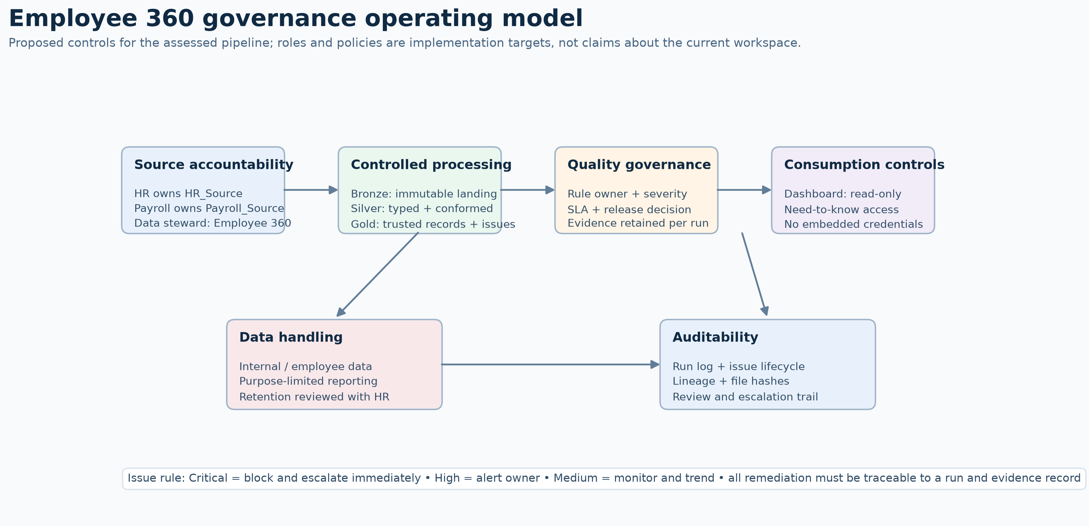
Delivery architecture, governance and dbt
The implementation keeps ingestion, transformation, controls and evidence traceable.
Implementation roles
PySpark ingests data, applies controls and writes Delta evidence
dbt builds documented SQL staging and reconciliation models
Azure DevOps runs regression checks before deployment
Run IDs, hashes, severity and ownership support auditability
dbt strengthens the SQL layer. It keeps the payroll-conflict model visible and prevents arbitrary first-value logic.
Employee 360 Data Quality | Anthony Grant Apollis
7 / 8
Notes:
The delivery design is deliberately small. PySpark handles file ingestion, incremental hashes, scalable checks and Delta outputs. dbt adds value for the SQL layer: it documents source tables, builds staging and reconciliation models, adds standard tests and exposes lineage for reviewers. Azure DevOps can run both the Python regression tests and dbt checks before deployment. The governance model links every issue to a run, source and rule.

Slide 8
Independent judgement and next steps
AI use
AI accelerated drafting and review. I challenged its suggestion to use groupBy().first() because that method could select an arbitrary conflicting payroll value and hide E1015.
Correction
The final approach treats conflicting payroll values as Cannot verify. The pipeline preserves the evidence and routes it to the data owner.
Close
The solution blocks unsafe data, identifies where problems begin, supports remediation and shows how a governed release can proceed once the defects are corrected.
Employee 360 Data Quality | Anthony Grant Apollis
8 / 8
Notes:
I used AI to speed up drafting and to challenge the implementation, but I kept independent judgement. The key correction was rejecting a grouped first-value approach because it could hide the payroll conflict for E1015. The final pipeline classifies that record as Cannot verify. I would next work with HR and payroll owners to correct the data, rerun the controls and only then change the release gate from BLOCK to PASS. Thank you.

