Slide 1
Leatt Fabric BI/ML Portfolio
2,000,000 transaction lines
R3,994,247,413 revenue
Fabric + Power BI + ML + SAP governance + AI agents

Slide 2
What The Data Tells Us
Scale: The modeled ecommerce estate is large enough for enterprise BI: R3,994,247,413 revenue and R1,938,497,252 gross margin across the analytical period.
Category economics: Apparel is the hero growth engine at R1,759,430,045; it deserves board-level tracking, product storytelling and protected availability.
Margin leakage: Returns absorb 4.9% of modeled revenue, with Footwear carrying the highest return-rate signal. Fit, sizing, delivery promises and PDP content should be inspected before scaling spend.
Marketing efficiency: Direct is the efficiency engine with ROAS 100.0x. Paid channels should be optimized with creative testing, landing-page relevance and bundle-led offers before budget expansion.

Slide 3
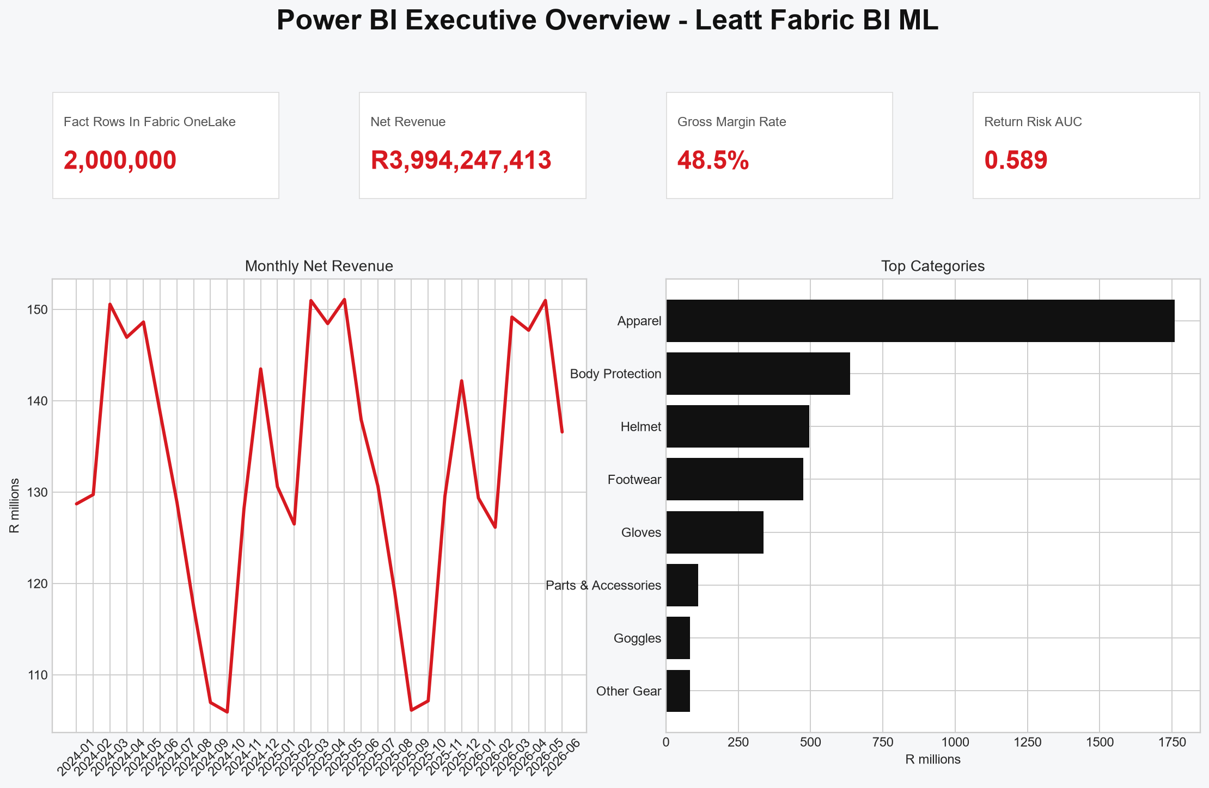
Power BI Executive Overview

Slide 4
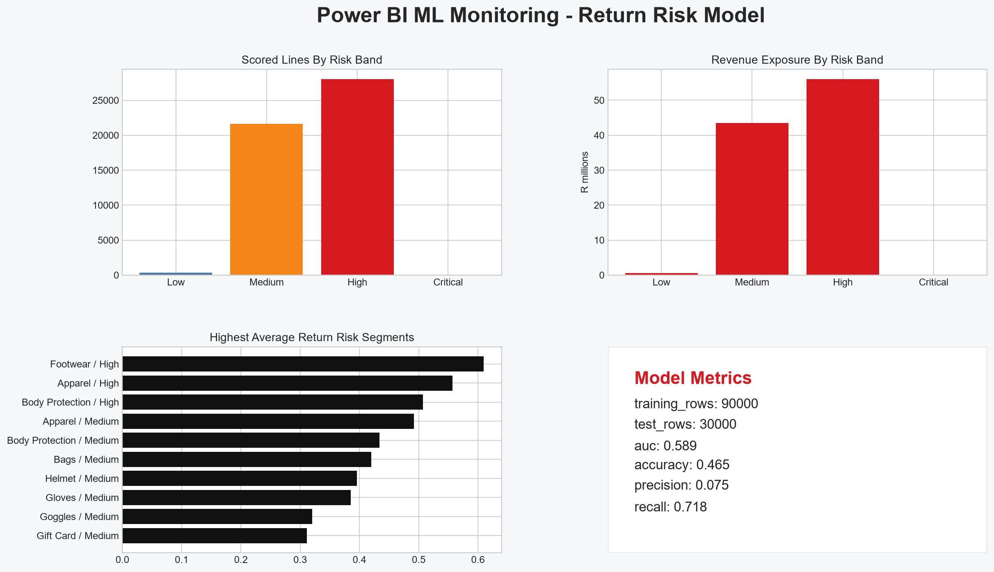
ML Return Risk Monitoring

Slide 5
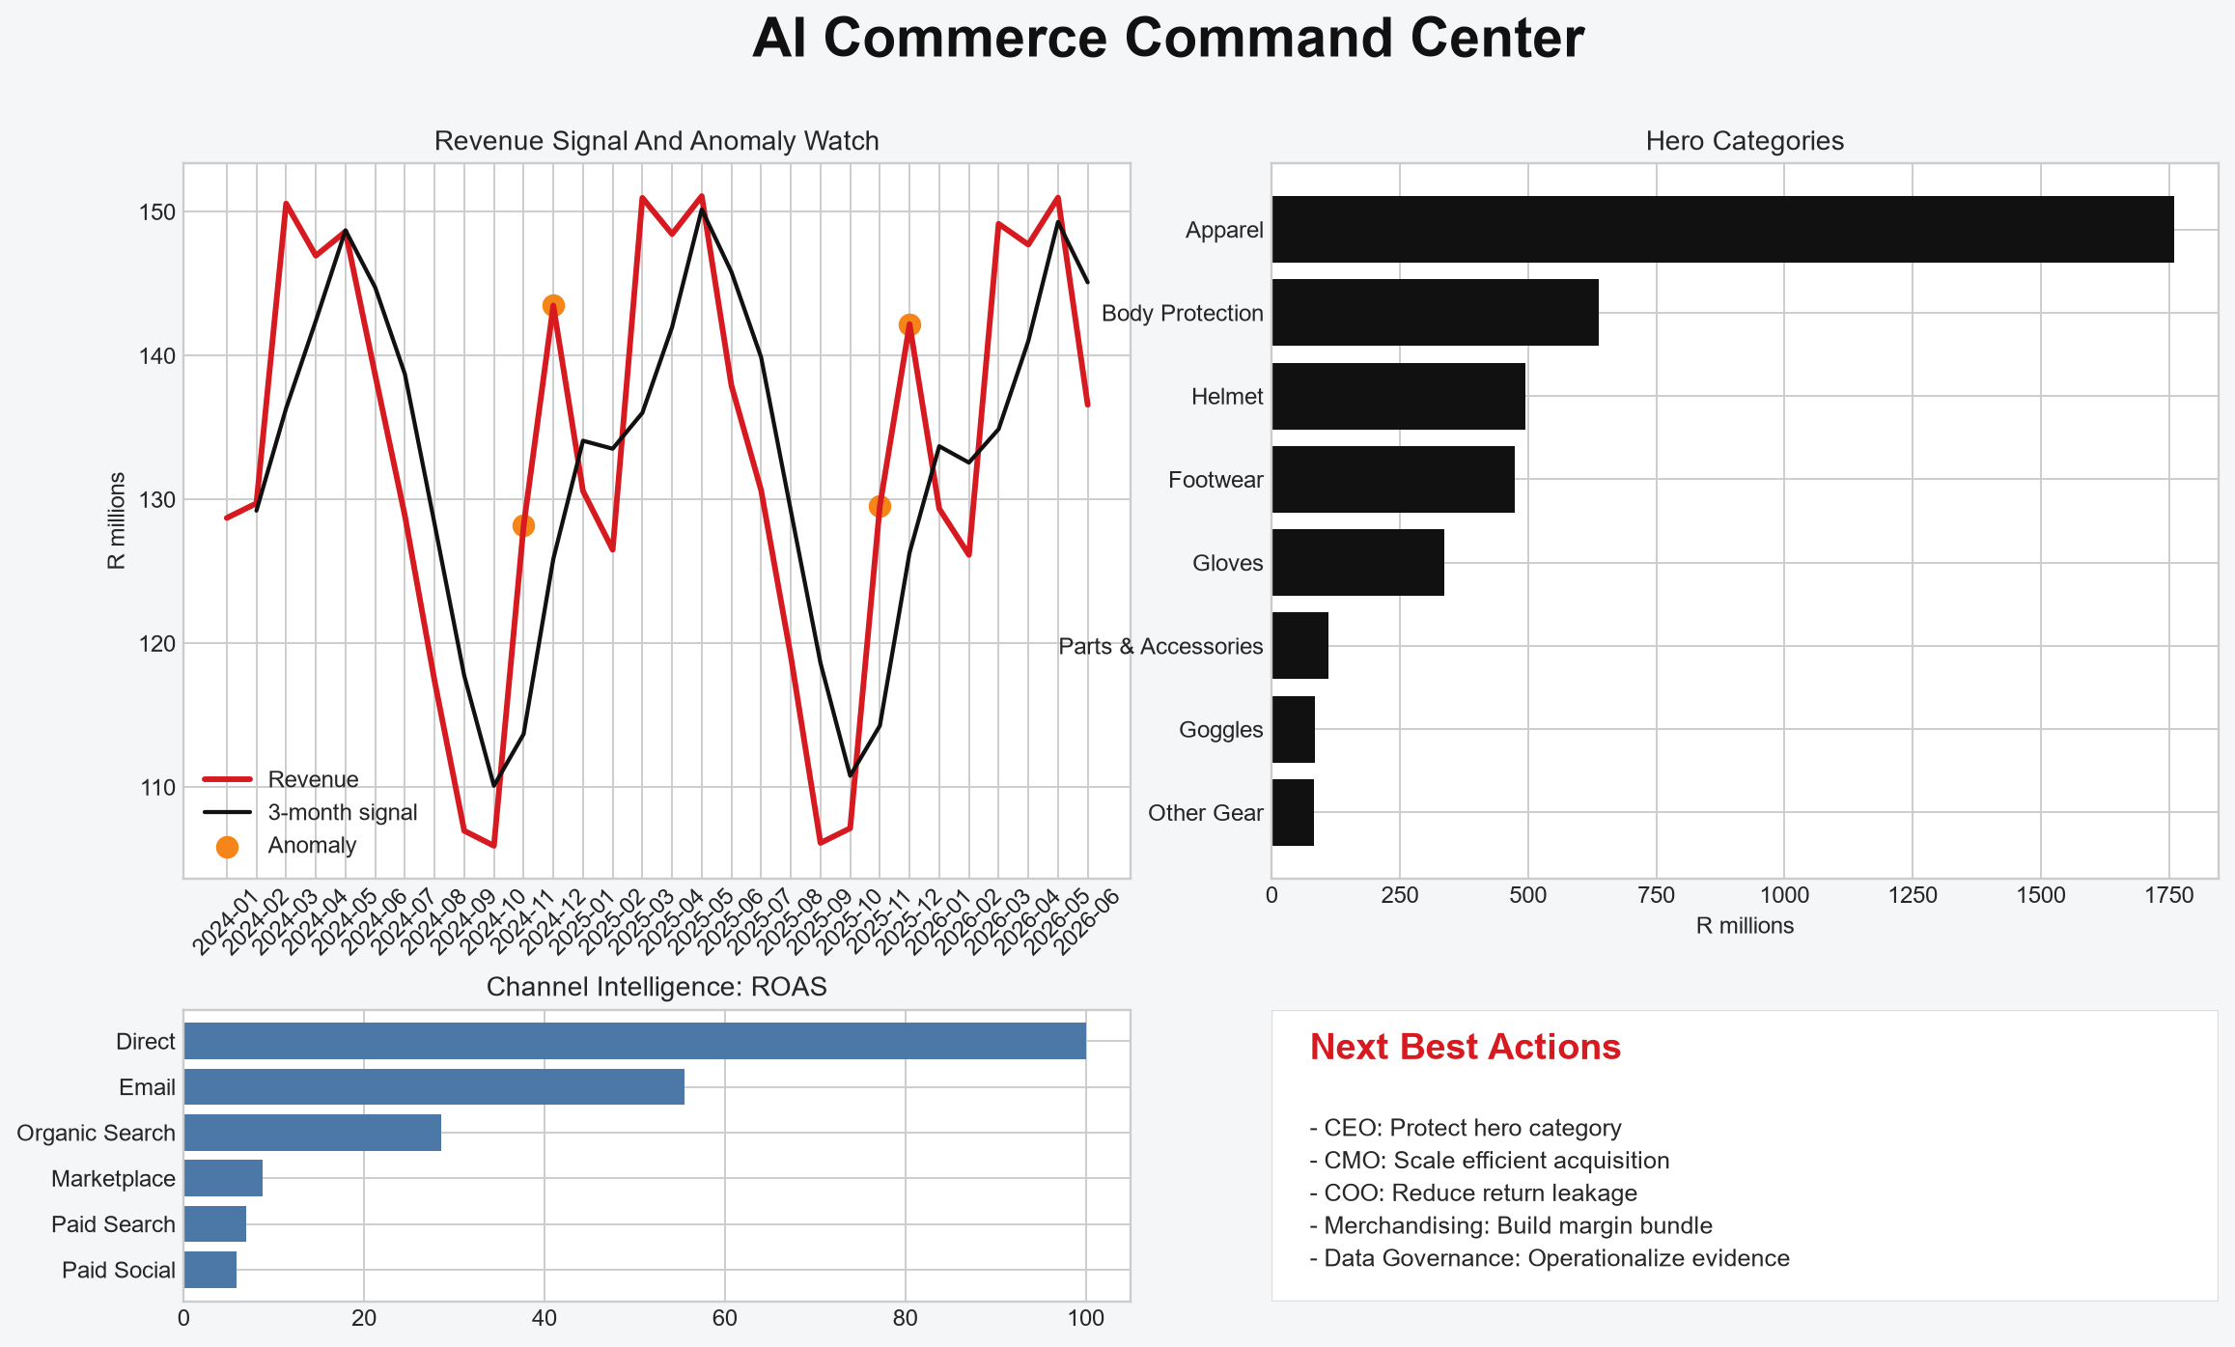
AI Commerce Command Center

Slide 6
Final Handover
GitHub: https://github.com/anthonyapollis/leatt-fabric-bi-ml-proof
Suspend Fabric F2 capacity after review.
Use the master Excel and dossier as interview leave-behinds.

