Slide 1
Merchant Sales &
Voucher Intelligence
BI Developer — Second-Round Practical Task
Microsoft Fabric · Power BI · dbt · Python ML
Anthony Apollis
1 Jan – 31 Jul 2026 · 25 merchants · 120,969 vouchers · 510,127 transactions
Notes:
[30 sec] Open here — do not read the slide.
"This is the second-round practical task. Four CSV files came in. What I will walk you through
is what I built from them, and more to the point, how I know the numbers are right."
Set the frame early: this is about trustworthy reporting, not about a dashboard. If anyone in
the room owns finance, that is the thing they care about.

Slide 2
What was built
Every figure below is reproducible: python scripts/run_all.py rebuilds it in ~2 minutes
Data pipeline
dbt project
Semantic model
Power BI
ML
Bronze → Silver → Gold medallion, 149,857 rows
18 models · 1 SCD2 snapshot 132 tests · 156 pass
14 tables · 15 enforced FKs 70 DAX measures
9 report pages + phone layout
5 models, time-split validation throughout
Quality is the deliverable, not a footnote.
14 warehouse integrity tests · 132 dbt tests · 33 idempotency assertions · 31 DAX measures each with a SQL-derived expected value.
The gold layer is built TWICE, by two independent implementations.
Once in pandas, once in dbt SQL. Every headline figure agrees to the cent — 27 of 28 checks tie exactly, and the one warning is a documented rounding convention. That is what makes "the numbers tie" verifiable instead of asserted.
It caught two real defects that no unit test would have found.
dim_date was absorbing the August redemption tail into the reporting window, inflating pro-rated targets by R984,046. And pandas rank(pct=True) is not the same statistic as SQL PERCENT_RANK() — that shifted the Health Score by up to 9.7 points.
Notes:
[90 sec] The line that matters: every figure in this deck is reproducible — one command
rebuilds the whole thing in about two minutes.
Then the point of the slide: the gold layer is built TWICE, once in Python and once in SQL,
and they must agree to the cent before anything ships. That turns "the numbers tie" from a
claim into something checkable.
Plant the two defects it caught, but do not explain them — slide 13 does that. Just establish
that the checking found real things.

Slide 3
Architecture
The journey of one row, and what each stage prevents
LANDING
BRONZE
SILVER
QUALITY GATE
GOLD
POWER BI
→
→
→
→
→
4 CSVs
raw + lineage
typed, conformed
132 dbt tests
Kimball star
Direct Lake
The quality gate sits BETWEEN silver and gold. That is the whole design.
If a test fails, the pipeline stops and gold is NOT rebuilt — the report keeps showing yesterday's correct numbers rather than today's wrong ones. Testing after loading gold means the wrong figures have already been published by the time anyone reads the alert. Stale-but-correct beats fresh-but-wrong.
Orchestration — Data Factory
Metadata-driven ingest: adding a source is a parameter change, not a pipeline edit.
Per-source row-count floors catch the failure that does not throw — a truncated file looks exactly like a quiet trading day.
Retry 3 on copy, retry 0 on the quality gate: a failing test is a defect, not a blip.
Why dbt is in this stack
Runs locally in seconds and on the Fabric Warehouse in production — the same models, only the adapter changes.
Tests, lineage and documentation are part of the build, not a separate exercise somebody does later.
Business rules live in ONE place and every consumer inherits them.
Notes:
[60 sec] Follow the row left to right. A file lands here, and by the time it reaches
Power BI it has passed a quality gate that stops the build if it fails.
The stage worth pausing on is the gate between silver and gold. If a test fails, gold is NOT
rebuilt, so the report keeps showing yesterday's correct numbers rather than today's wrong
ones. Stale and right beats fresh and wrong — that is a deliberate choice, not a limitation.

Slide 4
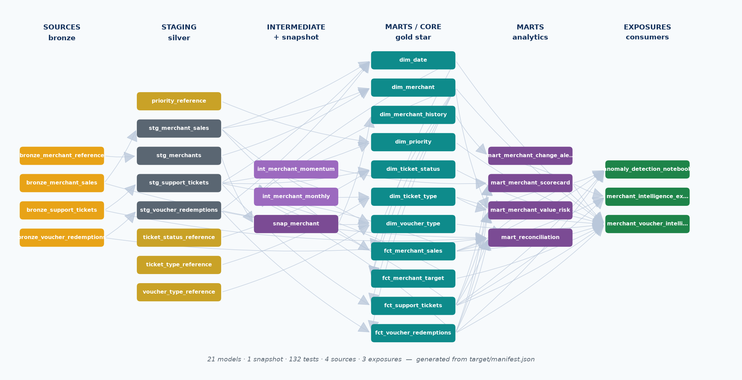
dbt lineage
Generated from target/manifest.json — 33 nodes, 70 edges, 6 layers
Notes:
[45 sec] This diagram is generated from dbt's manifest, not drawn by hand, so it cannot
drift from the code.
That is the whole point. Documentation maintained separately from code is wrong within a
month. Move on quickly unless asked — a technical audience will notice the lineage without you
labouring it.

Slide 5
What dbt earned
Stated as what would be LOST without it — a feature list invites “so what”
Contracts that stop a bad build
The snapshot — the one thing nothing else does
15 relationships tests
Without them: a broken join returns FEWER ROWS, not an error. Totals quietly shrink and nobody is told.
MerchantReference is a CURRENT-STATE extract.
Every load overwrites active status, account manager, region and target. Two merchants read “At Risk” today — and without a snapshot, “when did that change, and did sales fall before or after?” is unanswerable forever.
A Type 2 snapshot closes off the old version and opens a new one, so the history the source destroys is preserved in the warehouse.
It uses the check strategy, not timestamp: the source has no reliable last-modified column — OnboardedDate is when the merchant joined, not when the row last changed.
22 unique · 56 not_null · 2 composite
Without them: duplicate-proofing is a claim rather than a check. A fact gaining a second row per key double-counts every measure built on it.
16 accepted_values · 11 expression · 5 range
Without them: a new Priority value or a negative sales figure reaches the report looking entirely legitimate.
5 seeds
Without them: the commercial team needs a code deployment to change a margin band.
Proven, not asserted — 7/7 assertions
_test_scd2.py simulates a real change, re-runs the snapshot and checks: a new version is created, exactly one is current, the superseded row keeps the OLD value and is closed off, numbering stays contiguous, and unchanged merchants gain nothing. Then it restores state.
21 models, documented from the manifest
Without them: the ERD and lineage are drawn by hand and start drifting from the code the day they are written.
The honest limit of the argument
The transformation itself could have been written in Python — and it was. That duplication is deliberate: two implementations of the same logic must agree, and the reconciliation between them is what caught the R984,046 date-window defect that all 132 dbt tests passed straight through.
Notes:
[90 sec] This is the answer to "why not just write Python".
Left column: every one of those is a contract that stops a bad build. The line that lands is the first one — a broken join does not error, it returns fewer rows, so the totals quietly shrink and nobody is told.
Right column is the one to dwell on. MerchantReference is a current-state extract; every load overwrites status, owner and target. Two merchants read At Risk today. Without the snapshot, when that changed is gone forever — and that is the question an account manager actually asks.
Close on the amber card yourself, before they raise it: the transformation could have been Python, and it was. The duplication is the point — it is what caught the R984,046 defect that every dbt test passed straight through.

Slide 6
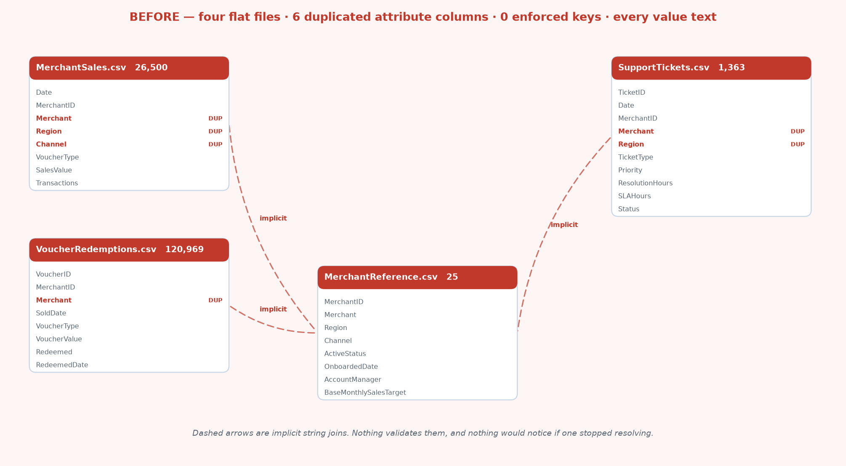
Before — what was delivered
Four flat files · 6 duplicated attribute columns · 0 enforced keys · every value text
Notes:
[60 sec] Be blunt about the starting point. Four flat files. The same merchant name in
four places, nothing enforcing they agree, every value arriving as text, and no calendar at
all.
The dashed lines are joins nobody validates — string matches that would fail silently. This
slide exists to make the next one mean something.

Slide 7
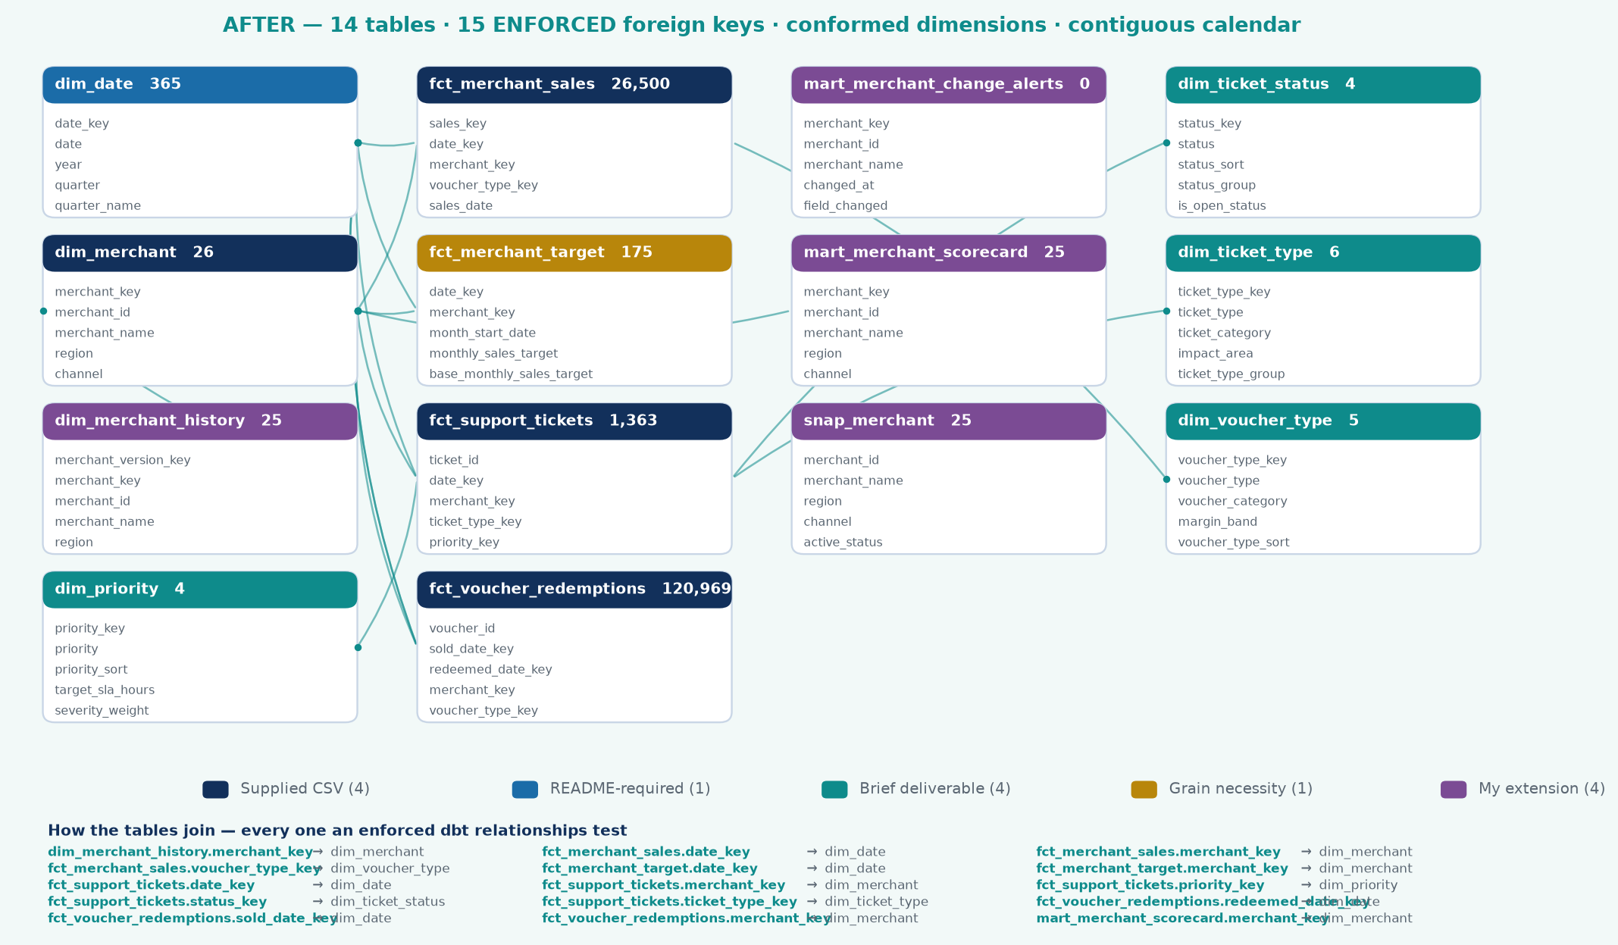
After — the gold star schema
14 tables · 15 ENFORCED foreign keys · conformed dimensions · contiguous calendar
Notes:
[75 sec] Same data, after modelling. Fifteen foreign keys, and each one is a test that
runs on every build.
The line for a technical room: a broken join does not throw an error, it returns FEWER ROWS.
The totals quietly get smaller and nobody is told. That is why they are tested rather than
trusted.
If asked why dimensions are flat rather than fully normalised: at this size normalising saves
no meaningful storage and costs an extra join on every query. That is Kimball's own guidance,
not a shortcut.

Slide 8
Why 14 tables when the README suggests 5
Justified individually — the honest split is a 10-table core plus 4 extensions
Supplied CSV
README-required
Brief deliverable
Grain necessity
My extension
4 tables
1 tables
4 tables
1 tables
4 tables
Named in the README and supplied as a file
Named in the README, no file — built here
Required by a stated deliverable
Separate grain — additivity
Beyond the brief, added on judgement
dim_merchant
fct_merchant_sales
fct_support_tickets
fct_voucher_redemptions
dim_date
dim_priority
dim_ticket_status
dim_ticket_type
dim_voucher_type
fct_merchant_target
dim_merchant_history
mart_merchant_change_alerts
mart_merchant_scorecard
snap_merchant
The fair criticism: four dimensions of 4–6 rows is over-normalisation.
That was the first design here — all three ticket dimensions in one table behind a discriminator — and it was worse: the FKs on fct_support_tickets could not be tested, and Power BI cannot build three independent filter paths off one physical table. Splitting them added 9 enforced foreign keys that previously could not exist.
Notes:
[75 sec] Expect a challenge, so raise it yourself. The README suggests five tables and I
built fourteen — that needs justifying table by table, not waving through.
Four come from supplied CSVs. One is DimDate, which the README asks for but does not supply.
Four exist because the brief requires them. One is a grain necessity. Four are mine, and they
are labelled as mine in the model itself.
The concession if pushed: those last four are the exposed surface. Say so before they do.

Slide 9
The numbers
1 January – 31 July 2026
TOTAL SALES
REDEMPTION
AVG BASKET
SLA BREACH
LIABILITY
R65.5m
84.2%
R128
26.3%
R3.5m
510,127 transactions
101,843 of 120,969
all voucher types
94.7% on High/Critical
unredeemed value
Umhlanga Value Mart is failing — and it is operational, not demand.
July sales −42.5% against its own prior three-month average, while support tickets rose +693% in the same month. R571,518 annualised at risk, and plausibly recoverable because the two moving together points to a service breakdown rather than lost customers.
The SLA policy is configured backwards.
Critical gets a 12-hour target and takes 52.7 hours (98.3% breach). Low gets 48 hours and takes 11.3 (0.2%). The ladder runs opposite to the actual workload, so 94.7% of all 358 breaches land on High and Critical. The metric is measuring a policy error, not the team.
Eastern Cape is the one declining region — on four independent signals.
Only region that peaked before July; 9.8% below its own peak while every other region is AT its peak; flattest trend slope; and a 12.2% June fall against +1.4% to +3.8% elsewhere. One signal would be noise. Four is a finding.
Notes:
[45 sec] Slow down and let the numbers sit. R65.5 million, 510,127 transactions, 84.2
percent redemption.
These are the same figures in the Power BI report, the Excel pack and the SQL — because they
come from one model, not three spreadsheets.
For a CFO, that sentence is the entire slide.

Slide 10
The five business questions
Section 6 of the brief — every answer computed, with the SQL in sql/02_business_questions.sql
Q1
Which merchants generate the highest sales value and transaction volume?
Durban Cash Hub leads on BOTH — R5,776,119 (8.8%) and 45,371 transactions. Both rankings are reported because they need not agree: a larger basket can put a merchant top on value and not on volume. Concentration matters more than the leader — the top 5 hold 35.4% of revenue, and 15 of 25 merchants make up 80%.
Power BI: Merchant Analysis · league table + Executive Overview KPIs
Q2
Which voucher type has the highest redemption rate?
Airtime at 92.8%; Gaming lowest at 76.0% — a 16.9pp spread. Value-based and volume-based rates are near identical within each type, and time-to-redeem is flat (3.5–3.7 days), so the difference is WHETHER customers redeem, not how quickly. Gaming's 24% non-redemption is the largest block of the R3.5m liability.
Power BI: Voucher & Redemption · redemption rate and liability by type
Q3
Which region shows declining sales or transaction behaviour?
Eastern Cape, on four independent signals: the only region to peak before July; 9.8% below its own peak while all others are AT peak; the flattest trend slope (+2.0% vs +4.4%–8.5%); and a 12.2% June fall against +1.4%–3.8% elsewhere. Three of the five Critical/Watch merchants sit there.
Power BI: Geographic Intelligence · province map and trend
Q4
Are ticket volumes, priority or resolution times associated with weaker performance?
Not at portfolio level — the apparent r = −0.56 is confounded by merchant size and collapses to −0.20 once controlled. The real signal is event-level, and is covered on the following slide.
Power BI: Operational View · and Business Answers for the confounding
Q5
Which merchants should management focus on first, and why?
Ranked by revenue at risk, not severity: 1. Umhlanga Value Mart (R571,518), 2. Table Bay Express (R354,163), 3. Pretoria PayPoint (R154,045). A 42.5% collapse at a small merchant costs less than a 6% slide at a large one — ranking on percentage change alone directs the account team to the wrong merchant.
Power BI: Merchant Value & Risk · ranked by revenue at risk
Notes:
[2 min] The brief's actual question set. The panel will care most about this slide. One
sentence each, then stop.
Two worth dwelling on. Voucher type: Airtime 92.8 percent against Gaming 76.0 — a 16.9 point
spread, and time-to-redeem is flat across types, so the difference is WHETHER customers
redeem, not how quickly.
And where management should focus: ranking by percentage decline sends you to the smallest
merchants. Ranking by RAND at risk sends you to the ones that matter.

Slide 11
Analytical rigour — a confounded correlation
Q4 — are ticket volumes associated with weaker merchant performance?
The surface reading
Tickets per 1,000 transactions correlates with target attainment at
r = −0.56
r = Pearson correlation coefficient. Runs −1 to +1. 0 means no linear relationship; the SIGN is the direction, the SIZE is the strength. −0.56 is a moderate inverse relationship: as one goes up, the other tends to go down.
"Operational friction hurts merchant performance." Clean, quotable — and not supported once tested.
Why it is confounded
That ratio is a size measure in disguise — it correlates with log(total sales) at r = −0.83. Small merchants score badly because the denominator is small.
Partial correlation, controlling for size: r = −0.20
SLA breach rate and resolution time show no association at all.
Where the real signal is: event-level, not portfolio-level
Durban Cash Hub — tickets +780% in June, and sales GREW 8.2%. A service problem at a healthy account.
Umhlanga Value Mart — tickets +693% in July, and sales FELL 42.5%. A failing account.
Identical operational signal, opposite commercial diagnosis. Ticket spikes are worth investigating immediately, but they do not predict revenue on their own — which is why the alerting logic pairs ticket movement with sales movement rather than firing on either alone.
Notes:
[2 min] The intellectual honesty slide. Take your time here.
The obvious analysis says tickets are associated with weaker performance — correlation minus
0.56. But it is confounded by size: bigger merchants have more of everything.
Control for size and it collapses to minus 0.20. So the portfolio-level rule is not supported.
The real signal is event-level — Umhlanga, tickets up 693 percent while sales fell 42.5
percent in the same month.
If they remember one slide about how you think, make it this one.

Slide 12
Machine learning
Time-based validation throughout — never a random split
Anomaly detection
8 flagged from 150
All 4 documented embedded patterns recovered unprompted
Isolation Forest
Redemption propensity
AUC 0.620
vs a theoretical ceiling of 0.621
HistGradientBoosting
Resolution time
MAE 9.8h
23.4% better than naive
HistGradientBoosting
Sales forecast
MAPE 4.69%
49.7% better than naive
Holt-Winters
Segmentation
silhouette 0.185
k chosen on business grounds; the cost is stated
K-Means (k=4)
How the models were validated
Time-based splits only — train Jan–May, test Jun–Jul. A random split leaks future information and produces a metric that will not hold in production. · Every supervised model is compared against a NAIVE baseline, not just reported in isolation. · The anomaly model was checked against four patterns documented in the dataset README and recovered all four without being told what they were. · The 0.620 AUC was tested against a theoretical ceiling: a voucher-type base-rate oracle scores 0.621, so the model captures 99.8% of achievable signal and the limit is the data, not the model.
Notes:
[90 sec] Keep it short and resist the jargon.
Five models, all validated on time-based splits — never a random split, because a random split
on time-series data lets the model see the future and reports a score you cannot reproduce in
production.
The honest line: the redemption model reaches AUC 0.620 against a theoretical ceiling of 0.621
for this dataset. That is 99.8 percent of the available signal. It is low because the data has
no customer-level features, not because the model is weak.

Slide 13
What the numbers mean
A legend for the previous slide — every metric and method in plain English
Metrics — how good is good
Methods — what each model does
Area under the ROC curve (AUC) · 0.620
HIGHER is better (0.5 = useless, 1.0 = perfect)
Ranking quality. ROC = receiver operating characteristic. Read it as: the chance the model scores a real redeemer above a non-redeemer.
0.620 against a measured ceiling of 0.621 for this data — 99.8% of the signal that exists here. Low because the data has no customer features, not because the model is weak.
Isolation Forest
Unsupervised — finds rows unlike the rest without being told what to look for.
Given no hints, it recovered all four documented patterns in the data.
Mean absolute percentage error (MAPE) · 4.69%
LOWER is better (0% = perfect, no upper limit)
Average forecast error as a percentage of the actual value.
A 30-day sales forecast wrong by about 4.7% on average. 49.7% better than assuming tomorrow equals today.
Histogram-based gradient boosting
Supervised — many small decision trees, each correcting the last.
Used for redemption propensity and resolution time. Handles missing values and mixed column types without manual preparation.
Mean absolute error (MAE) · 9.8 hours
LOWER is better (0 = perfect, measured in hours)
Average error in the units being predicted — here, hours.
Predicted ticket resolution time is out by about 10 hours on average, against a spread running to 74 hours at the 90th percentile.
Holt-Winters exponential smoothing
Classical time series — level, trend and repeating seasonality.
Chosen over a heavier model because seven months of daily data supports weekly seasonality and nothing more.
Silhouette score · 0.185
HIGHER is better (-1 to 1; above 0.5 = well separated)
How cleanly separated the clusters are.
Low, and stated rather than hidden. The merchants form a continuum, not four distinct types — so k was chosen on business grounds and the statistical cost is declared.
K-means clustering, k = 4
Groups merchants by similarity into a chosen number of clusters.
k=4 matches how the business already talks about accounts, which matters more than a marginally better statistical score nobody can action.
Naive baseline
BEAT IT or the model is not worth deploying
The simplest possible prediction: tomorrow equals today.
Every model is reported against it. A model that cannot beat the naive baseline is not worth deploying, whatever its headline score.
Time-based split
Train on earlier data, test on later data. Never random.
Train Jan-May, test Jun-Jul. A random split lets the model see the future and reports a score that will not survive production.
The four numbers that decide whether a model is any good — in this order
1. Does it beat the naive baseline? If not, stop — nothing else matters. 2. Train score vs test score. A wide gap means it memorised rather than learned. 3. The headline metric against its CEILING, not against 1.0. 4. How was it validated? A great score from a random split on time-series data is worthless.
Notes:
[45 sec] Only use this slide if the room needs it — if they are technical, skip straight past.
The line that does the work: "0.620 against a ceiling of 0.621 — so the model is capturing 99.8 percent of the signal that exists in this data. It looks low because there is no customer-level information in these files, not because the model is poor."
The silhouette score is the honest one. 0.185 is low, and it is on the slide rather than hidden: the merchants form a continuum rather than four clean types, so k was chosen on business grounds and the statistical cost is declared.
If asked why no deep learning: seven months of daily data on 25 merchants. The constraint is the data, not the algorithm.

Slide 14
Geographic intelligence
Where the business is — and, more usefully, where it is not
Free State
Gauteng
Western Cape
KwaZulu-Natal
Eastern Cape
R18.0m
R16.1m
R13.1m
R9.5m
R8.8m
27.5% · 10 merchants
24.6% · 4 merchants
19.9% · 4 merchants
14.5% · 3 merchants
13.4% · 4 merchants
5 of 9 provinces · 56% of the country uncovered
Limpopo, Mpumalanga, North West and Northern Cape carry no merchants at all. The choropleth draws them as hatched "no cover" rather than omitting them — an absent province otherwise reads as zero sales when it actually means no footprint.
Eastern Cape is the only province in decline
The only region below its own peak (−9.8%) while every other is AT peak, and the only one with negative recent momentum. Three of the five Critical/Watch merchants sit there — a regional pattern, not one bad account.
What the geography does NOT tell us — and why that matters
It is tempting to read 56% uncovered land as 56% untapped market. It is not. No population, GDP or competitor feed was supplied, and land area is a poor proxy for demand — Northern Cape is the largest province and the most sparsely populated in the country. The honest statement is a FOOTPRINT observation: four provinces have no merchant presence. Sizing that as opportunity requires population and income data the business already holds and this dataset does not.
Notes:
[45 sec] Five provinces, and the useful finding is where the business is NOT.
Eastern Cape is the only region below its own peak. Keep it brief — the map is doing the work,
and the detail sits on the Business Answers page if anyone wants it.

Slide 15
Reconciliation and controls
Controls that pass matter as much as controls that fail
5 of 6 controls PASS at zero variance
Sales value survives bronze → gold · voucher and ticket row counts survive · redeemed + outstanding = issued · the scorecard ties to the sales fact.
The 6th is a R43,501,446 variance — and it is EXPECTED
Sales fact: R65.5m across 510,127 transactions. Voucher fact: R22.0m across 120,969 vouchers. Different populations, ratio 4.2 : 1. They must never be forced to tie.
Why recording an expected variance is the point
Without it, someone compares R65.5m to R22.0m, calls it a reconciliation break and escalates — or divides one by the other and reports a value-based redemption rate against the wrong denominator. The control does not just check a number; it records which comparisons are legitimate.
Fraud controls follow the same discipline.
Supported and built: reversal rate, redemption velocity, liability concentration, behavioural anomaly. Tested and NIL: voucher value outliers — zero beyond 3 SD, because the generator used a bounded distribution; the control runs and correctly returns zero rather than being quietly dropped. Not supported: duplicate redemption, geographic anomaly, PIN misuse, customer CLV and churn — there is no customer identifier anywhere in the four files, so each one names the telemetry it would need instead.
Notes:
[2 min] Your strongest slide with a finance audience.
Twenty-eight controls. Twenty-seven tie exactly. One is a documented rounding convention. And
one variance of R43.5 million is recorded as EXPECTED, with its reason attached.
Explain that last part: the sales fact and the voucher fact count different populations —
510,127 transactions against 120,969 vouchers. They must NOT agree. Recording it as expected
is what stops someone escalating it as a break every quarter.
Then the R984,046 story, about forty-five seconds. Lead with the mechanism, not the mistake:
two implementations disagreed, and the gap pointed at a date window no schema test could see.

Slide 16
Fraud detection and prevention
Detection is one third of a control framework — prevention and correction are the other two
PREVENT
DETECT
CORRECT
Stops the loss occurring
Finds it after the fact — what is built
Limits the damage once found
Voucher expiry enforcement
90-day rule is modelled; enforce at redemption
Reversal rate per 1k txn
215 reversal tickets; range 0.00–1.99 per 1k
Quarantine on DQ failure
Bad loads never reach gold — the pipeline gate
Value ceilings per type
Gaming carries the highest non-redemption at 24%
Redemption velocity
Same-day share, ~23% and uniform across merchants
Change alerting
SCD2 diff raises status/target changes as Critical
Velocity limits per merchant
Cap redemptions per merchant per hour
Behavioural anomaly
Isolation Forest on merchant-month deviation
Reversal workflow
Financial tickets are 25% of volume; route separately
Onboarding due diligence
2 merchants are CRM 'At Risk' with no linked control
Liability concentration
R3.5m outstanding, tracked per merchant
Merchant suspension path
Risk band 'Review' should trigger a hold, not an email
Segregation of duties
Issuance and redemption approval must not share an owner
Value outliers
Implemented; correctly returns ZERO on this data
Audit trail
batch_id on every row answers 'which load produced this?'
Four controls cannot be built on this dataset, and each names what it needs.
Duplicate redemption — voucher_id is unique by construction, so a duplicate cannot appear; needs the raw redemption event log with failed attempts. Geographic anomaly — needs transaction location and timestamp, not static merchant province. PIN misuse — needs PIN, attempt outcome and failure reason. Customer velocity — needs a customer or session identifier, which does not exist in any of the four files.
Notes:
[90 sec] Frame it as prevent, detect, correct — detection alone is not a control
framework.
The part that lands: four controls CANNOT be built on this data, and each one names what it
would need. Duplicate redemption needs the raw event log including failed attempts. Customer
velocity needs a customer identifier, which does not exist in any of the four files.
Saying what you cannot do is more useful than a dashboard implying you can.

Slide 17
Deployed to Microsoft Fabric
Provisioned by API, authenticated without stored secrets
Provisioned and verified
Built to run on either engine
Workspace and Lakehouse WS_MerchantVoucher with LH_MerchantVoucher holding the medallion layers in OneLake
Warehouse WH_MerchantVoucher, provisioned through the Fabric REST API
Medallion pipeline ZIP to bronze to silver to gold, four notebooks, completed in 5m 54s
Gold in the Warehouse 26,500 sales rows, 120,969 vouchers, R65,521,298.75 — ties to the cent
Authentication az login CLI token — no service principal, no stored secret
One codebase, two targets.
Development runs against a local analytical engine — seconds per build, no cloud cost — and production targets the Fabric Warehouse through dbt-fabric. The project and the models are the same; only the adapter changes.
Dialect differences are handled in a portability macro layer rather than by maintaining two copies of the SQL: mvi_datediff, mvi_bool, mvi_median, mvi_percentile and mvi_arg_max dispatch per adapter.
Verified by connecting and running against the warehouse, not assumed.
Cost control, because unattended compute does not stop on its own
The daily trigger ships DISABLED with a hard end date of 2026-10-03 — one week before the capacity is due to be released. fabric_cost_guard.py --check / --stop / --nuke is the kill switch: it inventories every item, flags always-on item types that bill continuously rather than per run, and two scheduled tasks watch the clock. Deleting the workspace costs nothing irreplaceable — run_all.py rebuilds the entire warehouse locally in about two minutes.
Notes:
[90 sec] Provisioned by REST API, authenticated with a CLI token — no service principal
secret stored anywhere in the repository.
The number to land: the medallion pipeline completed in five minutes fifty-four seconds, and
the gold tables in the Warehouse tie to R65,521,298.75 — the same figure as the local build,
to the cent.
The cost-control card is deliberate. Unattended compute does not stop on its own, so there is
a kill switch and a hard end date. In a room with a CIO that is worth ten seconds.

Slide 18
Recommendations
Ranked by revenue at risk, not by severity of decline
Site visit to Umhlanga Value Mart this week
1
R571,518
Sales −42.5% and tickets +693% in the same month — operational failure causing commercial damage, which means it is plausibly recoverable
Re-base the SLA policy
2
Restores the metric
94.7% of breaches come from Critical/High because targets run inverse to workload. A 90th-percentile-compliant Critical SLA would be ~120h
Root-cause Durban Cash Hub's ticket volume
3
R5.8m
+780% tickets on the largest merchant in the book while sales still grow — a service problem that has not yet become a commercial one
Eastern Cape regional review
4
R8.8m
The only region below its own peak; 3 of the 5 Critical/Watch merchants sit there
Confirm the sales target basis with Finance
5
Makes attainment reportable
Targets sit ~6.1× below realised sales for ALL 25 merchants — a basis error, not outperformance
Notes:
[2 min] Ranked by revenue at risk, not severity of decline. Say that first.
Umhlanga: R571,518 at risk, sales down 42.5 percent and tickets up 693 percent in the same
month. Operational failure causing commercial damage — which means it is plausibly
recoverable, and that is why it is first.
Each recommendation names a merchant, a number and an owner. Account manager is carried onto
the risk register precisely so this resolves to a person rather than to a queue.

Slide 19
Further questions and answers
Questions this solution raises beyond the brief, with the evidence behind each answer
Why not simply average the per-merchant redemption rates?
It would weight a 3,500-voucher merchant the same as a 5,400-voucher one. Every ratio in the model is SUM/SUM, never an average of ratios — including in the filtered views of the report.
The two value facts differ by R43.5m. Is that a reconciliation break?
No, and the control records it as EXPECTED. MerchantSales aggregates all 510,127 transactions; VoucherRedemptions covers 120,969 individual vouchers — a 4.2 : 1 ratio, two different populations. Forcing them to tie would be the error.
Why is target attainment shown as an index rather than a percentage?
The supplied BaseMonthlySalesTarget sits ~6.1x below realised sales for ALL 25 merchants, so raw attainment reads 614%. The value is retained unchanged and flagged; a relative index is reported alongside it, which is comparable across merchants and immune to the calibration error.
Can this detect fraud?
Partly, and the boundary is documented. Reversal rate, redemption velocity, liability concentration and behavioural anomaly are built. Voucher-value outliers were implemented and correctly return zero. Duplicate redemption, geographic anomaly and PIN misuse cannot be built — each names the telemetry required.
What happens if the source file arrives truncated?
The pipeline fails loudly. Per-source minimum row counts turn a silent partial load into an error, because a truncated file otherwise looks identical to a quiet trading day on the dashboard.
How is the report protected from a bad data load?
The dbt test suite runs BETWEEN silver and gold. If it fails, gold is not rebuilt and the report continues to serve the last good load rather than publishing wrong figures.
Notes:
[90 sec] Questions the solution raises beyond the brief. Use this to show you thought
past the task.
If time is short this is the slide to drop. It is fine to say there is more detail here if
useful, and move on.

Slide 20
Principles applied throughout
Figures are verifiable, not asserted.
The gold layer is built twice by independent implementations and reconciled to the cent. 33 idempotency assertions prove a re-run cannot duplicate data.
Findings are tested before they are reported.
The friction/performance correlation proved confounded by merchant size. The redemption AUC sits at the data's ceiling. The two value facts do not tie — and correctly should not.
Known gaps are documented, not omitted.
dbt connects to Fabric and writes; the transformation models required a T-SQL port, which is recorded with its scope and current status.
Unbuildable requirements are named with the telemetry they need.
Customer lifetime value, churn, duplicate-redemption and geographic anomaly controls cannot be built from this dataset. Documenting that is more useful than metrics derived from fields that do not carry the signal.
Anthony Apollis · August 2026 · python scripts/run_all.py rebuilds everything
Notes:
[60 sec] Close on principles, not features.
Figures are verifiable rather than asserted. The gold layer is built twice by independent
implementations. Assumptions are labelled as assumptions — of the 34 source columns, 12 are
documented by the supplier and 22 are inferred, and the documentation says which is which.
Then stop talking. Do not summarise the deck. Invite questions.

