Slide 1

Project Release Plan
October 15, 2014
Team tRiLLbEaTs
Alfred Young (Product Owner)
Anthony Assi
Chris Egan
Giselle Gutierrez
Gabe de la Mora

Slide 2
Project Release Plan
Drum Synthesizer
The goal of this project is to produce a drum synthesizer/sequencer that emulates the workflow of devices such as the Roland TR808.
Up to eight channels can be added to a session, each containing a synth module or sample module.
Furthermore, the sounds produced by each channel can be step sequenced.

Slide 3
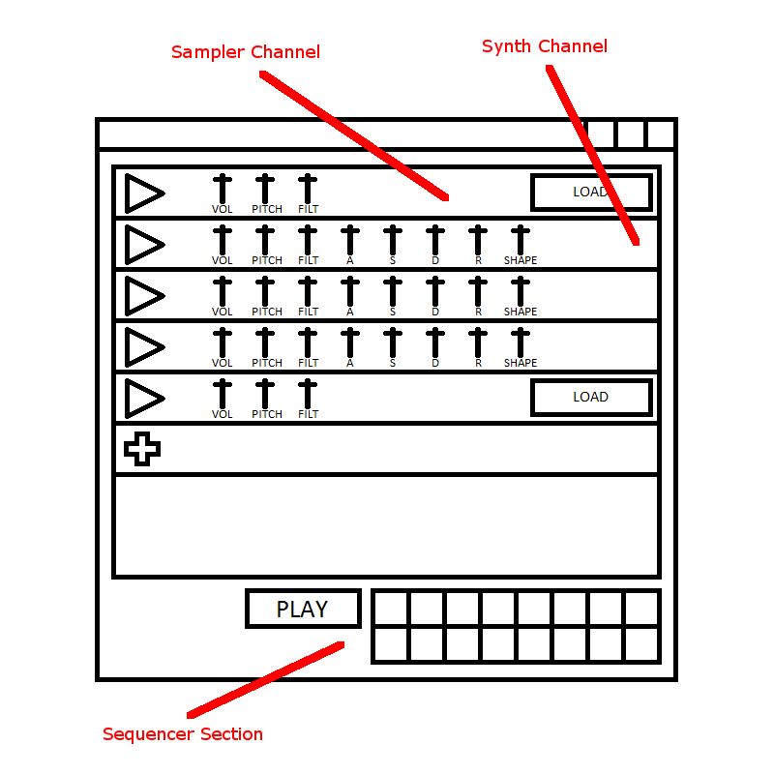
Project Release Plan – User Stories
m Synthesizer

Slide 4
Project Release Plan – User Stories
Drum Synthesizer
Sprint 1:
Simple interface for sampler channel
As a percussive musician, I want to be able to modularly add sampled elements to my composition so that I can use them to create full drum loops and breaks. 5 story points
As a digital artist, I want an intuitive interface that allows me to quickly add and subtract percussive elements to/from my session so that I can quickly sketch out musical ideas. 5 story points
As a sound designer, I want percussive modules who's volume can be changed so that I can balance the volume of samples that may be too low or high. 2 story points

Slide 5
Project Release Plan – User Stories
Drum Synthesizer
Sprint 1:
Task Breakdown
Sampler channels
1) Sample playback
2) File loading
3) Filter, volume, pitch parameters
Panels representing sampler channels
1) Discrete panels with ability to add more panels
2) Play/Parameter controls

Slide 6
Project Release Plan – User Stories
Drum Synthesizer
Sprint 2:
Extended interface with synthesis channel and sequencer
As a percussive musician, I want to be able to modularly add synthesized percussion to my composition so that I can use them to create full drum loops and breaks. 8 story points
As a sound designer, I want to be able to control the synthesis parameters of each synth module so that I can create interesting percussive elements. 3 story points
As a digital artist, I want an intuitive sequencer interface that allows me to quickly compose loops and drum breaks from the sounds I have sampled and synthesized. 5 story points

Slide 7
Project Release Plan – User Stories
Drum Synthesizer
Sprint 3:
Final features, polishes and portability
As a sound designer, I want to access to simple effects such as filters and reverb so that I can apply them to percussive modules and create more interesting percussive elements. 3 story points
As a percussive musician, I want to be able to alter the tempo of the sequencers playback as well as add swing so that I can create a variety of styles of drum loops. 5 story points
As a digital artist, I want to be able to export my compositions to audio files that I can use in a digital audio workstation. ? story points
As a digital artist and computer application user, I want a polished user interface so that I can use it without impediments to my creativity such as having to work around bugs and learn idiosyncrasies of the application. 8 story points

