Slide 1
ITP 475 Advanced Digital Forensics
Amcache

Slide 2
Overview
Understanding the Amcache.hve
What is it?
How is data stored?
Forensic significance?
Brief overview of RecentFileCache.bcf
Amcache Structure
Version differences?
Parsing Amcache files
Notes:
Not the Anthony Martinez Cache ;)

Slide 3
Background
Amcache.hve stores information related to the Windows Application Experience and Compatibility feature inside a registry hive file
As a result, it contains data about applications that have been run
Official use is to track application compatibility issues
First appeared in Windows 8 to replace the “RecentFileCache.bcf”, which was a similar structure in Windows 7
Notes:
Simply put, AppCompat allows an application to run even if it is no longer fully compatible with the system it is running on, or if the version of a dependency has changed

Slide 4
What is it?
It is a Registry hive containing critical information related to executed applications

Slide 5
Forensic Significance
Another indicator of program execution!
Unlike other artifacts such as UserAssist or RecentApps, it is not specifically user tied
Traces of anti-forensic programs
Traces of portable programs
Traces of external storage devices
Traces of malware executions

Slide 6
Structure and Stored Information
It’s just a Registry hive, we know the structure
Stored information includes
Execution path
First executed time
Deleted time (if deleted)
First installation time
SHA1 Hashes!!!

Slide 7
What does it track?
Application name and file path
Creation timestamp
Does NOT record the run count of applications
Corroborate with other artifacts for constructing a comprehensive timeline

Slide 8
Location
<SystemRoot>\Windows\AppCompat\Programs\Amcache.hve

Slide 9
Amcache Across Windows Versions
Available on Windows 10, 8.1, and 8 by default
Available on Windows 7 systems running the optional KB2952664 Windows Update or newer
Otherwise the RecentFileCache.bcf is in its place
NOT available on Vista or XP
Available on Windows Server 2019, 2016, 2012 R2, and 2012
Notes:
Whether the Amcache is “Amcache.hve” or “RecentFileCache.bcf” depends on the version of the libraries in charge of filling the cache, not the OS version. To update those libraries, a user should apply the Windows Update KB2952664 on a Windows 7 and KB2976978 on a Windows 8 and 8.1.
This implies the artifact has the same format on Windows 10 as on Windows 7
Fresh install of Windows 7 SP 1 has the old BCF file

Slide 10
More Caveats…
Different installed updates may result in a different Amcache structure
Microsoft has consistently changed the structure and behavior of the Amache between versions
The majority of the data remains the same between versions, the structure of the hive does not

Slide 11
Windows 7 SP0 and SP1 “fresh” RecentFileCache.bcf
<SystemRoot>\Windows\AppCompat\Programs\RecentFileCache.bcf
Application Experience service records the file names of executables
Temporary, the file is cleared when Application Experience ProgramDataUpdater task is run
The ProgramDataUpdater task runs at least once a day and knowing it clears the cache means the programs listed in the RecentFileCache.bcf file executed fairly recently

Slide 12
Windows 7 SP0 and SP1 “fresh” RecentFileCache.bcf
<SystemRoot>\Windows\AppCompat\Programs\AEINV_PREVIOUS.xml
<SystemRoot>\Windows\AppCompat\Programs\AEINV_WER

Slide 13
Forensic significance of the RecentFileCache.bcf
Programs listed in the RecentFileCache.bcf indicate that
The program is fairly new to the system
Recall the cache is cleared daily
The program executed on the system
Recall the cache tracks applications to determine if they need shimming
The program executed on the system after the ProgramDataUpdater task was last run
Recall the ProgramDataUpdater task flushes the RecentFileCache.bcf daily

Slide 14
Windows 10 1607 Updates to Amcache
Major changes beginning with version 10.0.14913.1002 of the libraries
What’s new?
Application shortcuts
Device containers
Device interfaces
Device PnP information
Device driver binary informatin
Device driver package information

Slide 15
New Amcache.hve Keys
InventoryDriverBinary
InventoryDriverPackage
DeviceCensus
InventoryDeviceMediaClass
InventoryDeviceContainer
InventoryDevicePnp
InventoryApplication
InventoryApplicationFile
Notes:
Taken on Windows 10 10.0.17763 N/A Build 17763

Slide 16
Root\InventoryApplicationShortcut Key
Contains information about the target of the LNK file (often truncated)
Each subkey contains a single value to a shortcut

Slide 17
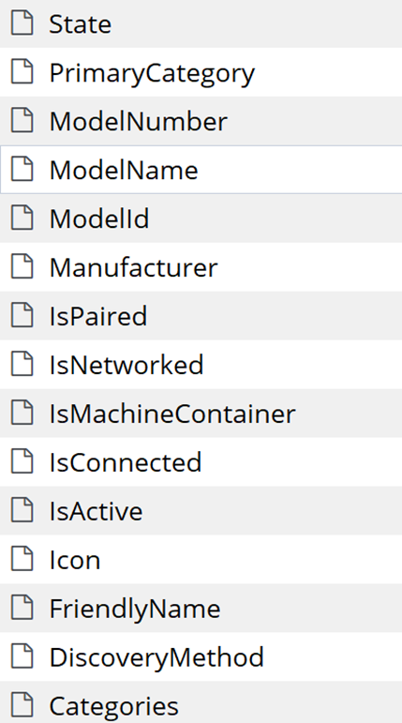
Root\InventoryDeviceContainer Key
Tracks devices such as Bluetooth, printers, audio, storage, etc.
Each key has 15 values
Notes:
Category such as “network.Bluetooth”

Slide 18
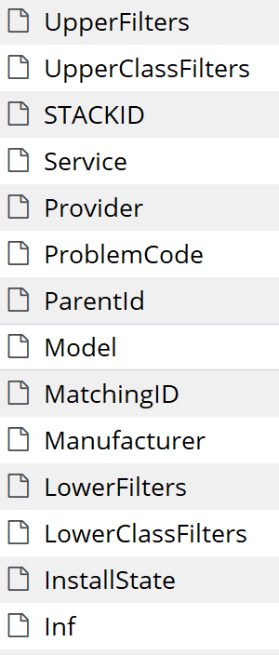
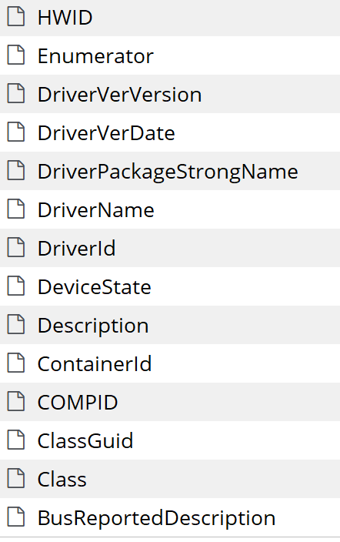
Root\InventoryDevicePnp Key
Plug and play devices
Each key has 28 values

Slide 19
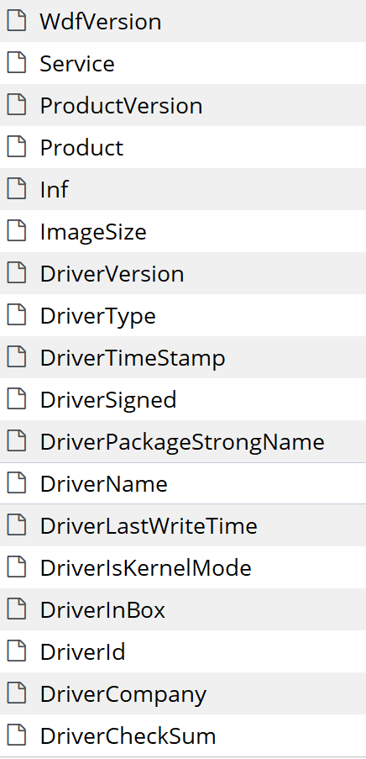
Root\InventoryDriverBinary Key
Subkeys refer to the full path of a driver
Each key has 18 values
Notable keys include:
DriverSigned
DriverIsKernelMode
DriverTimeStamp
DriverLastWriteTime

Slide 20
Parsing the Amcache
It is a registry structured file, EnCase can “parse” out the structure (ie. View the file structure)
Plugin for Harlan Carvey’s RegRipper
https://github.com/keydet89/RegRipper2.8
Eric Zimmerman’s Parser
https://ericzimmerman.github.io/#!index.md
Usage here https://binaryforay.blogspot.com/2015/07/amcacheparser-reducing-noise-finding.html
Works on the new format of the Amcache
Will Ballethin’s Parser
https://github.com/williballenthin/python-registry/blob/master/samples/amcache.py
Yogesh Khatri’s Enscript
http://www.swiftforensics.com/p/downloads.html
Or write your own as a pet project ;)

Slide 21
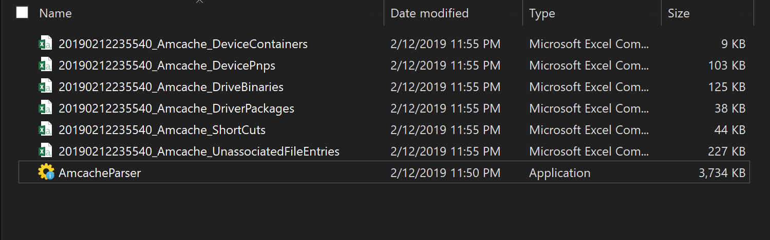
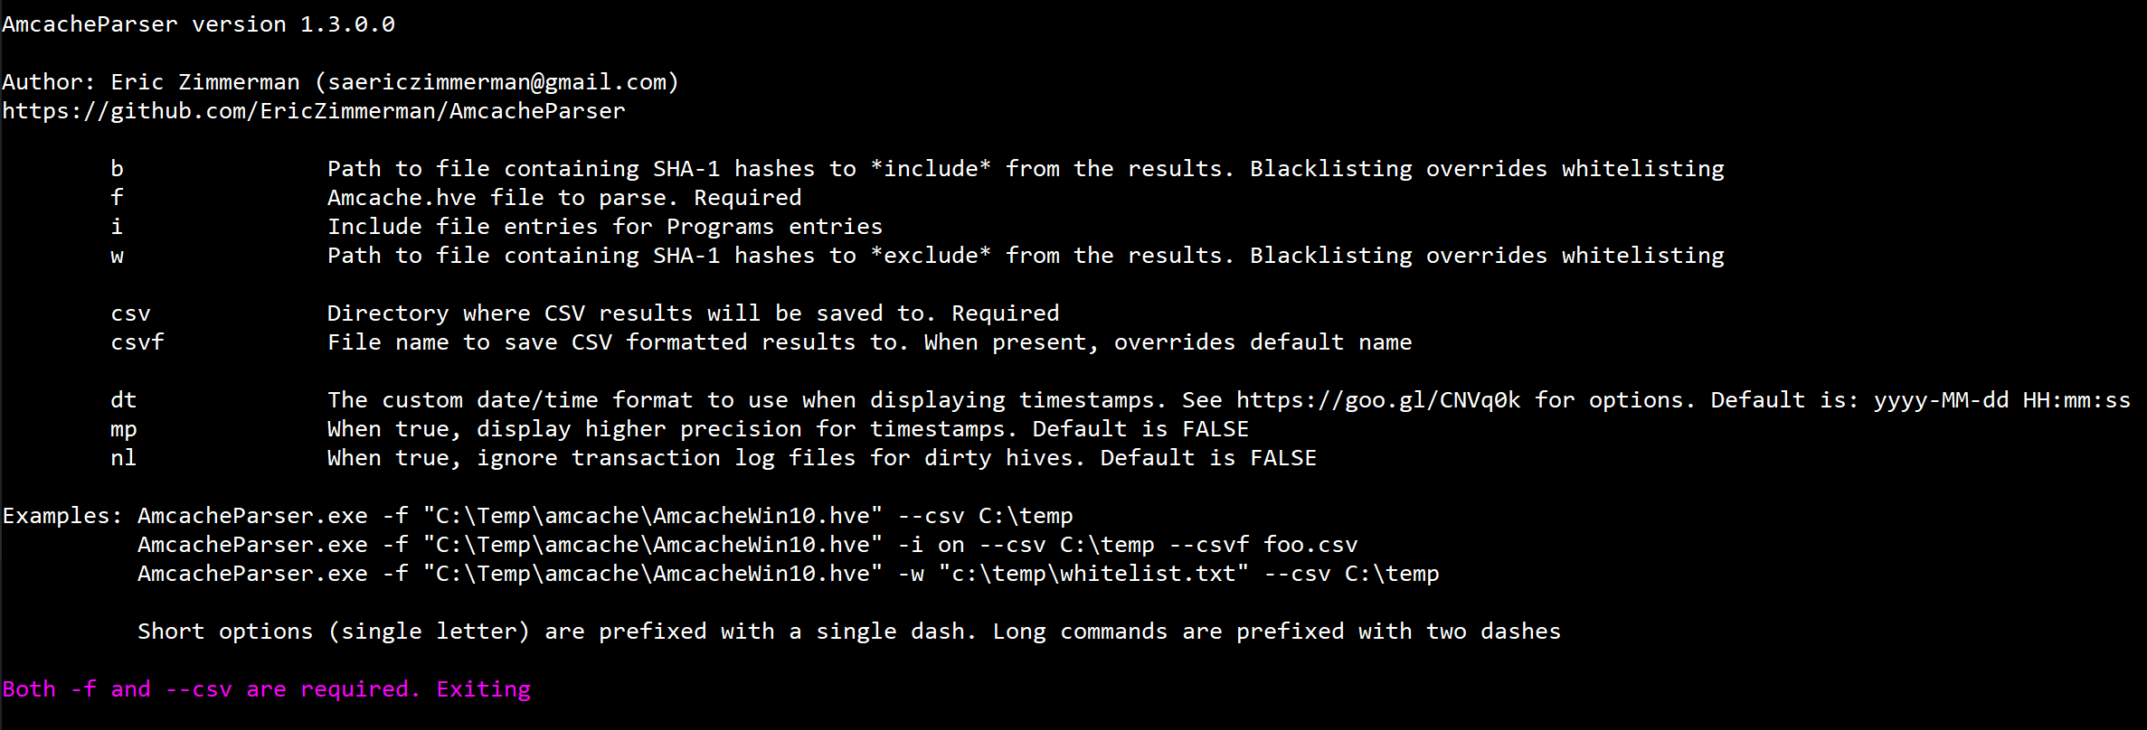
Parsing the Amcache (cont.)
Zimmerman’s command line tool that takes in the Amcache.hve file

Slide 22
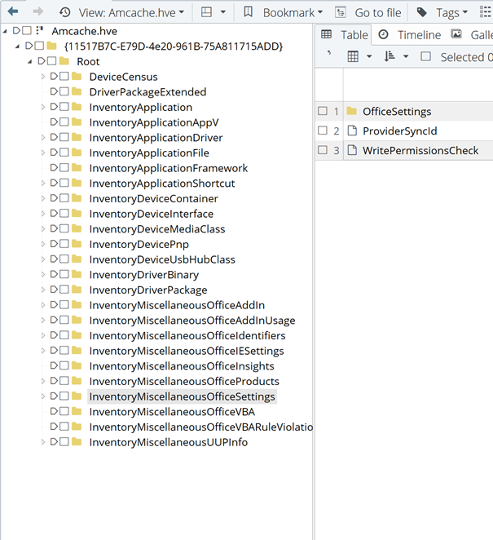
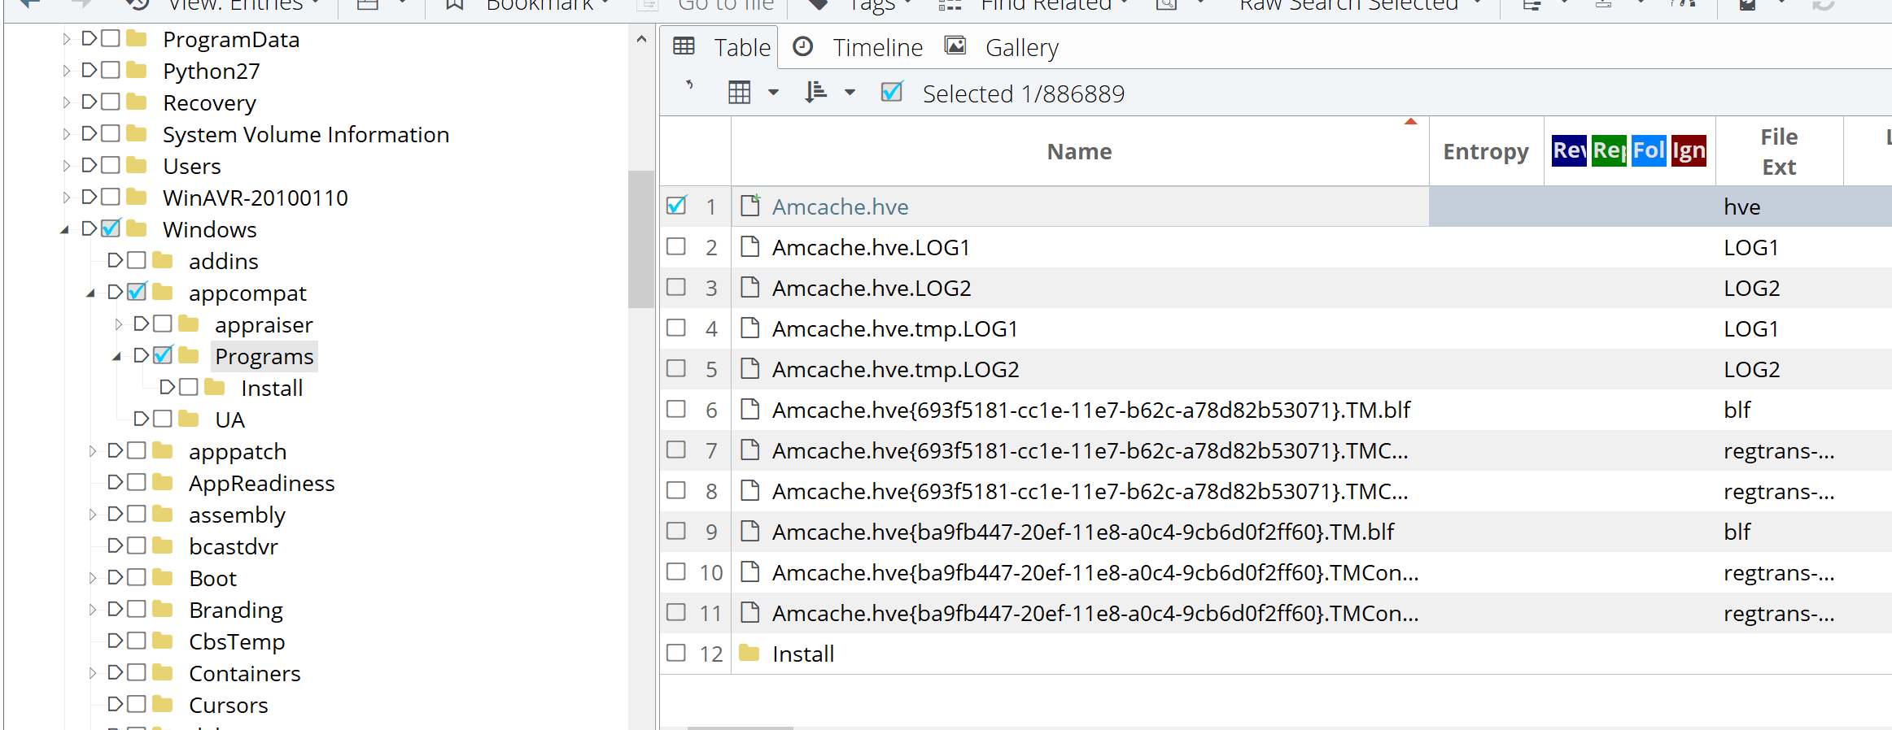
Viewing in EnCase

Slide 23
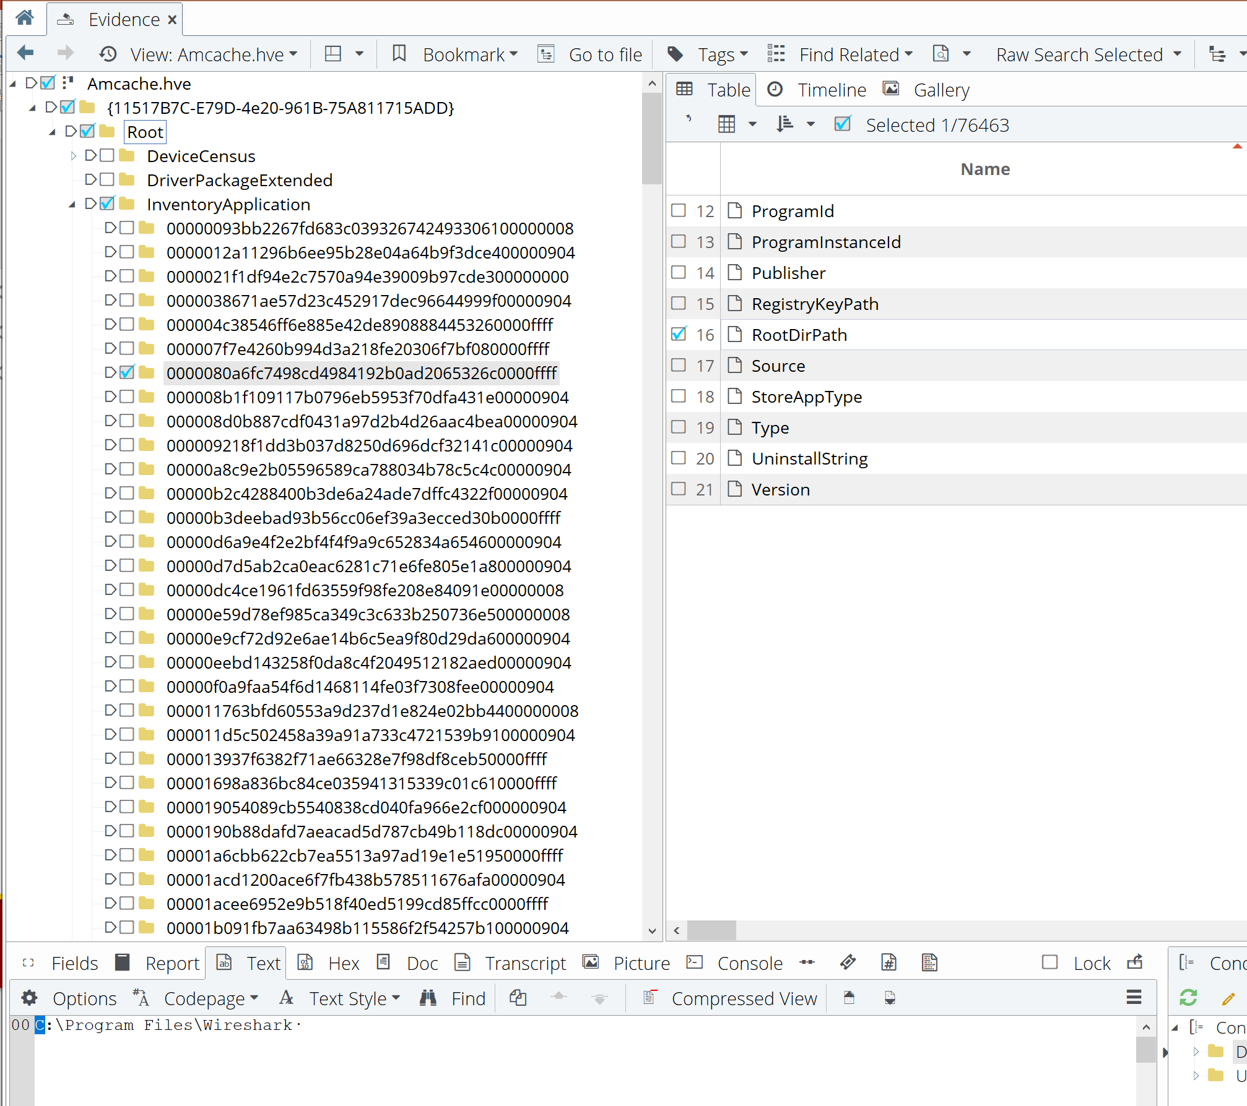
Viewing in EnCase (cont.)

Slide 24
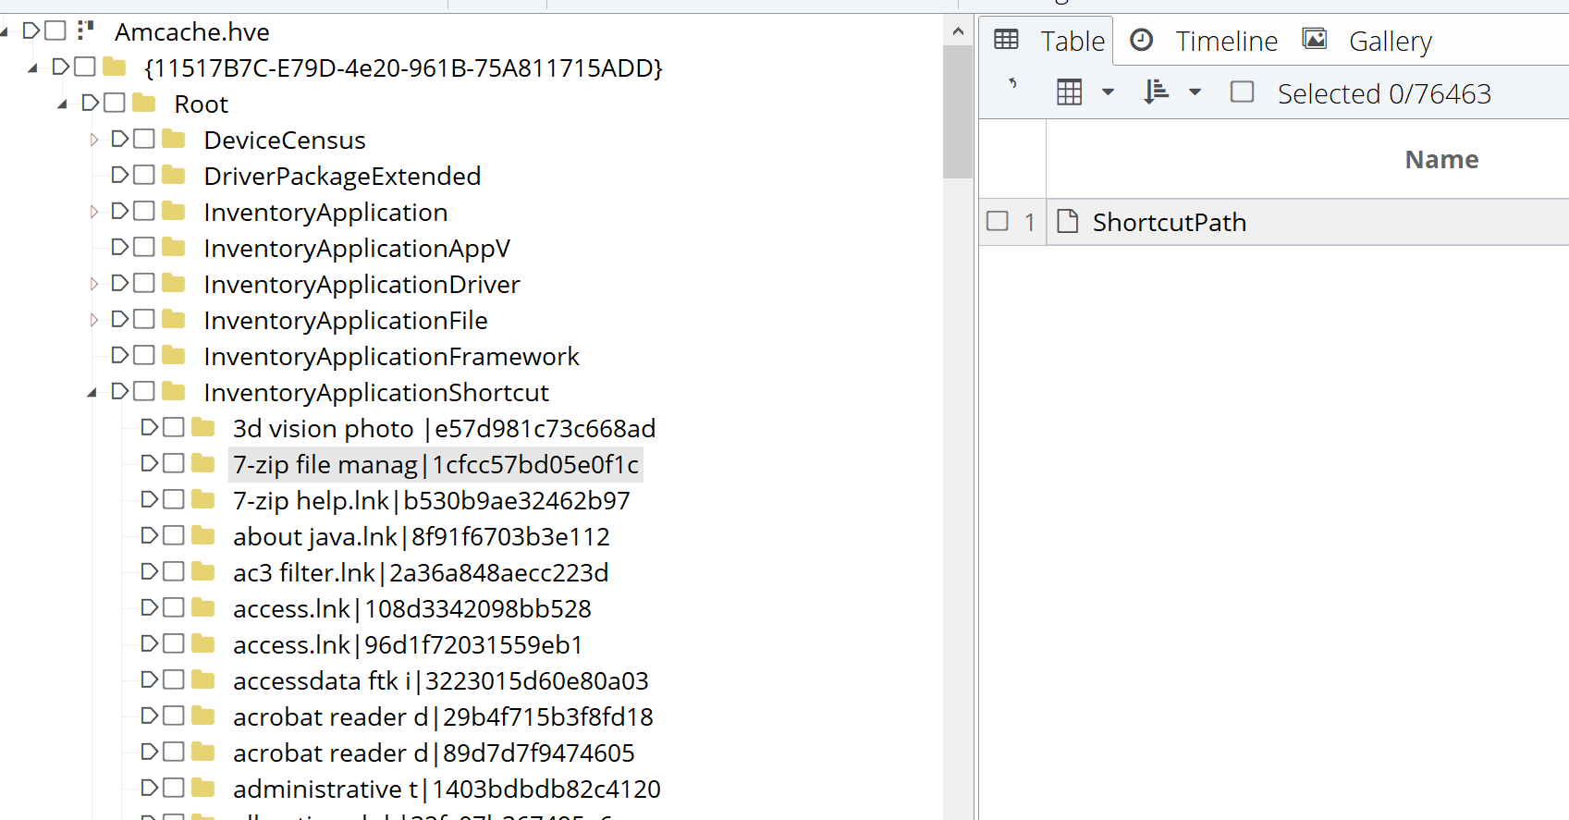
Viewing in EnCase (cont.)

Slide 25
Conclusion
The behavior of the Amache is dependent on the versions of the libraries, not by the OS version of the system
Ie. Investigating an older system that could have gone under several upgrades
Microsoft changed the structure of the Amcache over time
Some older parsers might not recognize the newer formats

Slide 26
Links and references
https://www.researchgate.net/publication/317258237_Leveraging_the_Windows_Amcachehve_File_in_Forensic_Investigations
http://www.ssi.gouv.fr/uploads/2019/01/anssi-coriin_2019-analysis_amcache.pdf
https://binaryforay.blogspot.com/2017/10/amcache-still-rules-everything-around.html

