Slide 1
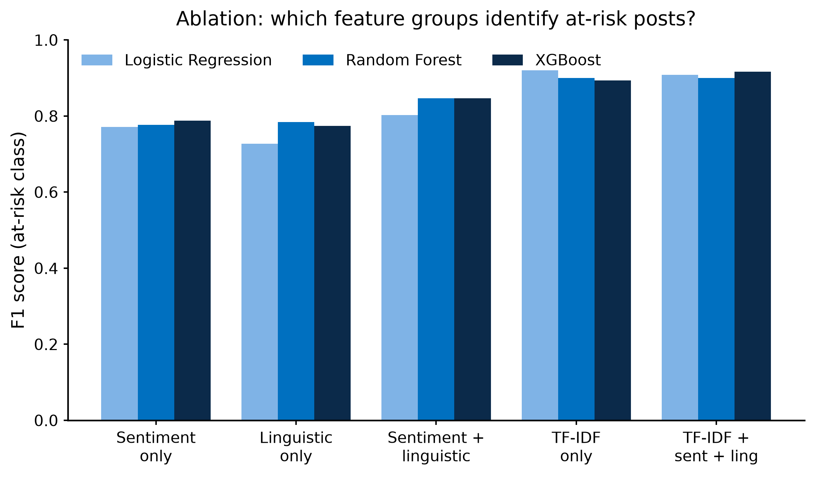
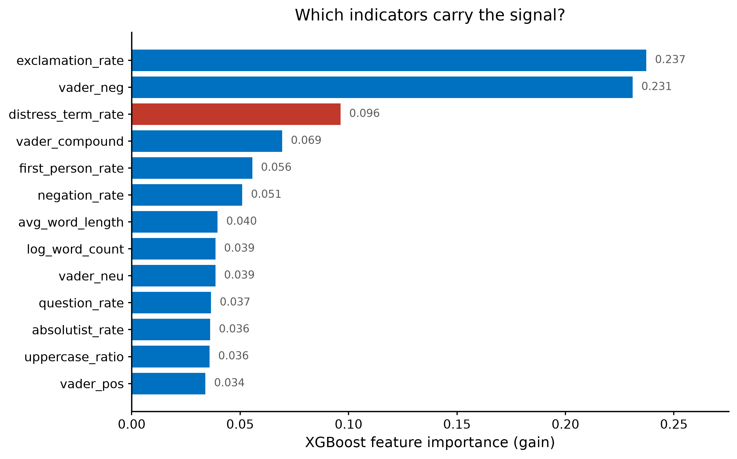
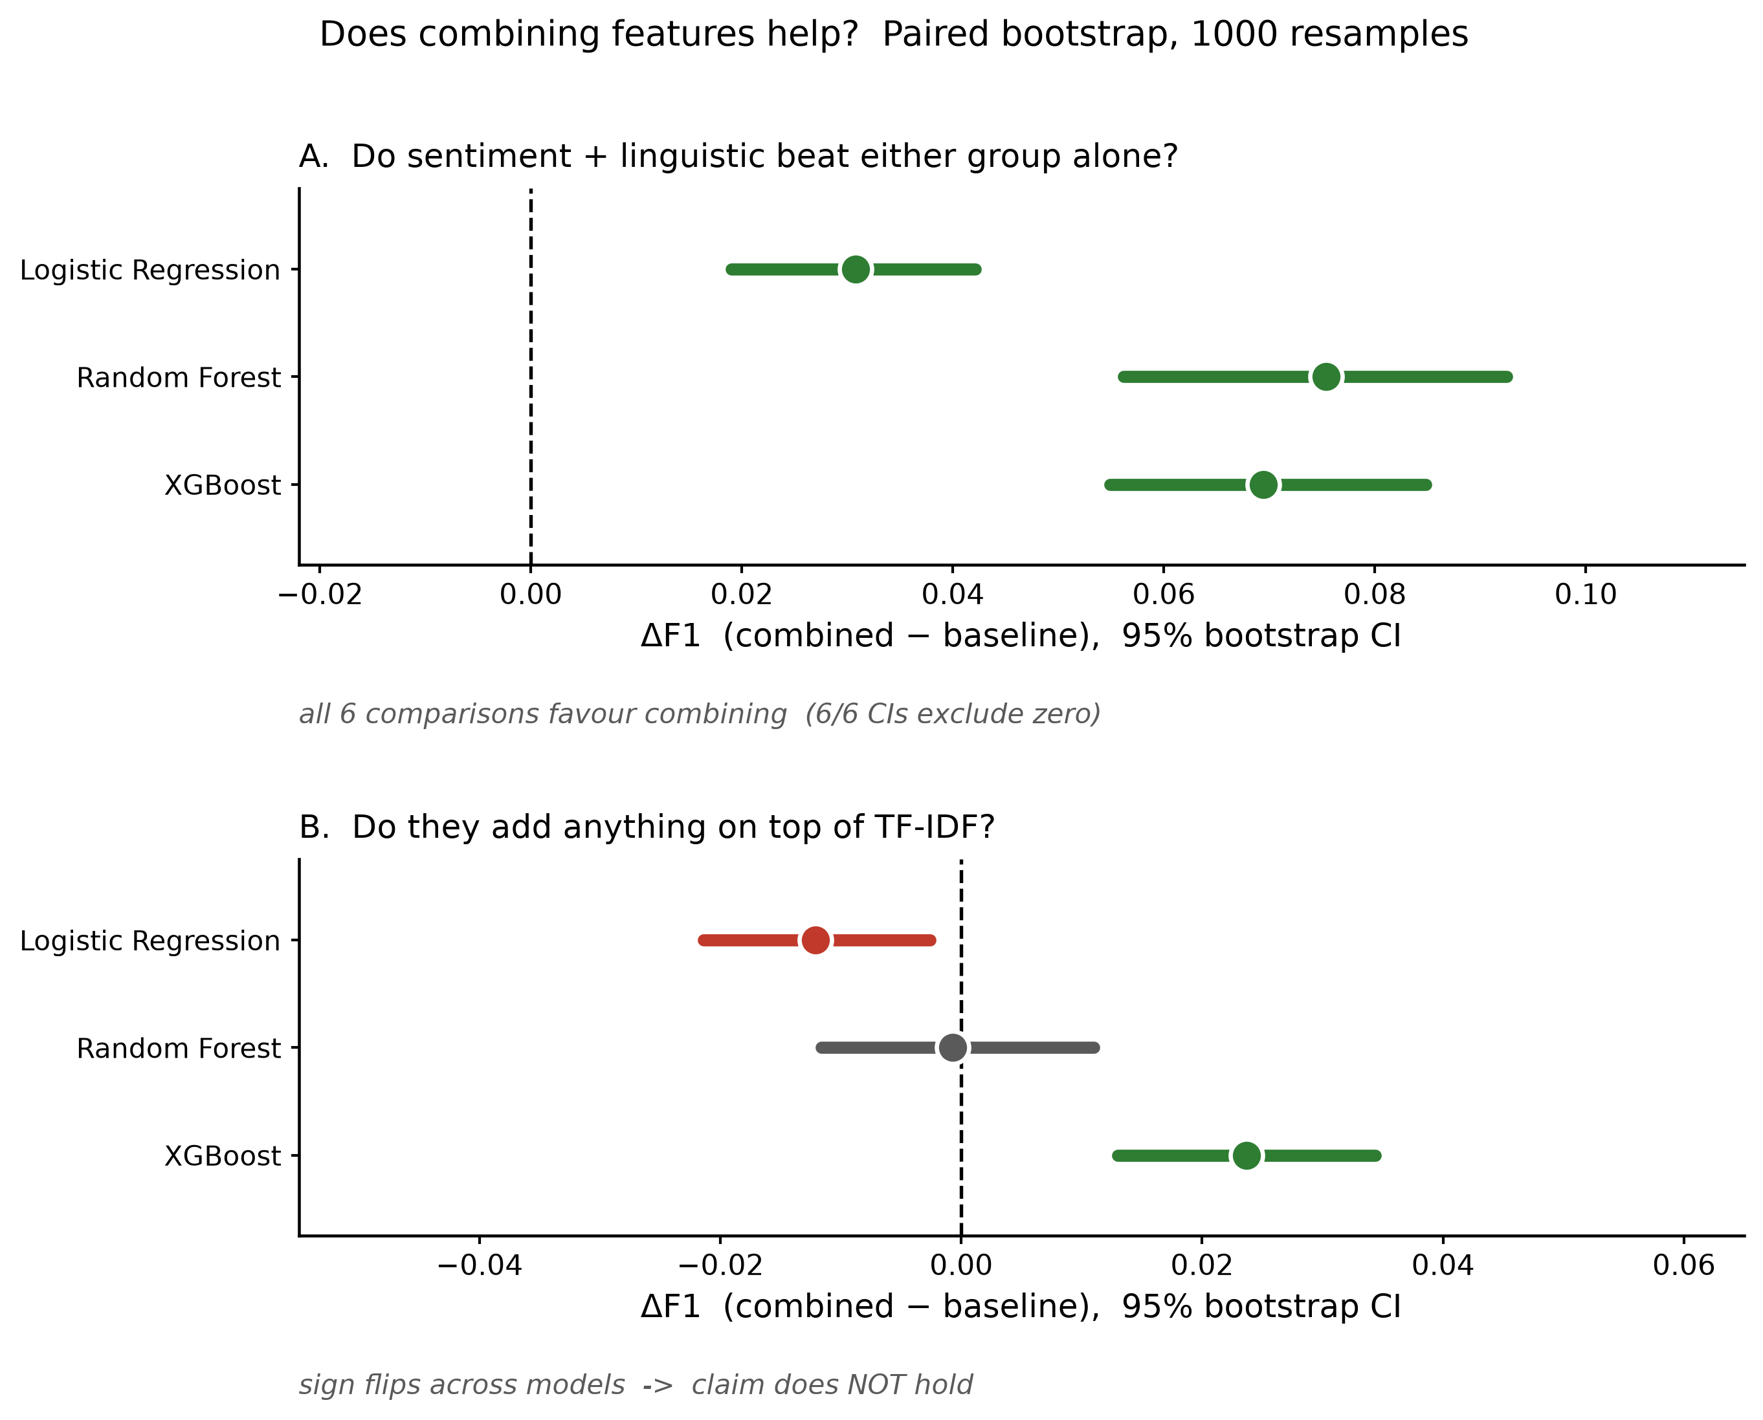
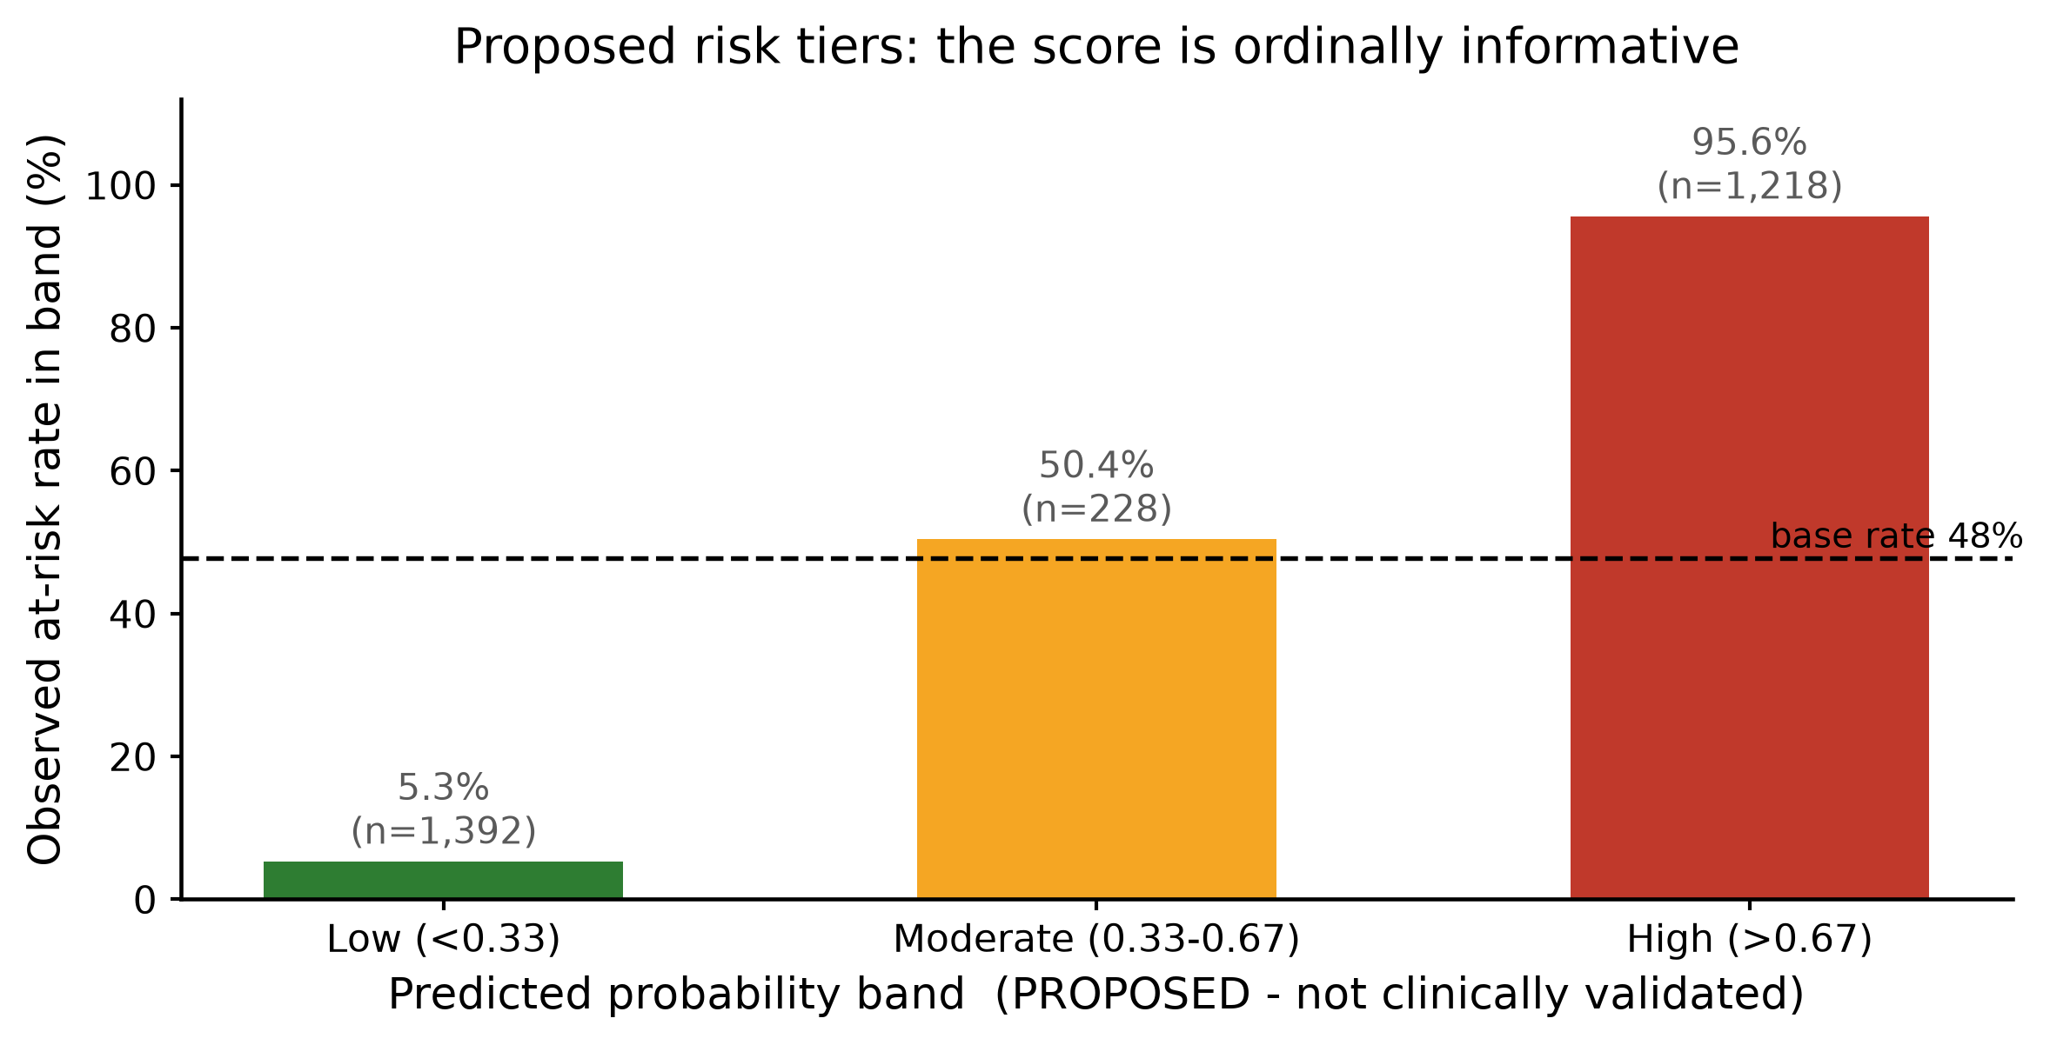
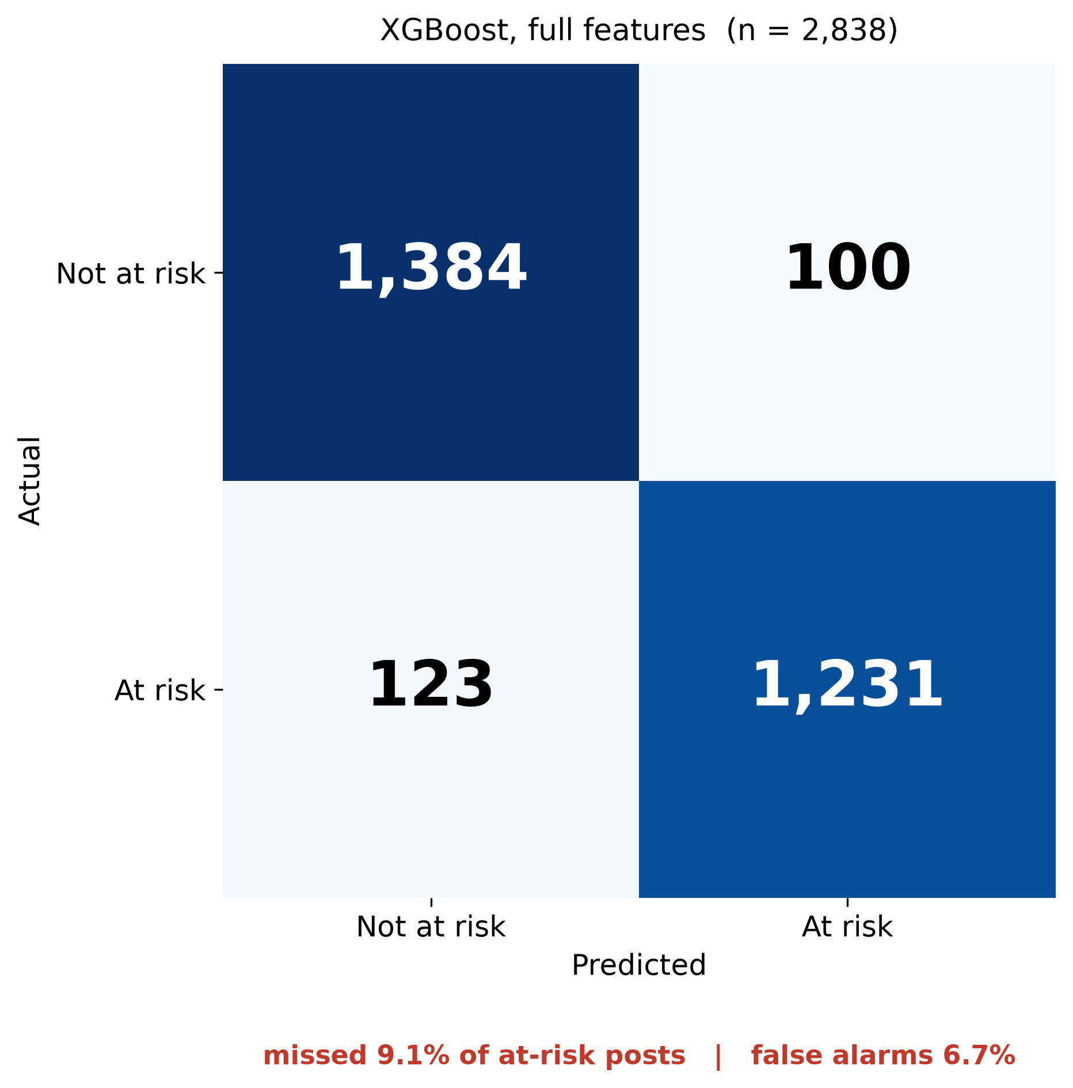
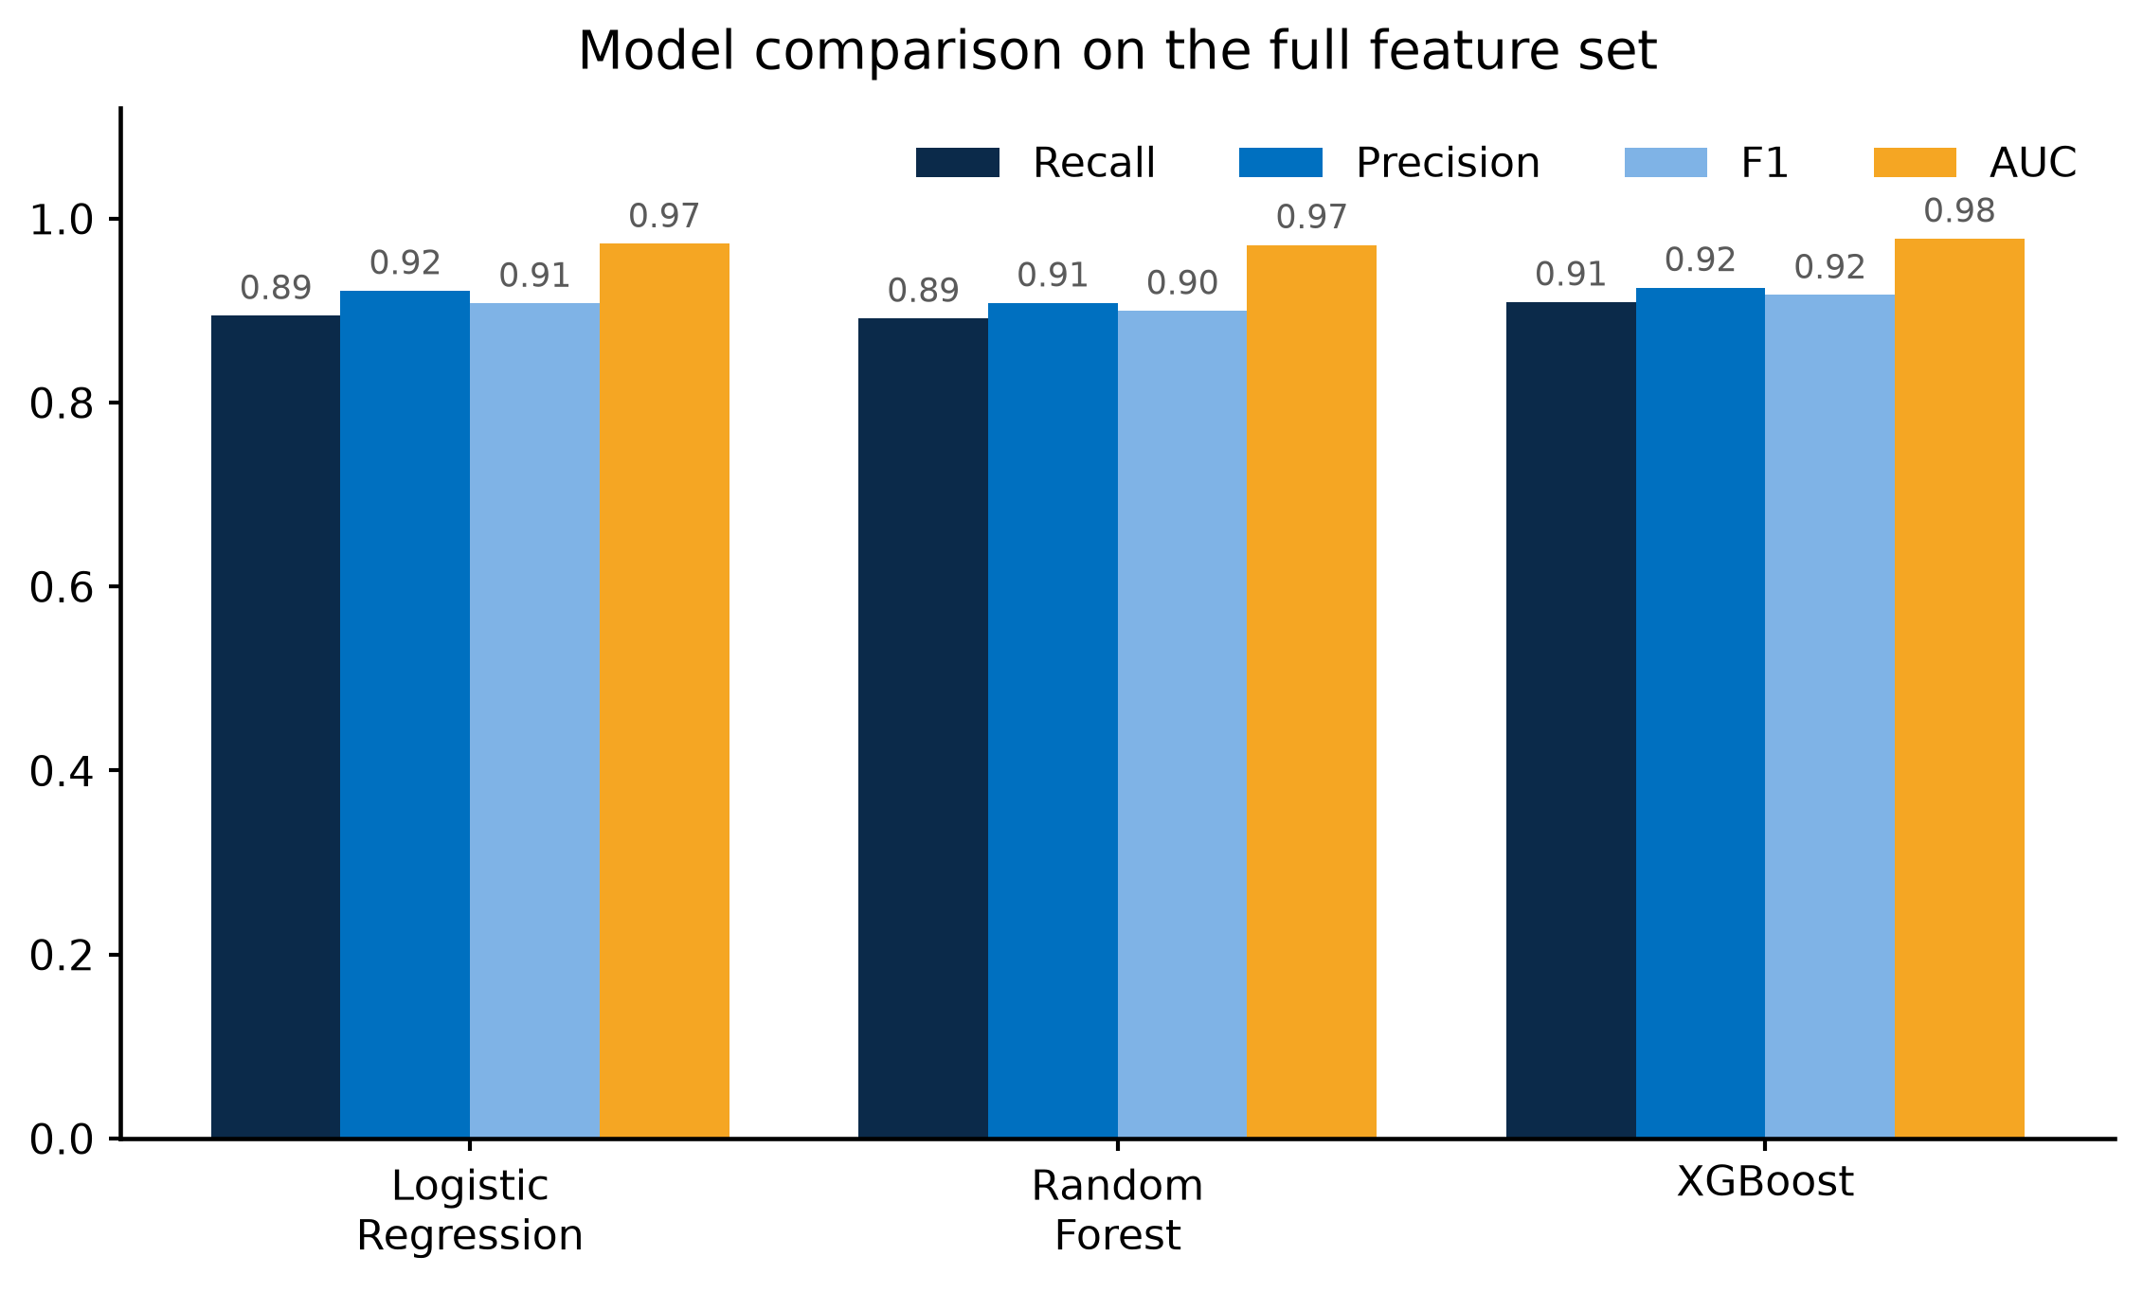
PLACEHOLDER - STUDY TITLE (aim for one line, max 15 words)
PLACEHOLDER - Author Name (superscript 1) | PLACEHOLDER Institution | PLACEHOLDER-email
PLACEHOLDER - Conference / venue and date · PLACEHOLDER - poster number
HEADLINE (one sentence, readable at 3 m):
PLACEHOLDER - the single claim the poster makes. Suggested, from the claim test: “Combining sentiment and linguistic features reliably beats either alone (F1 0.85 vs 0.79, 6/6 bootstrap CIs exclude zero) — but adds little on top of raw text.”
1. Background
5. Results — which feature groups work?
7. Which indicators matter?
PLACEHOLDER - background / problem statement
3-5 bullets. Why suicide prevention needs an early-warning signal; gap in cheap, scalable, language-light screening. Cite WHO/ministry figures here if you have them.
Figure 1. Ablation. F1 by feature set and model. Sentiment alone and linguistic alone reach F1 ≈ 0.79; together they reach 0.85. TF-IDF alone is stronger still (0.92).
Figure 4. XGBoost gain. VADER negativity and exclamations lead; first-person rate, negation and distress terms follow.
2. Aim and objectives
8. Proposed risk tiers
PLACEHOLDER - aim, and the specific question
State the claim being tested explicitly, so the Results answer it. The pre-filled headline above already commits to one claim - keep the two consistent.
3. Data
Figure 5. Observed at-risk rate rises 5% → 50% → 96% across the three bands, so the score is ordinally informative. Bands are PROPOSED, not clinically validated.
▪ Mendeley Data DOI 10.17632/z8s6w86tr3.2 (Matin & Alam, 2023), CC BY 4.0.
▪ 15,477 Reddit posts → 14,187 after removing empty and duplicate posts.
▪ 47.7% at-risk. Stratified 80/20 split: 11,349 train / 2,838 test.
▪ At-risk: r/SuicideWatch. Not at-risk: r/CasualConversation, r/BenignExistence, r/CongratsLikeImFive.
▪ Stand-in for Ugandan data not yet available — proof of concept only.
Figure 2. The claim test. (A) Combining sentiment + linguistic beats either group alone in all 6 comparisons, every CI clear of zero. (B) Added on top of TF-IDF, the sign flips — no reliable gain.
6. Model comparison
4. Method
▪ Sentiment: 4 VADER scores (neg / neu / pos / compound).
▪ Linguistic: 9 features — first-person pronouns, absolutist words, negation, distress terms, length, punctuation, capitals.
▪ Models: Logistic Regression, Random Forest, XGBoost (all class-balanced).
▪ Ablation over 5 feature sets × 3 models = 15 runs.
▪ Uncertainty: 1000-resample bootstrap CIs, and a paired bootstrap test of ΔF1 for every combined-vs-single comparison.
Figure 3. All three models on the full feature set. XGBoost leads on F1 (0.909) and recall (0.917), but its CI overlaps TF-IDF-only Logistic Regression (F1 0.920) — a tie, not a win.
Figure 6. 9.1% of at-risk posts missed; 6.7% false-alarm rate.
6b. Summary of all results
9. Limitations
Feature set | Best model | F1 (95% CI) | Recall | AUC
Sentiment only | XGBoost | 0.788 (0.772–0.804) | 0.790 | 0.869
Linguistic only | Random Forest | 0.784 (0.768–0.800) | 0.787 | 0.872
Sentiment + linguistic | XGBoost | 0.847 (0.832–0.861) | 0.846 | 0.932
TF-IDF only | LogReg | 0.920 (0.909–0.930) | 0.894 | 0.977
All features | XGBoost | 0.917 (0.906–0.928) | 0.909 | 0.978
▪ Labels come from Reddit communities, not clinicians — no clinical ground truth.
▪ Not Ugandan data. English, Western platform sample; coefficients and thresholds will not transfer without local recalibration.
▪ Risk tiers are proposed, not validated. The Low band holds 49% of posts at 5.3% residual risk, so it is not a safety net at scale.
▪ Lexical shortcut: 57% of at-risk posts contain explicit suicide vocabulary vs 4% of controls. A single-regex baseline already reaches F1 0.71.
▪ Posts treated as independent; no user-level or temporal modelling.
Table 1. Strongest model per feature set, with 95% bootstrap CIs (1000 resamples). Every number here is the held-out test set (n = 2,838).
10. Conclusion and next steps
▪ Sentiment and linguistic features are cheap, transparent and they combine — F1 0.847 versus 0.788 / 0.784 for either group alone.
▪ They add little on top of raw text (F1 0.917 vs 0.847), so this supports interpretable screening, not replacement of it.
▪ Next: Ugandan behavioural data, user-level modelling, ethical clearance, and human-in-the-loop triage.
References
▪ Matin, M. M. H., & Alam, M. S. (2023). Suicidal Ideation Detection Reddit Dataset (Version 2). Mendeley Data. doi:10.17632/z8s6w86tr3.2
▪ Hutto, C. J., & Gilbert, E. E. (2014). VADER: A parsimonious rule-based model for sentiment analysis of social media. ICWSM.
▪ PLACEHOLDER - add the first-person / absolutist-words literature you cite.
Proof of concept — not a validated clinical tool. Do not use for triage or screening decisions. Code and full results: PLACEHOLDER repo/URL

