Slide 1
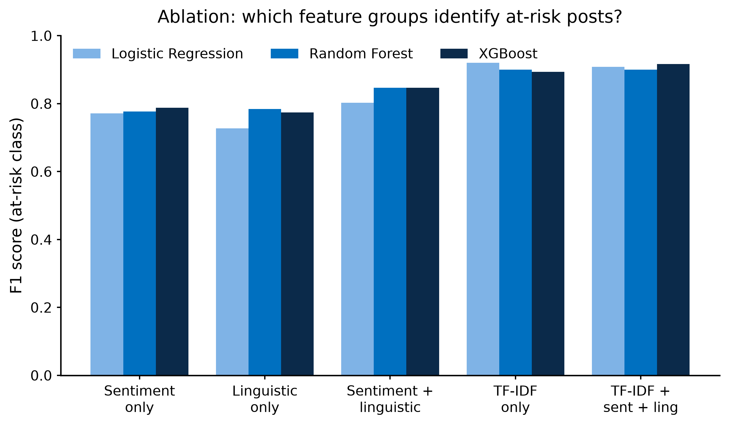
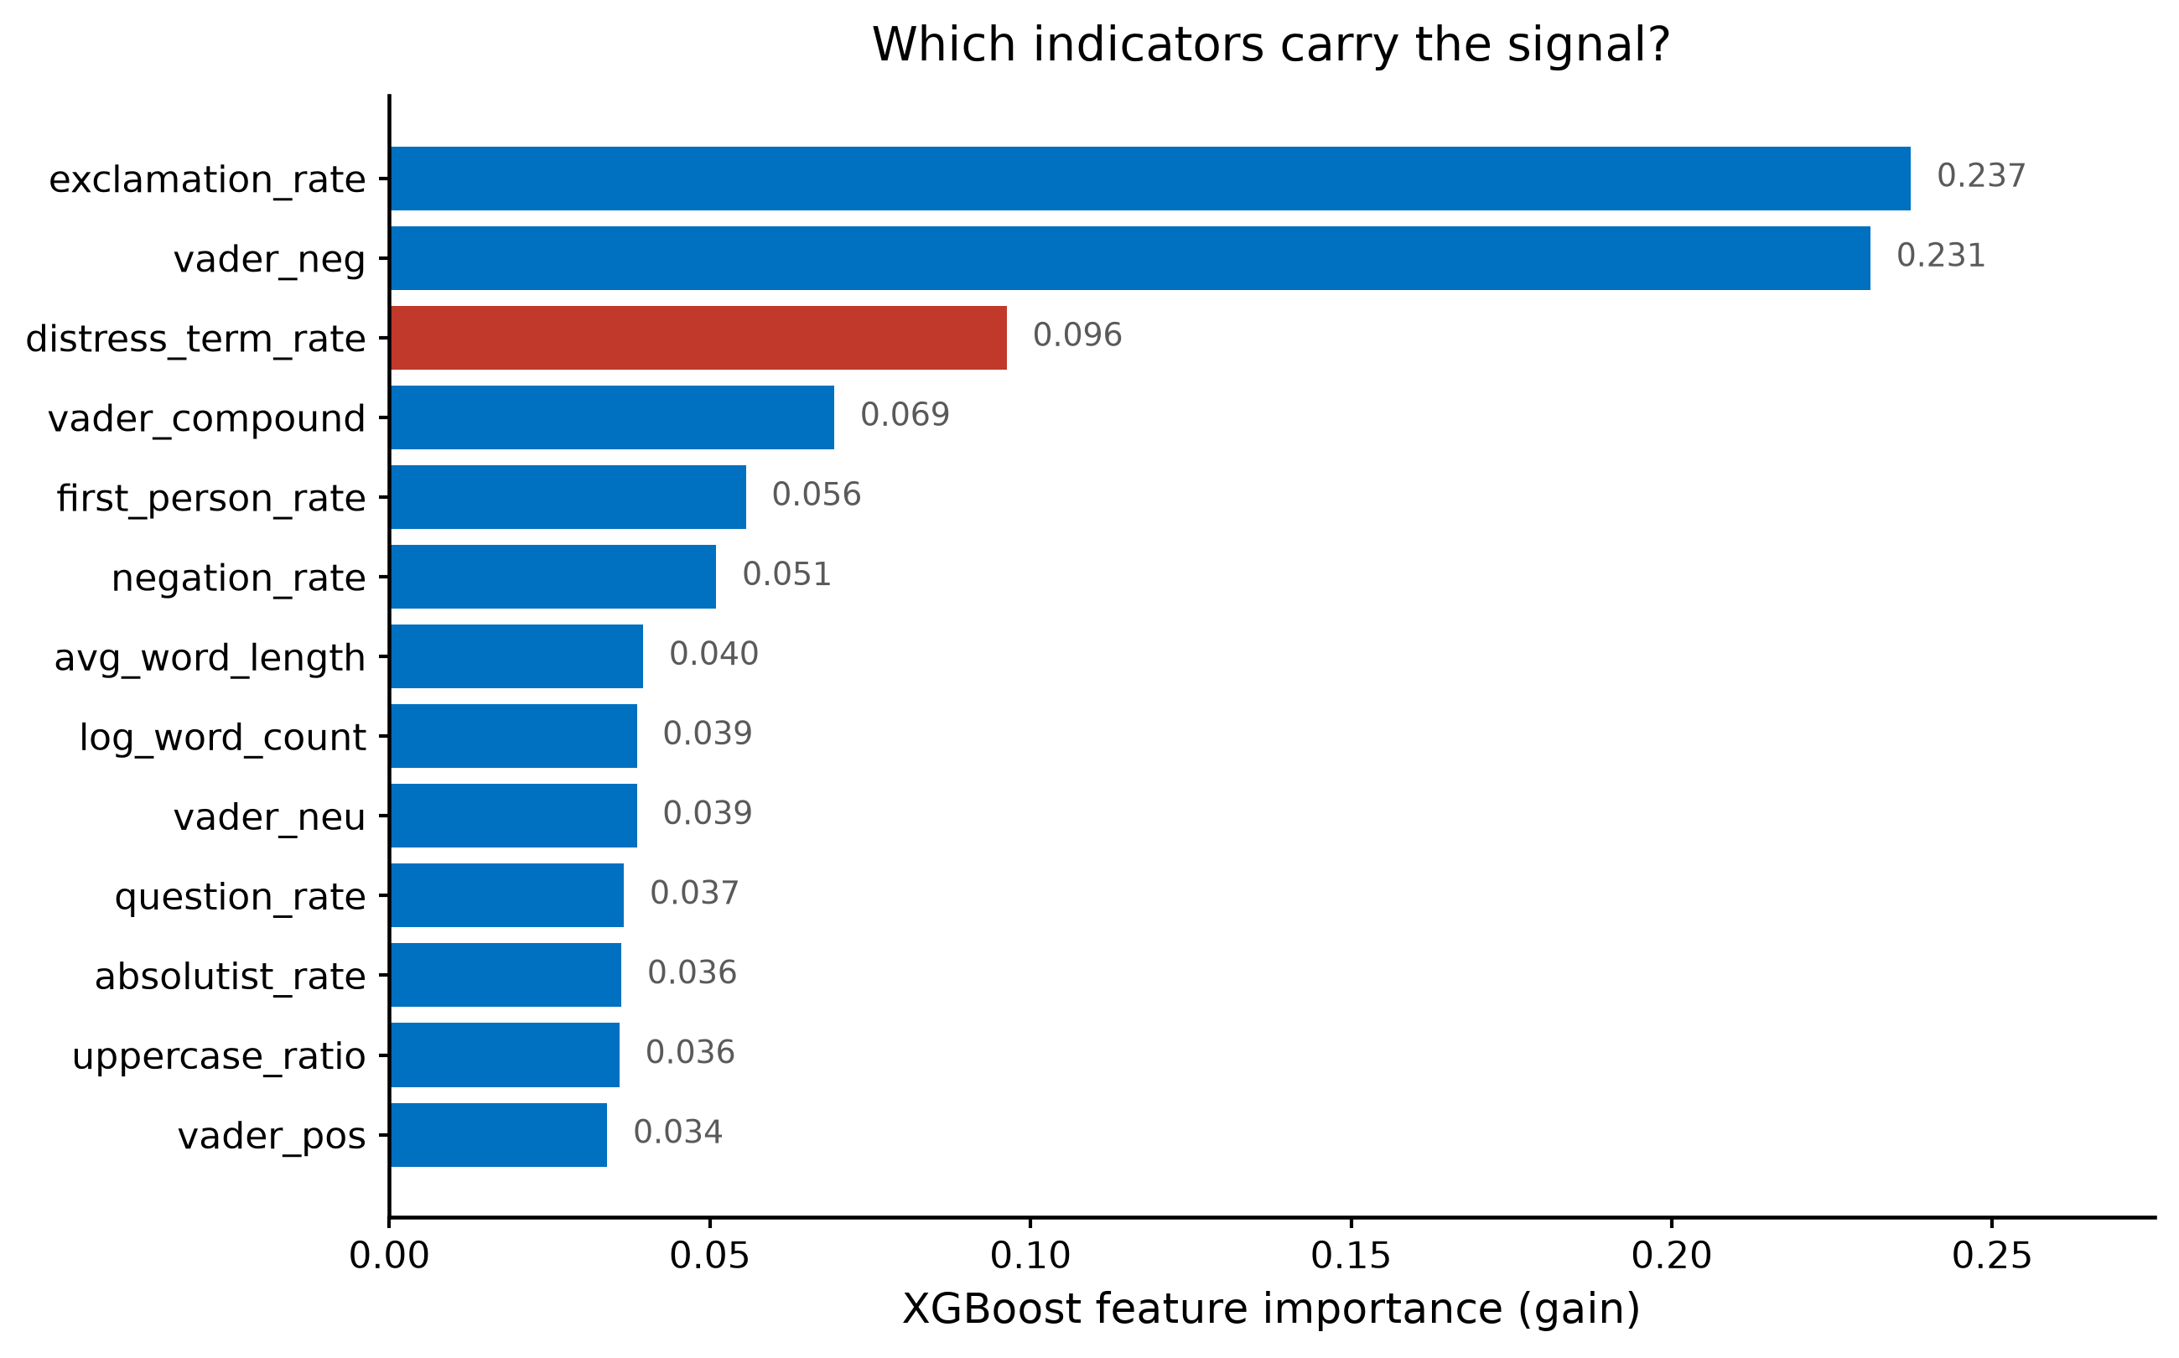
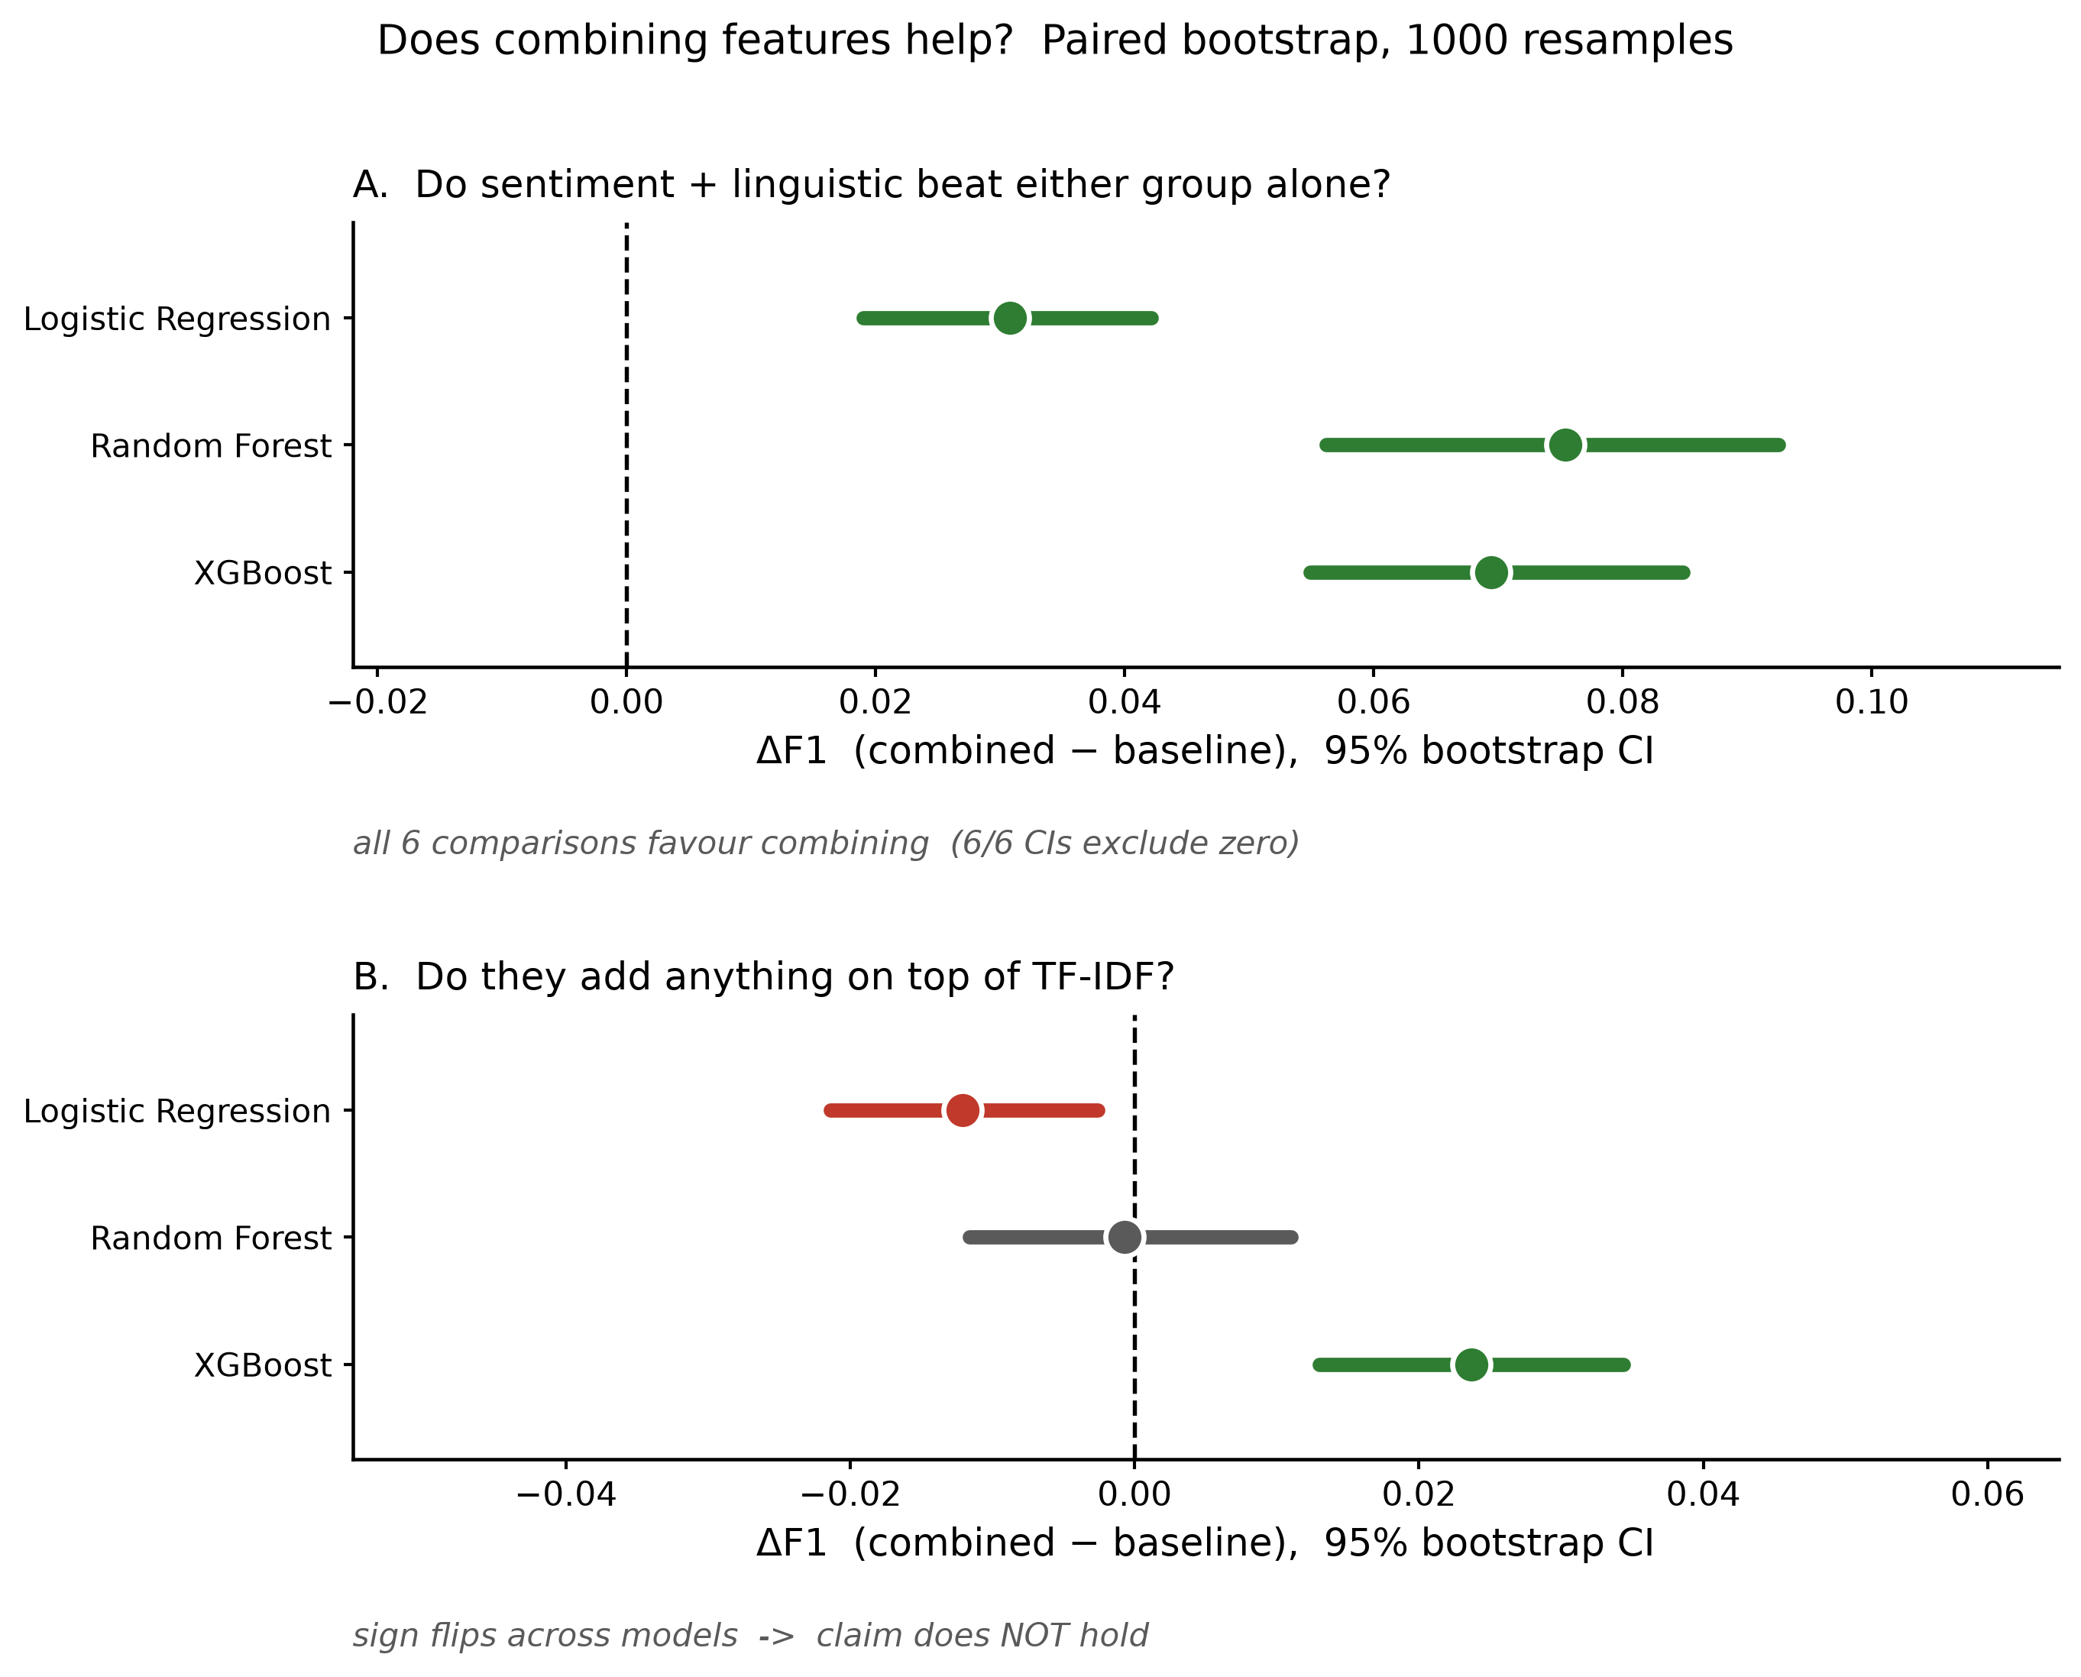
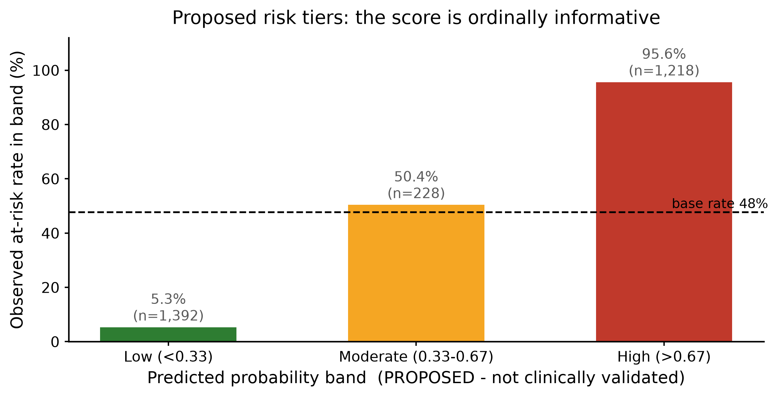
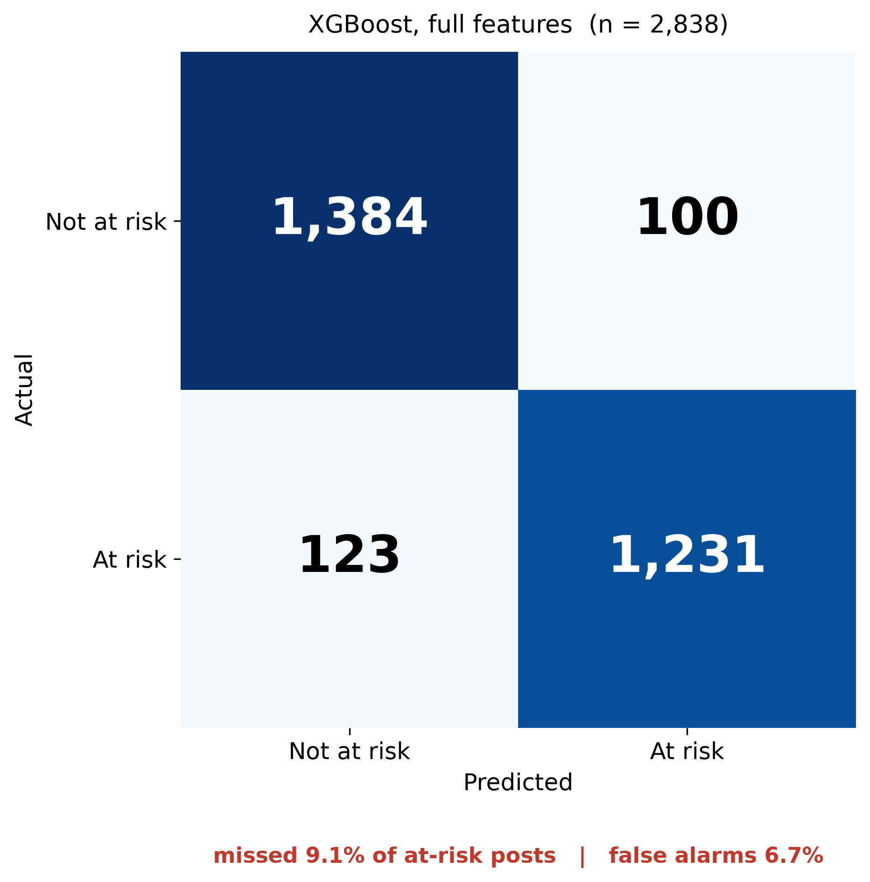
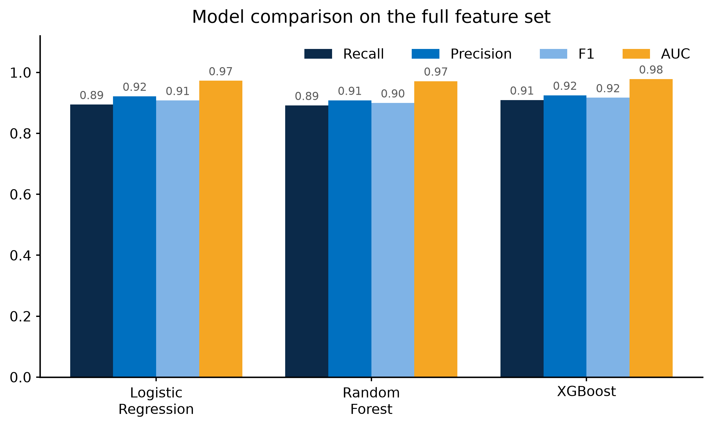
PLACEHOLDER - STUDY TITLE (aim for one line, max 15 words)
PLACEHOLDER - Author Name (superscript 1) | PLACEHOLDER Institution | PLACEHOLDER-email
PLACEHOLDER - Conference / venue and date · PLACEHOLDER - poster number
HEADLINE (one sentence, readable at 3 m):
PLACEHOLDER - the single claim the poster makes. Suggested, from the claim test: “Combining sentiment and linguistic features reliably beats either alone (F1 0.85 vs 0.79, 6/6 bootstrap CIs exclude zero) — but adds little on top of raw text.”
1. Background
5. Results — which feature groups work?
7. Which indicators matter?
PLACEHOLDER - background / problem statement
3-5 bullets. Why suicide prevention needs an early-warning signal; gap in cheap, scalable, language-light screening.
2. Aim and objectives
PLACEHOLDER - aim, and the specific question
State the claim being tested explicitly, so the Results answer it.
Figure 1. Ablation. F1 by feature set and model. Sentiment alone and linguistic alone reach F1 ≈ 0.79; together they reach 0.85. TF-IDF alone is stronger still (0.92).
Figure 4. XGBoost gain. VADER negativity and exclamations lead; first-person rate, negation and distress terms follow.
8. Proposed risk tiers
3. Data
▪ Mendeley Data DOI 10.17632/z8s6w86tr3.2 (Matin & Alam, 2023), CC BY 4.0.
▪ 15,477 Reddit posts → 14,187 after removing empty and duplicate posts.
▪ 47.7% at-risk. Stratified 80/20 split: 11,349 train / 2,838 test.
▪ At-risk: r/SuicideWatch. Not at-risk: r/CasualConversation, r/BenignExistence, r/CongratsLikeImFive.
▪ Stand-in for Ugandan data not yet available — proof of concept only.
4. Method
Figure 5. Observed at-risk rate rises 5% → 50% → 96% across the three bands, so the score is ordinally informative. Bands are PROPOSED, not clinically validated.
▪ Sentiment: 4 VADER scores (neg / neu / pos / compound).
▪ Linguistic: 9 features — first-person pronouns, absolutist words, negation, distress terms, length, punctuation, capitals.
▪ Models: Logistic Regression, Random Forest, XGBoost (all class-balanced).
▪ Ablation over 5 feature sets × 3 models = 15 runs.
▪ Uncertainty: 1000-resample bootstrap CIs, and a paired bootstrap test of ΔF1 for every combined-vs-single comparison.
Figure 2. The claim test. (A) Combining sentiment + linguistic beats either group alone in all 6 comparisons, every CI clear of zero. (B) Added on top of TF-IDF, the sign flips — no reliable gain.
6. Model comparison
Figure 3. All three models on the full feature set. XGBoost leads on F1 (0.917) and recall (0.909), but its CI overlaps TF-IDF-only Logistic Regression (F1 0.920) — a tie, not a win.
Figure 6. 9.1% of at-risk posts missed; 6.7% false-alarm rate.
6b. Summary of all results
9. Limitations
Feature set | Best model | F1 (95% CI) | Recall | AUC
Sentiment only | XGBoost | 0.788 (0.772–0.804) | 0.790 | 0.869
Linguistic only | Random Forest | 0.784 (0.768–0.800) | 0.787 | 0.872
Sentiment + linguistic | XGBoost | 0.847 (0.832–0.861) | 0.846 | 0.932
TF-IDF only | LogReg | 0.920 (0.909–0.930) | 0.894 | 0.977
All features | XGBoost | 0.917 (0.906–0.928) | 0.909 | 0.978
▪ Labels come from Reddit communities, not clinicians — no clinical ground truth.
▪ Not Ugandan data. English, Western platform sample; coefficients and thresholds will not transfer without local recalibration.
▪ Risk tiers are proposed, not validated. The Low band holds 49% of posts at 5.3% residual risk, so it is not a safety net at scale.
▪ Lexical shortcut: 57% of at-risk posts contain explicit suicide vocabulary vs 4% of controls. A single-regex baseline already reaches F1 0.71.
▪ Posts treated as independent; no user-level or temporal modelling.
Table 1. Strongest model per feature set, with 95% bootstrap CIs (1000 resamples). Every number here is the held-out test set (n = 2,838).
10. Conclusion and next steps
▪ Sentiment and linguistic features are cheap, transparent and they combine — F1 0.847 vs 0.788 / 0.785 for either alone.
▪ They add little to raw text, so this supports interpretable screening, not replacement of it.
▪ Next: Ugandan behavioural data, user-level modelling, ethical clearance, and human-in-the-loop triage.
References
▪ Matin, M. M. H., & Alam, M. S. (2023). Suicidal Ideation Detection Reddit Dataset (Version 2). Mendeley Data. doi:10.17632/z8s6w86tr3.2
▪ Hutto, C. J., & Gilbert, E. E. (2014). VADER: A parsimonious rule-based model for sentiment analysis of social media. ICWSM.
▪ PLACEHOLDER - add the first-person / absolutist-words literature you cite.
Proof of concept — not a validated clinical tool. Do not use for triage or screening decisions. Code and full results: PLACEHOLDER repo/URL

