Slide 1
2018.11.06 Georgia Cyber Center CTF
Networking

Slide 2
Question 1
We captured a web session from an amazingly awesome website. What domain is the website hosted from?

Slide 3
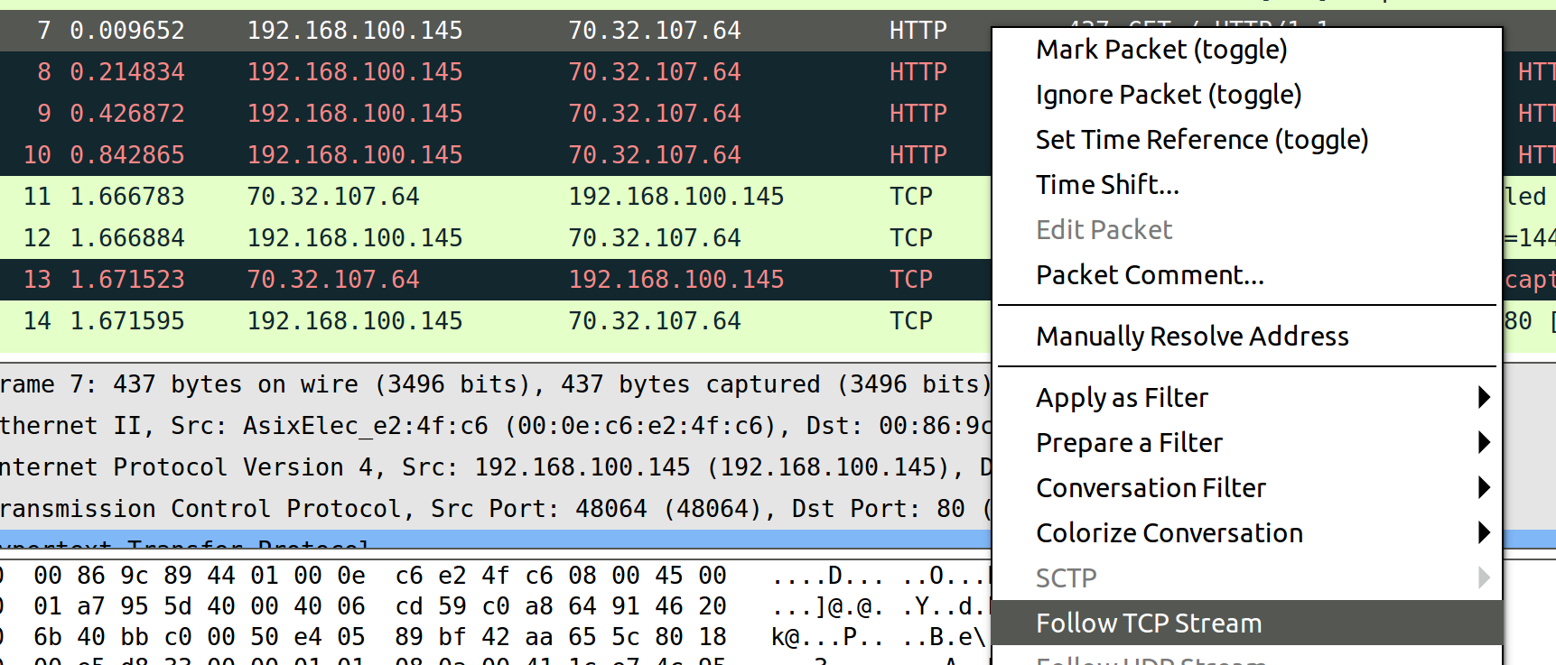
1. What is the domain the website is hosting?
First, you can open the .pcap in wireshark.
Then I saw the first HTTP packet (a GET /) and I right clicked and did “Follow TCP Stream”

Slide 4
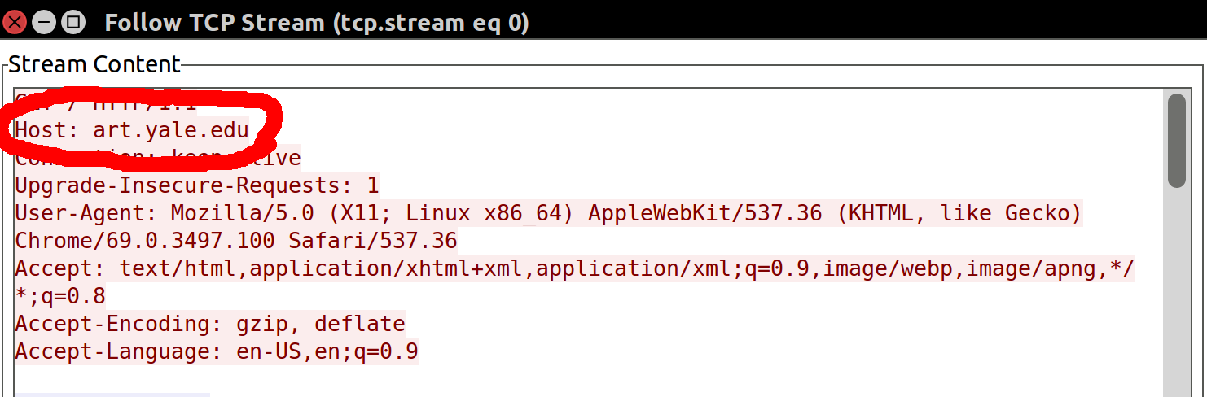
1. What is the domain the website is hosting?
It showed up right away – art.yale.edu

Slide 5
Question 2
We captured a web session from an amazingly awesome website. Who is most likely the Sysop of the page/site?

Slide 6
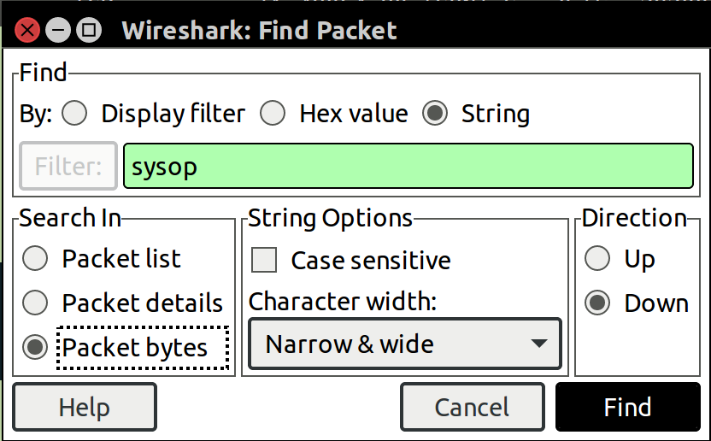
2. Who is most likely the Sysop of the page?
First, you can open the .pcap in wireshark.
Then you can Go to “Edit”, then “Find Packet”, to search for the word “sysop”
Make sure to do a String search and include Packet Bytes

Slide 7
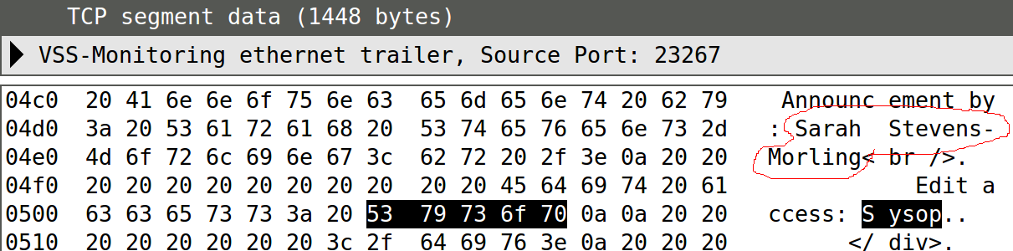
2. Who is most likely the Sysop of the page?
The first result shows us someone who edited the page with Edit Access: Sysop – Sarah Stevens-Morling is likely the Sysop!

Slide 8
Question 3
We captured a web session from an amazingly awesome website. On it, was a drawing of a woman dancing, that we think they stole from our sister site. Can you get the sha256 hash of the woman dancing image so we can compare it to ours to validate it is the same?

Slide 9
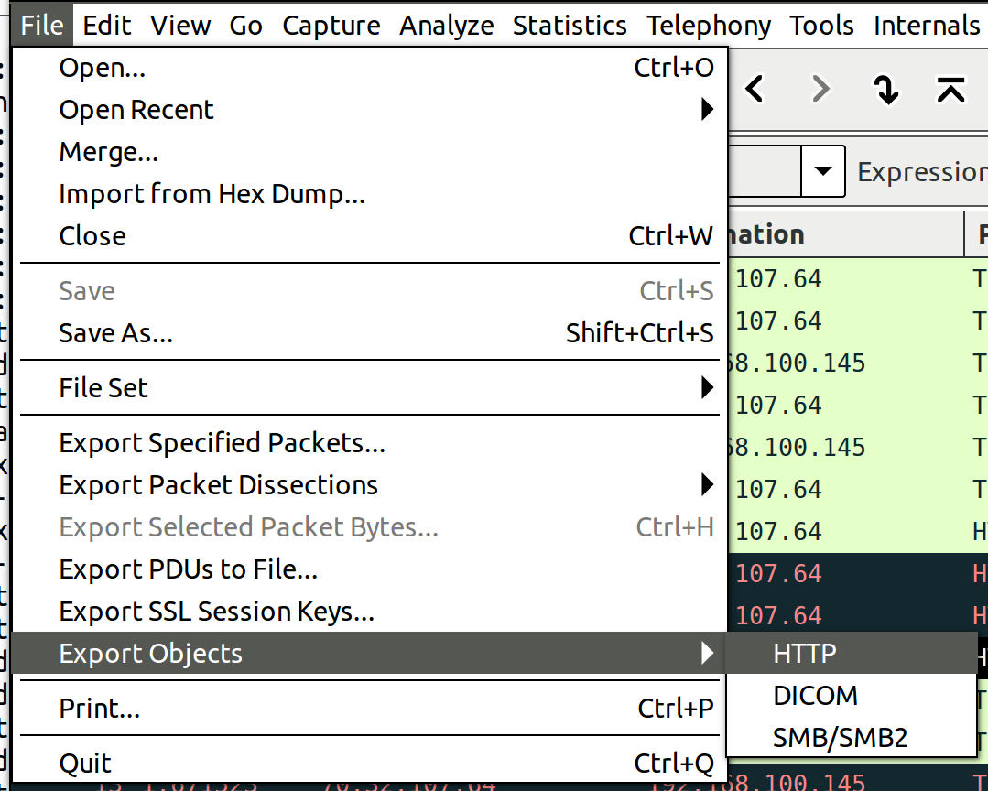
3. What is the sha256 hash of the pic of the woman dancing?
It is easiest to just export all the webpage/website info. Go to File, Export Objects, HTTP

Slide 10
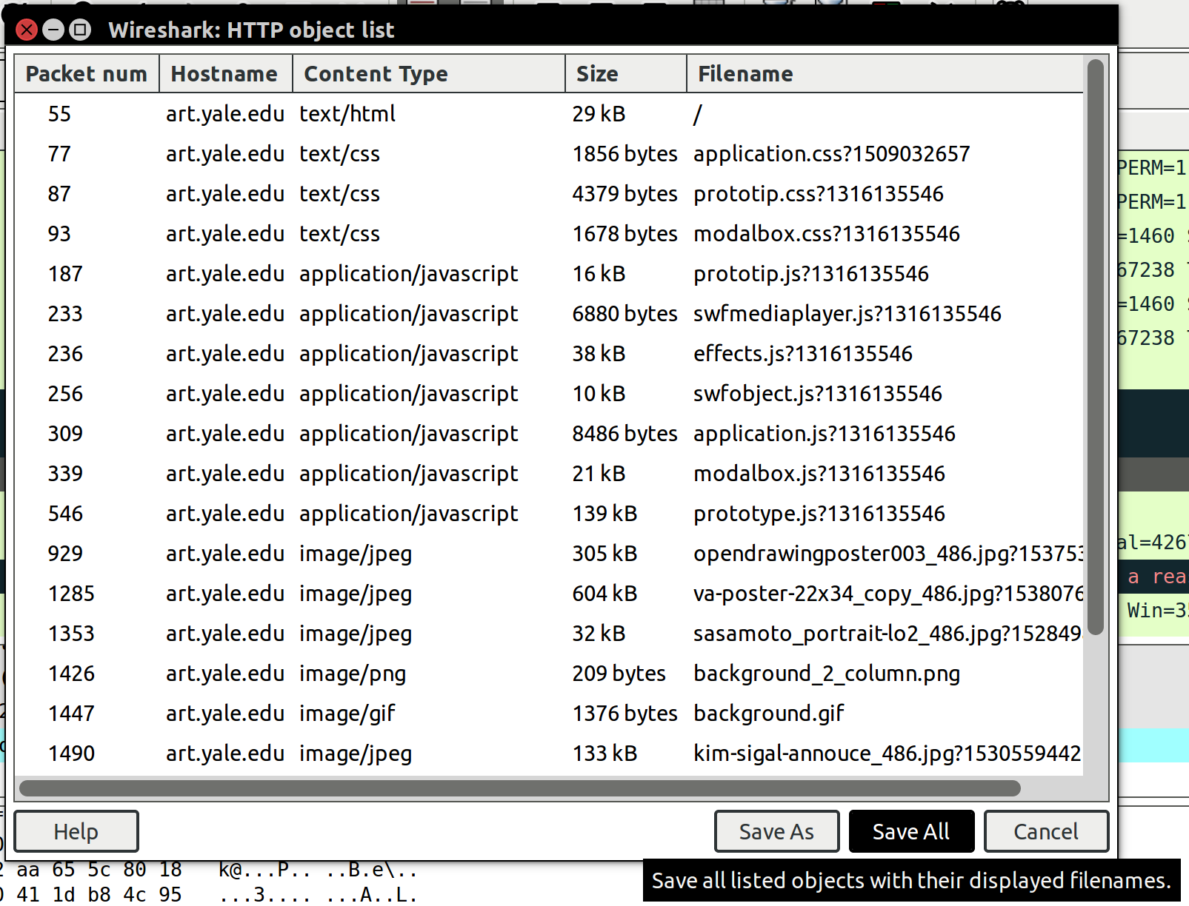
3. What is the sha256 hash of the pic of the woman dancing?
You can then do a “Save All” to save everything to an output folder on disk

Slide 11
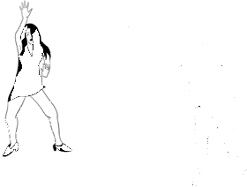
3. What is the sha256 hash of the pic of the woman dancing?
We open up an image viewer in that directory to look through the pictures and we see it - now that we know the picture is untitled-1.gif, we can just get the hash of it
sha256sum untitled-1.gif
3222e0c4a9fe2ba6c959e6aceda0c8405f6329447ce8f2b27f0e71b35bb1e3c0 untitled-1.gif

Slide 12
Question 4
We captured a web session from an amazingly awesome website. Our coworker Mike used it to hide a flag, via steganography methods, in 2.pcap. Utilizing the original pcap, find his hidden flag in 2.pcap.

Slide 13
4. Find the hidden flag in 2.pcap
I figured it was easiest to start by converting each packet to text and then try diffing them to see if the difference just pop out
tcpdump -nnn -tttt -X -r 1.pcap > 1.txt
reading from file data80filtered.pcap, link-type EN10MB (Ethernet)
tcpdump -nnn -tttt -X -r 2.pcap > 2.txt
reading from file modified.pcap, link-type EN10MB (Ethernet)
diff 1.txt 2.txt

Slide 14
4. Find the hidden flag in 2.pcap
Hrm, every other one looks like a header change (probably to deal with updating checksums from the packet being modified). So let's just look at the ones with clear ASCII differences
34c34
< 0x0020: 8018 00e5 d833 0000 0101 080a 0041 1ce7 .....3.......A..
---
> 0x0020: 8018 00e5 d8bf 0000 0101 080a 0041 1ce7 .............A..
42c42
< 0x00a0: 612f 352e 3020 2858 3131 3b20 4c69 6e75 a/5.0.(X11;.Linu
---
> 0x00a0: 612f 352e 3020 2858 3131 3b20 4669 6e75 a/5.0.(X11;.Finu
62c62
< 0x0020: 8018 00e5 d833 0000 0101 080a 0041 1d1b .....3.......A..
---
> 0x0020: 8018 00e5 b38b 0000 0101 080a 0041 1d1b .............A..
69c69

Slide 15
4. Find the hidden flag in 2.pcap
< 0x00a0: 612f 352e 3020 2858 3131 3b20 4c69 6e75 a/5.0.(X11;.Linu
> 0x00a0: 612f 352e 3020 2858 3131 3b20 4669 6e75 a/5.0.(X11;.Finu
< 0x0090: 6572 2d41 6765 6e74 3a20 4d6f 7a69 6c6c er-Agent:.Mozill
> 0x0090: 6572 2d41 6765 6e74 3a20 6c6f 7a69 6c6c er-Agent:.lozill
< 0x00b0: 7820 7838 365f 3634 2920 4170 706c 6557 x.x86_64).AppleW
> 0x00b0: 7820 7838 365f 3634 2920 4161 706c 6557 x.x86_64).AapleW
< 0x00e0: 2043 6872 6f6d 652f 3639 2e30 2e33 3439 .Chrome/69.0.349
> 0x00e0: 2067 6872 6f6d 652f 3639 2e30 2e33 3439 .ghrome/69.0.349
< 0x0200: 2048 544d 4c20 5055 424c 4943 2022 2d2f .HTML.PUBLIC."-/
> 0x0200: 2048 544d 3a20 5055 424c 4943 2022 2d2f .HTM:.PUBLIC."-/

Slide 16
4. Find the hidden flag in 2.pcap
< 0x00a0: 5f73 6563 6f6e 6461 7279 223e 5669 7369 _secondary">Visi
> 0x00a0: 5f73 6563 6f6e 6461 7279 223e 4869 7369 _secondary">Hisi
< 0x0030: 0041 1e86 3c64 6976 2069 643d 226d 6167 .A..<div.id="mag
> 0x0030: 0041 1e86 3c64 6976 2069 643d 2269 6167 .A..<div.id="iag
< 0x0030: 0041 1e87 3d22 7363 7265 656e 2c20 7072 .A..="screen,.pr
> 0x0030: 0041 1e87 3d22 7363 7265 656e 2c20 6472 .A..="screen,.dr
< 0x0040: 6465 726c 696e 653b 0a7d 0a61 2e73 6964 derline;.}.a.sid
> 0x0040: 6465 726c 696e 653b 0a7d 0a61 2e65 6964 derline;.}.a.eid
< 0x0080: 5465 7874 4d6f 6475 6c65 2220 7d29 3b0a TextModule".});.
> 0x0080: 6565 7874 4d6f 6475 6c65 2220 7d29 3b0a eextModule".});.
< 0x0050: 2020 2020 7469 746c 653a 2020 2244 6976 ....title:.."Div
> 0x0050: 2020 2020 6e69 746c 653a 2020 2244 6976 ....nitle:.."Div

Slide 17
4. Find the hidden flag in 2.pcap
Putting all of the differences together we get Flag:Hiden

