Slide 1
2018.11.06 Georgia Cyber Center CTF
Web

Slide 2
Question 1
Beat the game at match.php to find the flag.

Slide 3
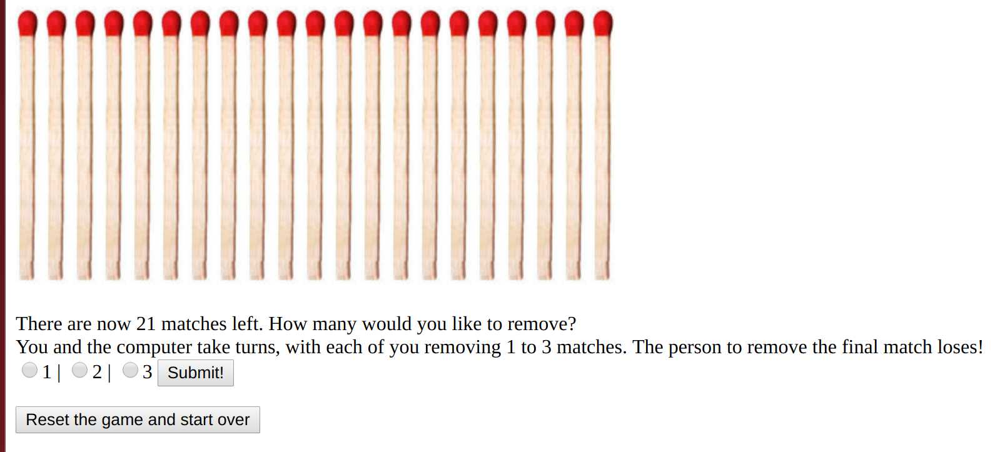
1. Beat the game at match.php to find the flag.
First, let's go to the site

Slide 4
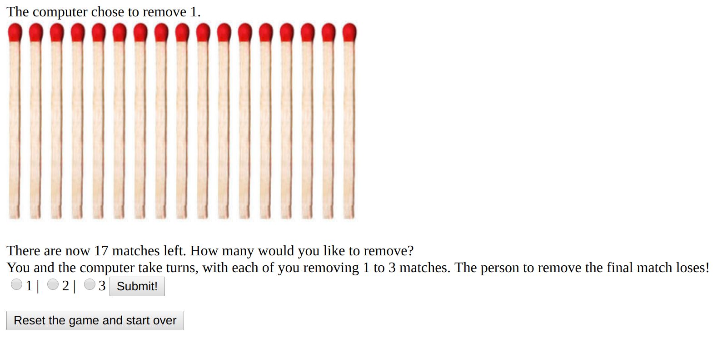
1. Beat the game at match.php to find the flag.
Okay, this game doesn't look too hard – let's remove 3

Slide 5
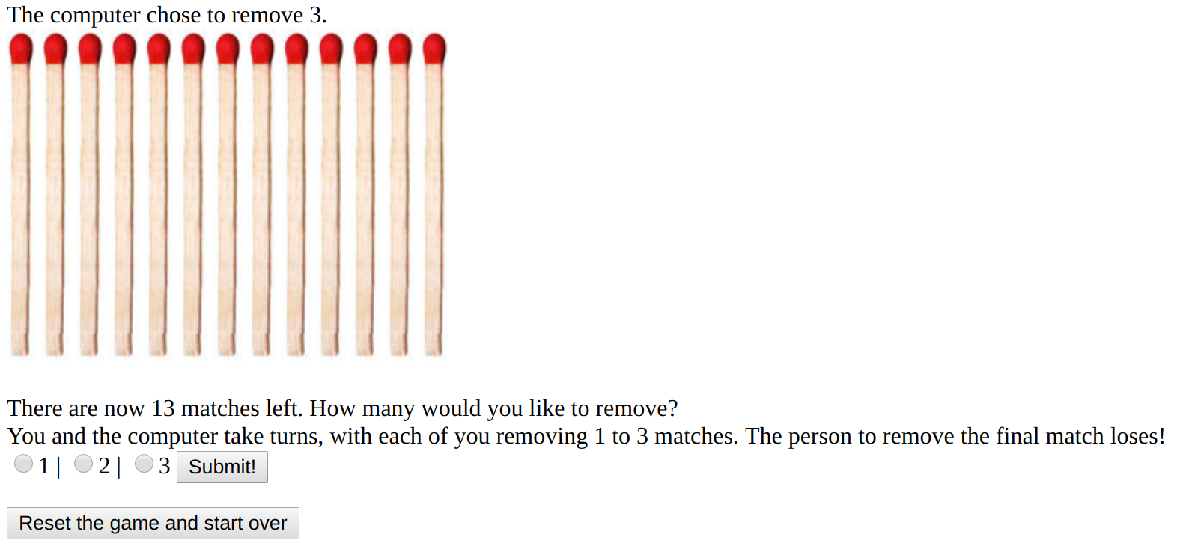
1. Beat the game at match.php to find the flag.
Okay, he removed 1. Let's remove 1. Now he removed 3..hrmm

Slide 6
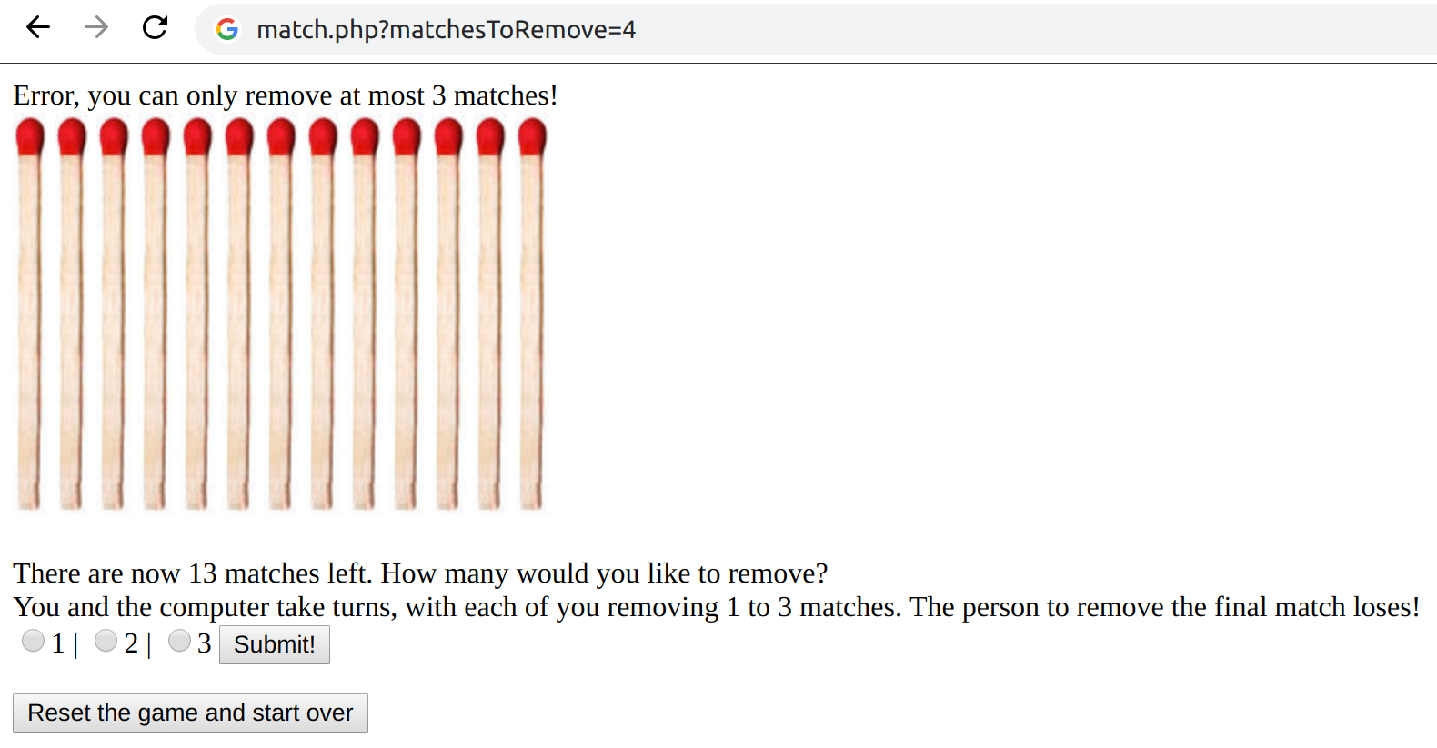
1. Beat the game at match.php to find the flag.
Maybe it isn't doing proper input checking. Let's try to remove 4 by editing the request....No luck.

Slide 7
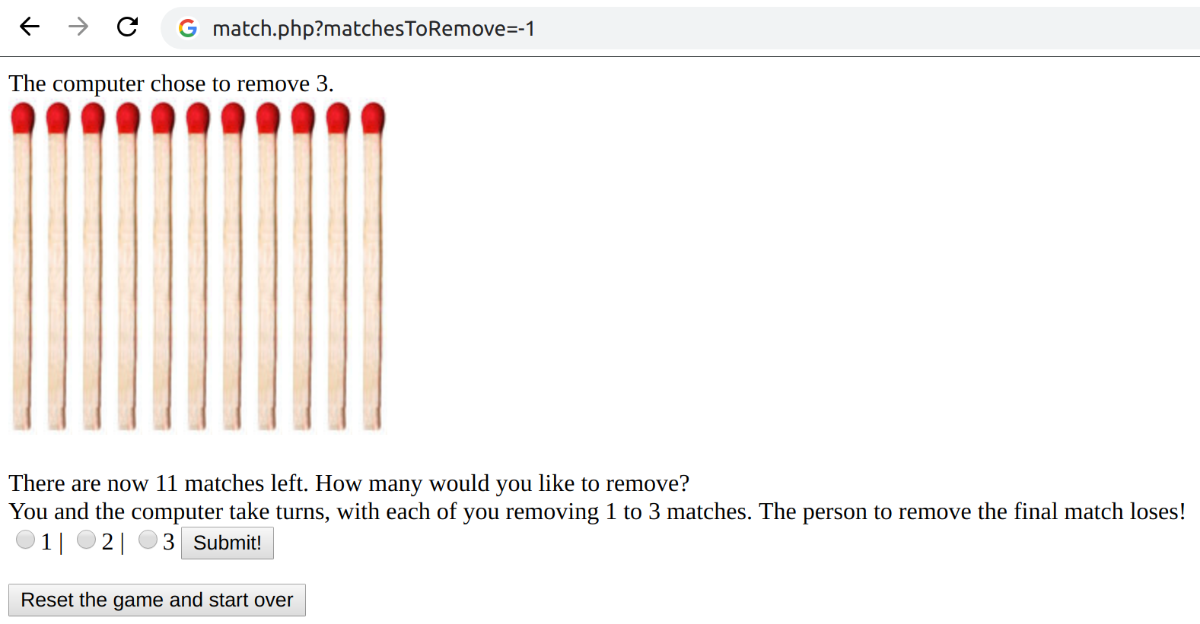
1. Beat the game at match.php to find the flag.
Maybe a negative value with work? Let's try -1..Viola!!!

Slide 8
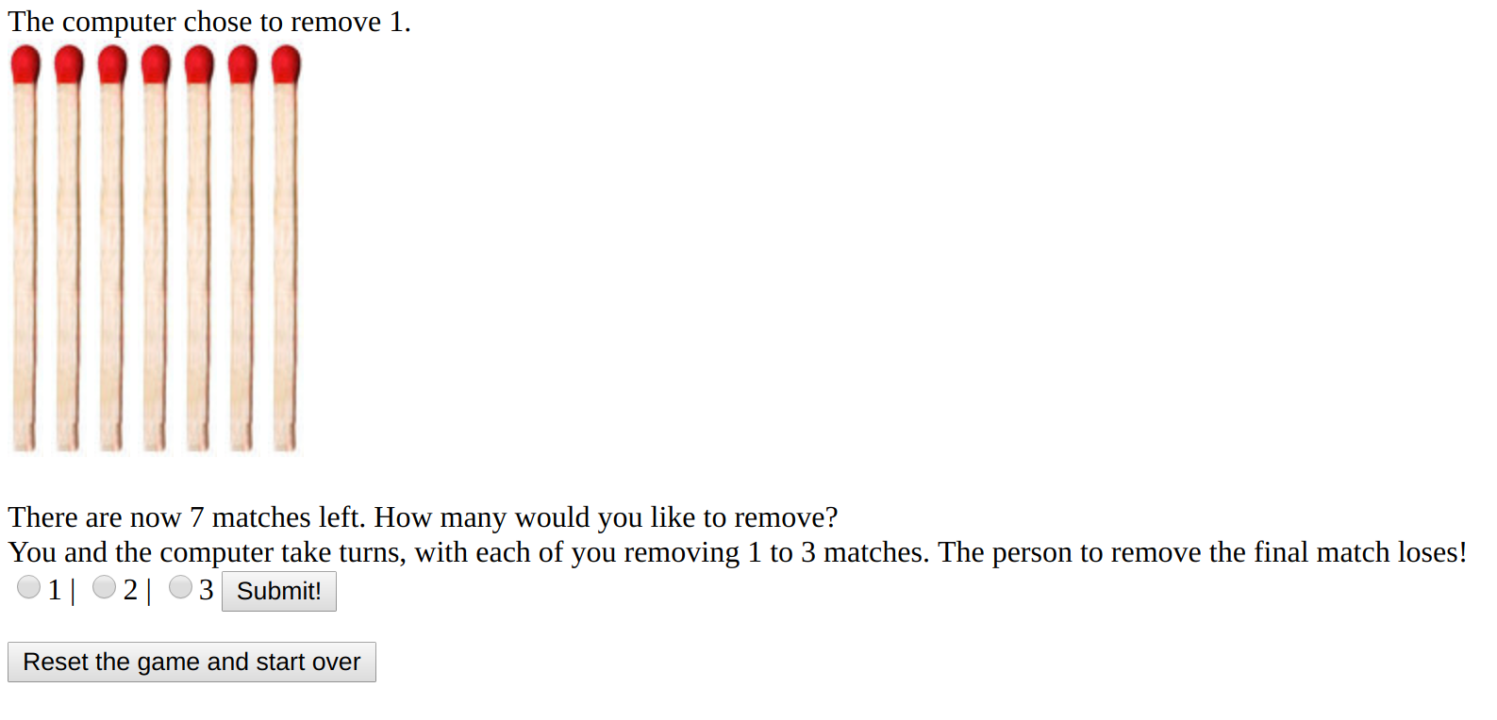
1. Beat the game at match.php to find the flag.
Let's keep picking 3 and walk it down to our victory!

Slide 9
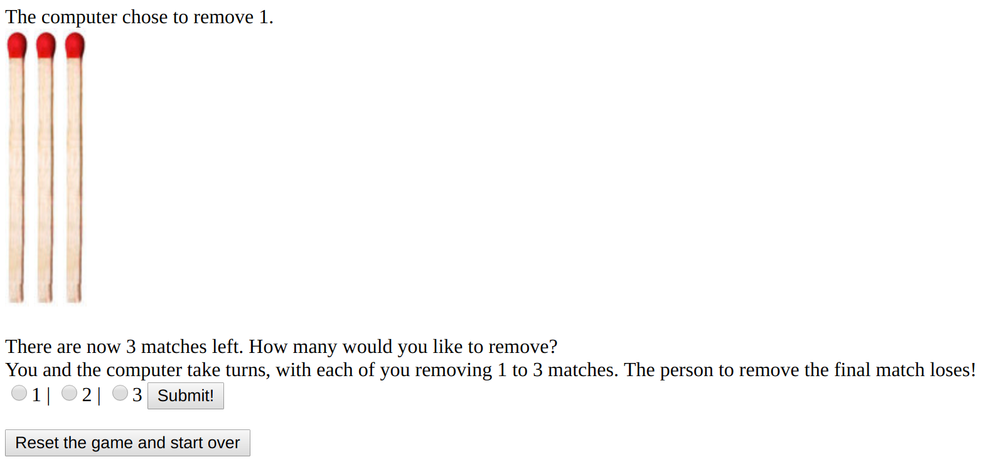
1. Beat the game at match.php to find the flag.
Let's pick 3 again and walk it down to our victory! Now we pick 2 and that should stick the computer with the final match!

Slide 10
1. Beat the game at match.php to find the flag.
That worked! We see the winning webpage!
Somehow, you have stumped the computer and won! Your prize is the flag: SnuffletyPlock

Slide 11
Question 2
Check if it is the right time at http://192.168.250.252/checkTime.php. Once it is the right time, the flag will appear..

Slide 12
2. Wait for the correct time to see the flag
First, let's go to the site
Is it time to see the flag?
No

Slide 13
2. Wait for the correct time to see the flag
Okay, I see an AJAX request to checktime.php?time=<hour>. Let's try going there directly
No

Slide 14
2. Wait for the correct time to see the flag
Let's view the source??
No<!-- It is not 0100 yet -->

Slide 15
2. Wait for the correct time to see the flag
Okay, so it just wants it to be 0100? Easy!
Let's go to checktime.php?time=1
Yes! It is time to see the flag: Relmarbli

Slide 16
Question 3
Find the not so well hidden flag at lights.php

Slide 17

3. Find the not so well hidden flag at lights.php
First, let's go to the site...Okay nothing obvious

Slide 18
3. Find the not so well hidden flag at lights.php
Let's try the obvious first thing – Viewing the source
<html>
<body style="background:#000000; flag:#436173706572546f6f">
<img src="nothing.gif"><img src="nothing.gif"><A HREF="/lights/lights.php?fliplight=1"><img src="lightimage.php?lightnumber=1"></a><img src="nothing.gif"><img src="nothing.gif"><br>
<img src="nothing.gif"><A HREF="/lights/lights.php?fliplight=2"><img src="lightimage.php?lightnumber=2"></a><img src="nothing.gif"><A HREF="/lights/lights.php?fliplight=3"><img src="lightimage.php?lightnumber=3"></a><img src="nothing.gif"><br>
<A HREF="/lights/lights.php?fliplight=4"><img src="lightimage.php?lightnumber=4"></a><img src="nothing.gif"><img src="nothing.gif"><img src="nothing.gif"><A HREF="/lights/lights.php?fliplight=5"><img src="lightimage.php?lightnumber=5"></a><br>
<img src="nothing.gif"><A HREF="/lights/lights.php?fliplight=6"><img src="lightimage.php?lightnumber=6"></a><img src="nothing.gif"><A HREF="/lights/lights.php?fliplight=7"><img src="lightimage.php?lightnumber=7"></a><img src="nothing.gif"><br>
<img src="nothing.gif"><img src="nothing.gif"><A HREF="/lights/lights.php?fliplight=8"><img src="lightimage.php?lightnumber=8"></a><img src="nothing.gif"><img src="nothing.gif"><br>
</body>
</html>

Slide 19
3. Find the not so well hidden flag at lights.php
flag:#436173706572546f6f
If we assume that is hex and convert it to ascii we get:
echo "0x436173706572546f6f" | xxd -r
CasperToo

Slide 20
Question 4
Solve the puzzle at lights.php to find the flag.

Slide 21
4. Solve the puzzle at lights.php to find the flag
First, let's go to the site

Slide 22
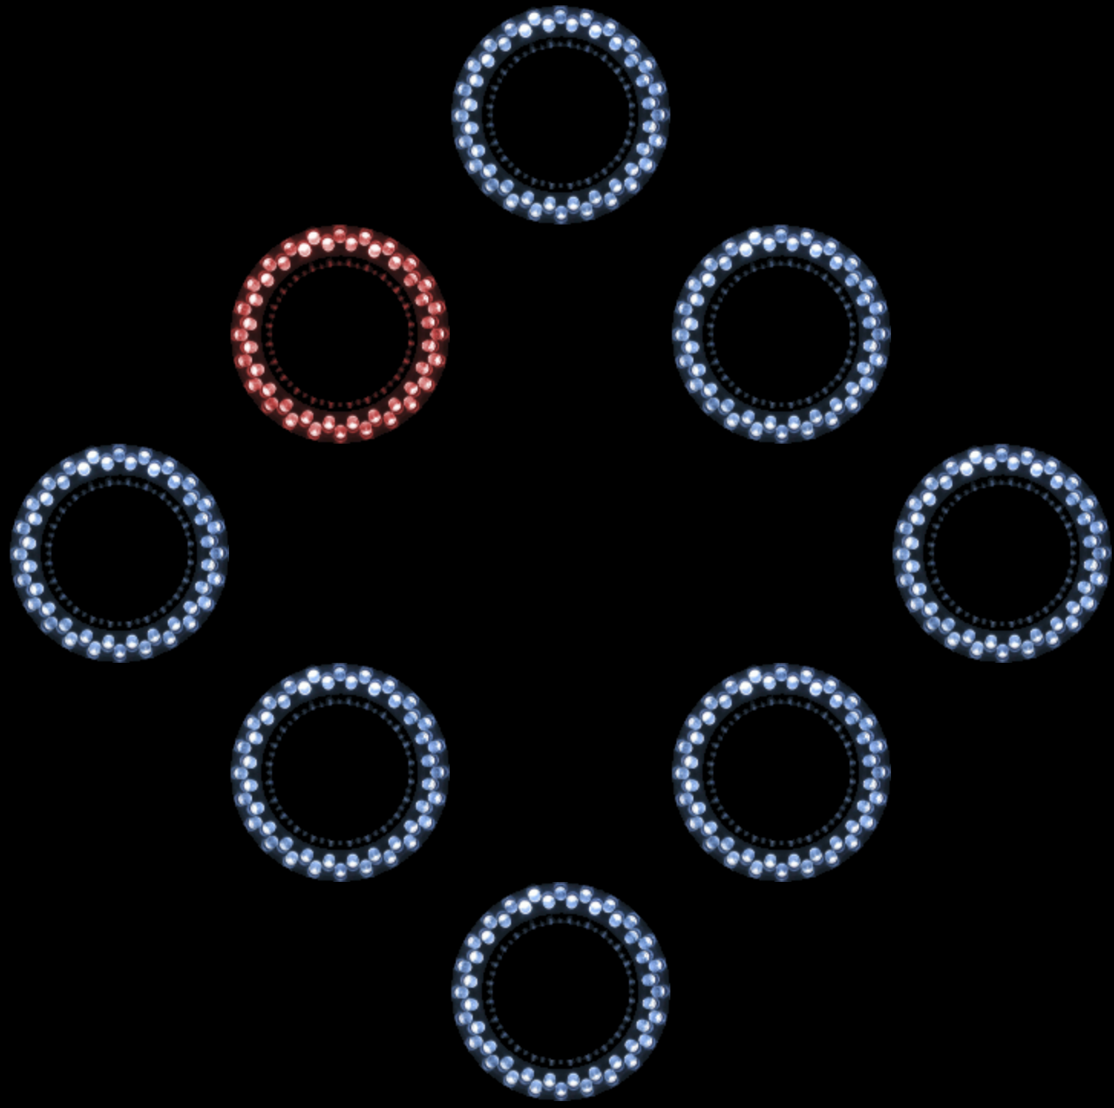
4. Solve the puzzle at lights.php to find the flag
Okay, if you click an image, it turns to red. Click it again, and it goes back to normal.
Now what do we do?

Slide 23
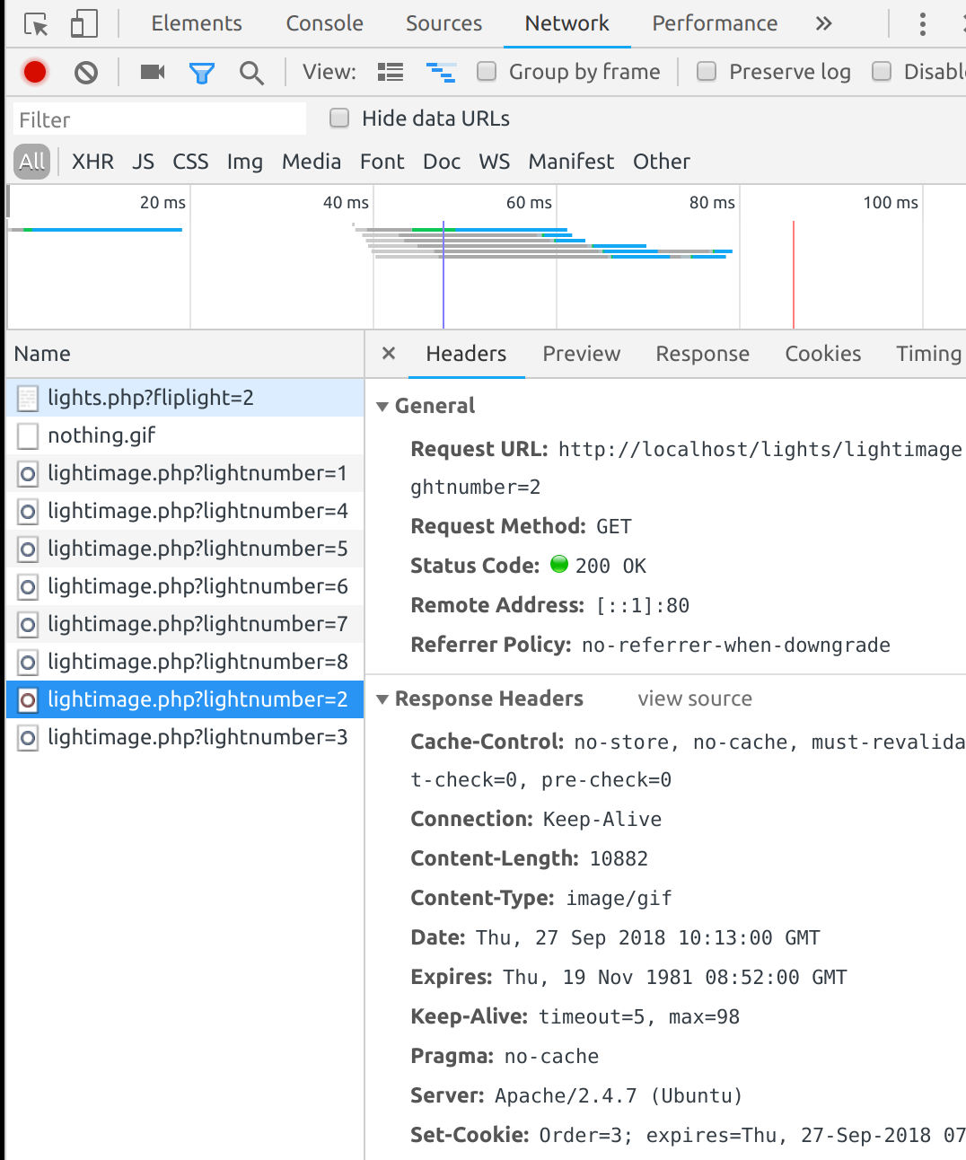
4. Solve the puzzle at lights.php to find the flag
I tried looking around a bit, eventually turning on the network tab in Chrome to see the network traffic (click the 3 dots to open up settings, the go to “More Tools”, then the network tab).
Then I started looking at the traffic the page and each image

Slide 24
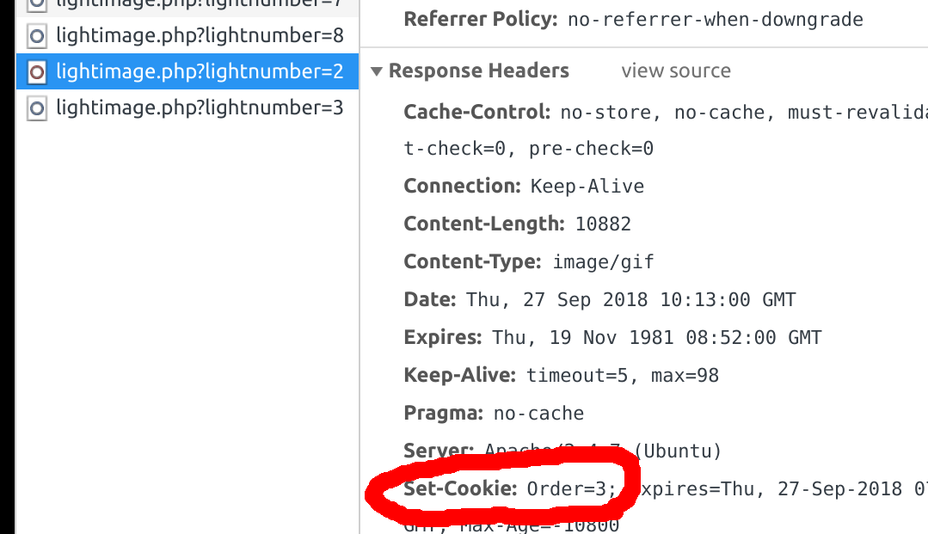
4. Solve the puzzle at lights.php to find the flag
If you look at the image I clicked (image 2), you see there is a Set-Cookie for “Order=3”. What is that?

Slide 25
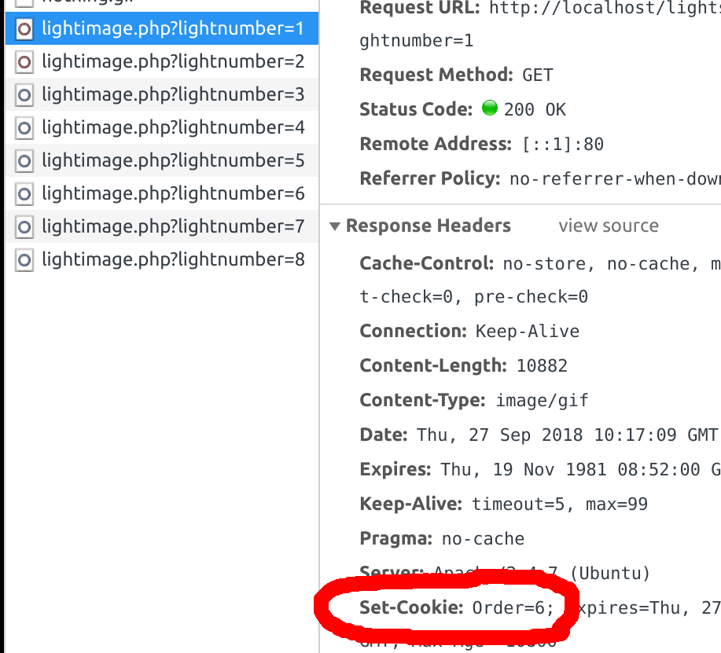
4. Solve the puzzle at lights.php to find the flag
If I click the first image, I see Order=6

Slide 26
4. Solve the puzzle at lights.php to find the flag
Each image I click gives me a unique order number, from 1 to 8. Maybe I need to click them in that order? If you notice, each light appears to have a number (based on the lightimage.php?lightnumber=X), from 1 to 8, starting from the top and reading left to right. First I turned everything off, then I clicked them based on the Order value from the Set-Cookie on each of them (from 1 to 8).

Slide 27
4. Solve the puzzle at lights.php to find the flag
If you click them in this order (starting with them all off) – 7, 6, 2, 4, 3, 1, 5, 8, you will be shown this on the screen!
You solved it! You have earned the flag: PuzzleSolvinMaster

