Slide 1
2018.11.06 Georgia Cyber Center CTF
Zipcrack

Slide 2
Question 1
What was the rock solid password used to encrypt challenge.zip?

Slide 3
1) What is the password?
First generate hash:
# zip2john challenge.zip > challenge.hash
Password can be found in the rockyou.txt wordlist
# john –wordlist=/usr/share/wordlists/rockyou.txt challenge.hash
Should return the password as Whatisthematrix3
Note: Use the latest community-enhanced version for this to work properly. Github: https://github.com/magnumripper/JohnTheRipper

Slide 4
Question 2
A key has been hidden within 02_key.txt. What is the key? Use 01_remove.txt to help uncover it.

Slide 5
2) What is the key?
key.txt contains a base64 encoded string but returns invalid characters when decode
remove.txt is a list of hexadecimal numbers and are indices to the characters in key.txt
Remove the character found at each index in key.txt and then decode the resulting base64 string
This gives the result: numpy.diag(M.reshape(21,21))

Slide 6
Question 3
The password used to encrypt next.zip is a permutation of the first 10 characters of the key from the previous problem. What is the password?

Slide 7
3) What is the password?
The first 10 characters of the key were: numpy.diag
Create a wordlist with all possible permutations using crunch
# crunch 0 0 -o /usr/share/wordlists/permutations.txt -p numpy.diag
Generate hash:
# zip2john next.zip > next.hash
Using this wordlist with john the ripper crack the password
# john –wordlist=/usr/share/wordlists/permutations.txt next.hash
Password is: gnyi.pmdua

Slide 8
Question 4
Use the key recovered from 02_key.txt to help you find the flag hidden in M.csv

Slide 9
4) What is the flag?
Opening M.csv shows a 49X9 grid of integers
The key we found earlier is a python statement that uses the numpy module
Import M.csv into a python program as a 2-D numpy array and then apply the key
If done correctly the result should be the following array:
[ 89 48 117 65 114 51 68 97 49 78 101 48 33 35 82 101 100 80 105 108 108 ]
And when these values are converted to their ascii equivalent:
Y0uAr3Da1Ne0!#RedPill

Slide 10
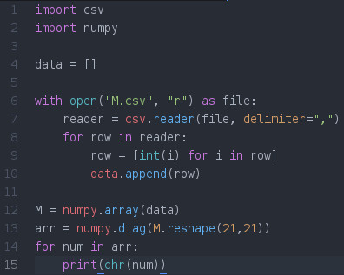
4) What is the flag?
Here is an example program for extracting the flag

