Slide 1
Course Basics
Programming Models for Emerging Platforms

Slide 2

Logistics
Instructor: Anthony Canino
  Research Interests: programming languages, software engineering, compilers, systems
  Email: acanino1@binghamton.edu, anthony.canino1@gmail.com
    ALWAYS feel free to email me
  Class: T R 11:40-1:05 (AP G014)
  Office Hours: TBA
    Willing to make additional scheduled appointments

Slide 3
Logistics
Course Webpage
  https://anthonycanino1.github.io/cs476-s19/
Blackboard system used for submissions

Slide 4
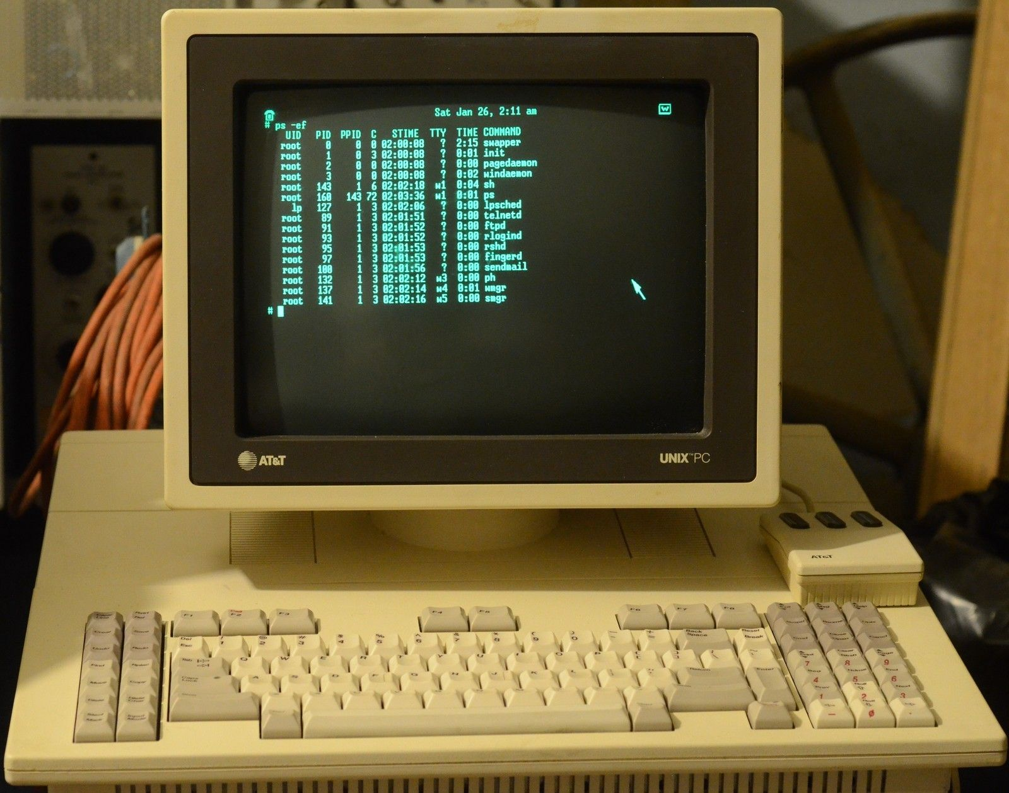
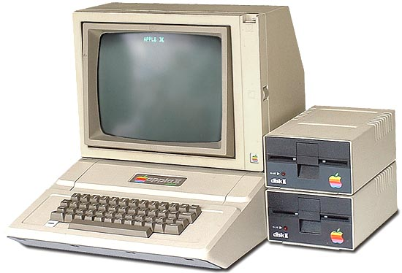


The Old

Slide 5
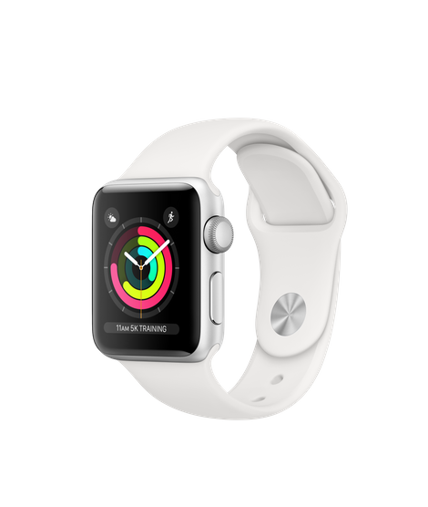
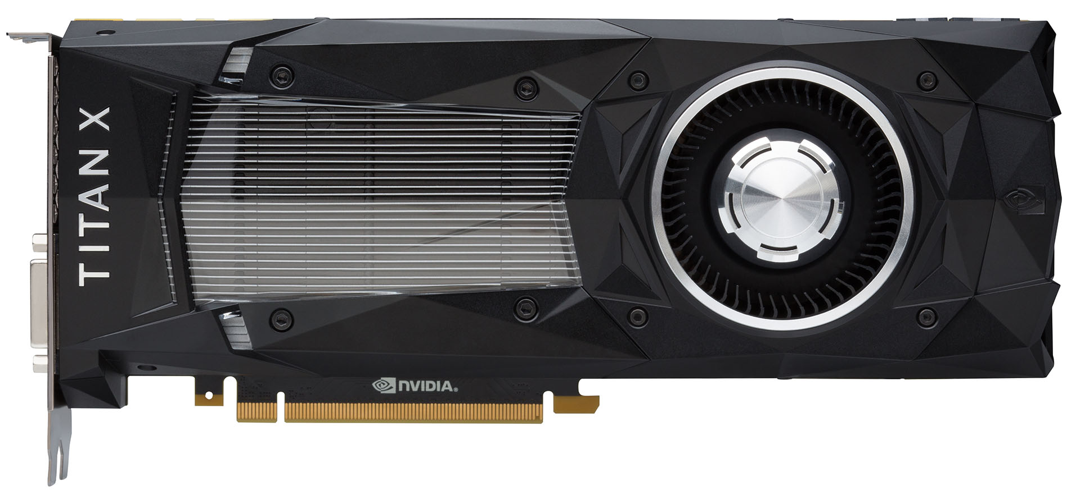
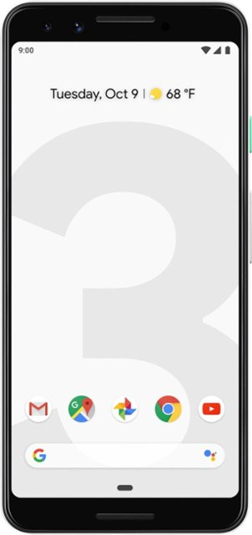
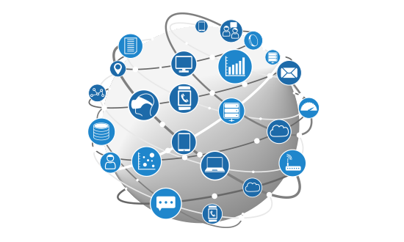
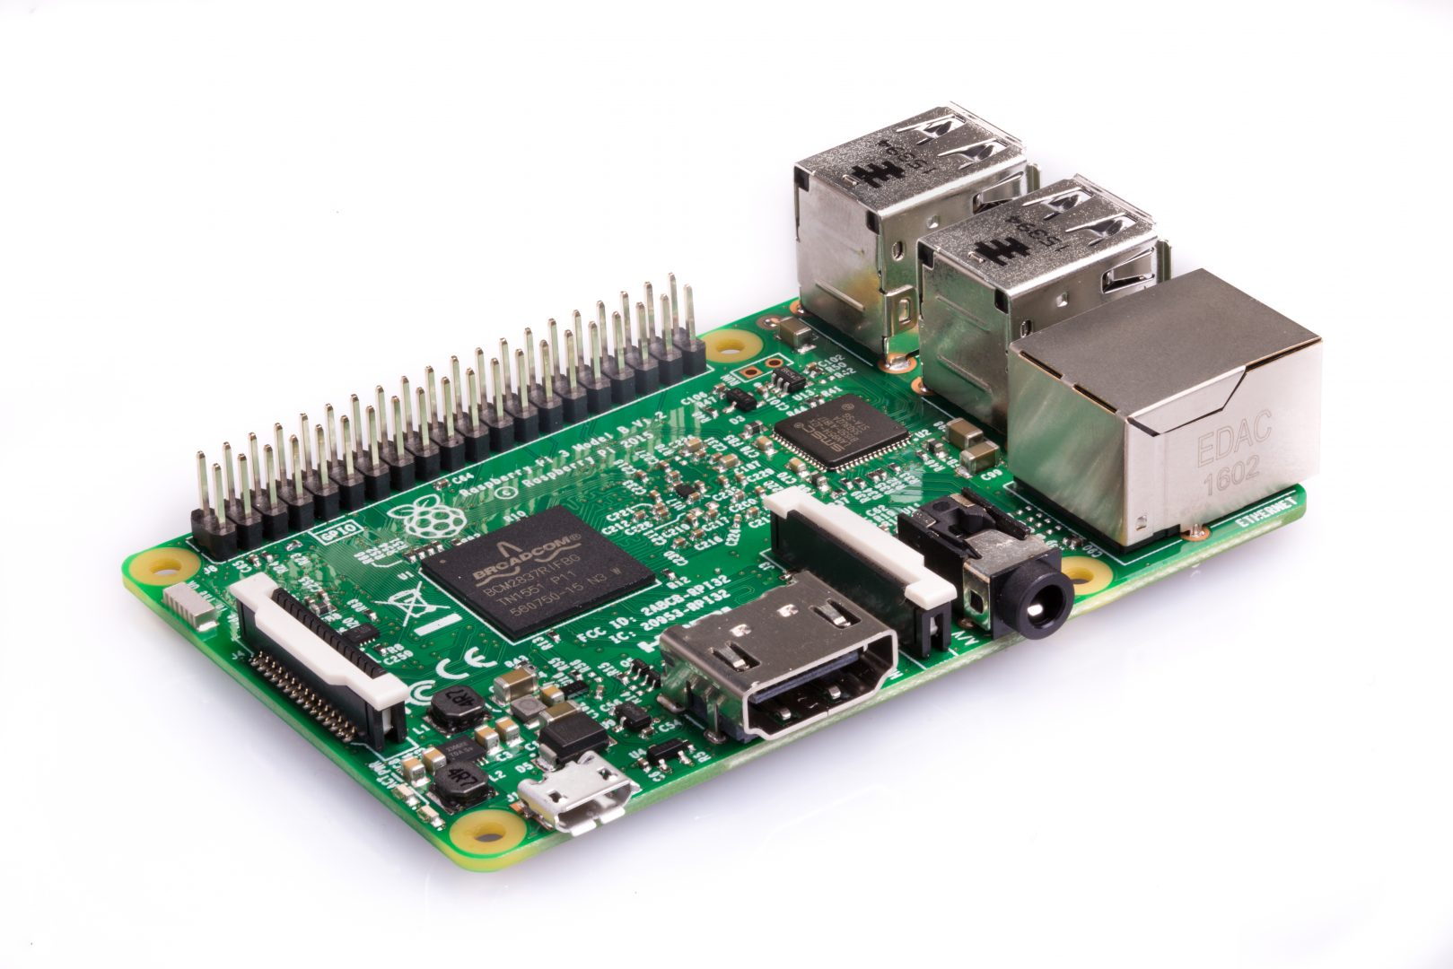
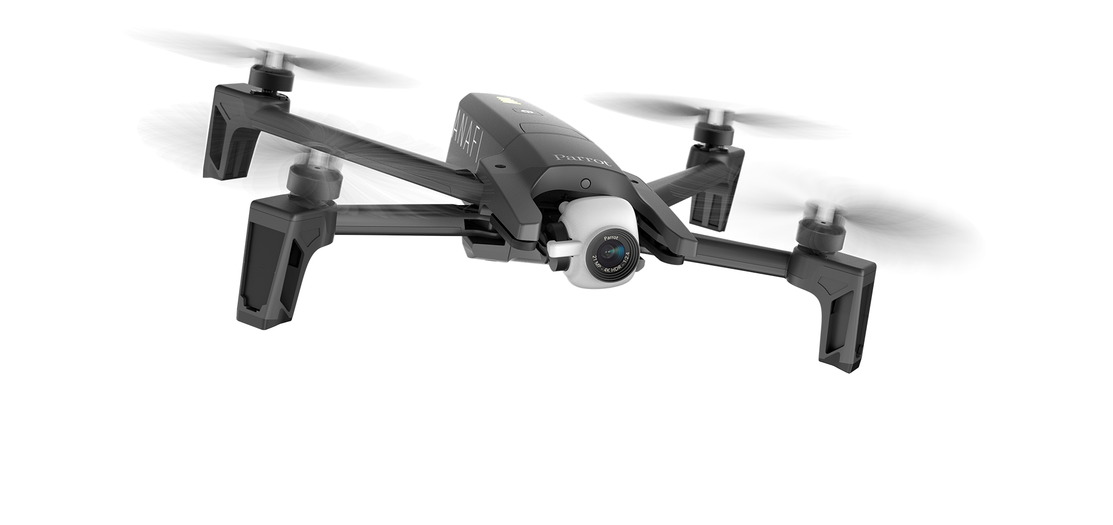
The New

Slide 6
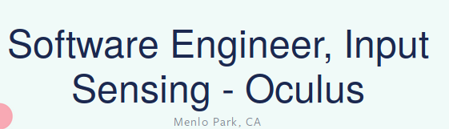
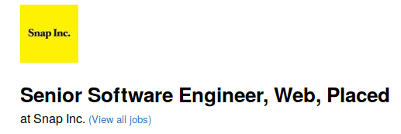
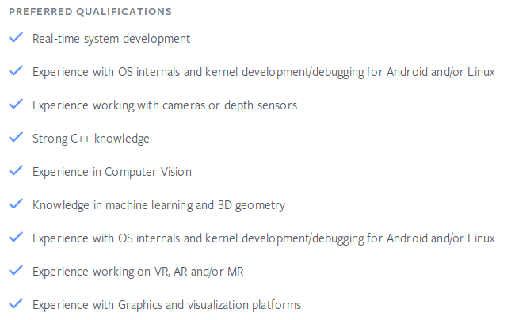


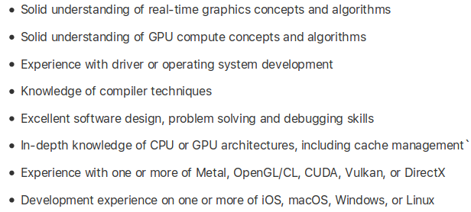

Slide 7
My goals for you
Rough understanding of emerging technologies
  We cant cover everything
Comfortable with discomfort
  I will make you write software for frameworks and technologies you have little experience with
Sharpen your resumes
  Everyone is a C/C++, Java, and Python programmer
Expose you to trendy topics that you may want to get a job in
  Industry or Academia

Slide 8
My goals for you
Rough understanding of emerging technologies
  We cant cover everything
Comfortable with discomfort
  I will make you write software for frameworks and technologies you have little experience with
Sharpen your resumes
  Everyone is a C/C++, Java, and Python programmer
Expose you to trendy topics that you may want to get a job in
  Industry or Academia

Slide 9
Hacking is a skill!

Slide 10
My Style
I will use slides minimally
  Don’t expect much information on the slides
I will write code during lecture
Bring your laptops! Have them open!
  I want you to follow along
  I will run mini-lab sessions during class, be prepared to code
  If you dont have a laptop, pair up with someone

Slide 11
I wont be strict with
Deadlines
  I understand you have multiple classes
Class Start Time
  We are far away
Outside Class Help
  ALWAYS feel free to ask questions, over email etc
  Questions don’t need to only be about assignments. Class material is important too.
Grading
  I am unlikely to leave you stuck and without concrete steps forward on an assignment if you come see me

Slide 12
I will be strict with
Deadlines
  If no one works on the assignment until the last minute
Class Start Time
  A little late is ok, showing up halfway through class is an absence
Outside Class Help
  Read through assignment details first
Grading
  Assignments have concrete test cases in code. You need to pass them.

Slide 13
This Class
Programming Models for Emerging Platforms
  Expect new languages
Programming Models for ...
  Multicore
  GPU
  Mobile Systems
  Unmanned Aerial Systems (UAV)
I may expand list

Slide 14
More Logistics
See Syllabus
  https://anthonycanino1.github.io/cs476-s19/syllabus.html

