Slide 1
C Programming
Programming Models for Emerging Platforms

Slide 2
“C is quirky, flawed, and an enormous success. “
- Dennis Ritchie

Slide 3
“[C has] the power of assembly language and the
convenience of … assembly language. “
- Dennis Ritchie

Slide 4
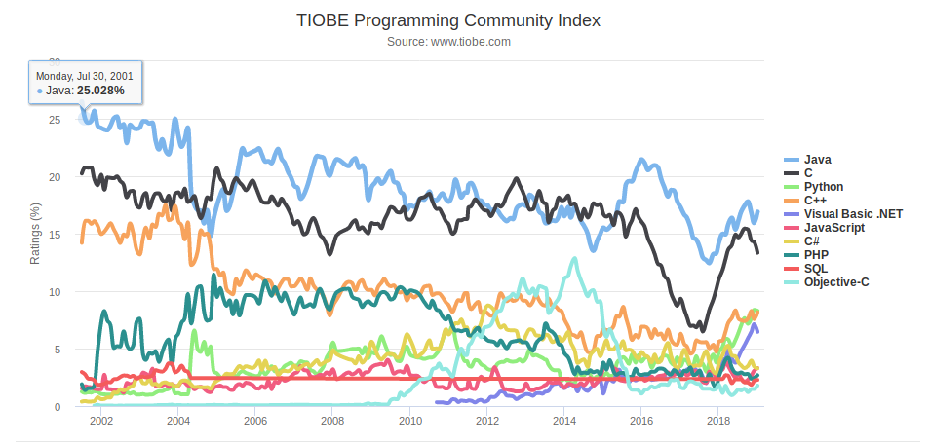

Slide 5
Why do we care about C?

Slide 6

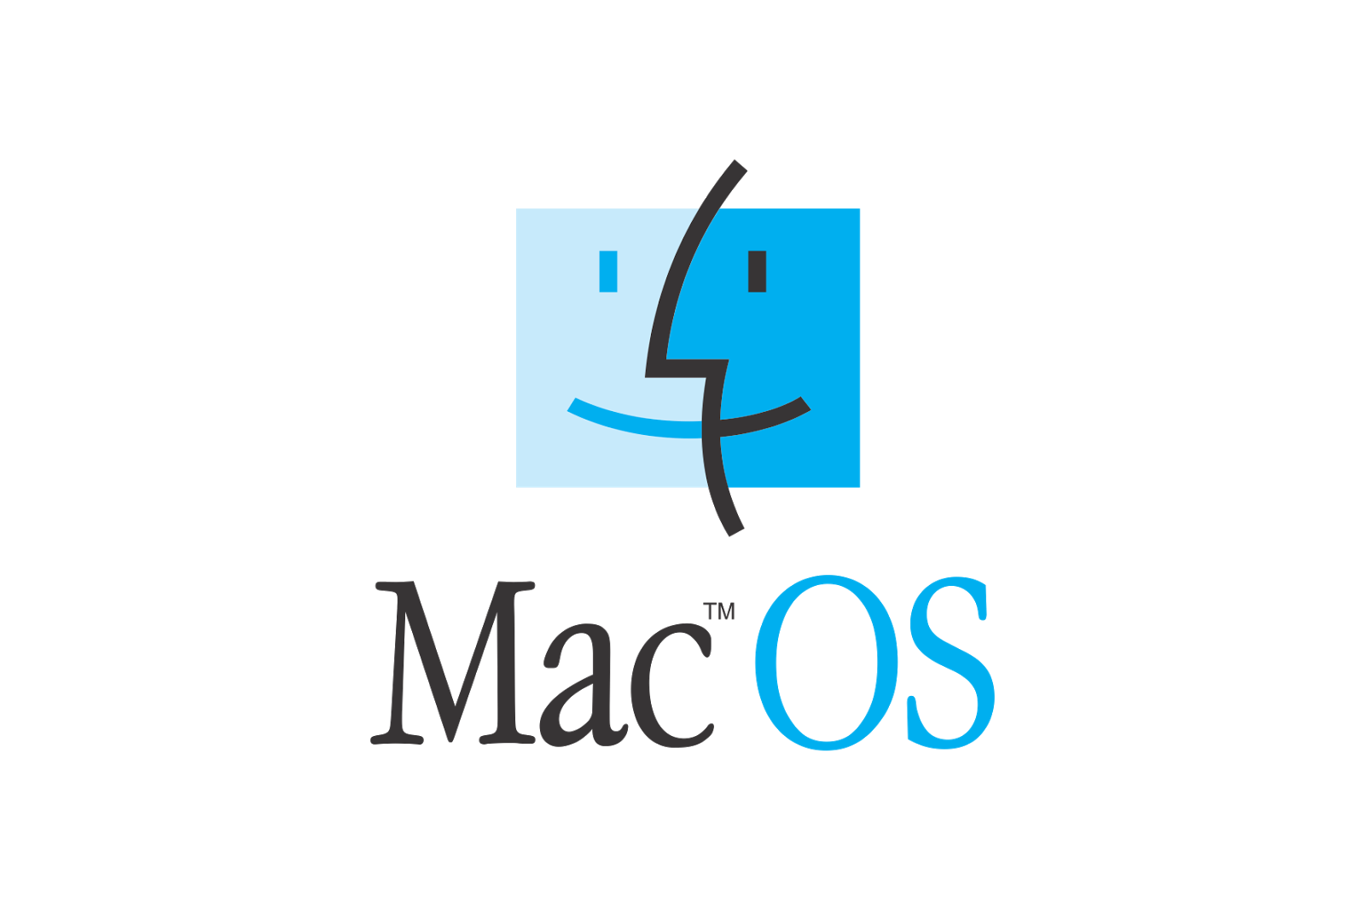


Slide 7
Why do we care about C?
1. Serves as a motivator for new approaches
2. Everything has to talk to C (eventually)

Slide 8
For Reference / Self Study
Memory
  Malloc
  C linked list
Structs
Function pointers

