Slide 1
Multi-core Programming in C
Programming Models for Emerging Platforms

Slide 2
Warm Up
Sample code at: https://anthonycanino1.github.io/cs476-s19/lectures/lec2-multicore/templates.tar.gz
Take 10 minutes, work on example

Slide 3
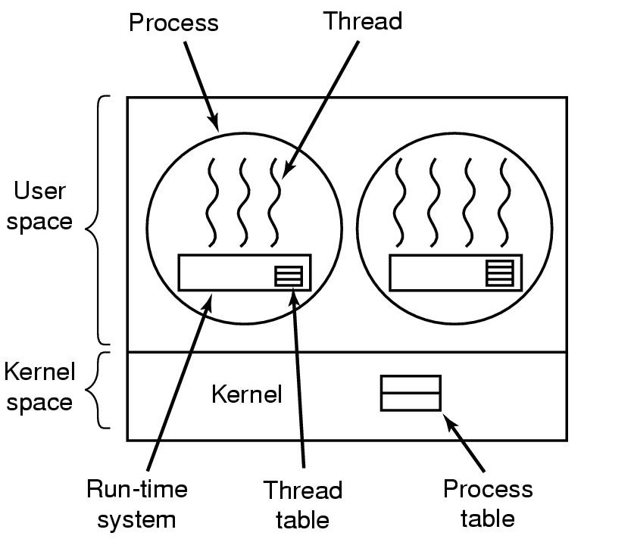
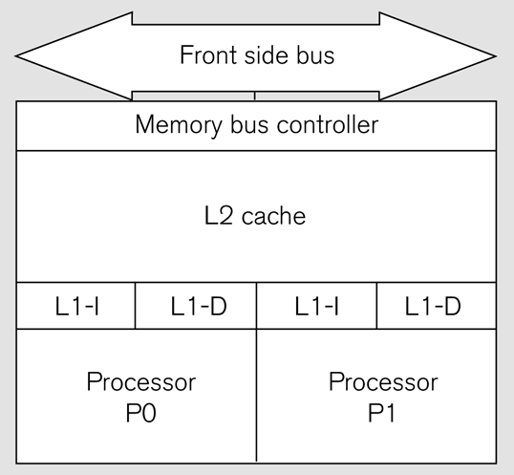
Multi-core Programming

Slide 4
Multi-core Programming
Sequential
Concurrent
Parallel
Distributed

Slide 5
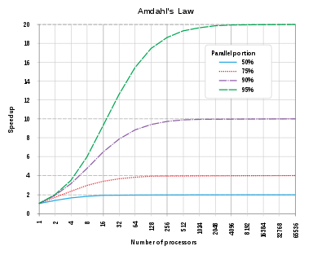
Amdahl’s Law

Slide 6
Is concurrent programming a poor version of
parallel programming?

Slide 7
Is concurrent programming a poor version of
parallel programming?
We want to study programming models for
Both concurrent and parallel programming

Slide 8
First Model: POSIX Threads
C library for thread programming
Almost as crude as it gets
Work through example

Slide 9
For Reference / Self Study
pthread library functions
  pthread_create
  pthread_join
  pthread_mutex_init
  pthread_mutex_lock
  pthread_mutex_unlock
  pthread_mutex_destroy
  pthread_cond_init
  pthread_cond_signal
  pthread_cond_wait
  pthread_cond_destroy
Compiling and linking
  Use pthread header: #include <pthread.h>, <semaphore.h>
  Compile: gcc –std=c11 -pthread code.c
semaphore library functions
  sem_init
  sem_wait
  sem_post
  sem_destroy
Compiling and linking
  Use pthread header: #include <pthread.h>, <semaphore.h>
  Compile: gcc –std=c11 -pthread code.c

