Slide 1
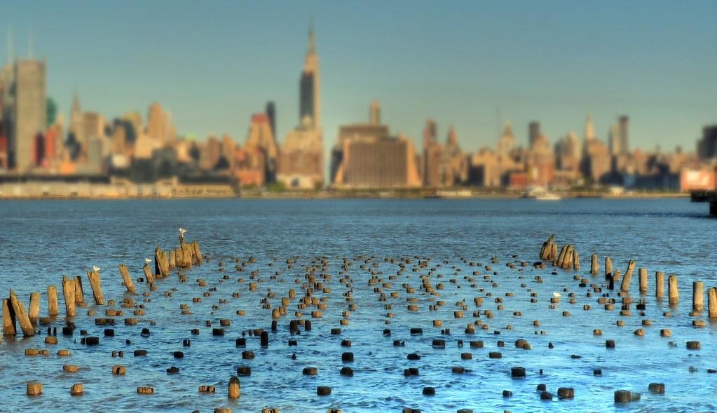
The Port Authority of NY and NJ
Team 8 :
Anthony Philippe Denis //// Pavana Sree Prathyusha Kollu

Slide 2
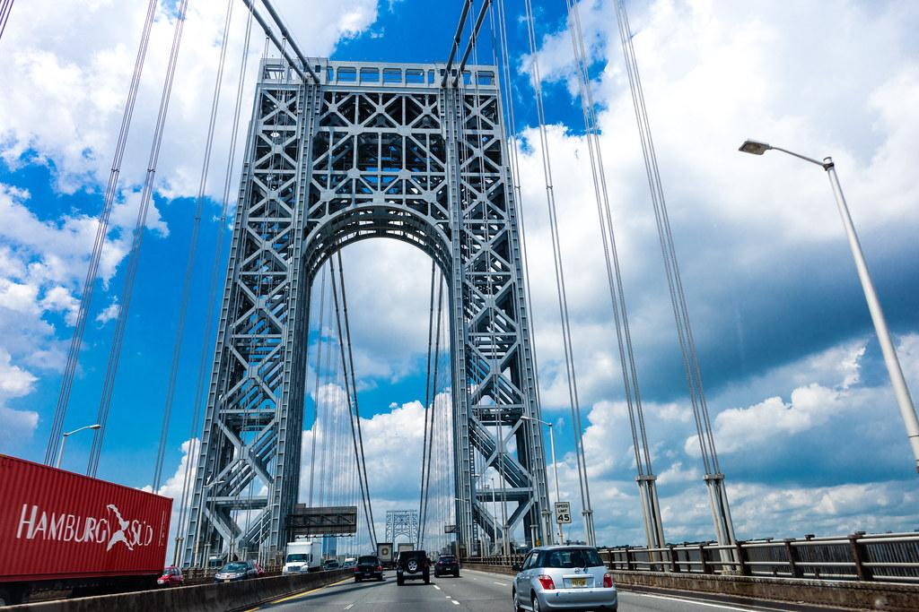
Agenda
1.Company & Goals
2. Models
3.Dashboards
4.Questions
5.Next Steps
6.Money Time

Slide 3
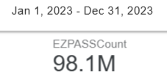
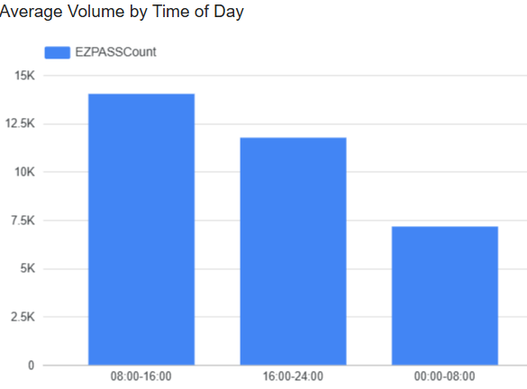
Company & Goals
Port Authority of NY & NJ
Manages Holland, Lincoln, GWB Upper/Lower, Bayonne, Goethals, Outerbridge
Project Goals
Identify factors driving bridge / tunnel usage
Detect & quantify toll violators
Pinpoint busiest periods to improve operations

Slide 4
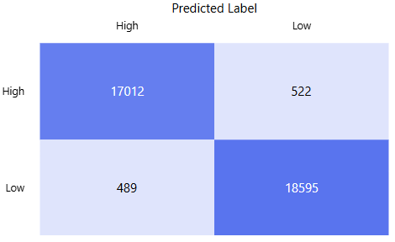
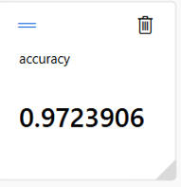
Predictive models
🎯 Classification Model
Classifies days as High-Risk vs Low-Risk for toll violations

Slide 5
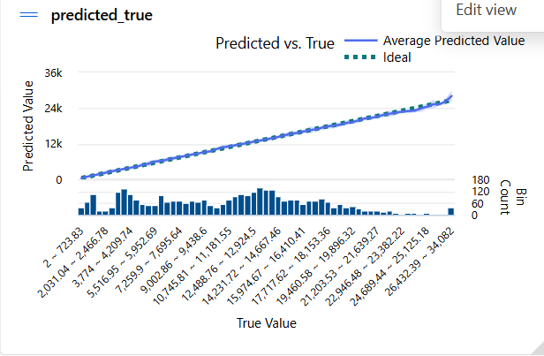
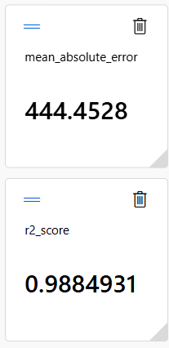
More model
🔧 Regression Model
Predicts how weather and time-of-day affect EZPASSCount (R² ≈ 0.99)

Slide 6
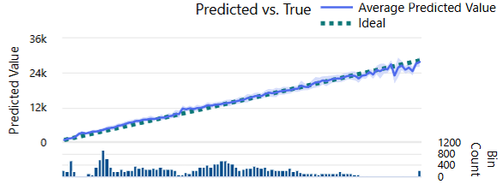
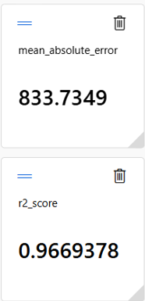
Last Model
📈 Time-Series Forecasting
Projects future traffic volumes to anticipate congestion (MAE=833)

Slide 7
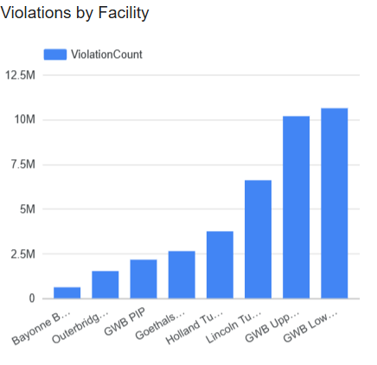
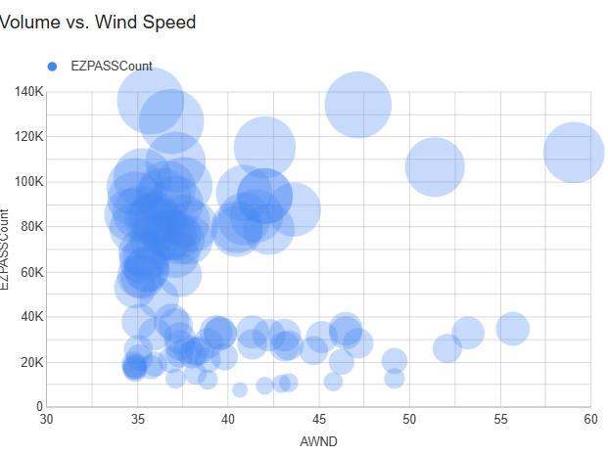
Dashboards Overview
Usage Drivers : What factors affect traffic usage ?
Toll Violations : Where and when do unpaid tolls occur ?
Peak Traffic: When are the busiest periods and what influences them ?

Slide 8
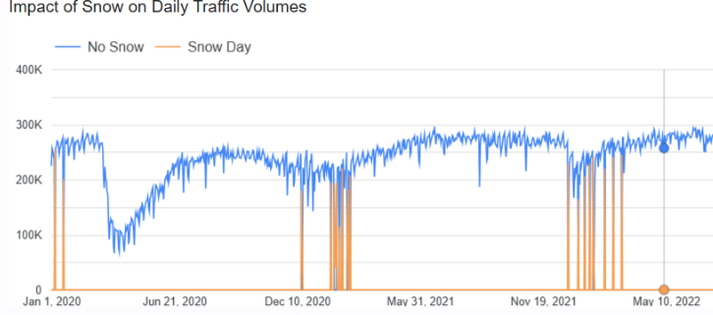

Q1 : What factors Affect Traffic Usage ?
Snow impacts:
On Snow Days, traffic volume drops by approximately 25% compared to clear days.
Time of Day:
08:00am –04:00pm block handles 43% of total daily traffic volume
Weather correlations:
Positive correlation with temperature (r = +0.07)
Negative correlation with precipitation and snow (r ≈ –0.03 to –0.07)

Slide 9
Q1 : Recommendations
- Boost Snow Day Readiness:
Port Authority 2023 Capital Plan allocates $725M to upgrade anti-icing systems and de-icing spray bars at key facilities.
- Prioritize 8 AM– 4 PM Staffing
- Weather-Responsive Traffic Management

Slide 10
Q1 : Recommendations
Boost Snow Day Readiness:
Port Authority 2023 Capital Plan allocates $725M to upgrade anti-icing systems and de-icing spray bars at key facilities.
→ Action: Proactively deploy de-icing and lane-treatment teams 4+ hours before forecasted snow events.
Prioritize 8 AM– 4 PM Staffing:
→ Consistent with Port Authority’s goal to “optimize peak-hour throughput” noted in Annual Report 2023.
Weather-Responsive Traffic Management:
→ Apply lessons from NYC DOT winter operations (expand real-time weather monitoring, dynamic alerts).

Slide 11
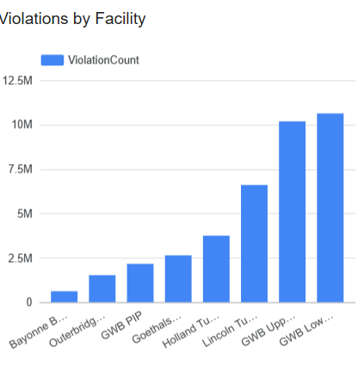
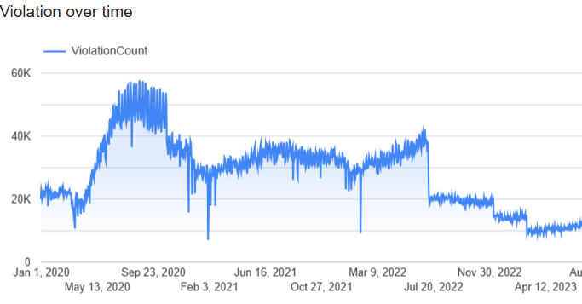
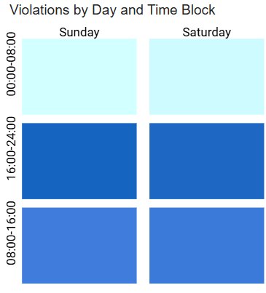
Q2 : Where and When Do Toll Violations Occur ?
Highest Violators:
→ GWB Lower Span shows the highest total violation counts (~1.2 million violations/year).
Violation Trends Over Time:
→ Sharp spikes in violations on Weekends. (Friday, Saturday, Sunday).
Violation Timing Patterns:
→ Peak violations typically occur during 4:00pm–00:00AM (afternoon–evening block).

Slide 12
Q2 : Recommendations
Targeted Enforcement at High-Risk Sites:
Install Automated License Plate Recognition (ALPR) Systems:
ALPRs reduced toll violations by 47% in pilot programs.
Recommended at GWB first.
Dynamic Fining Strategy:
Implement escalating fines (e.g., 5× fine after 30 days) to encourage faster payment compliance, similar to practices in Maryland and Australia (success rates above 90%).
- Peak Violation Alerts for Field Teams:
Set up automatic internal alerts when violation volumes exceed daily thresholds.

Slide 13
Q2 : Recommendations
Targeted Enforcement at High-Risk Sites:
→ Prioritize GWB Lower Span, Holland Tunnel, and Lincoln Tunnel for enhanced monitoring during peak violation times (Weekends).
Install Automated License Plate Recognition (ALPR) Systems:
→ ALPRs reduced toll violations by 47% in pilot programs.
→ Recommended at GWB first.
Dynamic Fining Strategy:
→ Implement escalating fines (e.g., 5× fine after 30 days) to encourage faster payment compliance, similar to practices in Maryland and Australia (success rates above 90%).
Peak Violation Alerts for Field Teams:
→ Set up automatic internal alerts when violation volumes exceed daily thresholds.

Slide 14
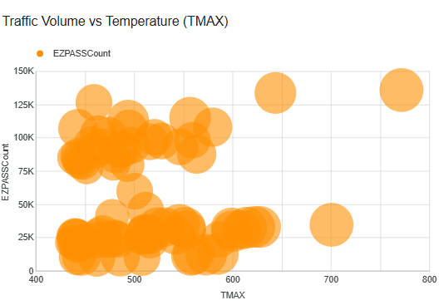
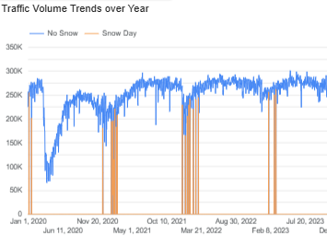
Q3 : When are the busiest periods and what influences them ? :
Traffic Volume Seasonality:
- Peaks in July and August (~10–12% higher than winter months).
Temperature Effects:
- Higher temperatures (TMAX) correlate with higher traffic volumes (visible cloud upward trend).
Precipitation Effects:
- On heavy rain/snow days (PRCP > 1 inch), traffic volume drops significantly
Events Dips:
- Holiday events (like Christmas, New Year) show clear dips in the time series line.

Slide 15
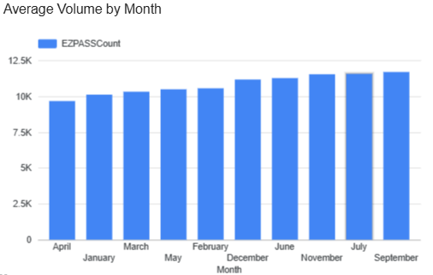
Q3 : Recommendations
Seasonal Staffing Adjustments:
→Increase lane staffing and incident response capacity from June to August.
Dynamic Traffic Alerts:
→Use real-time traffic management systems to issue alerts.
Holiday Traffic Monitoring:
→Prepare alternate routing for major holidays when demand shifts sharply.

Slide 16
Q3 : Recommendations
Seasonal Staffing Adjustments:
→Increase lane staffing and incident response capacity from June to August.
Dynamic Traffic Alerts:
→Use real-time traffic management systems to issue alerts.
Holiday Traffic Monitoring:
→Prepare alternate routing for major holidays when demand shifts sharply.
Invest in Weather-Responsive Infrastructure:
→Expand dynamic signage and expand real-time weather monitoring, dynamic alerts(rain/snow).

Slide 17
What is next ?
Enhance Winter Operations:
→ Expand early de-icing deployment on forecasted snow days to reduce 25% traffic drops.
Prioritize Peak Hour Staffing:
→ Allocate more personnel to the 08:00AM–04:00PM peak block to handle 43% of daily volume.
Install Automated Toll Enforcement:
→ Use ALPR to cut unpaid tolls by 40–50%, replicating national best practices.
Implement Dynamic Fine Escalation:
→ Recover up to 90% of unpaid tolls by increasing fines over time for late payers.
Deploy Real-Time Traffic & Violation Alerts:
→ Create automatic alerts for field teams based on violation spikes (especially Friday–Saturday- Sundays evenings).

Slide 18
Data + Action
=
Safer Roads, Faster Flow, and Higher Revenue.

Slide 19
MONEY TIME
WINTER Operations : 25% reduce of traffics drops
Average Cost EZ Pass tolls : 15$
Clear Day : 250,000/day
Snow Day : 190,000/day
Difference : 60,000/day
25% : 15,000/day
15,000 x 33 days of snow a year = 495,000
495,000 x 15$ = ???
7.4 Millions of $/Year

Slide 20
MONEY TIME
Automate Liscence Plate Recognition : 40%-50% of Violations recovered
Average $ recovered per violations: 50$
ALPR between 40% and 50% : 40%
Average violation : 10,000/day
Pourcent of violation recovered : 10,000 x 40%
4,000 /day
4,000 x 50$ = 200,000$/day
200,000 x 365 = ???
73 Millions of $/Year

Slide 21
MONEY TIME
Dynamic Fine Escalation : 90% of Violations recovered
Average $ recovered per violations: 50$
90% of the rest of the daily violation : 6,000 x 0.9 = 5,400
Pourcent of violation recovered : 5,400 x 50$
270,000 $/day
270,000$ x 365 =
98,6 Millions of $/Year

Slide 22
TOTAL
7,4 + 73 + 98,6 =
179 Millions of $/Year
Cost of Implementaton = 7 facilities x 4 Millions = 28 Millions
179 – 28 = 151 Millions of $ Recovered

Slide 23
THANK YOU

Slide 24
LINK DASHBOARDS
https://lookerstudio.google.com/reporting/f7ef7580-3c10-40c1-9b0f-df0d3528b385

