Slide 1
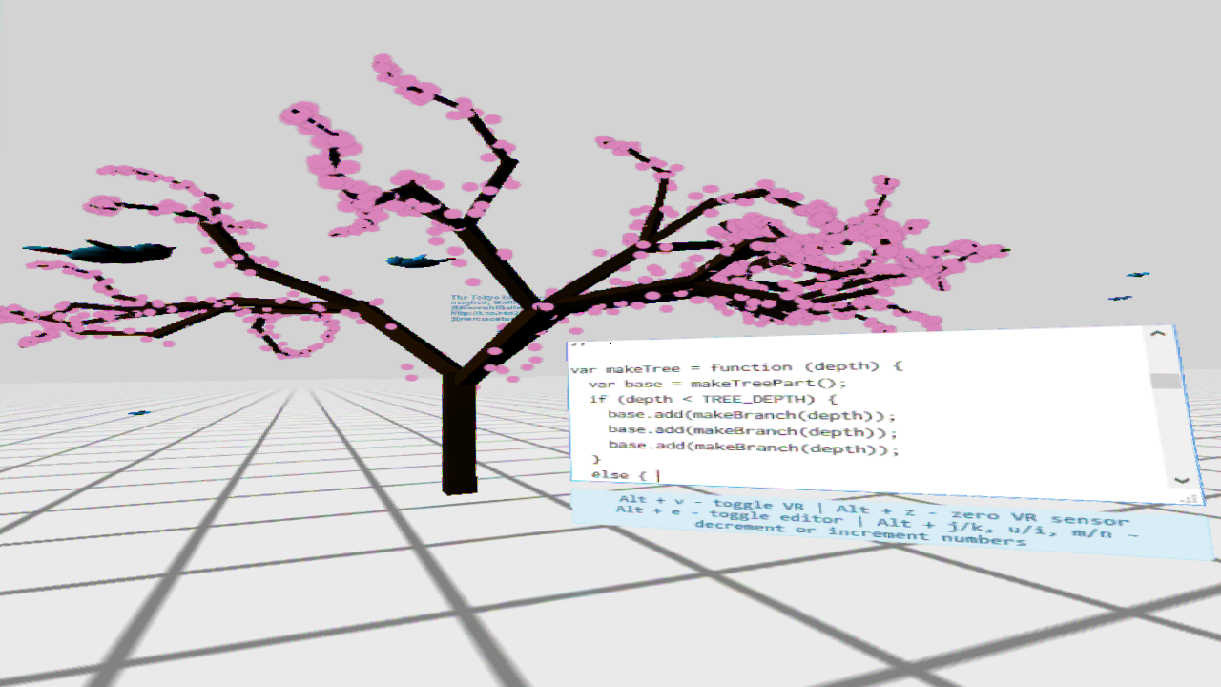
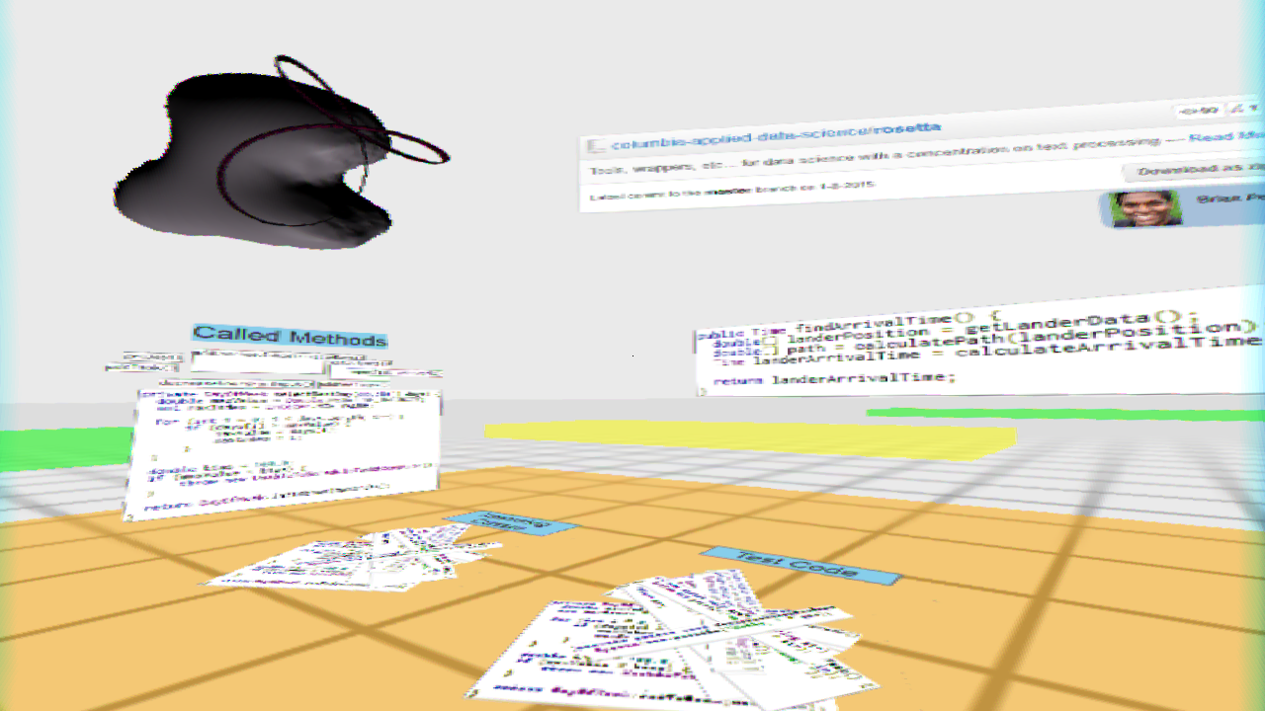

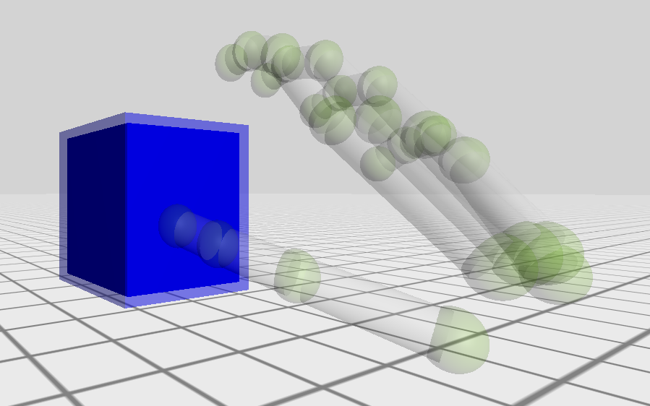
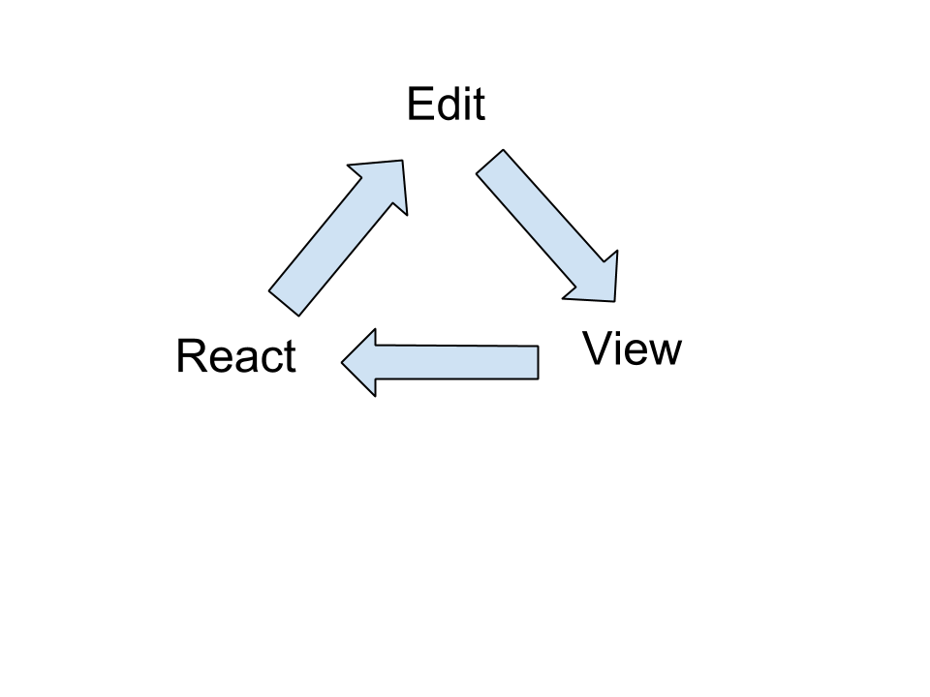

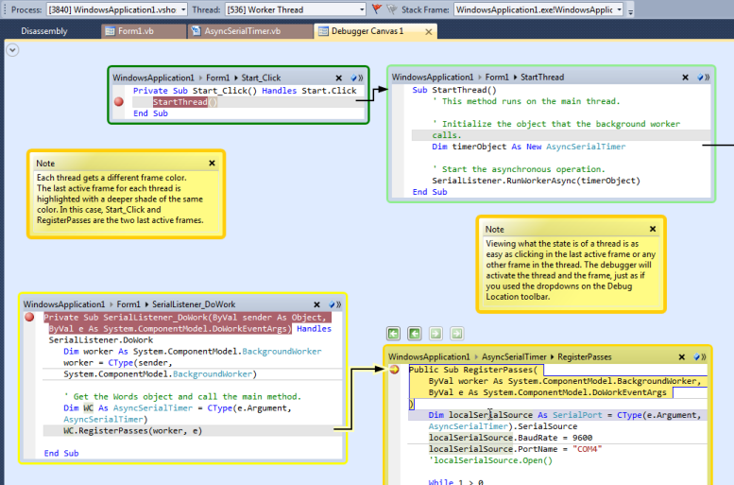


Virtual Reality (VR) and Software Engineering
Anthony Elliott*, Brian Peiris, Chris Parnin*
* North Carolina State University, USA
Programming
Code Review
RiftSketch presents a user with a simple text editor, floating in front of them in an otherwise empty VR world. As the user types code into the editor, the world around them updates instantly to display the 3D scene dictated by their code. RiftSketch also allows the user to animate their scene via a callback function which is executed on every frame. The user can manipulate the state of the 3D scene in this looped block of code in order to add behaviour to the objects in their scene. This animation makes the user truly feel inside the scene in a way not captured by a 2D screenshot.
The reviewer is reviewing code to reposition
A lander on a comet. The reviewer sees the active method, piles of relevant fragments on the floor, and has expanded one pile into a fragment ring on the left to read the details of those fragments. A model of the comet and
the lander’s expected flight path is shown in the upper left. The reviewer can walk between code packages on the floor which are color coded according to amount of modification for this review. GitHub details are shown in the upper right.
How VR can help
1) Spatial Cognition:
Stereoscopic vision (depth)
Head rotation
2) Manipulation:
Direct manipulation
Walking
3) Feedback
Overcoming ‘Gulf of Evaluation’
Easier to see what’s going on and plan next action
Users remembered bookmark placement on 3D plane after 6 months.
Data Mountain
Microsoft Research, 1998
Programmer selecting object with hand
Short feedback cycles improve productivity
How you can help:
3) Create developer tools for
Visualization
Debugging
Simulation
1) Create a 3D visual programming language for education similar to Scratch
2) Explore where augmented reality could be better suited than immersive virtual reality
Microsoft’s Debugger Canvas improves on spatial cognition, but is limited to two dimensions.
@anthonyE_vr
@brianpeiris
@chrisparnin

