Slide 1
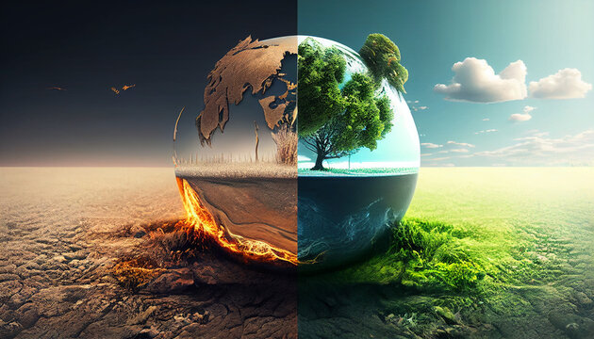

Climate Change Meets
Anthony Banks

Slide 2
Questions
What trends, if any, or present in climate related tweets? Has the stance, sentiment, aggression of Tweets changed significantly in the 2010’s?
What trends might we uncover by isolating the tweets denying climate change? Are there any patterns to find that would help make sense of the spread of misinformation on social media?
What does x activity look like before and after a major natural disaster?

Slide 3
Data Sets Used
Climate Change Twitter Data Set
Contains over 15 million climate related Tweets
Includes the longitude, latitude, sentiment, stance, aggressiveness, and more for each tweet
“These dimensions were produced by testing and evaluating a plethora of state-of-the-art machine learning algorithms and methods, both supervised and unsupervised”
We extracted smaller datasets based on location and stance due to scale and time constraints
Disasters Data Set
The dataset is also accompanied by environmental disaster events that took place during this 13-year period.
We extracted some of the deadliest climate disasters in the US to determine their effect on X behavior

Slide 4
Question 1: Overall Trends

Slide 5
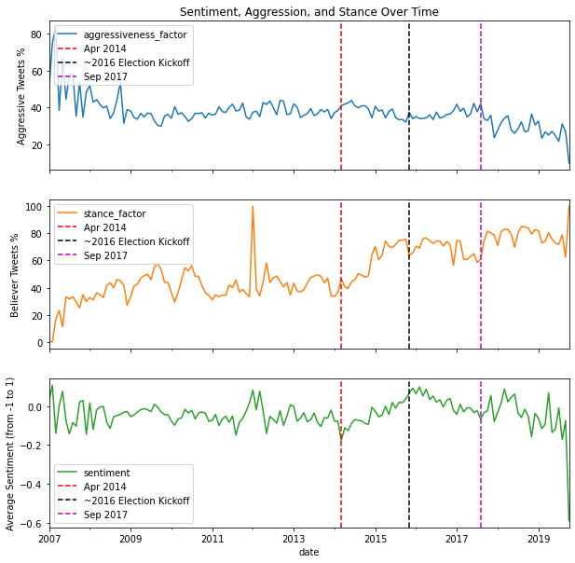
Trends Over Time
The % of aggressive tweets is gradually decreasing
The % of tweets that support the belief of climate change is increasing overall
The average sentiment for each month fluctuates and contains smaller trends
2016 election cycle: new decline in sentiment and % of believer tweets, while aggression slight picks up
June 2017: US leaves the Paris Climate Agreement

Slide 6
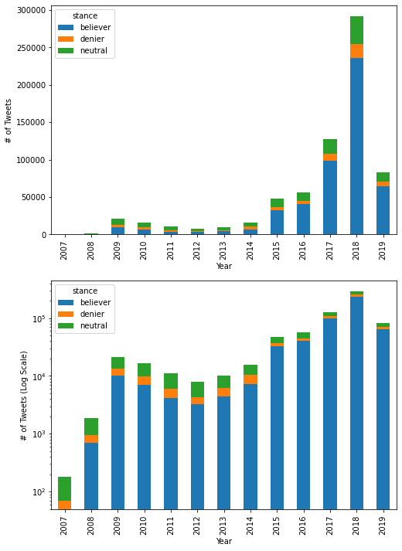
Number of Tweets by Stance Over Time
Logarithmic scale makes it easier to see exponential change in overall number of tweets.
The number of tweets about climate change drop until 2012
After 2012, there appears to be an exponential increase in the number of tweets concerning climate change
Is there an exponential increase in just the number of tweets that believe in climate change?

Slide 7
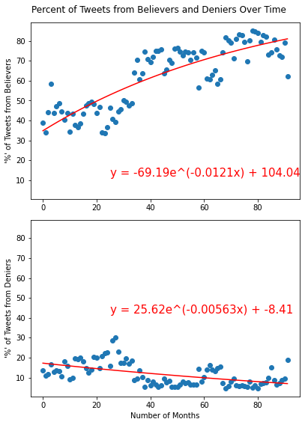
Closer Look Percentage of Tweets from Believers and Deniers
There is growth in the % of believer tweets
BUT the rate is slowing down
There is a decrease in the percentage of tweets that deny climate change
If these trends continue, the percent of tweets from believers will reach 100% in 12-15 years
Deniers will reach 0% in 7-8 years
Result of more and more people believing in climate change OR are climate deniers leaving Twitter?
Notes:
*We could look further into where the tweets are originating from and try to figure out if those users are just being less active or have switch their stance

Slide 8
Question 2:
Tracking Trends in Climate Misinformation

Slide 9
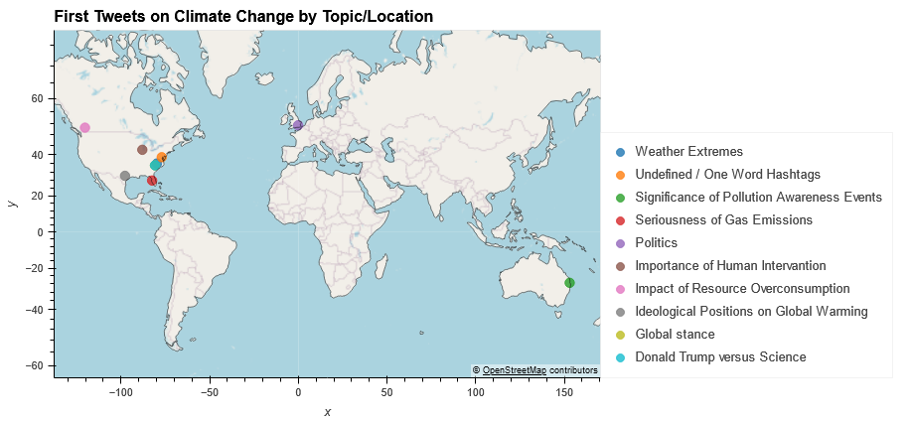
Each point represents 1 tweet on one of the 10 topics related to climate change covered in our dataset
Nearly all are coastal or near-coastal regions
8 of 10 are from large cities, 7 are from the US, and 3 are from the same state (NC)

Slide 10
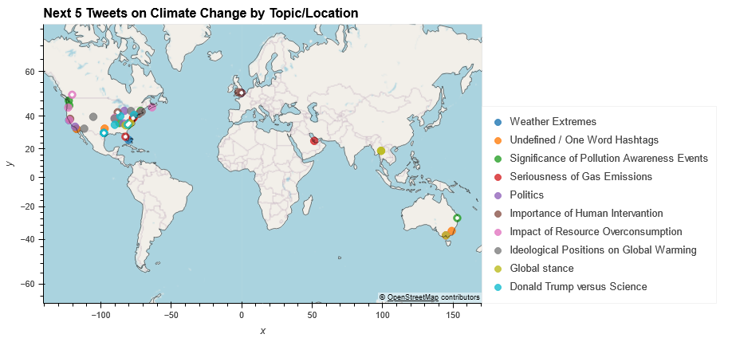
Here we see the spread of the following 5 tweets on each topic
Continues to remain heavily focused in the US (as does most of our dataset)
Still tends toward coastal areas & large cities

Slide 11
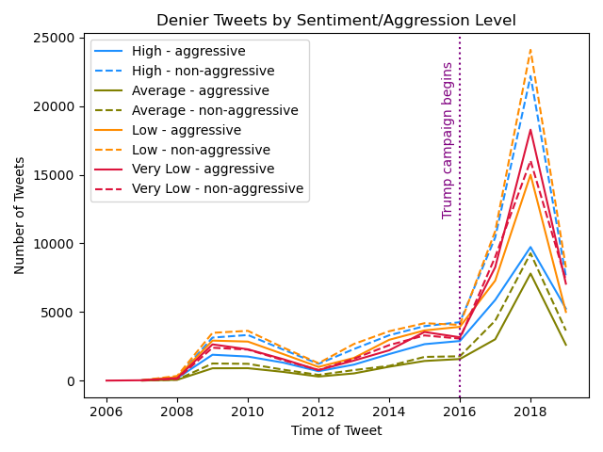
Broad Overview of Climate Denier Tweets Over Time
High and Low sentiment consistently favored across the full timeframe
Average sentiment consistently least common
Very Low sentiment aggressive more often than not, especially during times of high engagement
Sharp increase in overall number of tweets around 2016 election cycle (common to all stances)

Slide 12
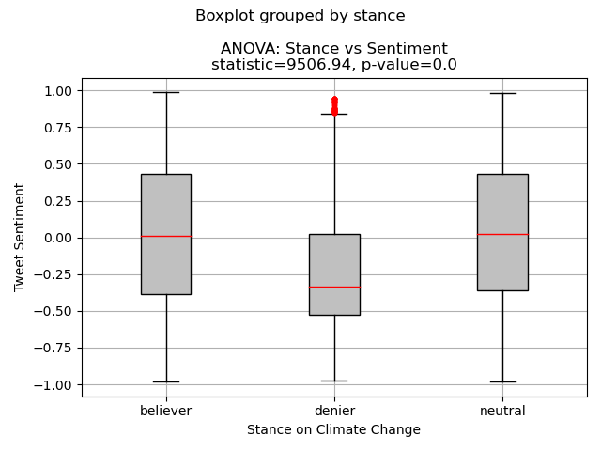
ANOVA Test: Stance vs Sentiment
5% sample of original worldwide dataset
Deniers mean sentiment is significantly lower than other users
8% of total users, likely to have more negative interactions
Values above 0.85 likely to be outliers

Slide 13
Question 3: Disasters
Tweet Activity Trends Before and After Disaster

Slide 14
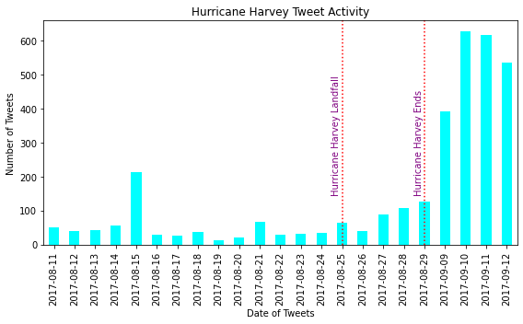
Hurricane Harvey (2017)
Significant increase in tweets after Hurricane Harvey
Not much concern leading up to Harvey’s landfall but increased once Harvey concluded considering the damage and widespread flooding around the Texas gulf coast

Slide 15
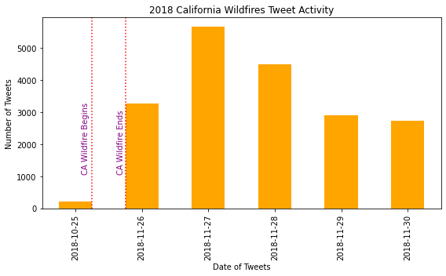
California Wildfires (2018)
Climate and weather topics not significant leading up to the wildfires
Activity does increase once the fires conclude but not at a scale compared to the two other disasters
Considerable decrease once the wildfires had been contained

Slide 16
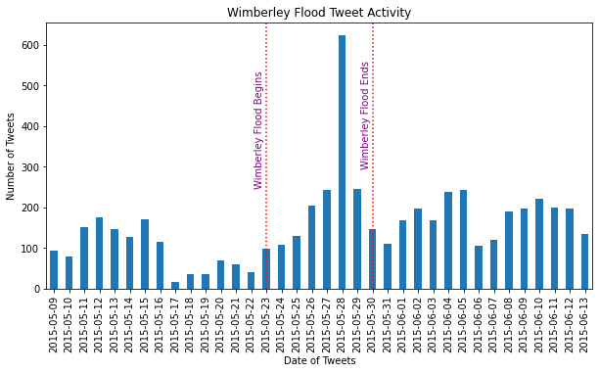
Wimberley Floods (2015)
The Wimberley Floods showed a significant increase as the storms continued to worsen
Two weeks prior there was a decent amount of activity in regards to climate and weather related events on twitter with a decrease the days leading up the the flood

