Slide 1
MODEL SELECTION
Three linear predictors for a yes-or-no outcome
Linear regression
Identity-link GLM
Logistic regression
Normal model, identity link. The probability is the straight line.
Binomial GLM. The probability is still that straight line.
Binomial GLM. The straight line is on the log-odds.
On the 20,769 plays from 2023–2025, 501 fitted values fall below 0.
The highest prediction is 0.66, under the 0.74 rate for an open-field called run on 3rd-and-1.
At 20 yards the called-run line is negative.
Only 4 fitted values on those plays leave 0 to 1.
At 1 yard it gives 0.61 and 0.45, against observed rates of 0.74 and 0.58.
At 20 yards it is still near 0.23 to 0.28, against 0.00 and 0.03.
No fitted value on those 20,769 plays leaves 0 to 1.
At 1 yard the chances are 0.71 and 0.60, close to the observed 0.74 and 0.58.
At 20 yards they are 0.00 and 0.08.
WHY THE LOGIT
It is the binomial GLM whose chance stays between 0 and 1 and follows the drop in the rates. AIC cannot rank these three.
7

Slide 2
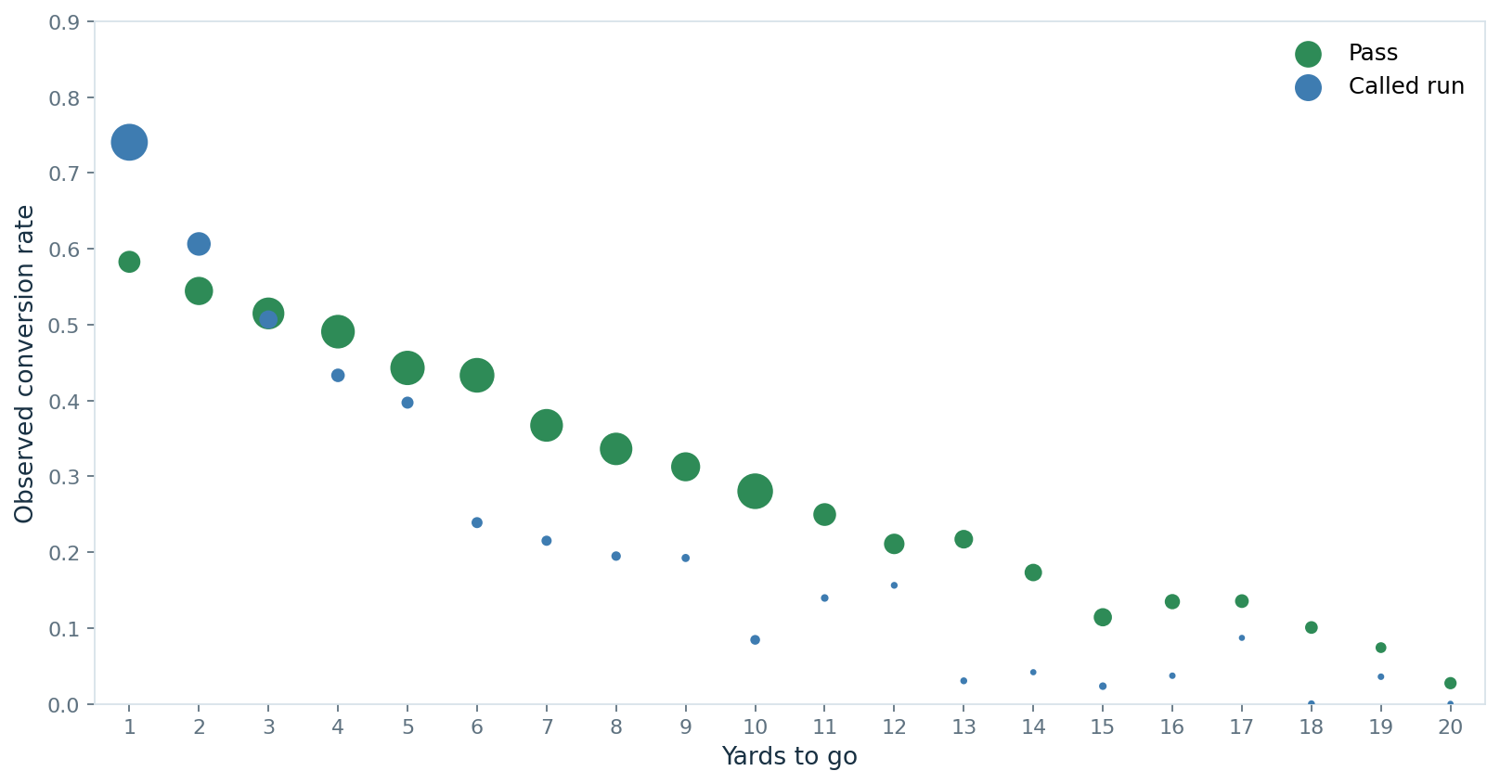
BEFORE THE FIT
The two calls cross before any line is drawn
THE PATTERN
Called runs sit above passes at 1 and 2 yards. From 4 yards on, the pass rate is higher. Dot size is the number of plays.
8

Slide 3
THE MODEL
Give it the down. It returns a conversion chance.
1
Yards to go
Pass
The distance for the first down.
Called run
2
Called run or pass
A scramble is a pass, not a run.
One more yard multiplies a pass’s odds by 0.86.
Goal-to-go multiplies the odds by 0.635.
3
Goal-to-go
Whether that first down is the goal line.
THE OUTPUT
The number is the model’s chance that this third down converts, for the call that is on the field.
9

Slide 4
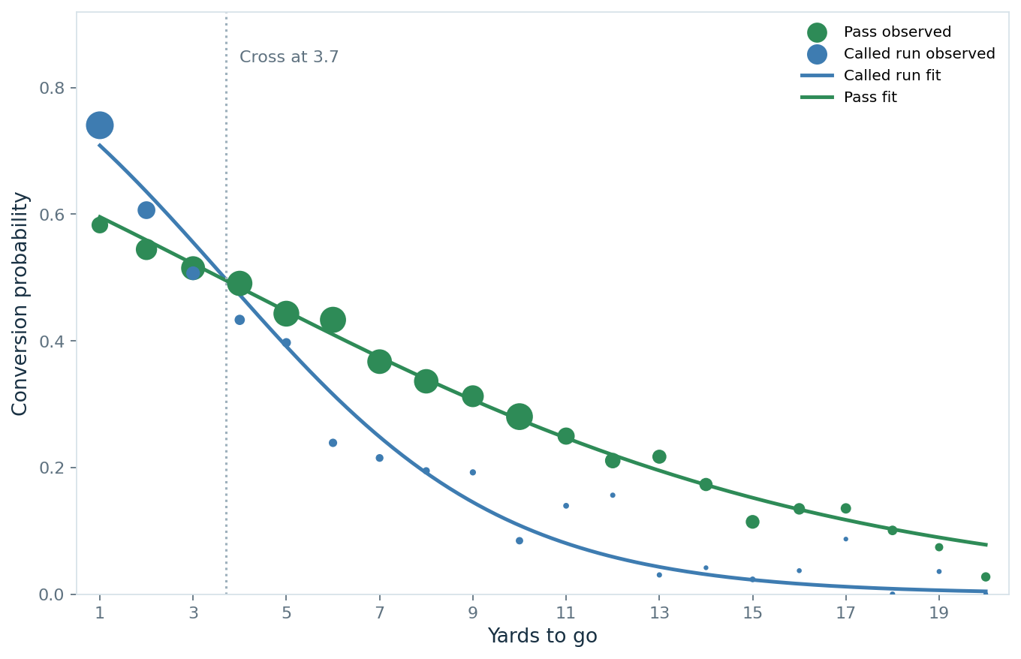
WHERE THEY CROSS
The called run leads only until 3.7 yards
BEFORE THE CROSS
Open-field 3rd-and-1
Called run 0.71 Pass 0.60
Run is higher by 0.11.
AT THE CROSS
The lines meet at 3.7 yards
3rd-and-3 predicted: run 0.56, pass 0.52
3rd-and-4 predicted: run 0.47, pass 0.48
The lead flips between 3 and 4.
AFTER THE CROSS
Open-field 3rd-and-10
Pass 0.28 Called run 0.11
Pass is higher by 0.17.
GOAL LINE
A 3rd-and-1 called run falls from 0.71 to 0.61. The cross stays at 3.7 yards, because goal-to-go multiplies both odds by 0.635.
10

Slide 5
WHAT IT MEANS
The higher chance flips at about 4 yards
3rd-and-1
3rd-and-10
3rd-and-1
Open field
Open field
Goal line
0.71
0.28
0.61
called run
pass
called run
0.60 pass
0.11 called run
0.48 pass
Higher chance inside 4 yards
Higher chance past 4 yards
Same split, both chances lower
How to use it
2026 CHECK
Before the snap, read the chance for this distance and this call. Compare the two calls. Inside 4 yards expect the called run. Past 4 yards expect the pass. On the goal line both chances fall, and a 3rd-and-1 run goes from 0.71 to 0.61.
0.393 predicted
0.412 observed
THE LIMIT
This is the chance for the call on the field. It is not the effect of forcing the other call.
11

Slide 6
CONCLUSION
Distance sets the higher chance
WHAT HOLDS
Called run leads inside about 4 yards. Pass leads after that.
On the goal line both chances fall. A 3rd-and-1 called run goes from 0.71 to 0.61.
Three weeks of 2026: 0.393 predicted, 0.412 observed. Too small to refit the line.
Read the number as the chance for the call that was made.
NEXT
1 Standard errors by game.
Recheck the gap at 1 yard and the reversal at 10. Near 4 yards the chances are too close to keep.
2 The look that chose the call.
Formation is already in the file. How that defense had been playing is not in this model.
3 A full 2026 season.
Refit the line only after the year is complete. Three weeks cannot rank teams.
12

