Slide 1
Research

Slide 2
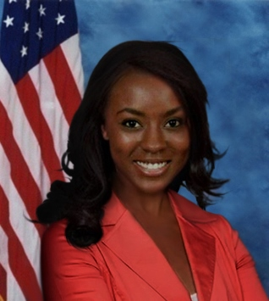
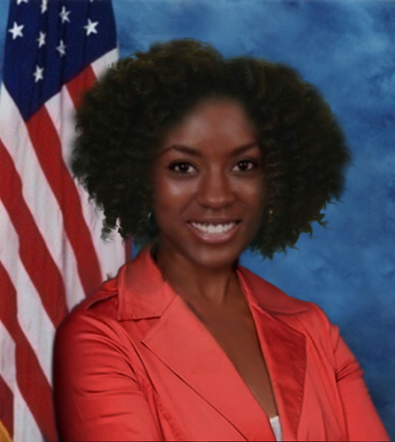
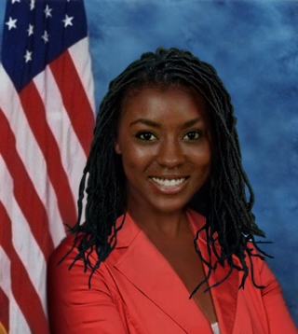
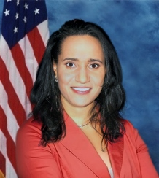
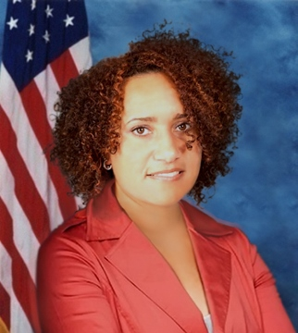
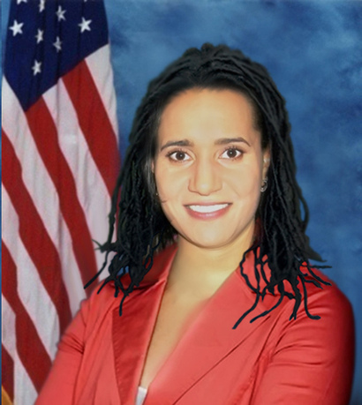
Gender Bias: Hair Texture and Colorism

Slide 3
Implicit Bias
Do You Have Subconscious Biases? Let’s See Click on Project Implicit and Scroll down to: I wish to Proceed

Slide 4
Research Related Articles
National Science Foundation Funding
Emotional Responses to the Confederate Flag
BioPolitics
Ethnocentrism is not Biological, it’s Learned

Slide 5
Legislative Politics
Mississippi Black Legislators
Robert Clark: Mississippi Black Legislators
The Intersection of Race and Gender

Slide 6
Videos and Media Appearances
A Black President in My Lifetime
Does the Mississippi State Flag Make You Sick?
Police Killings of Blacks and Race Based Trauma

Slide 7
Media Quotes
CNN
PBS
The Election of Chokwe Lumumba
Business Insider

Slide 8
The Mississippi State Flag
Old Fashioned Racism and the Mississippi State Flag
Trent Lott and the Mississippi Flag

Slide 9
Black Subconscious Biases Against Blacks
Negative Attitudes Toward Blacks by Blacks

Slide 10
Self Hatred
Black Conservatism
Black Conserevatism2
Black Conservatism: Opposition to Progressive Policies
Black Conservatism: Opposition to Progressive Policies 2

Slide 11
Students

Slide 12
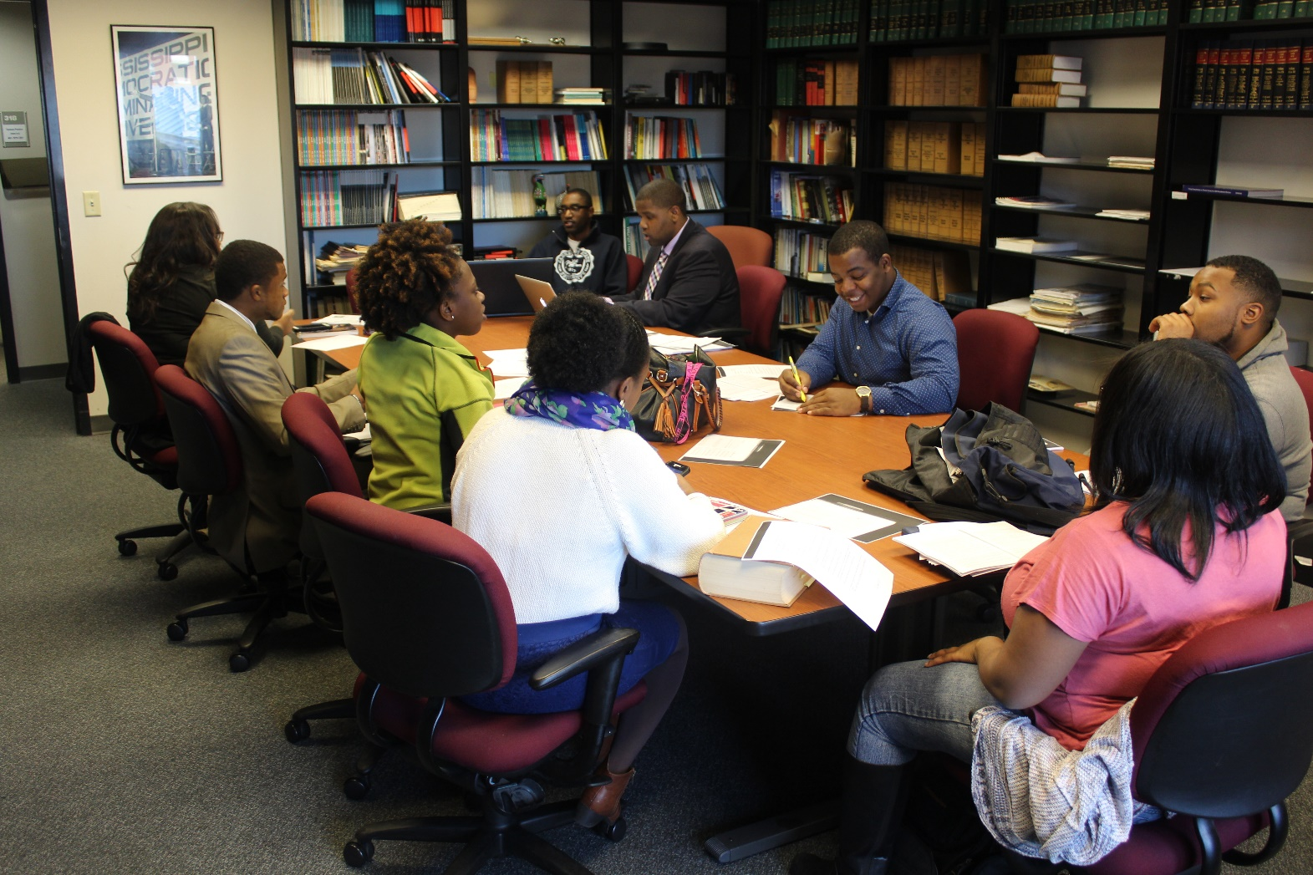
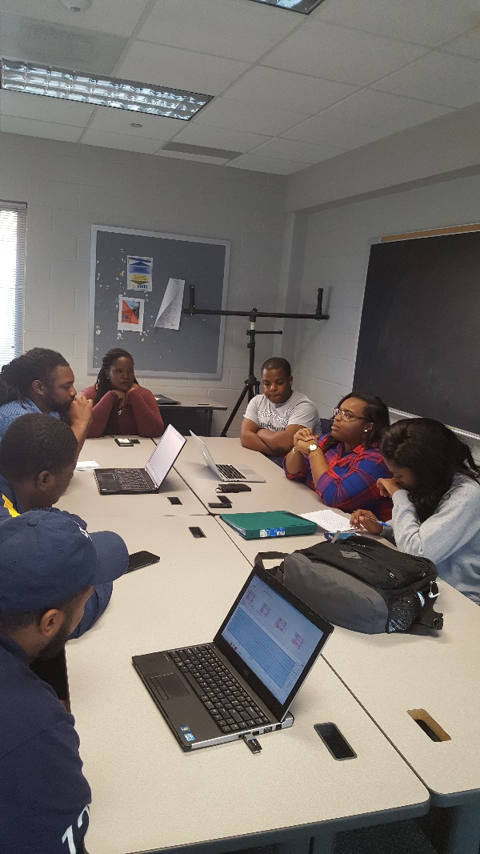

Slide 13
Jackson Political Science Research Laboratory

Slide 14
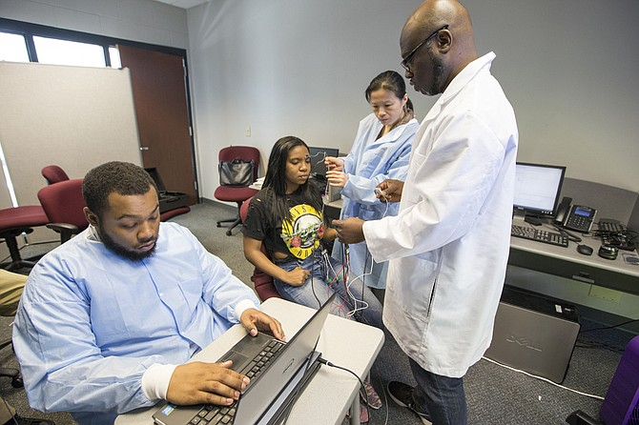

Slide 15
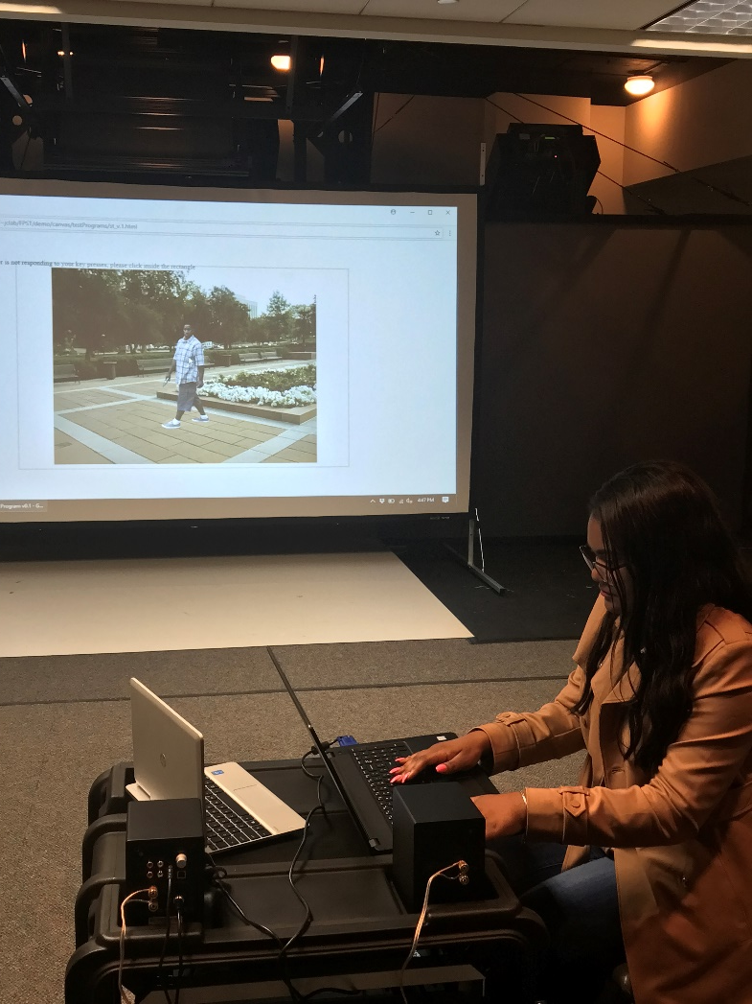
Shooter Lab (insert video): Need Better Images

Slide 16
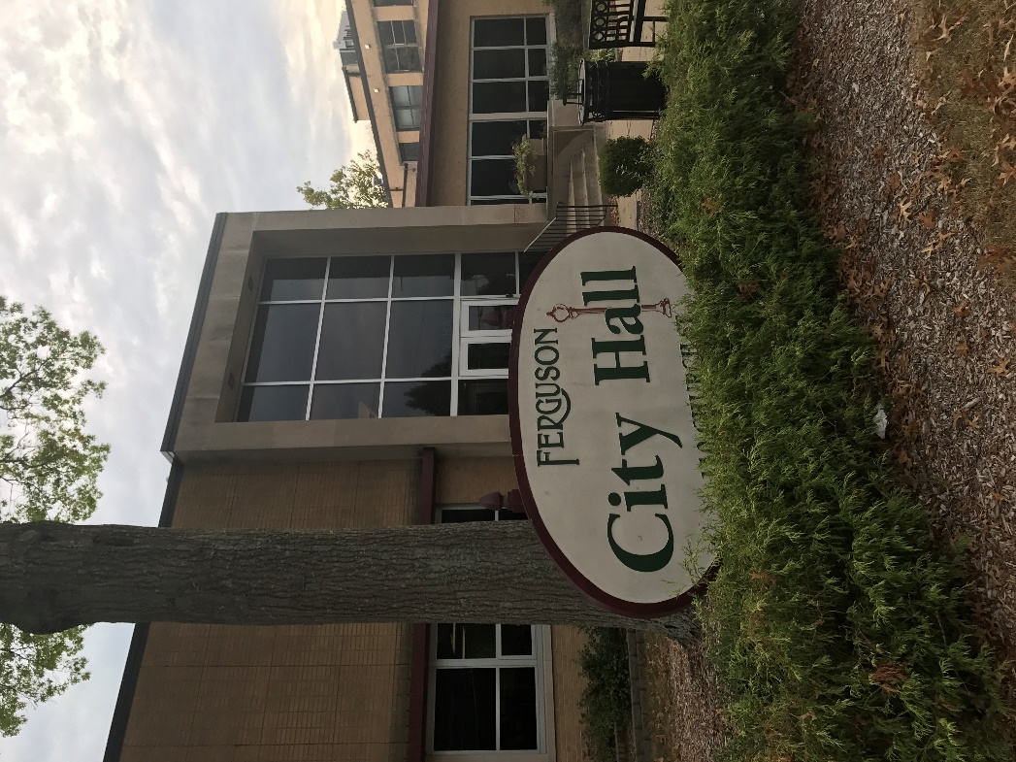
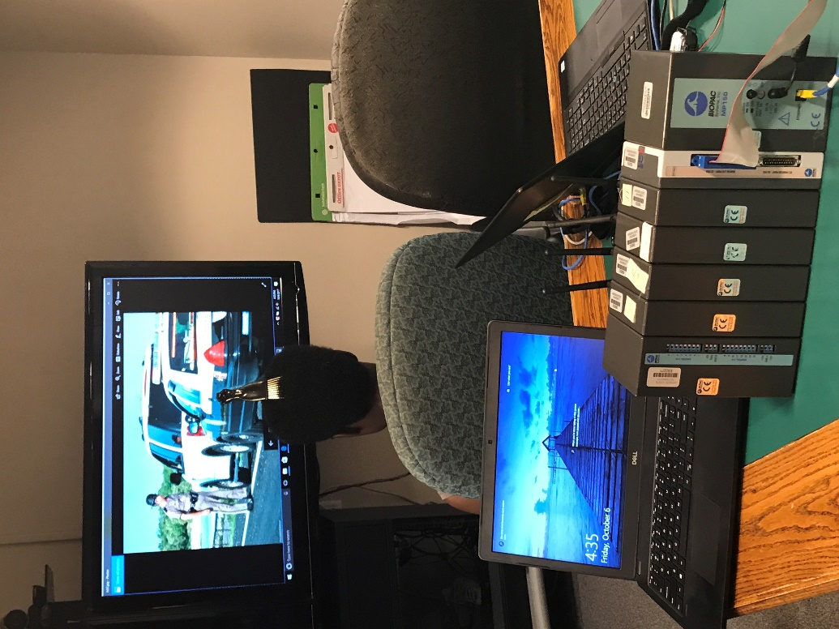
Mobile Laboratory

Slide 17
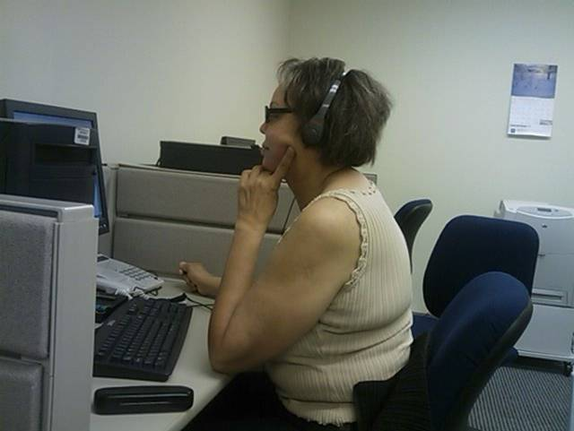
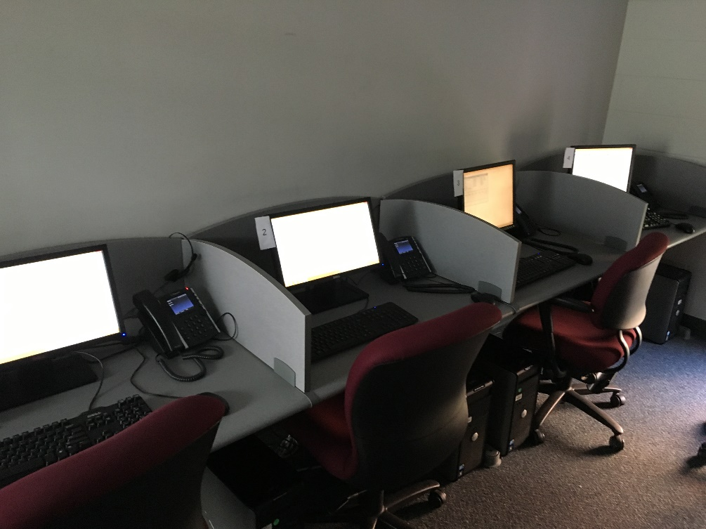
Call Center

Slide 18
Oral Histories
State Senator Doug Anderson
Ed Blackmon

