Slide 1

PS
PS Monthly Review
Redis Professional Services • June 30, 2026
Professional Services

Slide 2
Active Projects Summary
June 30, 2026
219
12
5
63
33
60
20
Total Open
Awaiting Handoff
Awaiting Kickoff
In Progress
On Hold
NL Awaiting GL
NL Awaiting Close
Awaiting Handoff (12)
Awaiting Kickoff (5)
In Progress (63)
Tesla
110 hrs
MLP
109 hrs
Bank of America
3,739 hrs
Intrado Life and Safety
80 hrs
Jefferies LLC
85 hrs
United Overseas Bank Lim
2,364 hrs
Credit Agricole CA-GIP
40 hrs
iFood
67 hrs
Wells Fargo
1,780 hrs
CIBC
32 hrs
Character AI
40 hrs
Credit Agricole CA-GIP
1,387 hrs
ING España & Portugal
20 hrs
Verisure Securitas Direc
Lumen Technologies
1,345 hrs
On Hold (33)
NL Awaiting Go Live (60)
NL Awaiting Closure (20)
CVS Health
356 hrs
IBM
184 hrs
Axon
194 hrs
Vietcombank
177 hrs
Clalit Health Services
145 hrs
Caisse Nationale des All
54 hrs
Banca Monte dei Paschi d
145 hrs
euro-information
104 hrs
Express Scripts Canada
53 hrs
VIZIO
68 hrs
Boerse Stuttgart
100 hrs
Alpitour
39 hrs
Leonardo Company
46 hrs
Energisa
97 hrs
InnovAccer
16 hrs
Professional Services

Slide 3
Projects by Owner & Tier
June 30, 2026 • Excludes Sophi Operations
Owner | Tier 1 | Tier 2 | Tier 3 | Tier 4 | Total
Akshay Chopra | 1 | 8 | 9 | 19 | 37
Varsha Malhotra | 0 | 1 | 5 | 29 | 35
Gloriana Diaz | 0 | 4 | 10 | 17 | 31
Kent Johnson | 0 | 11 | 12 | 6 | 29
Nadia Droubi | 1 | 12 | 9 | 5 | 27
Sirisha Yaddanapudi | 0 | 10 | 12 | 5 | 27
Anil Kondapaneni | 2 | 7 | 1 | 3 | 13
Camille Dubois | 0 | 1 | 5 | 4 | 10
Sophi Operations | 0 | 1 | 2 | 7 | 10
TOTAL | 4 | 55 | 65 | 95 | 219
Professional Services

Slide 4
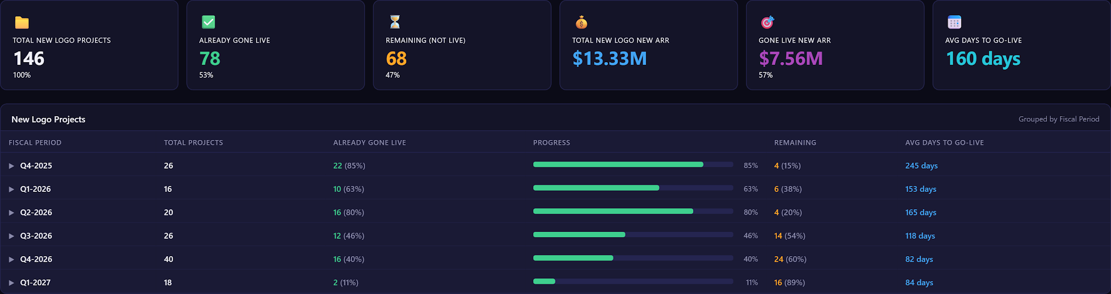
Go Live Summary
June 30, 2026
1:
2:
3:
Professional Services

Slide 5
Annual Plan & RE Summary
Project count by region and utilization ratio
Region | <50% | 50–89% | ≥90% | Total
AMER | 5 | 6 | 8 | 19
APAC | 2 | 3 | 0 | 5
EMEA | 3 | 2 | 3 | 8
TOTAL | 10 | 11 | 11 | 32
1:
2:
3:
Professional Services

Slide 6
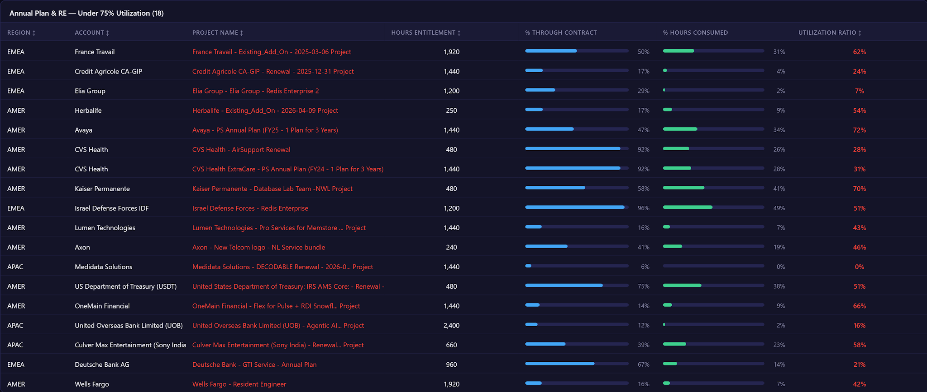
Annual Plan & RE — Under 75% Utilization
June 30, 2026
1:
2:
3:
Professional Services

Slide 7
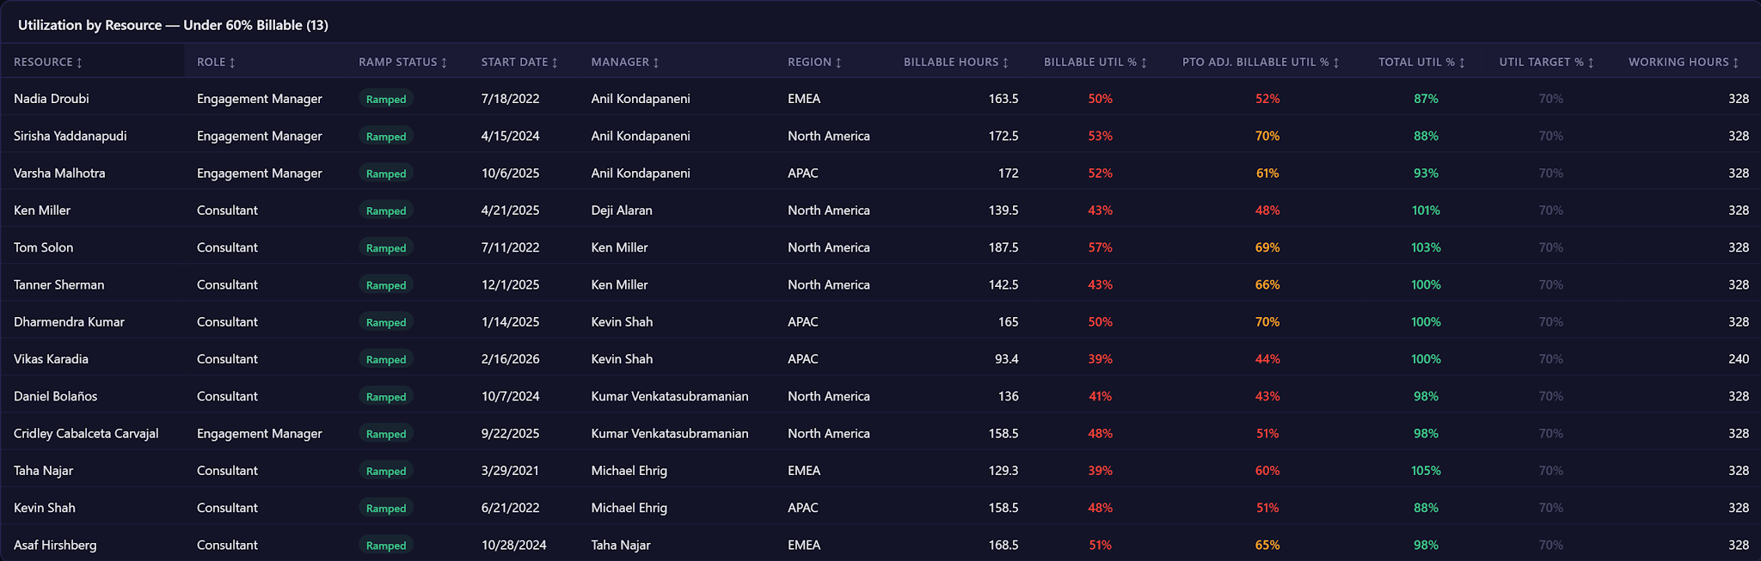
Utilization by Resource — Under 60% Billable
Q2-2027
APAC
EMEA
NORTH AMERICA
6 resources
5 resources
14 resources
BILLABLE UTIL
PTO ADJ UTIL
BILLABLE UTIL
PTO ADJ UTIL
BILLABLE UTIL
PTO ADJ UTIL
59%
67%
57%
67%
62%
71%
1:
2:
3:
Professional Services

Slide 8
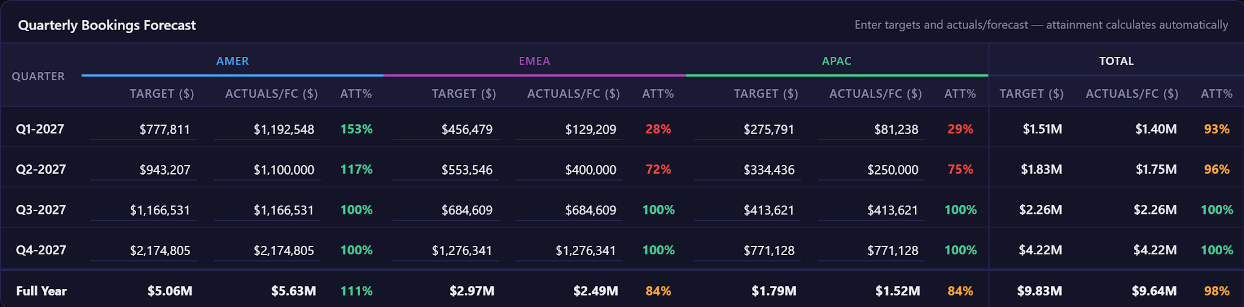
Quarterly Bookings Forecast
FY2027
1:
2:
3:
Professional Services

Slide 9
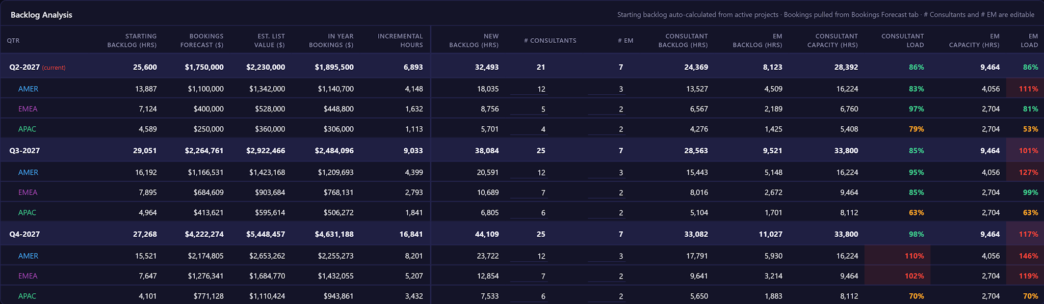
Backlog Analysis
FY2027
1:
2:
3:
Professional Services

Slide 10
P&L Status
June 30, 2026
[ Paste P&L screenshot here ]
1:
2:
3:
Professional Services

