Slide 1
Examining excess mortality by cause during the COVID-19 pandemic in Switzerland
09.01.2025
Anthony Hauser

Slide 2

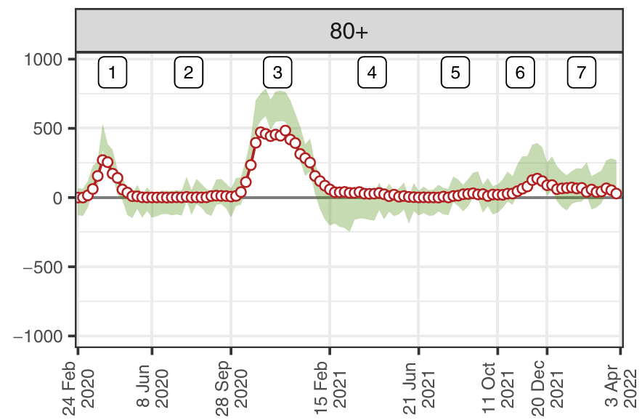

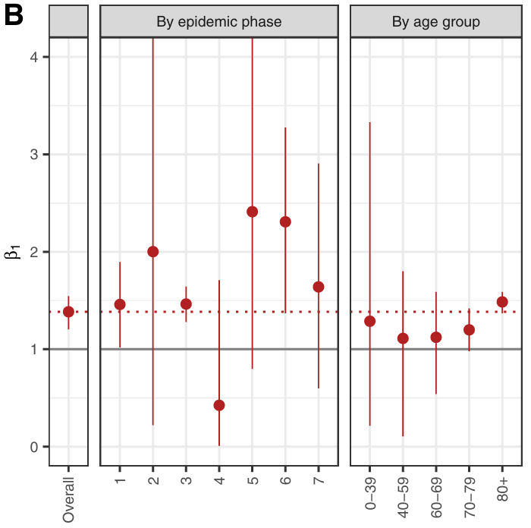
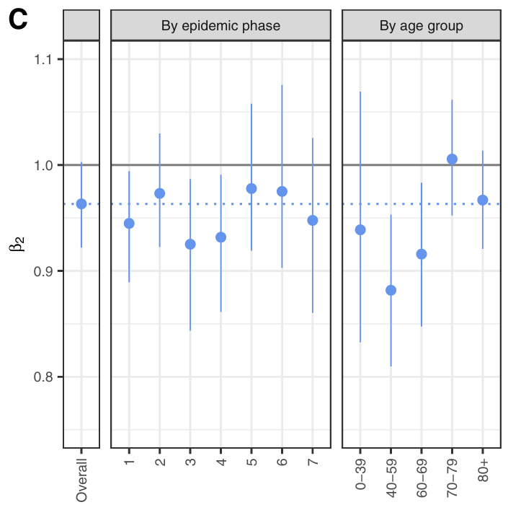
Direct and indirect effect of COVID-19
Previous project^{1.}:
Partition all-cause mortality into
deaths directly attributable to SARS-CoV-2 infection and,
deaths indirectly attributable to the pandemic
Laboratory-confirmed deaths underestimates COVID-19 mortality (72%)
Indirect beneficial effect of pandemic on mortality, due to
Restriction measure
mortality displacement or “harvesting effect”
Questions:
Can we identify the deaths that should have been attributed to COVID-19?
What were the indirect effects of pandemic on the different causes of deaths?
1. Riou et al. (2022) Nat Com.
Notes:
Ce projet est essentiellement issu d’un projet sur lequel j’ai travaillé avec Julien notamment.
S’intéressait à la mortalité tout cause confondue, et plus particulièrement à la surmortalité, en Suisse et variation géographique et temporelle
Les décès confirmés en laboratoire représentaient seulement 72% de la mortalité due covid.
Mesures mis en place, confinement, -> réduit l’activité humaine et le risque de décès par accident
À la suite de tous les changement en matière de santé, de soins et de conditions de vie
Résultats soulèvent aussi passablement de questions comme
Peut-on mieux identifier et charactériser les décès qui auraient dû être attribués au COVID, mais ont été attribué à une autre cause.
Est-ce qu’on a observe une deficit de mortalité lié à une certaine cause en raison des effets indirects de la pandémie.

Slide 3
Objectives
Develop a statistical model producing expected mortality over time, by cause and age-group
Assess excess mortality during 2020-2021, by cause and age group
Investigate the correlations between mortality causes (e.g., COVID-19 and other causes)
Notes:
Par étapes, ça donne les objectifs suivants
Prendre des données avant la pandémie pour estimer la mortalité attendue, par cause de décès et par groupe d’âge
Ensuite mesurer la surmortalité par cause de décès en 2020-2021 en comparant les décès observés aux décès attendues
Enfin,

Slide 4
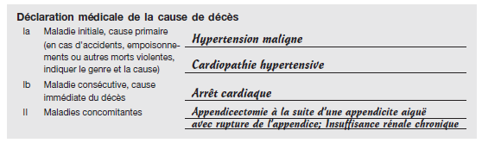
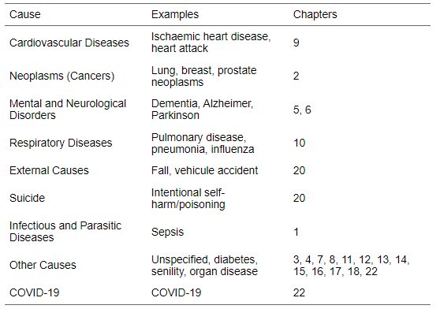
Data: causes of deaths
Causes of deaths
Deaths from 2011 to 2021
Cause of deaths
Week and year of deaths
Age, sex, canton
Data collection
Physician who reports deaths indicate
Primary cause/illness (initial illness)
Secondary cause (direct cause)
Concurrent illnesses
Based on this information and on the WHO guidelines, OFS will then determine and code (ICD-10)
(Principal) Underlying cause of death -> used in the statistics
Notes:
Pour cela on utilise les données collectées par l’OFS qui répertorie chaque décès entre 2011 et 2021, en lui attribuant une cause principale de décès et contenant des informations basiques telles
Ce travail de collection des données prend particulièrement de temps car il diviser en plusieurs étapes.
Premièrement, c’est le médecin qui constate le décès qui doit attribuer une cause primaire, maladie initiale qui a amorcé le processus morbide
Maladies concomitantes, tels que des comorbidités,
CIM: classification internationale des maladies

Slide 5
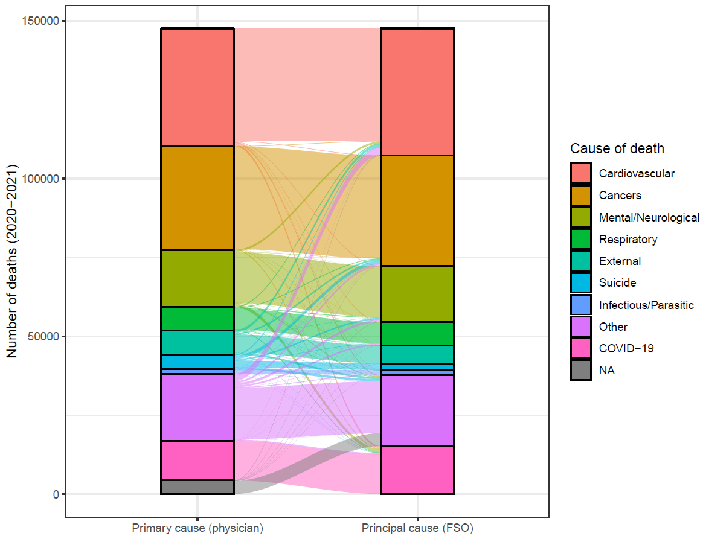
Data: 9 causes of deaths
Primary vs principal cause of deaths
identical for >95% of deaths
5 age groups
0-17, 18-39, 40-64, 65-79, 80+
Aggregated by cause, age group, sex, NUTS-2 region and week

Slide 6
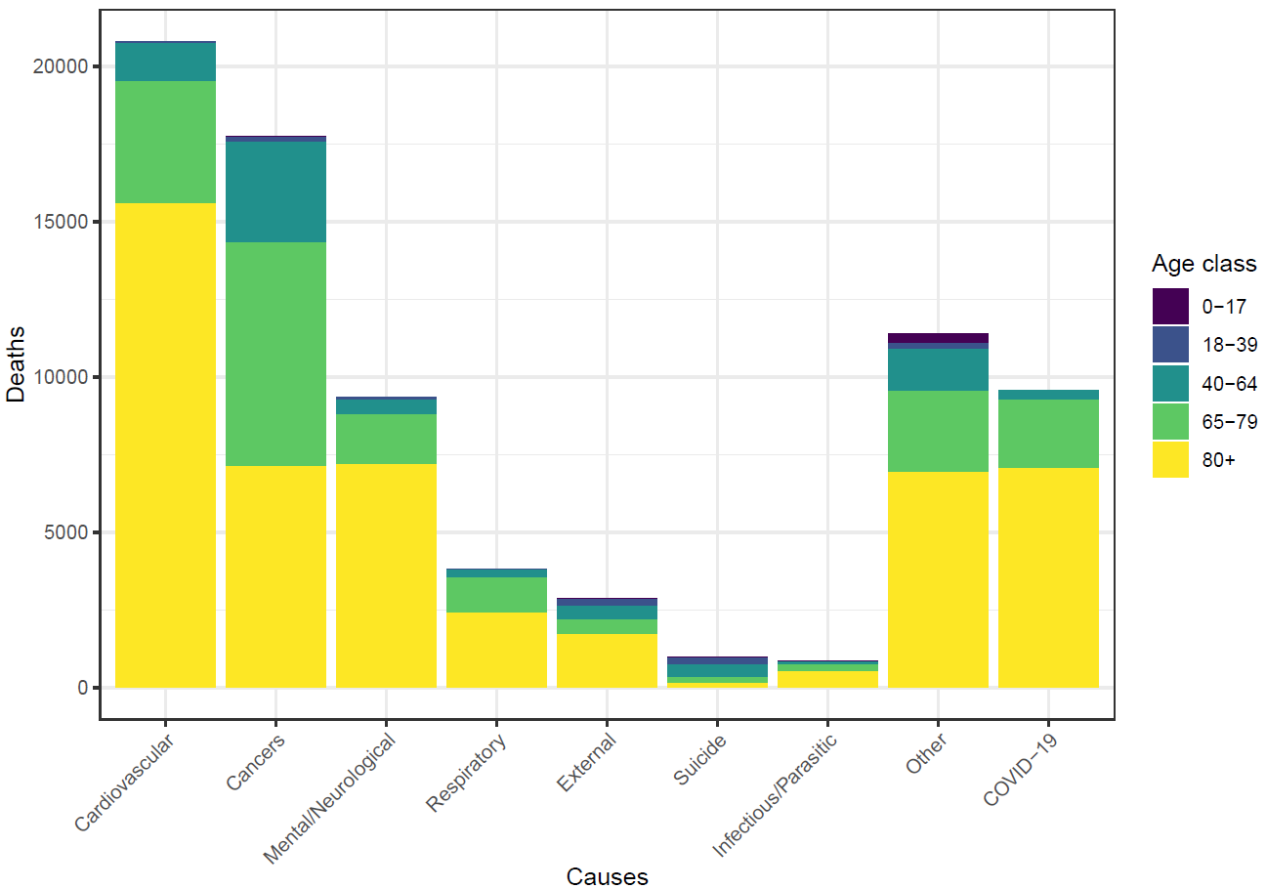
Data: mortality by age and cause
Primary vs principal cause of deaths
identical for >95% of deaths
5 age groups
0-17, 18-39, 40-64, 65-79, 80+
Aggregated by cause, age group, sex, NUTS-2 region and week
Deaths in 2020
Notes:
Groupe hétérogène des autres causes et finalement le covid-19 qui est spécifique aux années 2020-21

Slide 7
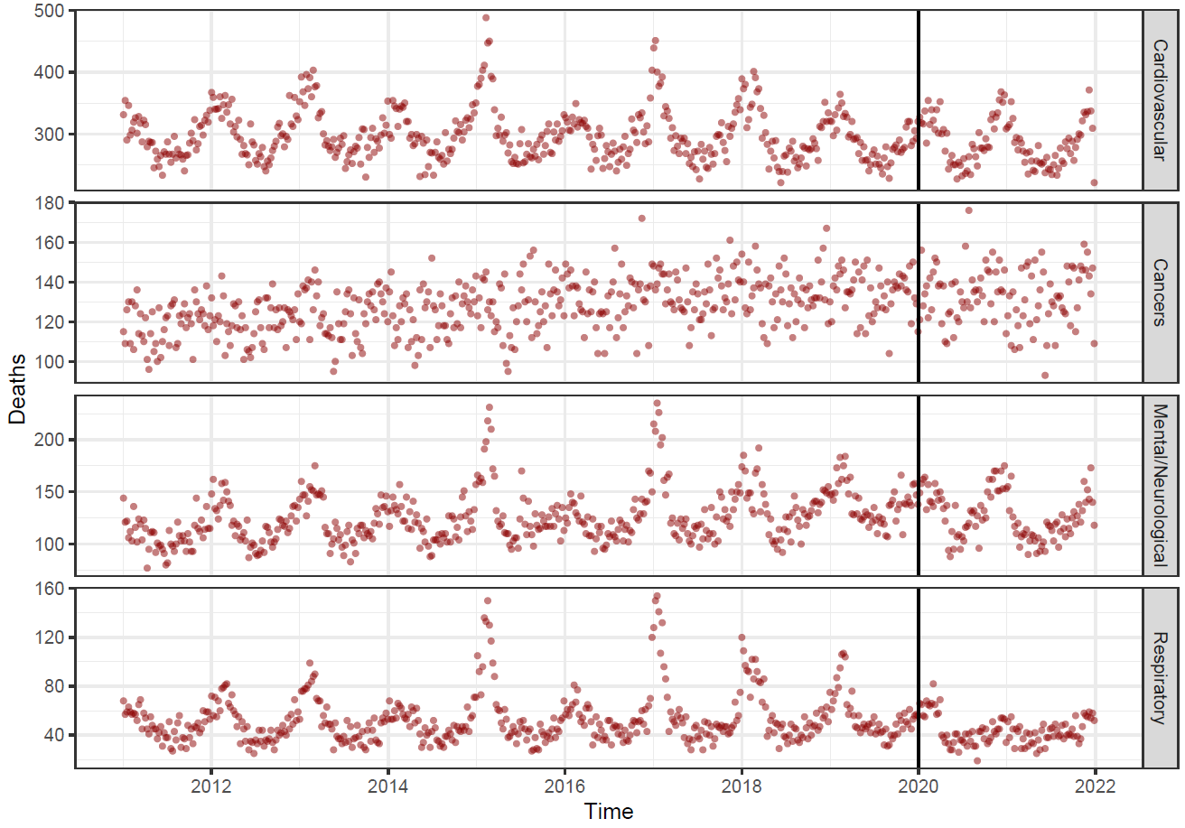
Data: mortality over time
Primary vs principal cause of deaths
identical for >95% of deaths
5 age groups
0-17, 18-39, 40-64, 65-79, 80+
Aggregated by cause, age group, sex, NUTS-2 region and week
Seasonal patterns
Long-term trend
Similar fluctuations between causes
Quantify expected mortality using weekly mortality data from 2011-2019
Notes:
Donc le premier objectif de ce projet c’est
Pour cela le modèle devra prendre en compte un certain nombre de choses
En l’absence d’événements perturbateurs tels que le covid

Slide 8
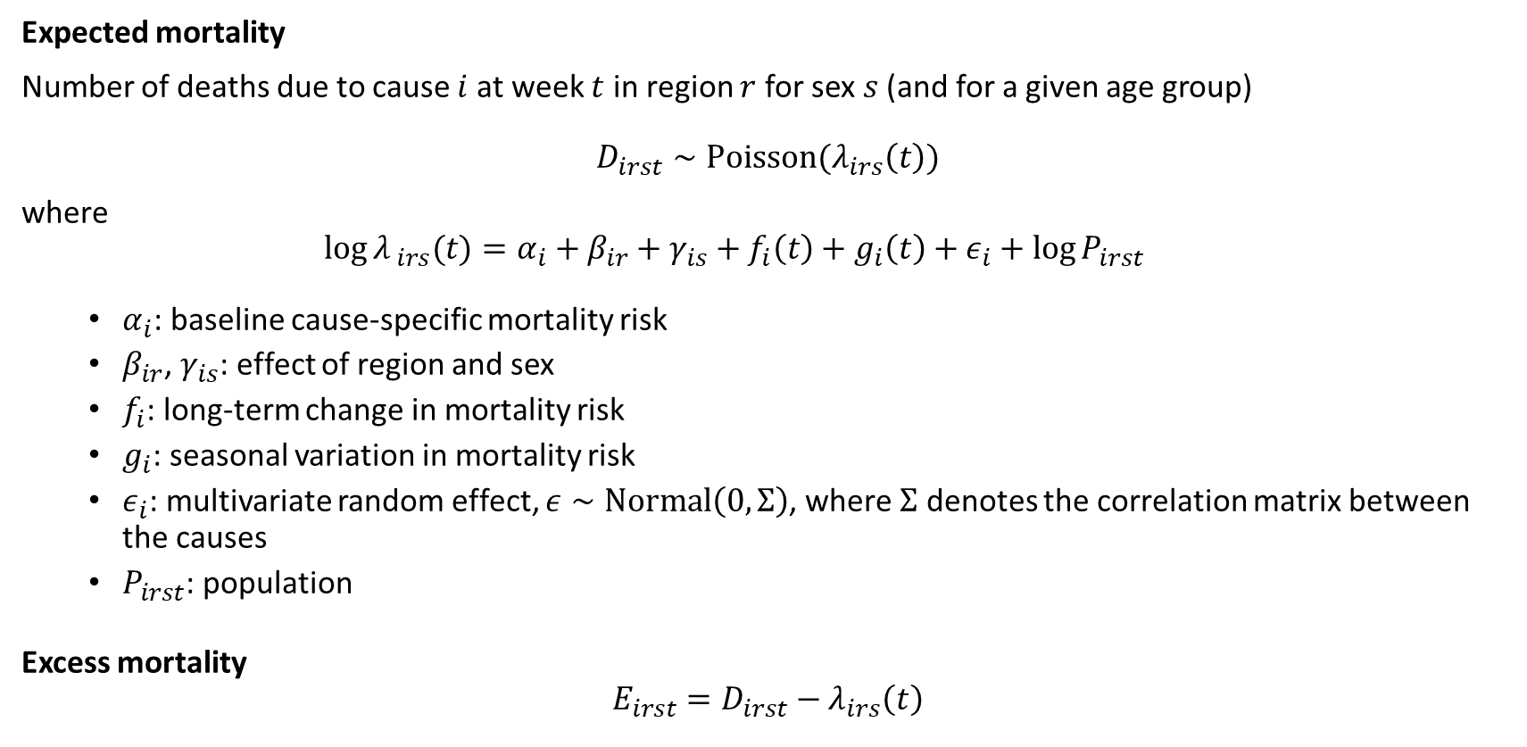
Model
Expected mortality
Number of deaths due to cause $i$ at week $t$ in region $r$ for sex $s$ (and for a given age group)
$$D_{irst}∼Poisson(λ_{irs}\left(t\right))$$
where
$$\log{λ_{ irs}(t)}=α_{i}+β_{ir}+γ_{is}+f_{i}\left(t\right)+g_{i}\left(t\right)+ε_{i}+\log{P_{irst}}$$
$α_{i}$: baseline cause-specific mortality risk
$β_{ir}$, $γ_{is}$: effect of region and sex
$f_{i}$: long-term change in mortality risk
$g_{i}$: seasonal variation in mortality risk
$ε_{i}$: multivariate random effect, $ε∼Normal\left(0, Σ\right)$, where $Σ$ denotes the correlation matrix between the causes
$P_{irst}$: population
Excess mortality
$$E_{irst}=D_{irst}−λ_{irs}\left(t\right)$$
Notes:
Risque de mortalité de base

Slide 9
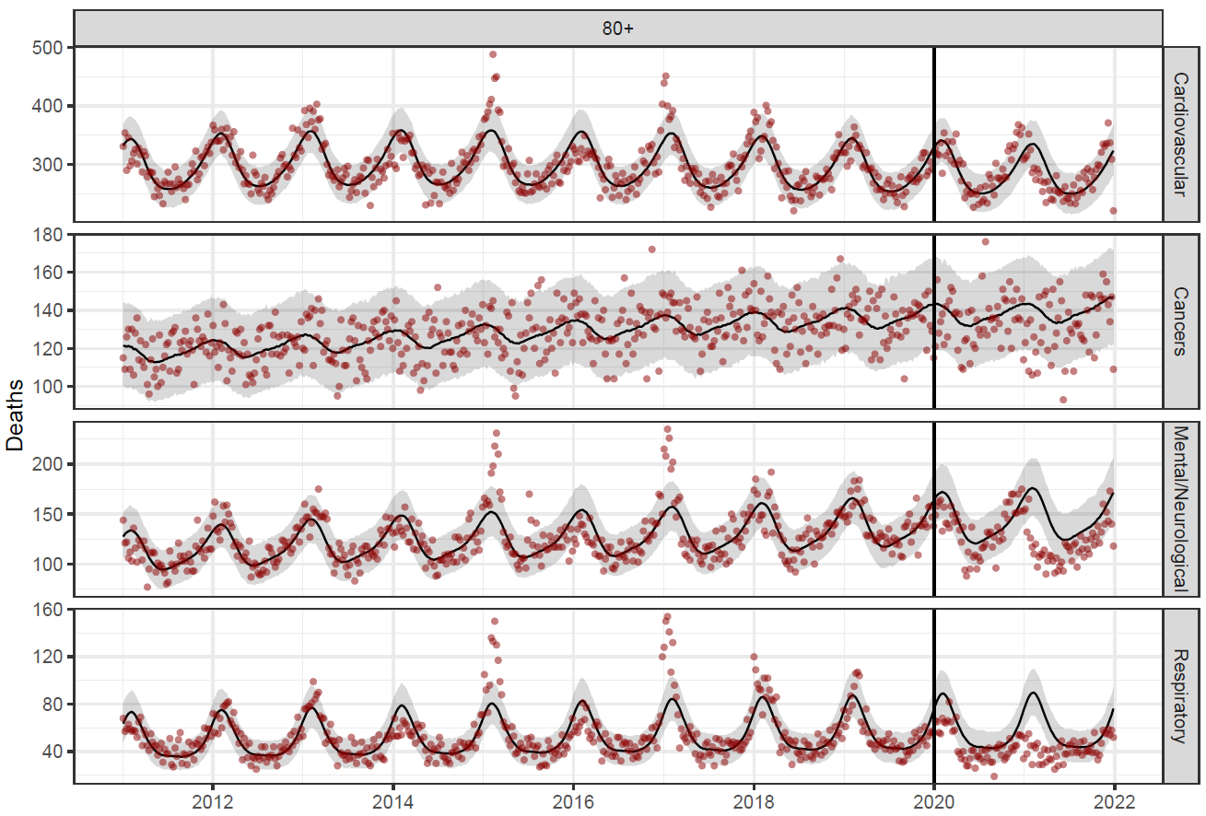
Cause-specific fit
Fit reproduces observed mortality in 2011-2019
Differences observed from 2020
Peak of observed mortality precedes expected mortality
Consistently lower mortality

Slide 10
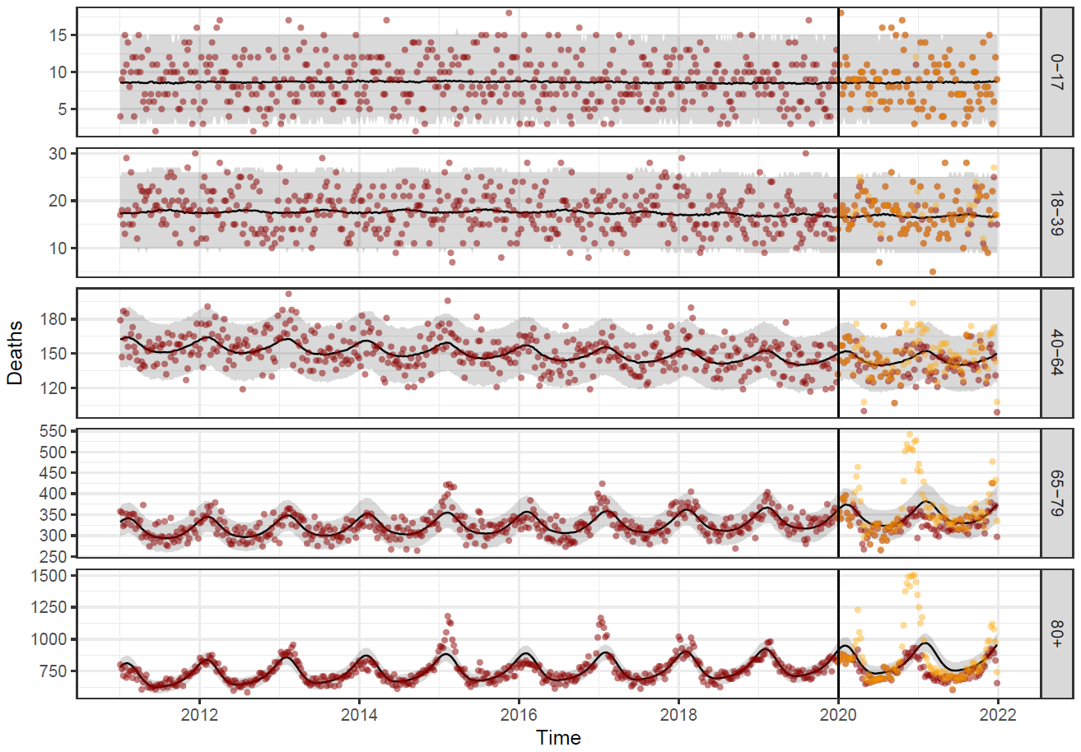
Fit: all-cause mortality
Total mortality (aggregated over causes) by age group
Good fit before 2020 -> validation
High mortality peak due to COVID-19 in fall and winter 2020-21
Notes:
Agréger entre causes
Fit est bon, ce qui montre que même si le modèle est calibrer avec les données par cause, il est quand même capable de reproduire le nombre total de décès
A présent si on veut représenter la surmortalité, il suffit de faire la différence entre la mortalité observée et la mortalité attendue comme prédit par le modèle

Slide 11
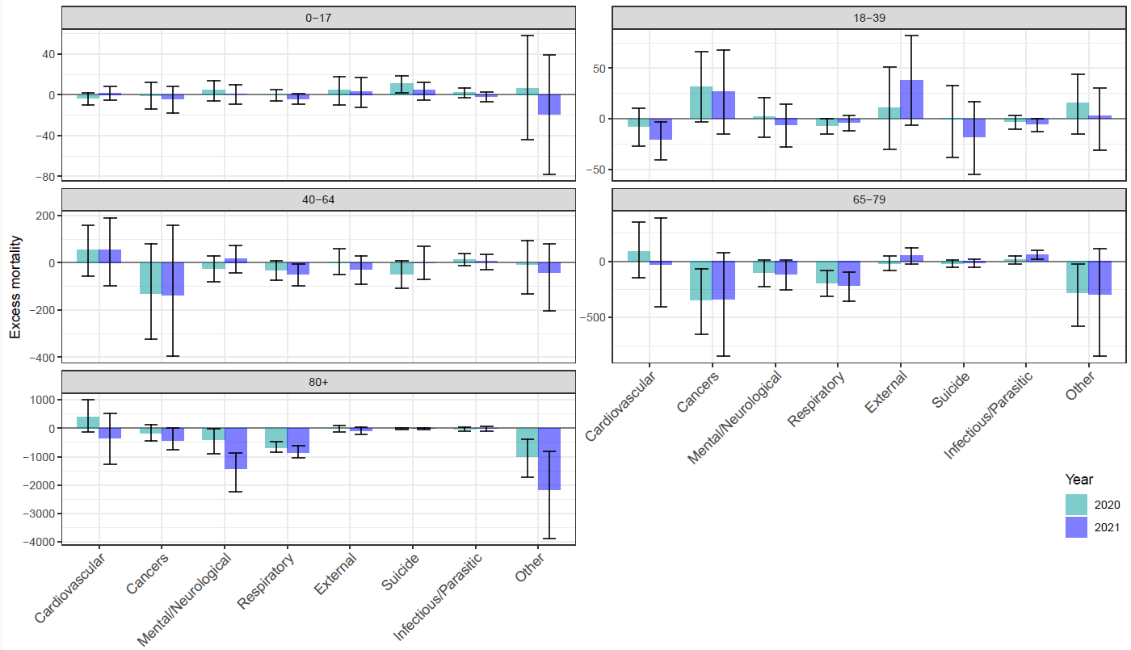
Excess mortality in 2020 and 2021
No excess mortality due to suicide
Lower mortality due to
respiratory diseases
Cancers
Mental/neurological diseases
Other causes
Notes:
Population jeune -40 ans: pas réellement de sur ou de sous-mortalité, en raison de nombre restreint de décès pour ces classes d’âge
Rassurant d’observer qu’on a pas d’excès de suicide comme certaines personnes durant le covid le prédisaient
Par contre, on observe une sous mortalité des maladies respiratoires, en raison des mesures d’hygiènes qui ont limité la circulation des virus respiratoires
Pour les plus de 65 ans on observe généralement moins décès due au cancer, maladie mentale
Autres causes: catégories assez hétérogène car elle regroupe aussi bien des décès dont la cause n’est pas connue que des maladies comme le diabète

Slide 12
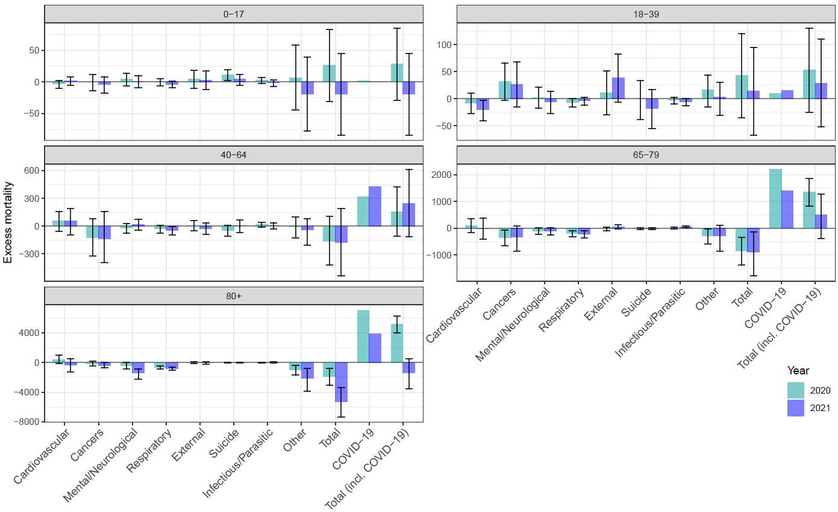
Excess mortality in 2020 and 2021
Negative excess mortality when excluding COVID-19
Total excess mortality
2020: 6736
2021: -680
Notes:
Même graphe en ajoutant les décès du covid que je n’ai évidemment pas pu calibrer dans mon modèle pour des raisons évidents
Mais c’est toujours intéressant de comparer la surmortalité par cause

Slide 13
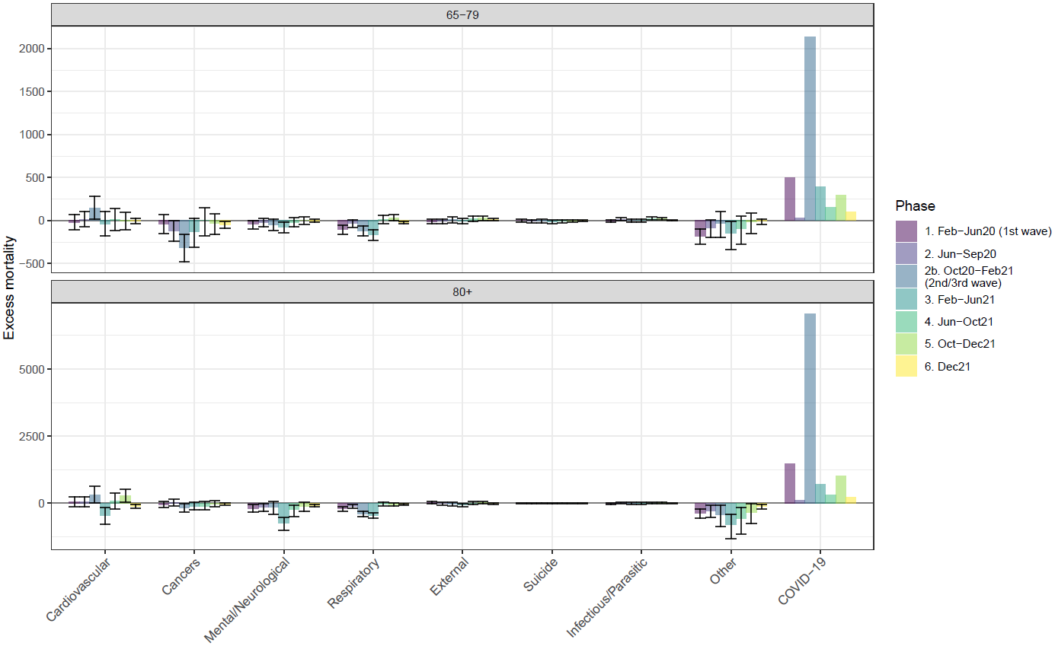
Excess mortality by epidemic phase
Check similarity between deaths due to COVID-19 and to other causes by phase
Other causes, respiratory: almost consistently lower mortality
Cancer: lower mortality in 65-79 age group during 2nd wave
“immediate” harvesting effect?
cancer is a risk factor for COVID-19 among 65-79 ^{1.}
Mental/neurological, cardiovascular: lower mortality after 2nd wave in 80+ age group
delayed harvesting effect

Slide 14
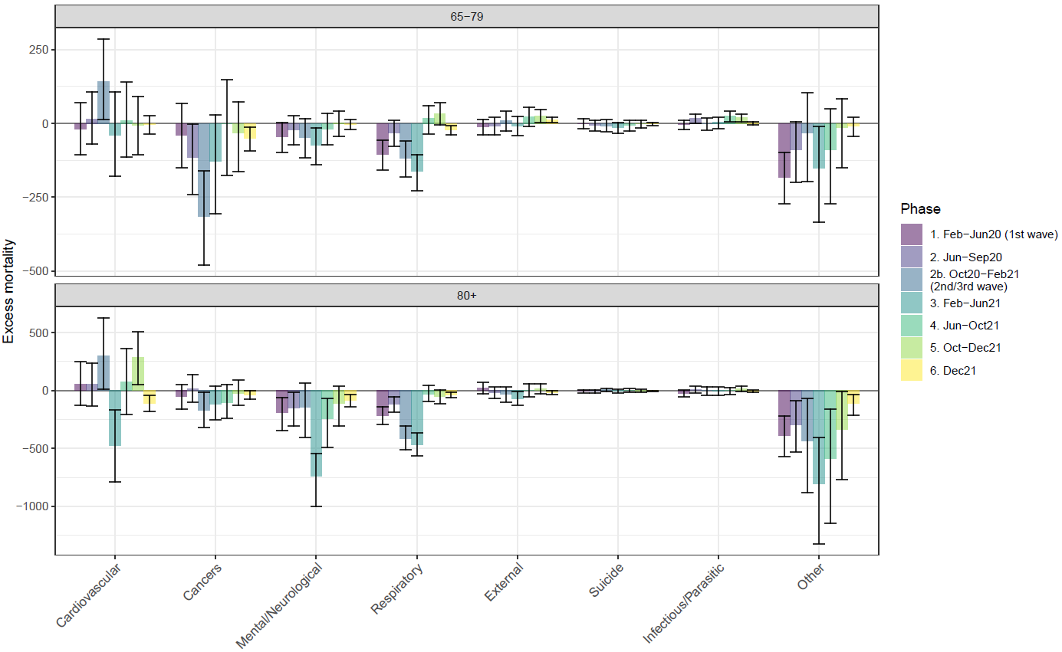
Excess mortality by period
Check similarity between deaths due to COVID-19 and to other causes by phase
Other causes, respiratory: almost consistently lower mortality
Cancer: lower mortality in 65-79 age group during 2nd wave
“immediate” harvesting effect?
cancer is a risk factor for COVID-19 among 65-79 ^{1.}
Mental/neurological, cardiovascular: lower mortality after 2nd wave in 80+ age group
delayed harvesting effect
1. Zhang (2022) Front Med.
Notes:
Un effet de moisson

Slide 15
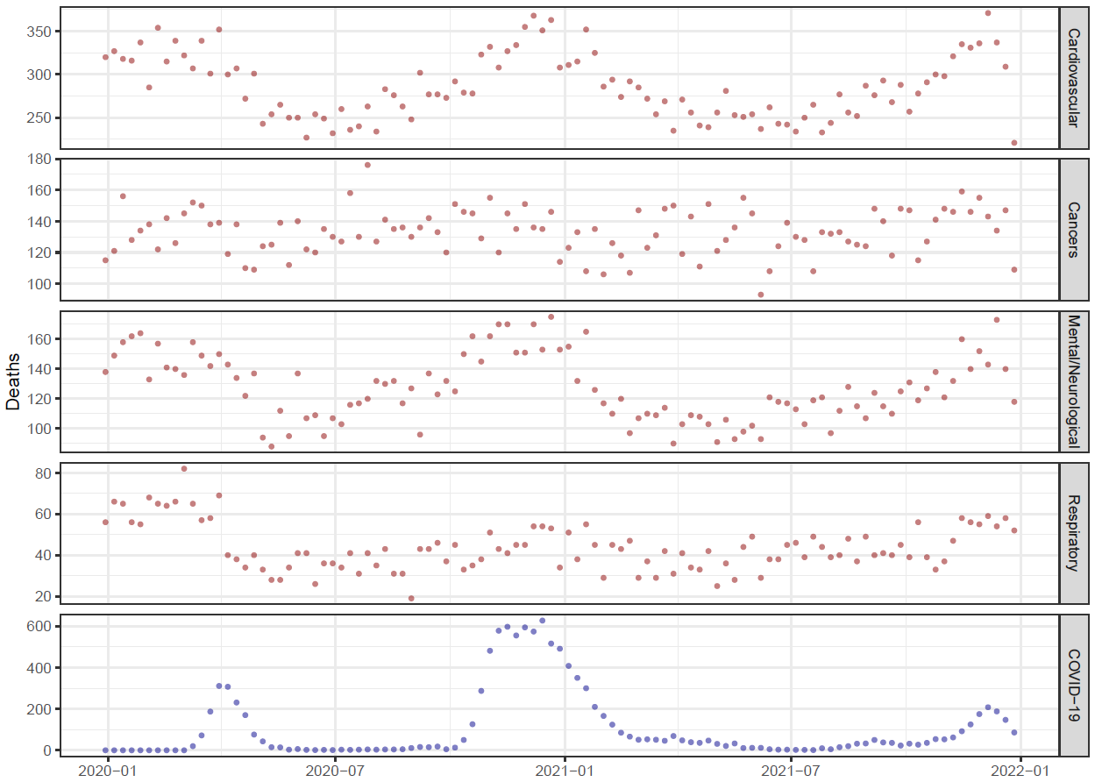
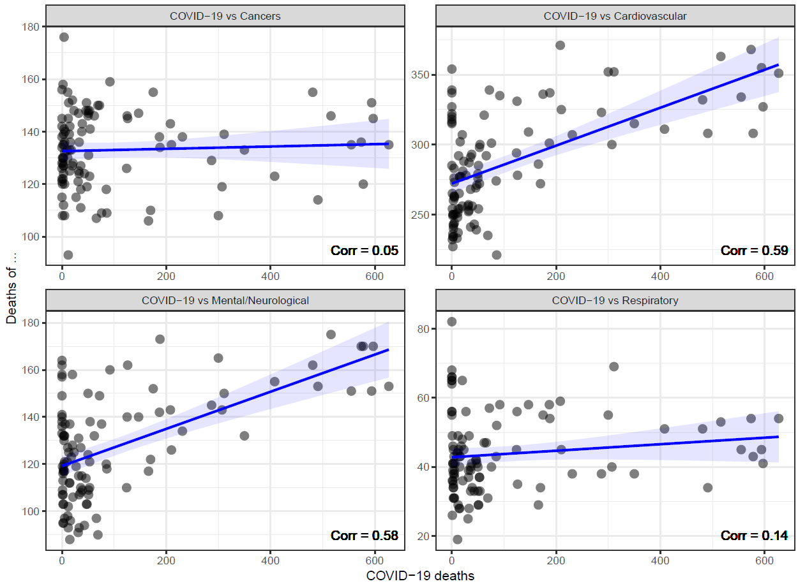
Correlation with COVID-19
Deaths of different causes in 2020-2021
Correlation with COVID-19

Slide 16
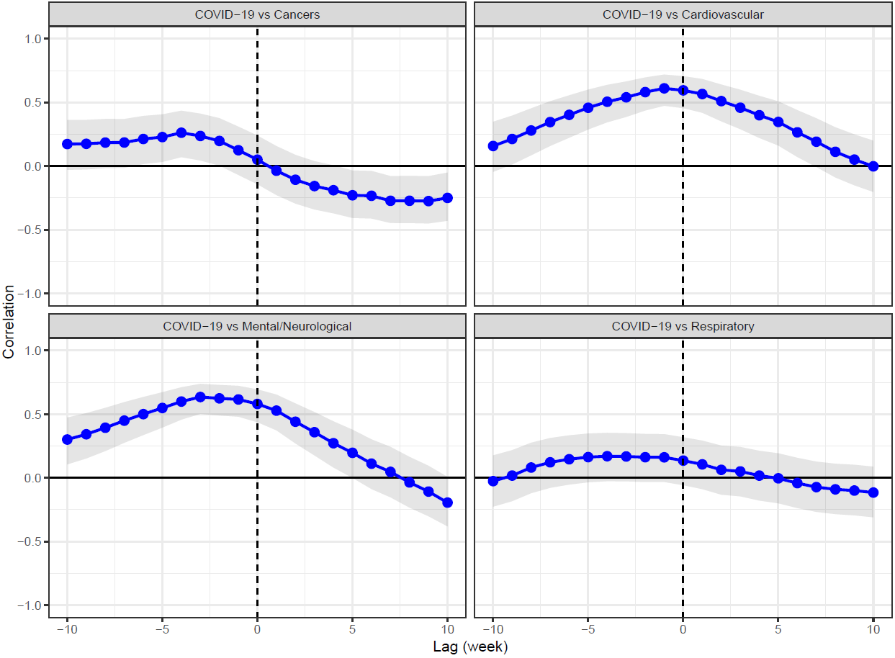
Correlation with COVID-19
Deaths of different causes in 2020-2021
Correlation with COVID-19, adding lag
Notes:
Tester la corrélation en ajoutant un délai et on remarque que la plus haute corrélation est obtenue sans délai ou alors un petit délai de deux trois semaines

Slide 17
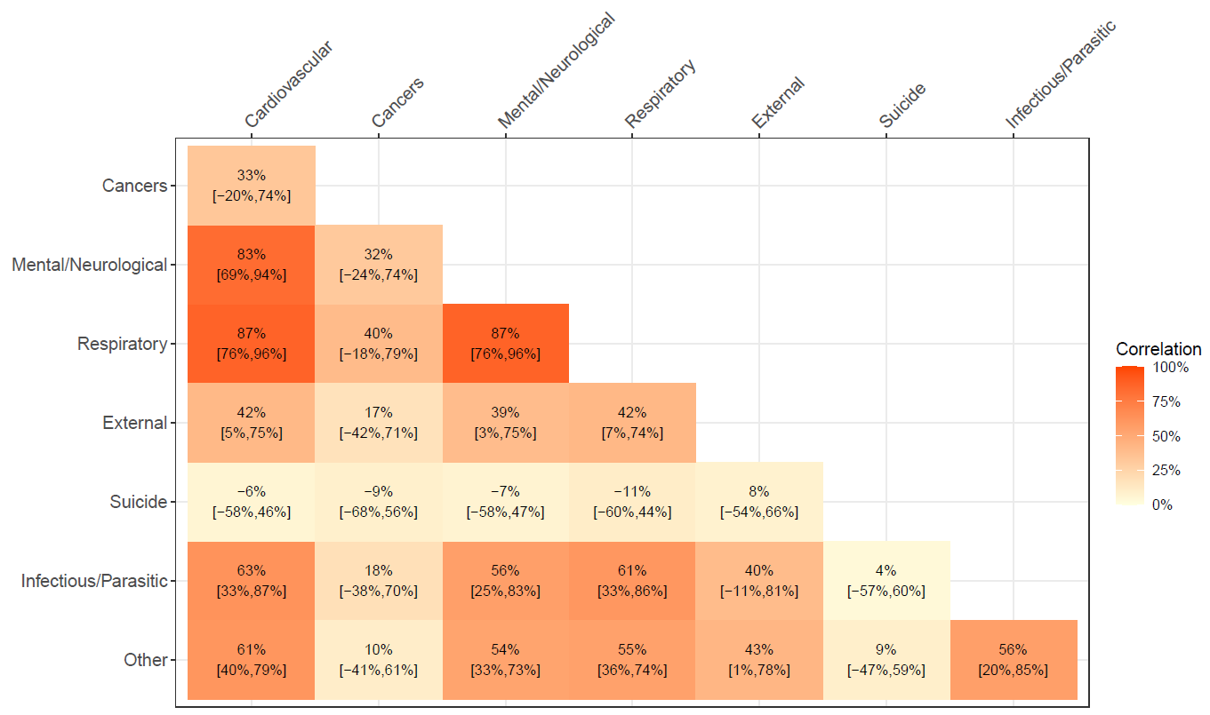
Correlation matrix
Correlations between excess mortality due to
cardiovascular,
mental/neurological and
respiratory diseases
Reason: deaths due to respiratory diseases/viruses wrongly assigned as deaths due to mental/neurological or cardiovascular disease?

Slide 18
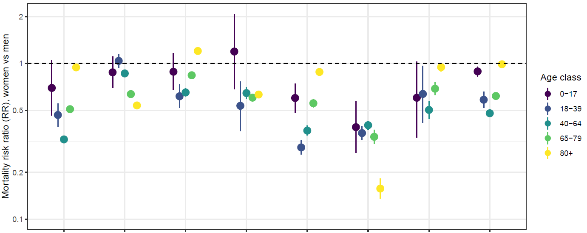
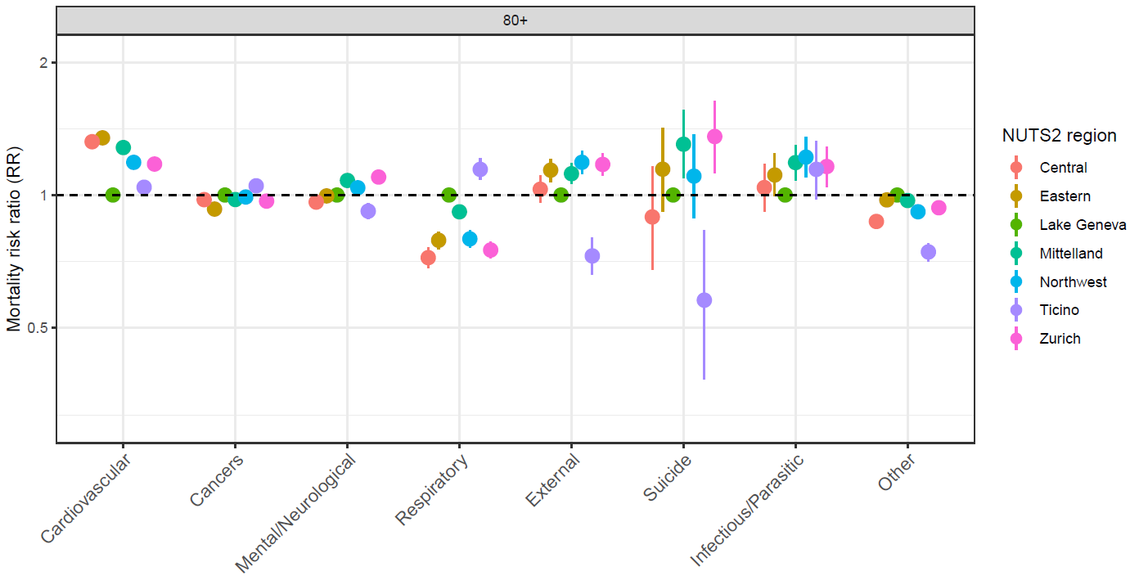
Sex and regional differences
Almost consistently lower mortality in women compared to men
Limited variation in mortality risks between regions (e.g., cancer)

Slide 19
Summary
We developed a statistical model to identify excess mortality by cause in Switzerland during COVID-19 pandemic, integrating several features into the calculation of expected mortality (seasonality, long-term trend, correlation between causes, effect of sex, region).
Deaths due to some causes (e.g., cardiovascular or mental/neurological diseases) are correlated with COVID-19 deaths
Mortality displacement
Incorrect assignment of deaths (cardiovascular -> COVID-19)
Correlation between deaths due to respiratory diseases and cardiovascular or mental/neurological diseases also identified before the pandemic.
Incorrect assignment of deaths (cardiovascular -> respiratory disease)
Underestimation of mortality due to respiratory diseases or COVID-19
Lower excess mortality due to cancer in population aged 65-79 during epidemic wave
Incorrect assignment deaths (COVID-19 -> cancer)?
Effect is marginal
Next steps:
Other causes: difficult to interpret the results as it mixed different causes -> define more categories
Integrate mortality from 2022 and 2023

Slide 20
Questions?

Slide 21
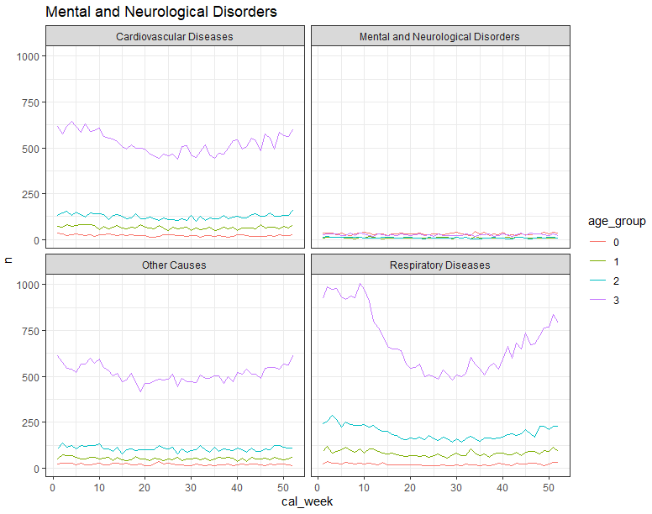
Secondary (direct) cause

Slide 22
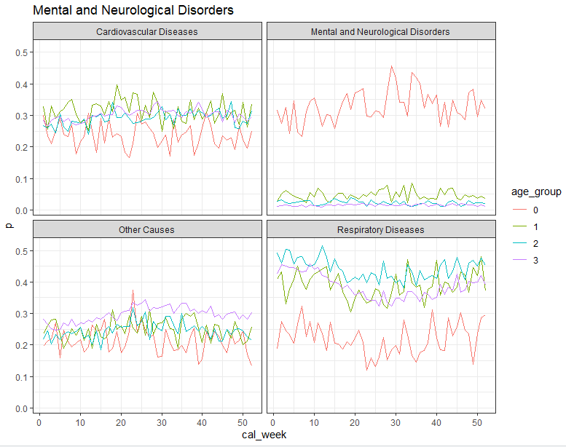
Secondary (direct) cause

Slide 23
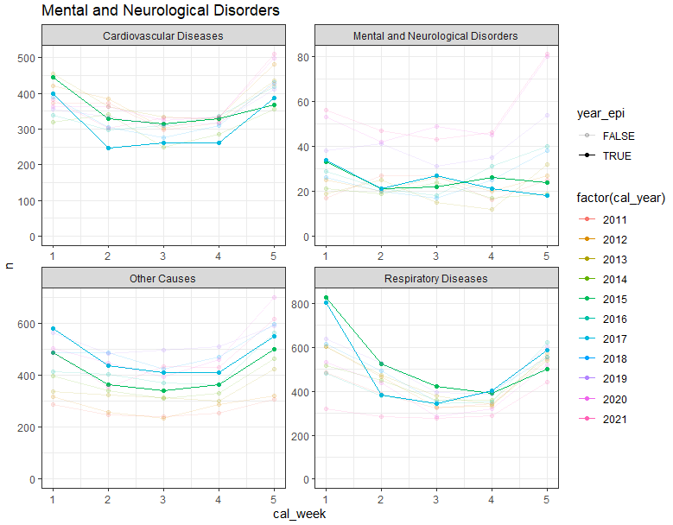
Secondary (direct) cause, 70+

Slide 24
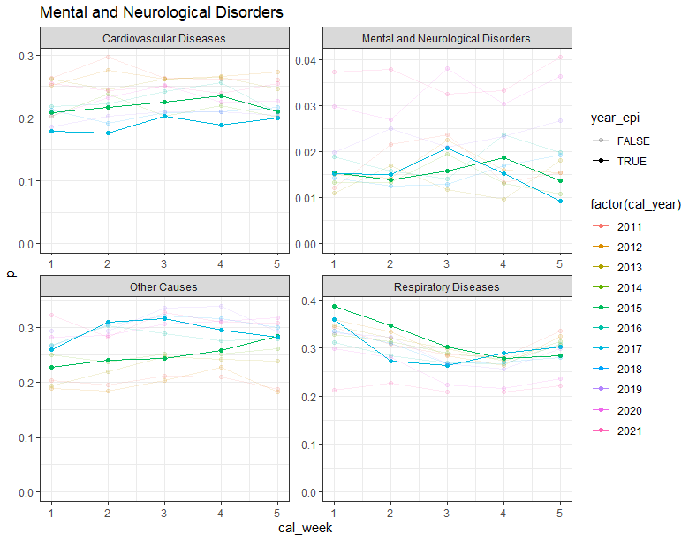
Secondary (direct) cause, 70+

Slide 25
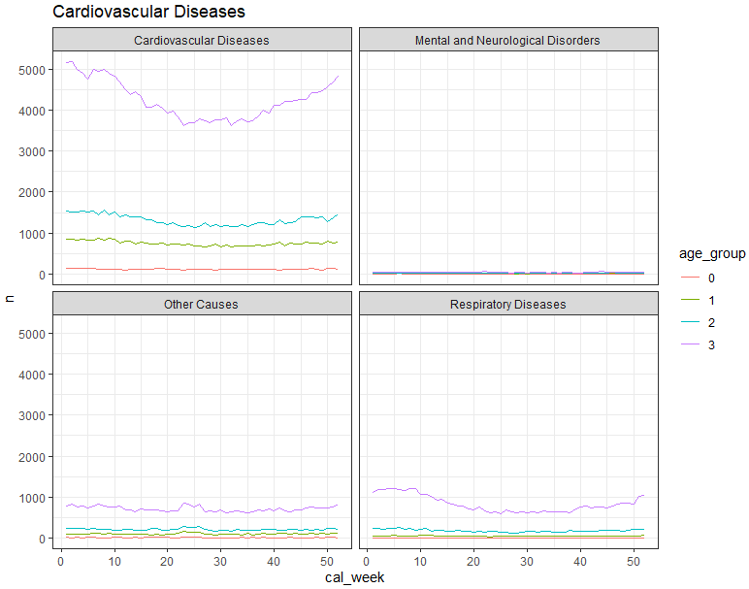
Secondary (direct) cause

Slide 26
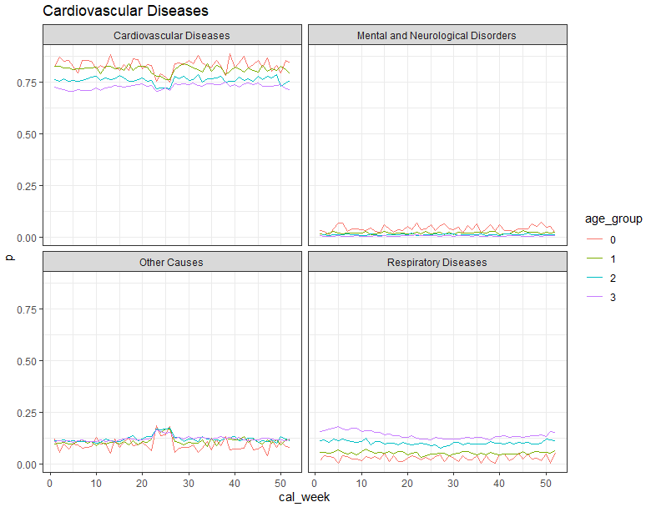
Secondary (direct) cause

Slide 27
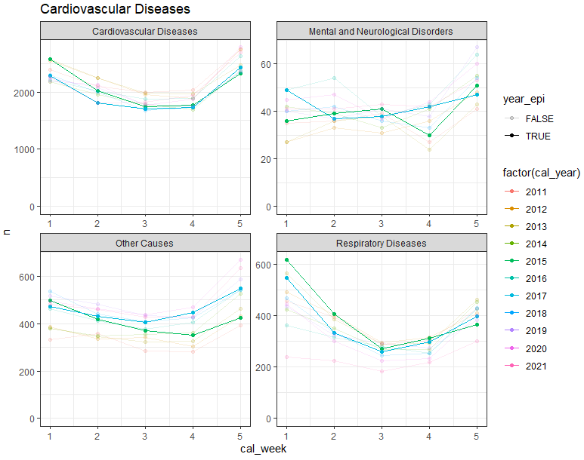
Secondary (direct) cause, 70+

Slide 28
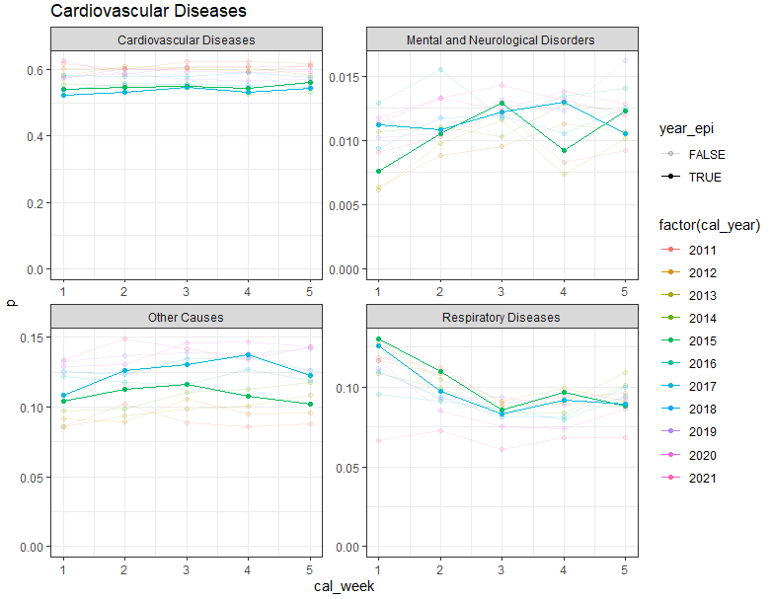
Secondary (direct) cause, 70+

Slide 29
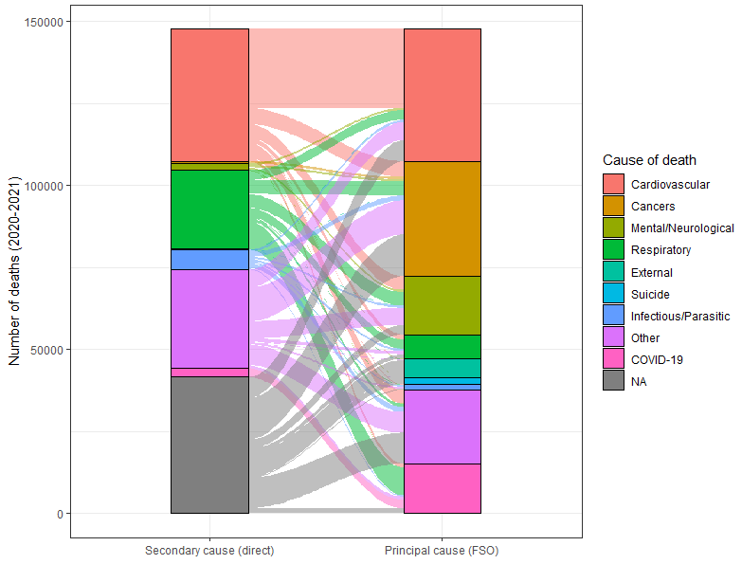
Secondary (direct) cause, 70+

Slide 30
Secondary (direct) cause, 70+
Mechanism | Causal Type | Causal Diagram Shape | Notes
1. Shared External Drivers | Confounding
Temp/Flu → Resp
Temp/Flu → CVD | Spurious correlation at population level, no direct link between outcomes
2. Mortality Displacement | Competing risk / collider bias
Frailty → (Resp or CVD)
Only one cause realized | Removal of frail individuals from risk pool for other causes
3. Misclassification / Attribution | Measurement artifact
Obs(CVD) ≠ True(CVD)
Misclassification due to testing/coding | Statistical bias; not a real link
4. Biological Causal Mediation | Direct or mediated causation
Resp infection → Inflammation → CVD death | Real physiological pathway; individual-level causation
5. Healthcare Disruption | Indirect causation via system mediator
Resp wave → Hospital overload → CVD mortality | Causal but indirect; system-level mediation

