Slide 1

CIS 014 – C++ Programming
Lecturer: Joseph Su

Slide 2
Optional Textbook:
Programming: Principles and Practice Using C++, 2nd ed, B. Stroustrup, Addison-Wesley, 2014
PDF:
http://www.cplusplus.com/files/tutorial.pdf
Online:
http://www.cplusplus.com/doc/tutorial/
The C++ Programming Language, 4th ed.
B. Stroustrup, Addison-Wesley, 2013
C++ How to Program, 10th ed
Deitel & Deitel, Pearson Hall, 2016
C++ Primer, 5th ed
S. Lippman, J. Lajoie, and B. Moo, Addison-Wesley, 2012
REFERENCES

Slide 3
READING ASSIGNMENTS
ONLINE
Arrays
Array Declaration
Dynamic Memory
Operator delete
Operator delete[]
TEXBOOK
5.9 Debugging - 5.11 Testing
18.6 Arrays - 18.6.3 Array initializations

Slide 4
READING ASSIGNMENTS
REFERENCES
ASCII http://www.cplusplus.com/doc/ascii/
BOOLEAN http://www.cplusplus.com/doc/boolean/
http://www.cplusplus.com/doc/tutorial/
http://www.cplusplus.com/files/tutorial.pdf (pages 1-62)
✔ Program Structure
✔ Structure of a program
✔ Functions (Functions I & II)
✔ Compound Data Types
✔ Arrays
✔ Character sequences

Slide 5
TODAY
Debug
How to debug
Debugging: command-line outputs
Debugger Tools
Common debugging options in tools
Assert
Arrays
Initialization
Declaration
Usage
Dynamic allocation

Slide 6
HOW DO WE DEBUG?
Debug – trace your control flow in code as it is run
Objective: correct syntactic and logic errors, and capture edge conditions to produce better code
Code level (primitive way):
Example: cout, printf, sprintf, etc
IDE level: use debugger (platform-specific)
Example:
* With Eclipse, use gdb for C/C++ to step through code
* With Code::Blocks, use its built-in debugger tool

Slide 7
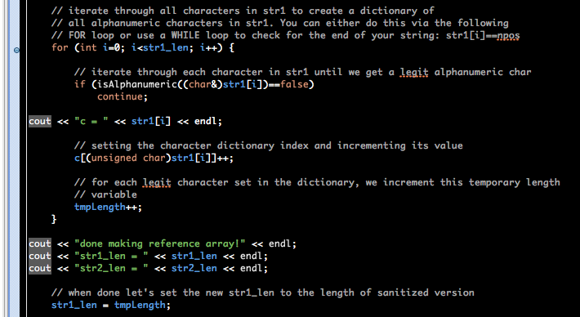
DEBUGGING: BACK TO THE BASICS
Use command line output:

Slide 8
DEBUGGING TOOLS
Code::Blocks
http://wiki.codeblocks.org/index.php?title=Debugging_with_Code::Blocks
Visual Studio (2005/2008)
http://www.cprogramming.com/tutorial/visual_studio_debugging_setup.html
Qt Creator
https://doc.qt.io/qtcreator/creator-debugging.html
Eclipse
https://www.softwaretestinghelp.com/eclipse/debugging-your-code-in-eclipse/
Debug a C Program: https://www.youtube.com/watch?v=ThYE5IllvB0
Debug a C++ Program: https://www.youtube.com/watch?v=azInZkPP56Q

Slide 9
COMMON DEBUGGING OPTIONS IN TOOLS
Execute a single instruction on your compiled code one step at a time, with the following common debugging options:
Debug | Restart
Debug | Stop Debugging
Debug | Start Debugging
Debug | Break
Debug | Step Into
Debug | Step Over
Debug | Step Out

Slide 10
ASSERT
#include <assert.h>
void assert(int boolean_expression)
Assert terminates the program with a message when its boolean argument turns out to be false:
Assertion failed: [expression, file filename, line line number]
Assertion failed: (INT_MAX==214748364), function main, file ../src/HelloWorld.cpp, line 18.
It is used frequently in development unit testing, continuous integration, QA, etc., or many situations during testing of code before deployment to production

Slide 11
ASSERT
It is used to allow program to fail more obviously than allowing it to continue in the face of errors (as with printing out values)
Examples:
assert(reverseInt(-1)==-1); // OK if this function call // doesn’t produce side effects
assert(n > 0);
Use one assert for each assumption you are testing
We may disable assert() in release by #define NDEBUG before the insertion of #include <assert.h> in C++

Slide 12
ASSERT
We can also write our own custom macro ASSERT:
// ASSERT(condition) checks if the condition is met, and if
// not, calls ABORT with an error message indicating the //
// module and line where the error occurred.
#ifndef ASSERT
#define ASSERT(x)
if (!(x)) {
char buf[2048];
snprintf (buf, 2048, "Assertion failed in \"%s\",
line %d\n\tProbable bug in software.\n",
\ __FILE__, __LINE__);
ABORT (buf);
} else // This 'else' exists to catch the user's
//following semicolon
#endif

Slide 13
ARRAYS
Array declaration:
type array_name[array_size];
List of multiple values of the same type
Examples:
float floatArr[3];
std::string stringArr[100];

Slide 14
ARRAYS: INDEXING & INITIALIZATION
Arrays in C++ are zero-indexed
First element has an index of 0
To access the third element in an array, arr, we write arr[2]
The index itself may be directly provided, derived from a variable or computed from an expression:
arr[2];
arr[j];
arr[j+4];
There are several ways to initialize an array
// Declare array first, then initialize some or all the elements:
int arr[4];
arr[0] = 3;
arr[1] = 8;
// initializing an int array of 5 integers at the time of declaration
int array[5] = {1, 2, 2, 5, 4};

Slide 15
ARRAYS: INDEXING & INITIALIZATION
In C++, the compiler initializes an array of 5 integers given the
5 integer literals in {}
int array[] = {1, 2, 2, 5, 4};
The above lets the compiler determine the array size at compile time, based on how many (in this case 5) elements we give it
In the above the compiler will create an integer array of dimension 5
An array can also be initialized at run-time:
int arr[4];
cout << “Please enter 4 integers:” << endl;
for (int i =0; i<4; i++)
cin >> arr[i];

Slide 16
ARRAYS: INITIALIZATION
Examples:
Initializing a string array of two strings
std::string strArray[2] = {“PCC”, “student”};
Declaring a zoo of 100 animals
Animal zoo[100];
For any array with size N, where N must be a positive integer and the array indices run from 0 to N-1
For an array with size N, array[N] exceeds the indices but will still compile. In C++, it is syntactically correct to go over the valid range in an array. This can cause run time errors, e.g., in Java you get an ArrayIndexOutOfBound exception.

Slide 17
ARRAY DECLARATION
type array_name[arraySize];
array_size must be a constant integer, namely,
const int arraySize = 3; // GOOD
NOT
int arraySize = 3; // BAD
const means array_size won’t change and cannot be changed
Will the following work?
int size;
cin >> size;
int array[size];

Slide 18
ARRAY USAGE
int array[3] = {10, 20, 30};
array[0] array[1] array[2]
What is the index of the first element?
What is the index of the last element?
There is NO such thing as CIRCULAR ARRAY
We often use loops to assign array values
string names[3];
for (int i=0; i<3; i++) {
cin >> names[i];
}

Slide 19
ARRAY: AS FUNCTION ARGUMENT
Arrays can be passed into functions as arguments
Array as parameter – without a dimension
#include <iostream>
using namespace std;
int sum(const int a[], int length) {
int sum = 0;
for (int i=0; i<length; sum += a[i++]);
return sum;
}
int main() {
int arr[] = {1, 2, 3};
cout << sum(arr, 3);
}

Slide 20
ARRAYS: DYNAMIC ALLOCATION
Declaring an array with fixed size is not always good:
int array[100000000]
Expansion limitation
Space limitation (exceeding maximum)
Problems avoided: dynamic allocation of arrays
Two steps:
Pointer declaration:
int* array;
Memory allocation:
array = new int[100000000];
Or, combining the two steps:
int* array = new int[100000000];

Slide 21
ARRAYS: DYNAMIC ALLOCATION
When something is dynamically allocated, you need to remember to de-allocate it when done
For every array created, namely:
int* array = new int[100000000]; // allocating memory
// you may initialize array elements using a FOR loop next
You need to remember to deallocate it when program is done:
delete [] array; // deallocating memory reserved for array
array = NULL; // set array in memory to NULL
Otherwise you will have MEMORY LEAKS!
Deletion: you must use [] with delete to free any array

