Slide 1

CIS 014 – C++ Programming
Lecturer: Joseph Su

Slide 2
Optional Textbook:
Programming: Principles and Practice Using C++, 2nd ed, B. Stroustrup, Addison-Wesley, 2014
PDF:
http://www.cplusplus.com/files/tutorial.pdf
Online:
http://www.cplusplus.com/doc/tutorial/
The C++ Programming Language, 4th ed.
B. Stroustrup, Addison-Wesley, 2013
C++ How to Program, 10th ed
Deitel & Deitel, Pearson Hall, 2016
C++ Primer, 5th ed
S. Lippman, J. Lajoie, and B. Moo, Addison-Wesley, 2012
REFERENCES

Slide 3
READING ASSIGNMENTS
ONLINE
https://cplusplus.com/doc/oldtutorial/control/
https://cplusplus.com/doc/tutorial/preprocessor/
https://cplusplus.com/doc/tutorial/
https://cplusplus.com/files/tutorial.pdf
Basics of C++
auto & decltype
Operators
Statements
Preprocessor
Increment/Decrement Operators
Control Structures: Loops
While
Do … While
Break & Continue

Slide 4
READING ASSIGNMENTS (Continued)
TEXTBOOK
3.4 Operations and Operators
3.5 Assignment and Initialization, 3.5.1
3.6 Composite assignment operators, 3.6.1
3.7 Names
3.8 Types and objects
4.3.2 Operators
4.4 Statements (4.4.1.1, 4.4.2.1, 4.4.2.3, etc)
20.5.2 auto
A.7 Declarations,
A.8 Built-in types
A.17 Preprocessor directives, A.17.1, A.17.2
Chapter 17 Vector Basics, 17.1 – 17.3
Chapter 18 Vectors and Arrays, 18.1-18.2

Slide 5
TODAY
More C/C++ Data Types
Type Deduction in C++
Arithmetic Operations
Variable Initialization
Constructor (parameterized)
Uninform (C++11)
Statements
Preprocessor Definition / Macros
Increment / Decrement Operators (++, --)
Control Structures
While; Do...While (see additional slides)
Break/Continue Keywords
Vectors
Operations
Examples / Sample Code

Slide 6
MORE C++ DATA TYPES
char, char16_t, char32_t, wchar_t
short = signed short int
long = signed long int
float (7 digit precision)
double (15-16 digit precision)
long double = more precise than double
bool
void (no storage but is a valid fundamental type in C/C++; used primarily to indicate a function’s return type)

Slide 7
TYPE DEDUCTION IN C/C++
auto (C/C++)
Decltype (C++)
Example:
int x = 2;
auto y = x; //same as int y = x;
decltype(x) z; //same as int z;

Slide 8
ARITHMETIC OPERATIONS
Arithmetic is performed with operators
+ for addition
- for subtraction
* for multiplication
/ for division
Example: storing a product in the variable total_grade total_grade = average_grade * number_of_exams;

Slide 9
VARIABLE INITIALIZATIONS
Initialization of variables = at same time as declaration
Examples:
int x = 0;
int x (0); (constructor initialization)
int x {0}; (uniform initialization)

Slide 10
CONSTRUCTOR INITIALIZATIONS
Constructor: a special member function of class
Constructor is a function
A class is static (before run time)
An object is dynamic (run time)
An object is created from its class at run time
int x (0) means an int object called x is created from C++’s primitive Integer class, by passing 0 into its constructor function

Slide 11
UNIFORM INITIALIZATIONS
New in C++11
Examples:
std::vector<int> v { 1,2,3,4,5 };
std::set<int> s { 1,2,3,4,5 };
std::map<int,std::string> m {
{0,"zero"},
{1,"one"},
{2,"two"}};

Slide 12
STATEMENTS
See https://www.cplusplus.com/doc/tutorial/control/
Examples:
Declarations
Expression (unary, binary operators & operands)
Compound (brace-enclosed blocks {…})
Selection (if .. else, switch)
Iteration (while, for, do..while)
Jump (break, continue)
Statements are executed/computed in the order they appear in a program

Slide 13
PREPROCESSOR DIRECTIVES
https://www.cplusplus.com/doc/tutorial/preprocessor/
Preprocessor runs before the compiler, transforming source code into compiler-compatible source code
No semi-colon at the end of a directive!!
Directives include:
#include
#define
#ifdef … #endif
Etc.

Slide 14
PREPROCESSOR DEFINITIONS / MACROS
These are also called “Macros”
For assigning a constant value to an identifier
Example:
#define PI 3.14159
#define TAB ‘\t’
int main() {
cout << PI << TAB << PI *2 << endl;
return 0;
}

Slide 15
PREPROCESSOR DEFINITIONS / MACROS
Example:
#define SQUARE(a) a*a
int main() {
cout << SQUARE(2) << endl; // 2*2
return 0;
}

Slide 16
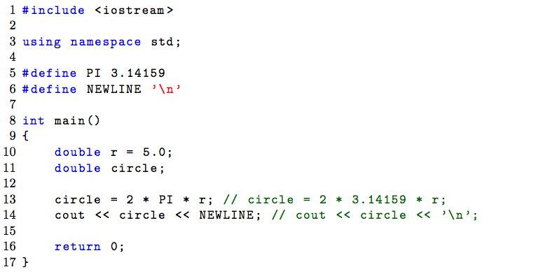
PREPROCESSOR DEFINITIONS / MACROS
Ex:

Slide 17
INCREMENT / DECREMENT OPERATORS (++, --)
a++ and ++a are shorthand for a = a + 1
++a: increment a, then return the value one more than the original a
--a: decrement a, then return the value one less than the original a
a++: return the current value, then increment
a--: return the current value, then decrement

Slide 18
CONTROL STRUCTURES: WHILE & DO … WHILE
Please see additional slides and videos in the course for information

Slide 19
BREAK & CONTINUE STATEMENTS
break statement:
Used in a loop
for exiting a loop immediately
continue statement:
Used in a loop
for skipping current iteration

Slide 20
VECTORS
http://www.cplusplus.com/reference/vector/vector/
Sequence container that can change in size
Similar to an array (will go through Array in next lecture)
Consists of contiguous storage locations for their elements
Vector elements are accessible via indices
Buffer is allocated dynamically
May need to be reallocated in order to grow in size (very expensive operation!)
In C++, vector is a template (container class)
To specify the data type for the vector you can declare the type inside its <data_type> during declaration:
#include <vector>
std::vector<int> v;

Slide 21
VECTOR OPERATIONS
Element access:
v.at(…)
v.operator[…]
v.front(): access first element
v.back(): access last element
Modifiers:
push_back(): add element at the end
pop_back(): delete last element
clear(): clear vector as whole
Iterators
Example:
for (vector<int>::iterator it=v.begin(); it != v.end(); ++it) {
cout << *it; // printing out the element
}

Slide 22
VECTOR EXAMPLES
See: http://www.cplusplus.com/reference/vector/vector/vector/
vector<int> first; // empty vector of ints
vector<int> second (4,100); // four ints with value 100 each
// iterating through second
vector<int> third (second.begin(),second.end());
// a copy of third
vector<int> fourth (third);
// construct from arrays:
int myints[] = {16,2,77,29};
vector<int> fifth (myints, myints + sizeof(myints)/sizeof(int));
cout << "The contents of fifth are:";
for (vector<int>::iterator it=fifth.begin(); it!=fifth.end();
++it)
cout << ' ' << *it; std::cout << '\n’;

Slide 23
VECTORS: SAMPLE CODE
This example illustrates the use of array indexing to loop through a collection of elements in an integer vector. Note this iteration does not make use of pointers or other advanced C++ syntax, but with a positional index i, from beginning to end.
#include<iostream>
#include<vector>
using namespace std;
int main()
{
// Create a vector of integers
vector<int> vec_of_num{1, 3, 4, 7, 8, 9};
// Iterate over vector of integers by indexing
for(int i = 0; i < vec_of_num.size(); i++) {
cout << vec_of_num[i] << " at index position: " << i <<endl;
}
return 0;
}

