Slide 1

CIS 014 – C++ Programming
Lecturer: Joseph Su

Slide 2
Optional Textbook:
Programming: Principles and Practice Using C++, 2nd ed, B. Stroustrup, Addison-Wesley, 2014
PDF:
http://www.cplusplus.com/files/tutorial.pdf
Online:
http://www.cplusplus.com/doc/tutorial/
The C++ Programming Language, 4th ed.
B. Stroustrup, Addison-Wesley, 2013
C++ How to Program, 10th ed
Deitel & Deitel, Pearson Hall, 2016
C++ Primer, 5th ed
S. Lippman, J. Lajoie, and B. Moo, Addison-Wesley, 2012
REFERENCES

Slide 3
READING ASSIGNMENTS
ONLINE
C/C++ Compilation
C++ Constants/Literals
C++ Variables, Literals and Constants
Variable Scope in C++
Basic Input/Output
Namespace in C++
TEXTBOOK
Chapter 2
8.7 Namspaces, 8.7.1 using declarations and using directives
A.1 and subsections
A.2 – A.2.5 Literals
A.3 and subsections
A.4 – A.4.1 Scopes
3.1 Input
3.2 Variables
3.3 Input and Type

Slide 4
TODAY
API Documentation & Examples
How a Program Works
Compilation Processes in C++
Literals
Namespace
Input & Output
Variables
Syntax & Naming Convention
Types
Declaration
Initialization
Assignment
Numeric Literals
Data Storage & Scope
Function Anatomy

Slide 5
API Documentation
What is the best way to document your code, its logic, input, and output, etc.?
Treat this code like any Application Programming Interface (API).
We write API documentation to make our code sustainable and maintainable, now and in the future.
API documentation: a concise reference manual containing all the information required to work with the API (code), with details about the functions, classes, return types, arguments and more, supported by tutorials and examples

Slide 6
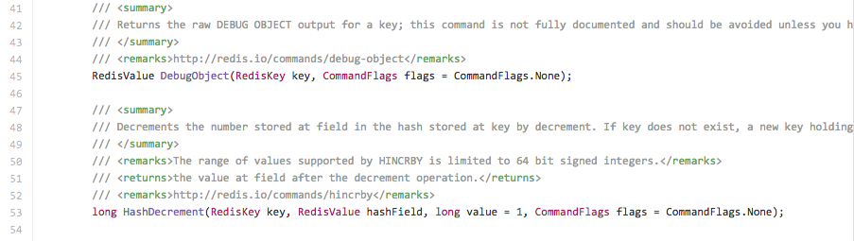
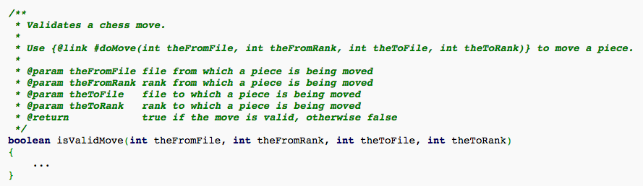
EXAMPLES: API DOCUMENTATION
C#
Java

Slide 7
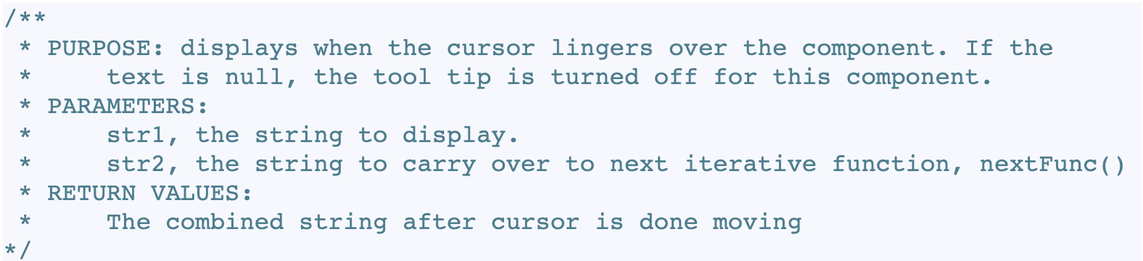
YOUR API DOCUMENTATION
API Documentation is required for your homework.
An API documentation should have THREE (3) parts
Purpose: a brief description of what this function/method is for.
Parameters: a list of input parameters, and their data types.
Return Values: the date type and value to be returned at the end of this function/method.
Example:

Slide 8
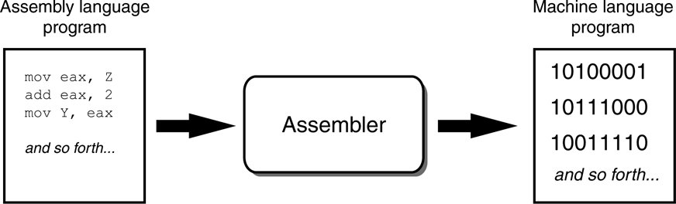
HOW A PROGRAM WORKS
A computer’s CPU can only understand instructions that are written in machine language.
Machine language is hard to understand and write; machine language instructions are in 1s and 0s.
Assembler is used to translate an assembly language program to machine language.
Assembly language: low-level language.

Slide 9
HOW A PROGRAM WORKS: COMPILERS
There are high-level languages that we can use to create machine language instructions without knowing how CPU works:
C++, C, Java, Python, C#, etc.
The statements written in a high-level language are called source code or code.
Source code is translated to machine language using a compiler or an interpreter.
Compilation error includes syntax error, which is a mistake such as a:
Misspelled keyword
Missing punctuation
Incorrect use of an operator
etc.

Slide 10
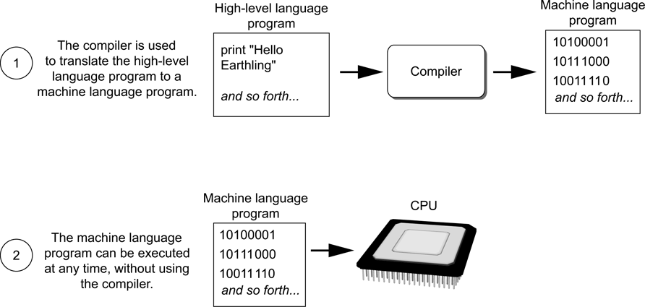
HOW A PROGRAM WORKS: COMPILERS
In other words:
Attribution: Gaddis, T. Starting Out with Games and Graphics in C++, 2nd Edition, Addison-Wesley, 2014

Slide 11
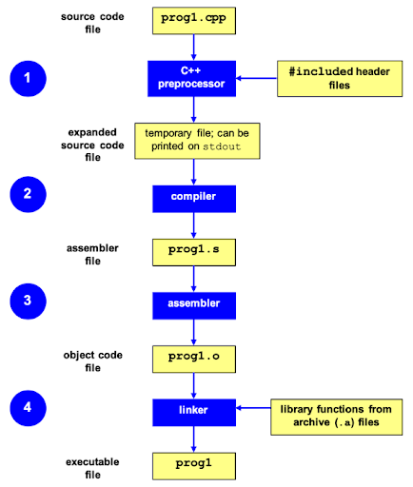
COMPILATION PROCESS IN C++

Slide 12
COMPILATION PROCESS IN C++
Preprocessing (Step 1)
http://www.cplusplus.com/doc/tutorial/preprocessor/
Preprocessor finds #includes, #defines and other preprocessor directives in code
Replaces directives with actual replacement code
Outputs: a "pure" C++ file without pre-processor directives
Compilation (Steps 2, 3)
Compiler takes the pre-processor's output and produces an intermediate assembler file (.s), which is then assembled into an object file (.o).
Linking (Step 4)
Linker takes the object files produced by the compiler and produces either a library or an executable file.

Slide 13
NAMESPACE: USAGE
Namespaces
For convenience: don’t need to write prefixes (function scopes)
Less clarity
Examples: if we have getNumOfStudents that are both declared and defined in the following namespaces in code:
using namespace CIS14;
using namespace CS2;
CIS14::getNumOfStudents(); // this one?
CS2::getNumOfStudents(); // this one?

Slide 14
NAMESPACE: EXAMPLE
#include <iostream>
using namespace std;
// first namespace
namespace first {
void func() { cout << "Inside first" << endl; }
}
// second namespace
namespace second {
void func(){ cout << "Inside second" << endl; }
}
int main () {
// Calls function from first namespace.
first::func();
// Calls function from second namespace.
second::func();
return 0;
}

Slide 15
NAMESPACE: EXAMPLE
#include <iostream>
using namespace std;
// first namespace
namespace first {
void func() { cout << "Inside first" << endl; }
}
// second namespace
namespace second {
void func(){ cout << "Inside second" << endl; }
}
using namespace first;
int main () {
// Which func() does it get called here?
func();
return 0;
}

Slide 16
NAMESPACE: STANDARD PRACTICE
Therefore it is a good practice to explicitly spell out <prefix>::<function> despite the “inconvenience”
It makes your code more maintainable in future
For this course, you may continue to use using namespace std --- but you should know that its pitfalls may outweigh its merit when your software becomes complex
Examples:
std::cout
std::list
CIS14::getNumOfStudents(); CS2::getNumOfStudents();

Slide 17
INPUT & OUTPUT
Both I/O are part of the iostream library
cout (pronounced as “see-out”)
cin (pronounced as “see-in”)
Examples:
cout << “Hello, World!”;
string first_name; // declaring first_name
cin >> first_name; // reads characters from // input (keyboard)
// into the first_name
// variable

Slide 18
INPUT & TYPE
Prompt the user for input that is desired first
Examples:
cout << “Enter your first name:”;
string first_name; // declaring first_name
cin >> first_name; // reads characters from input (keyboard) // into the first_name variable
//NOTE: the absence of newline before the first_name cin
int age;
cin >> age; // read an integer string first, second;
// read two strings separated by whitespace
cin >> first >> second;
cout << first << “was just entered” << endl;
//NOTE: give the user a chance to verify data entered

Slide 19
VARIABLES
A storage location in memory
object
Has a name and a type of data it can hold
Must be declared before it can be used
<Data Type> <Variable Name>:
Example of a variable declaration:
int data; //data is an integer variable
string first_name; // first_name is a
// variable of type // string

Slide 20
VARIABLES - SYNTAX
Data Type: A variable’s data type indicates the type of data that the variable
will hold
Variable Name: A variable name identifies a variable in the program code. When
naming a variable, you should always choose a meaningful name
that indicates what the variable is used for.
A variable name should represent the purpose of the variable.
For example: numberOfStudents The purpose of this variable is to hold the number of students.

Slide 21
VARIABLES: NAMING CONVENTION
IDENTIFIER | VALID? | REASON IF INVALID
totalStudents | Yes
Total_Students | Yes
total.Students | No | Cannot contain .
4thQtrStudents | No | Cannot begin with digit
totalStudents$ | No | Cannot contain $

Slide 22
VARIABLES: POPULAR DATA TYPES
int: storing integers
float, double: storing real numbers
double is short for “double-precision floating point”
long: storing integers of wider range than int
short: storing integers of shorter or equal range than int
char: storing characters
an individual character enclosed in single quotes (‘a’-’z’, ‘0’-’9’, etc.)
string: storing a sequence of characters
a sequence of characters enclosed in double quotes (“Hello”, “ab”, etc.)
bool: true (1) or false (0)

Slide 23
VARIABLES: DECLARATION
A variable must be declared before usage
When declared it causes a variable to be created in memory
A variable's declaration must appear before any other
statements involving usage of the variable
int grade; // declaration grade = 100; // assignment cout << grade << endl; // usage
Note ; is used after each statement

Slide 24
VARIABLES: INITIALIZATION
Initialization is by nature an assignment, namely the very FIRST
assignment for a declared variable
To initialize a variable means assigning it a value during its
definition:
int length; // declaration
int length = 12; // definition
Initializing some or all variables:
int length = 12, width = 5, area;

Slide 25
VARIABLES: ASSIGNMENT
An assignment statement uses the = operator to store a value in a
variable. numberOfStudents = 12;
This statement assigns the value 12 to the numberOfStudents
variable.
You can display the value of a variable with a cout statement: int grade; grade = 100; cout << grade << endl;

Slide 26
VARIABLES: ASSIGNMENT
The variable receiving the value must appear on the left side of the
= operator. // ERROR! 60 = grade;

Slide 27
VARIABLES: ASSIGNING NUMERIC LITERALS
Numeric literal is a number that is written in the program code
If the number is integer, the literal is also called integer literal
int grade = 60;
integer literal

Slide 28
RULES ON NUMERIC LITERALS
int literals: If a numeric literal is written as an integer (without a
decimal point), and fits within the range of an int, it is treated as
an int
double literals: If a numeric literal is written with a decimal point,
and fits within the range of a double, it is treated as a double.
You can assign int literals to int variables, but you cannot assign
double literals to int variables. (Note: strictly speaking assigning
double to int will truncate all the decimal values in the double)
You can assign either int or double literals to double variables.

Slide 29
VARIALBES: DATA STORAGE
Hold one value at a time
#include <iostream>
using namespace std;
int main() {
int grade = 60;
cout << “Enter your grade” << endl;
cout << grade << endl;
grade = 100;
cout << grade << endl;
return 0;
}

Slide 30
VARIALBES: SCOPE
The part of the program in which the variable can be accessed
A local variable’s scope begins at the variable’s declaration
and ends at the end of the function in which the variable is declared.
#include <iostream>
using namespace std;
int main() { //main function
int grade = 60; //local variable
cout << grade << endl; //local scope
return 0; //end of scope
}

Slide 31
VARIALBES: SCOPE
A variable cannot be used before it is declared.
A local variable cannot be accessed by code outside the function in which it is declared.
You cannot declare two variables with the same name in the same scope.

Slide 32
FUNCTION ANATOMY
type function_name(parameter1, parameter2, …)
{
// statement
}
Example:
int addition(int a, int b) {
return (a+b);
}

