Slide 1

CIS 014 – C++ Programming
Lecturer: Joseph Su

Slide 2
Optional Textbook:
Programming: Principles and Practice Using C++, 2nd ed, B. Stroustrup, Addison-Wesley, 2014
PDF:
http://www.cplusplus.com/files/tutorial.pdf
Online:
http://www.cplusplus.com/doc/tutorial/
The C++ Programming Language, 4th ed.
B. Stroustrup, Addison-Wesley, 2013
C++ How to Program, 10th ed
Deitel & Deitel, Pearson Hall, 2016
C++ Primer, 5th ed
S. Lippman, J. Lajoie, and B. Moo, Addison-Wesley, 2012
REFERENCES

Slide 3
READING ASSIGNMENTS
ONLINE
(Review) C++ Variables, Literals and Constants
Simple Control Structures
C++ Strings (W3School)

Slide 4
READING ASSIGNMENTS
TEXTBOOK
8.7 Namspaces, 8.7.1 using declarations and using directives
A.1 and subsections
A.2 – A.2.5 Literals
A.3 and subsections
A.4 – A.4.1 Scopes
3.1 Input
3.2 Variables
3.3 Input and Type
3.4 Operations and Operators
3.7 Names
3.8 Types and objects
A.2.1, A.2.3, A.2.4, A.2.5: Integer, Boolean, Character, String Literals

Slide 5
TODAY
Review: Questions
Review: Compilation Processes in C/C++
Literals and Constants
Bits & Bytes, ASCII
C/C++ Data Types: In-Depth Review
Boolean
Char
Integer
Control Structures
For Loop
While Loop
Do … While Loop
C++ String

Slide 6
REVIEW QUESTIONS
Can you:
Write an input statement (cin) to place a value in the variable num_students?
Write an output statement (cout) to prompt the user for the value to store in num_students?
Write an output statement that produces a newline?
Write an output statement that produces a tab in the statements?
Format output of a double/float number to show only 4 decimal places?

Slide 7
REVIEW: COMPILATION PROCESS IN C++
Preprocessing
http://www.cplusplus.com/doc/tutorial/preprocessor/
Preprocessor finds #includes, #defines and other preprocessor directives in code
Replaces directives with actual replacement code
Outputs: a "pure" C++ file without pre-processor directives
Compilation
Compiler takes the pre-processor's output and produces an object file from it
Linking
Linker takes the object files produced by the compiler and produces either a library or an executable file.

Slide 8
LITERALS/CONSTANTS
The term is interchangeable with the word “constant”
Data types:
int, char, bool, string (C++), double, float, void, etc.
They are fundamental types
Basic storage units in computers
Data type literals
123 // integer constant; integer literal
‘a’ // character/char constant; character/char literal
0.23 // float constant; float literal
“CIS14” // string constant; string literal

Slide 9
How Computers Store Data
Concept:
All data that is stored in a computer is converted to sequences of 0s and 1s.

Slide 10
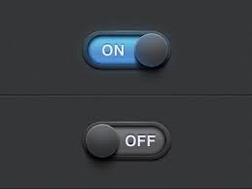
BITS & BYTES: INTRODUCTION
Computer’s memory is divided into very small storage locations known as bytes
One byte represents one number
A byte is divided into eight smaller storage locations known as bits
Bits are small electrical components that can hold either a positive (+) or a negative (-) value
A positive charge is similar to a switch in the on position
A negative charge is similar to a switch in the off position

Slide 11
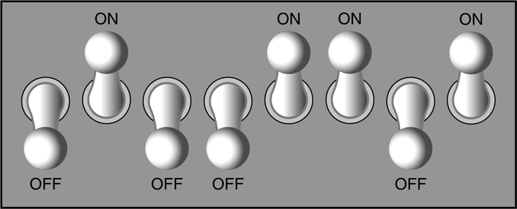
BITS & BYTES: INTRODUCTION
Bit: single numeric value, 0 or 1 (2 possible values)
8 Bits = 1 Byte
Think of a byte as 8 switches:
A single byte can be stored in an « array » of 8 bits
What is an array in programming?
How many possible values can we generate by varying 0s and 1s in above array of 8 bits?
1 or 0
0 | 1 | 0 | 0 | 1 | 1 | 0 | 1

Slide 12
BITS & BYTES: INTRODUCTION
Array is a data structure allowing storage of 1 or more elements having the same data type
A byte can be considered as an array of 8 elements of the type called Bit (which has a value of 0 or 1)
8 Bits = 1 Byte
1 Byte: 256 possible values of 0’s and 1’s (bits)
2⁷ | 2⁶ | 2⁵ | 2⁴ | 2³ | 2² | 2¹ | 2⁰

Slide 13
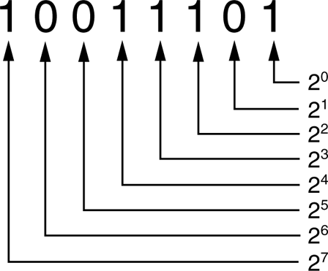
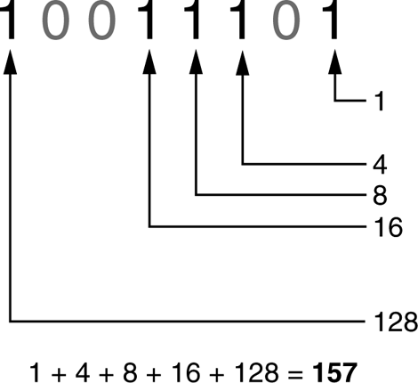
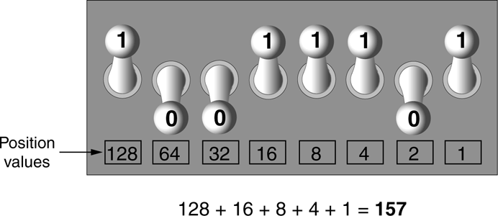
BITS & BYTES: EXAMPLE
Each digit in a binary number has a value assigned to it
Say we have an 8-bit number: 10011101. The values are as follows:
Adding all of the values we get:

Slide 14
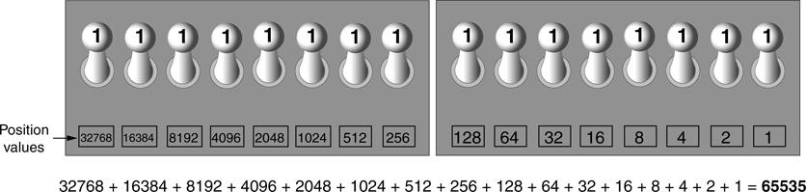
BITS & BYTES: ANOTHER EXAMPLE
The largest value that can be stored in a byte (8-bit) is 255
The largest value that can be stored in 2 byte (16-bit) is 65535
1st Byte:
2nd Byte:
32768 + 16384 + 8192 + 4096 + 2048 + 1024 + 512 + 256 + 128 + 64 + 32 + 16 + 8 + 4 + 2 + 1
= 65535
2¹⁵ | 2¹⁴ | 2¹³ | 2¹² | 2¹¹ | 2¹⁰ | 2⁹ | 2⁸
2⁷ | 2⁶ | 2⁵ | 2⁴ | 2³ | 2² | 2¹ | 2⁰

Slide 15
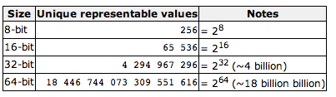
BITS & BYTES
sizeof(char) = 1 byte; ex: ‘a’, ‘c’, ‘\n’, etc.
sizeof(int) = 4 bytes; ex: 1, 2, 3, etc.
sizeof(std::string) = ?
sizeof(3.14159f) = ?
sizeof(3.14159L) = ?

Slide 16
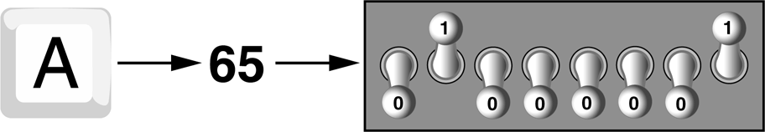
STORING CHAR DATA
Characters are stored in the computer’s memory as binary number.
The character, ‘A’, is stored in memory as the number 65, or in the bit pattern, 01000001:

Slide 17
CHAR
Integral data type
Guarantee to be 1 byte in memory space cross C/C++ compilers
In C/C++, all characters are saved as a number value in ASCII
ASCII (American Standard Code for Information Interchange)
http://www.asciitable.com/
Each numeric code in an ASCII table represents a character
Each text character is enclosed with a pair of single quotes (‘)
‘0’-’9’, ‘a’-’z’, ‘A’-’Z’, symbols, control characters, etc.
Can be any characters from the keyboard
Every character in ASCII has an assigned value between 0-255
0 – character NULL (‘\0’)
32 – space (‘ ‘)
97 to 122 – small letters ‘a’ to ‘z’

Slide 18
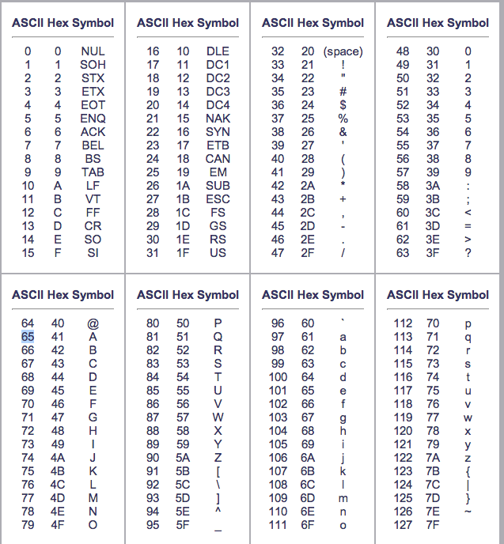
WHAT DOES A CHAR LOOK LIKE?

Slide 19
CHAR DECLARATION
CHAR = 1 byte (across all platforms)
char some_char;
cout << sizeof(‘a’); // C++ Program
printf("%c", 'a'); // C Program
signed or unsigned
SIGNED: both negative and positive
signed char: -128 to 127 (256 possible values)
UNSIGNED: 0 and positive
unsigned char: 0 to 255 (256 possible values)

Slide 20
CHAR DATA TYPE
char initialization exmaples:
char example_char = ‘c’;
(SAME AS char example_char = 99)
char tab = ‘\t’;
C standard requires char to hold at least 256 characters (or 8 bits)
char uses single quote (‘)
Is ‘pasadena’ a char???
There is NO such thing as multi-character literal in C/C++
string of characters, even if only one character is enclosed in double quotes
"a" is a string of characters containing one character
'a' is a value of type char

Slide 21
CHAR LITERALS
Newline: ‘\n’
Backspace: ‘\b’
Carriage return: ‘\r’
Tab: ‘\t’
What value is ‘0’?
What value is ‘1’?
What value is ‘a’?
What value is ‘b’?

Slide 22
CHAR INTIALIZATIONS
Good practice:
char letter = ‘a’;
Bad practice:
char letter = 97;
Invalid:
char letter = ‘abc’;

Slide 23
INTEGER DECLARATION
2 and 2.0 are not the same number
A whole number such as 2 is of type int
A real number such as 2.0 is of type double
int: stored as exact values
double: may be stored as approximate values due to limitations on number of significant digits that can be represented
Type int does not contain decimal points
Ex:
2
14
432
etc

Slide 24
INTEGER DECLARATION
INT = 4 Bytes or above (machine dependent)
Ex:
int some_int;
cout << sizeof(9); // C++ Program
printf("%d", sizeof(9)); // C Program
signed or unsigned
SIGNED: both negative and positive
signed int: -2147483648 to 2147483647
(2³² possible values)
UNSIGNED: 0 and positive
unsigned int: 0 to 4294967295
(2³² possible values)

Slide 25
BOOLEAN DECLARATION
bool in C/C++
Integral type with value of 0 or 1
Typically 1 byte in memory space
0 = false; 1 = true
For use in logical operations and assignments
Ex:
if (isAvailable) {…}
Ex:
if (isAvailable == true) { … }
Ex:
if (isAvailable == 1) { … }
Ex:
bool isGood = 7; // integer 7 is implicitly converted
// to bool
cout << isGood; // output: 1

Slide 26
BOOLEAN
Integer can be implicitly converted to bool values: non-zero integers to true, and 0 to false
bool x = true;
bool y = true;
bool sum = x + y;
cout << sum; // C++
printf("%d", sum); // C
sum = x – y;
cout << sum; // C++
printf("%d", sum); // C

Slide 27
C++ STRING DECLARATION
A C++ string is a series of characters enclosed in double quotes.
A newline cannot be a part of a string:
Error:
”C++
is fun!
”
Correct:
”C++\n is fun!”
String can be created statically via:
string s = ”C++”;
Reference: http://www.cplusplus.com/reference/string/string/

Slide 28
C++ STRING USAGE
A C++ string is an array of characters and can be iterated in an array fashion, namely:
// create a string
string str = ”C++”;
// get string length
int N = str.length();
// traverse the string
for (int i = 0; i < N; i++) {
// print current character
cout<< str[i]<< " ";
}

Slide 29
CONTROL STRUCTURES
for (initialization; condition; increase/decrease)
{
// statement
}

Slide 30
CONTROL STRUCTURES
if (condition)
{
// statement
} else if (another condition)
{
// statement
} else
{
// statement
}

Slide 31
CONTROL STRUCTURES
while (boolean condition) {
// statement
}
// condition is boolean
// example: n > 0

Slide 32
CONTROL STRUCTURES
do {
// statement
} while (condition);
// condition is boolean
// example: n > 0

