Slide 1

CIS 014 – C++ Programming
Lecturer: Joseph Su

Slide 2
Optional Textbook:
Programming: Principles and Practice Using C++, 2nd ed, B. Stroustrup, Addison-Wesley, 2014
PDF:
http://www.cplusplus.com/files/tutorial.pdf
Online:
http://www.cplusplus.com/doc/tutorial/
The C++ Programming Language, 4th ed.
B. Stroustrup, Addison-Wesley, 2013
C++ How to Program, 10th ed
Deitel & Deitel, Pearson Hall, 2016
C++ Primer, 5th ed
S. Lippman, J. Lajoie, and B. Moo, Addison-Wesley, 2012
REFERENCES

Slide 3
READING ASSIGNMENTS
ONLINE
Arrays
C++ Strings
C Strings
C++ String Operator+ Concatenation
TEXTBOOK
Review
Control structures (4.4, 4.4.1.1, 4.4.2.1, 4.4.2.3)
4.5 Functions (4.5.1, 4.5.2)
A.5 Expressions
3.4 Operations and Operators
3.5 Assignment and Initialization, 3.5.1
3.6 Composite assignment operators, 3.6.1
Required
18.6 Arrays, 18.6.3 Array initialization
23.1 Text, 23.2 Strings
27.5 C-style strings, B.11.3 C-style strings

Slide 4
READING ASSIGNMENTS
REFERENCES
http://www.cplusplus.com/doc/tutorial/
http://www.cplusplus.com/files/tutorial.pdf
✔ Program Structure
✔ Structure of a program
✔ Functions (Functions I)
Compound Data Types
✔ Arrays
✔ Character sequences

Slide 5
TODAY
Review: Control Structures/Examples
Review: Operators
Relational/Equality
Standard
Modulus
Compound
Unary Operators (++/--)
Logical/Conditional
Arrays
C-Style String vs C++ Style String
C/C++ String Initialization
C String Usage
C String API
String Concatenation

Slide 6
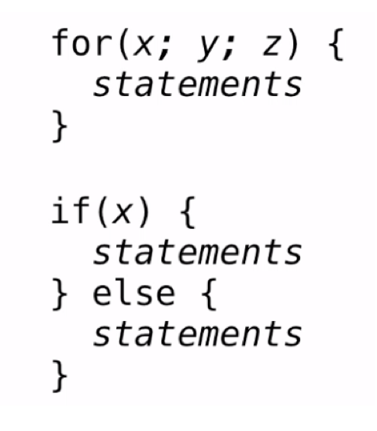
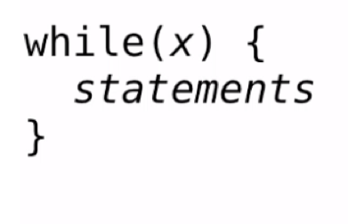
REVIEW: CONTROL STRUCTURES

Slide 7
REVIEW: CONTROL STRUCTURE EXAMPLE
Example: Print all positive odd numbers less than 20
int x = 1; while (x != 20) { cout << x << endl; x = x + 2; }
WHAT IS WRONG WITH THE ABOVE?

Slide 8
REVIEW: CONTROL STRUCTURE EXAMPLE
We have an infinite loop – loop that never stops
The loop body should contain an expression that will eventually become false, to break out of a loop
Example: Print all positive odd numbers less than 20
int x = 1; while (x < 20) { cout << x << endl; x = x + 2; }

Slide 9
REVIEW: CONTROL STRUCTURE EXAMPLE
What do you get here?
int x = 10; while (x > 0) { cout << x << endl; x = x – 3; }
What if x < 0?

Slide 10
REVIEW: RELATIONAL/EQUALITY OPERATORS
Relational Operators | Description
== | Equal to
!= | Not equal to
> | Greater than
< | Less than
>= | Greater than or equal to
<= | Less than or equal to
Examples:
If (3 <= 5) {
// statement
}

Slide 11
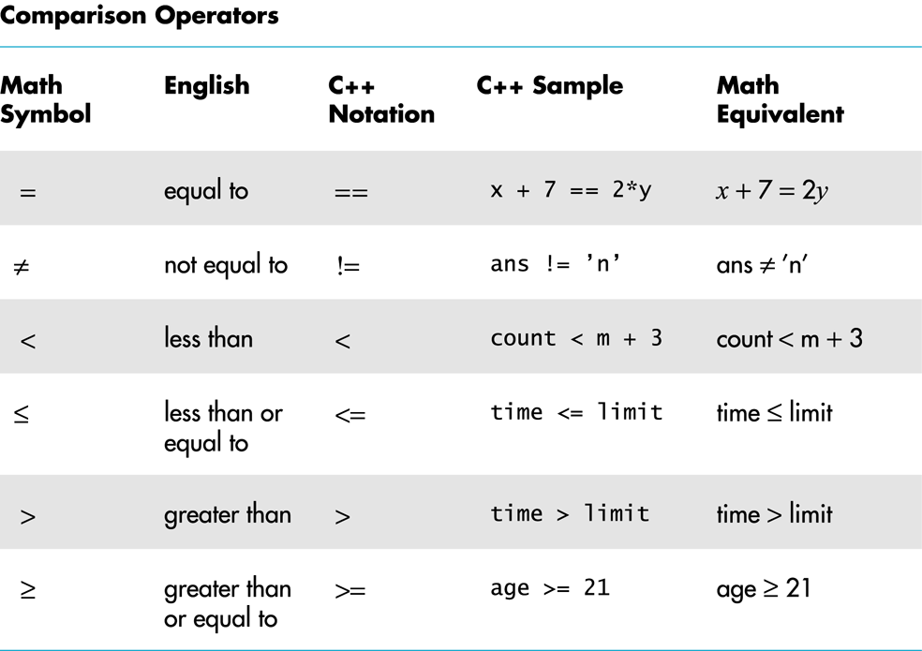
REVIEW: RELATIONAL/EQUALITY OPERATORS

Slide 12
REVIEW: STANDARD OPERATORS
Operation | Description
+ | Addition
- | Subtraction
* | Multiplication
/ | Division
% | Modulo
Examples:
A = 11 % 3; (modulo operator)
A = 11 / 3;

Slide 13
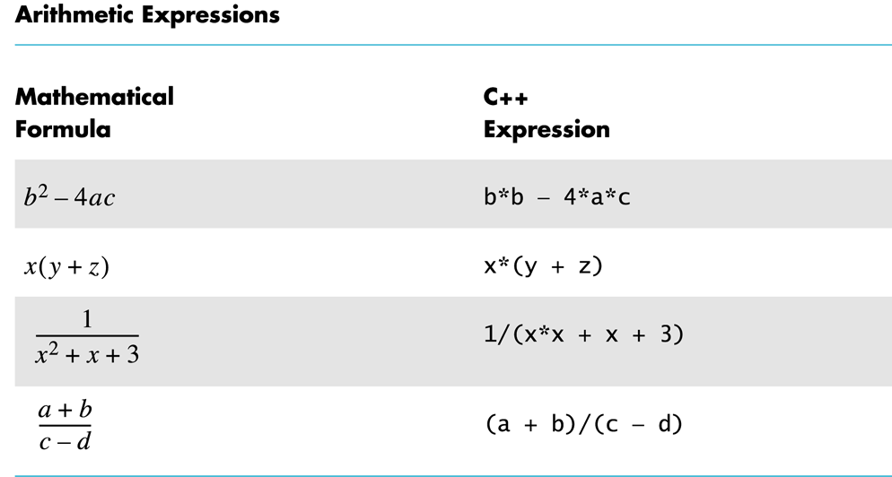
REVIEW: STANDARD OPERATORS

Slide 14
REVIEW: MOD OPERATOR %
• The mod operator % gives the remainder after integer division.
• 5 divided by 3 is 1, Remainder 2.
int x = 5%3; sets x = 2
• Why a percent % sign? Because it kind of looks like division /.
• Given currency value in integer cents,
For example, value = 312 cents:
int dollars = value / 100; sets dollars = 3
int cents = value % 100; sets cents = 12

Slide 15
REVIEW: COMPOUND OPERATORS
Compound Assignments | Examples
+= | A += B (A = A + B)
-= | A -= B (A = A – B)
/= | A /= B (A = A / B)
*= | A *= B (A = A * B)
%= | A %= B (A = A % B)

Slide 16
REVIEW: UNARY ++/-- OPERATORS
++ (addition by 1)
-- (minus by 1)
Example: consider for example the following
int A = 3;
int B;
Suffix
B = A--;
What is B?
Prefix
B = --A;
What is B?

Slide 17
REVIEW: LOGICAL OPERATORS
AND (&&)
A | B | A && B
TRUE | TRUE | TRUE
TRUE | FALSE | FALSE
FALSE | TRUE | FALSE
FALSE | FALSE | FALSE
OR (||)
A | B | A || B
TRUE | TRUE | TRUE
TRUE | FALSE | TRUE
FALSE | TRUE | TRUE
FALSE | FALSE | FALSE

Slide 18
REVIEW: LOGICAL OPERATORS
if (isTrue && (isTotal==20)) {…}
while (quantity > 0 && quantity < 10) {…}
if (radius!= 0 || earthHasAir==true) {…}

Slide 19
ARRAYS
Integer array
int i[3] = {1000000000, 22323234, 300000};
Char array
char a[3] = {‘\t’, ‘\n’, ‘\0’};
char c[4] = {‘e’, ‘d’, ‘u’, ‘\0’};
char c[] = “edu”; // C-style string
C++ string array
string str[3] = {“Pasadena”, “City”, “College”};

Slide 20
C-STYLE STRING vs C++ STYLE STRING
Declaration:
C
char test_string[];
C++
std::string test_string;
Initialization:
C
char test_string[] = “EDU”;
C++
std::string test_string = “EDU”;
C string literal
C++ string literal

Slide 21
C/C++ STRINGS - INITIALIZATIONS
Initializations
C
char test_string[] = “EDU”;
(allocated 4 bytes at compile time, 3 for chars and 1 for NULL terminator; calculation of array size at compile time)
NULL terminated (0, or ‘\0’)
C++
std::string test_string = “EDU”;
string is a class
Preferred over C-style strings
NOT NULL terminated

Slide 22
C STRING – USAGE EXAMPLES
C-string family of functions: strcpy(), strcat(), strlen(), etc., in <cstring> header
C Standard Library
char str[80];
strcpy (str, "Pasadena");
strcat (str, "City");
strcat (str, "College");
char array buffer of 80

Slide 23
C STRING – USAGE EXAMPLES
Why do we have to use strcpy() before strcat()?
What do you think strcat() does to the following line?
char str[80];
strcat(str, "City");

Slide 24
C STRING – APIs from C Standard Library
Mostly in <string.h> or <cstring>
atoi(): converts a string to an integer
strncpy(): writes exactly n bytes, copying from source
strlen(): returns the length of a string
strchr(): finds the first occurence of a byte in a string
Etc.

Slide 25
C STRING – USAGE EXAMPLES
char str[80];
strcpy(str, ”PCC");
cout << str;
cout << sizeof(str);
char str[80] = {}; // initializing str w/ 0’s
strcat(str, ”PCC");
cout << str;
cout << sizeof(str);

Slide 26
C STRING – USAGE EXAMPLES
char str[] = "PCC”;
OR C string
std::string str = ”PCC”;
cout << str[0]; operator []
cout << str[1];
cout << str[2];
cout << str[3];
cout << sizeof(str);

Slide 27
C++ STRING CONCATENATION
Concatenation: adding two strings together, which is done with a plus sign +
string first_name = “Joe”;
string last_name = “Cam”;
string full_name = first_name + last_name;
cout << full_name;
OUTPUT?
* Inserting a space “ ”
string full_name = first_name + “ “ + last_name;

Slide 28
C++ STRING CONCATENATION INVOLVING INTEGER
Using stringstream class in <sstream>
stringstream ss;
ss << 123;
string result = ss.str();
Using sprintf() in C’s <stdio.h>
int number = 3;
char result[10];
sprintf(result, “%d”, number);

