Slide 1

CIS 014 – C++ Programming
Lecturer: Joseph Su

Slide 2
Optional Textbook:
Programming: Principles and Practice Using C++, 2nd ed, B. Stroustrup, Addison-Wesley, 2014
PDF:
http://www.cplusplus.com/files/tutorial.pdf
Online:
http://www.cplusplus.com/doc/tutorial/
The C++ Programming Language, 4th ed.
B. Stroustrup, Addison-Wesley, 2013
C++ How to Program, 10th ed
Deitel & Deitel, Pearson Hall, 2016
C++ Primer, 5th ed
S. Lippman, J. Lajoie, and B. Moo, Addison-Wesley, 2012
REFERENCES

Slide 3
READING ASSIGNMENTS
TEXTBOOK
(Stroustrup, Programming: Principles and Practice Using C++)
Chapter 0 (pages 1-15)
Chapter 1 (pages 17-34)
Chapter 2 (pages 43-52)
REFERENCES
ONLINE: http://www.cplusplus.com/doc/tutorial/
PDF: http://www.cplusplus.com/files/tutorial.pdf

Slide 4
COMPUTER SCIENCE
What is computer science?
What is programming?
What is a programming language?
What is the most popular programming language?
Why C/C++?

Slide 5
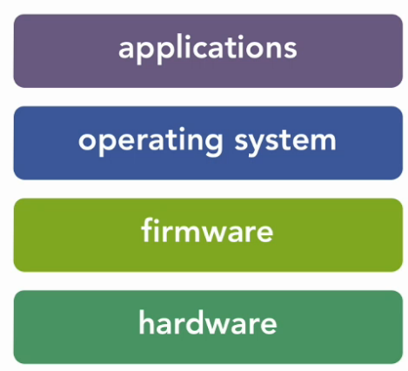
LAYERS OF TECHNOLOGY
Applications:
Microsoft Office, web browsers, etc.
Operating System:
Windows 1.0 and beyond, most of Mac OS X, etc.
Firmware:
Drivers

Slide 6
C/C++
C
Background
Language
C++
Background
Language

Slide 7
C: BACKGROUND
Developed by Dennis Ritchie of Bell Laboratories, between 1972 and 1973.
Foundation of C++, Java, JavaScript, PHP, Python, Perl, etc
Originally used to write utilities (software) for Linux OS.
As alternative to Assembly programming in OS and embedded
systems
Small, portable, efficient, fast and powerful at low level
Still popular after 40 years

Slide 8
C: BACKGROUND
Imperative, procedural - code described as statements
subroutines as functions
arguments - passed by value
procedural - code in blocks, and blocks can call upon
each other in a structured way
strongly typed - variable with declared type at compile time
fast, no run time indirections vs. dynamically typed system
Evolution:
ANSI C (C89, C90)
function prototypes, void pointers, etc.
C99: include C++ style comments
C14 latest today (2014)

Slide 9
C++: BACKGROUND
Developed by Bjarne Stroustrup in late 1970s
Object-oriented, procedural, functional
C++ extends C by adding powerful features while retaining C
Very popular after 30 years
Foundation behind vast number of medium to large scale
Applications, such as Microsoft Office, Adobe Photoshop,
Illustrator, Firefox, Google Chrome, etc.
Evolution:
C++98 -> C++03 -> C++TR1
First standard was ratified in 1998, called C++98
C++03 was issued in 2003 with bug fixes
C++TR1 (technical report version) evolves into C++11
C++11 still the very widely adopted
C++14 came out in 12/14 is is now the de-facto standard
C++17 came out Dec 1, 2017
C++20 came out Feb 2020

Slide 10
ROADMAP FOR LEARNING C++
Basic Facilities:
preprocessor (defining constants, including files defining
macros, etc.)
data types (int, floating, chars, strings, bits, structured data,
unions, typedef, void)
operators (assignment, arithmetic, logical, bitwise,
function call, cast, sizeof, operator precedence, etc.)
statements, expressions, loop, etc.
Standard Library
file I/O, string, system error handling, etc.
C++ Objects
classes, inheritance, friends, protected, private, etc.

Slide 11
ANATOMY OF A C++ PROGRAM
Example: a console application
#include <iostream>
using namespace std;
int main()
{
return 0;
}
include directive
which namespace to use
beginning of function named main
beginning of block for main
You will write other C++ statements here
send 0 to operating system
end of block for main

Slide 12
#INCLUDE DIRECTIVE
Inserts the contents of another file into the program
This is a preprocessor directive
#include lines are not seen by the compiler
Do not place a semicolon at end of #include line

Slide 13
SCREEN OUTPUT: COUT
The cout Statement:
Displays output on the computer screen
Part of the standard library collections (namespace std)
You use the stream insertion operator << to send output to cout:
cout << "Hello world”;

Slide 14
SCREEN OUTPUT: COUT
Can be used to send more than one item to cout:
cout << "Hello " << "world”;
Or:
cout << "Hello ";
cout << "world";
This produces one line of output: cout << "Programming is "; cout << "fun!”;

Slide 15
SCREEN OUTPUT: ENDL
The endl Manipulator:
The endl manipulator starts a new line of output. The following produces two lines of output: cout << "Programming is" << endl; cout << "fun!";

Slide 16
SCREEN OUTPUT: ENDL
The endl Manipulator:
The endl manipulator starts a new line of output. The following produces two lines of output: cout << "Programming is" << endl; cout << "fun!";
Don’t need quotations around endl.
The last character in endl is a lowercase L, not the number 1

Slide 17
SCREEN OUTPUT: NEWLINE
The newline escape sequence:
You can also use the \n escape sequence to start a new line of output. This will produce two lines of output: cout << "Programming is\n"; cout << "fun!";
Notice that the \n is INSIDE
the string.

