Slide 1
TPU Design Review
ASIC Lab 1
Anthony Hermez

Slide 2
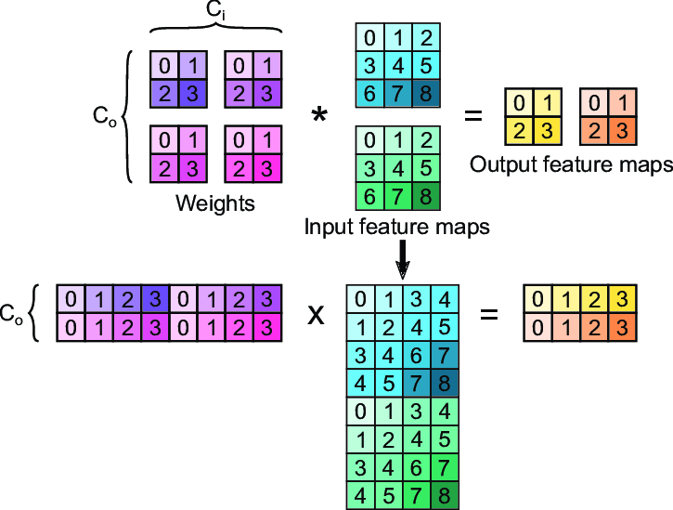
Motivation
The crux of ML workloads is massively parallel multiply-accumulate (MAC) operations, often in the form of matrix multiplication.
The quantity of MACs is on the order of trillions per LLM inference (such as ChatGPT).
Thus, a tensor processing unit (TPU) would be beneficial in speedup and power for the quantity matrix operations.
Figure 1. Convolutional Neural Network as matrix multiplication.

Slide 3
Problem Statement
Design a TPU to accelerate matrix multiply operations.
Integrate this accelerator with the scan chain I/O interface.
Approximate a realistic system design to interface the accelerator with an ML application.

Slide 4
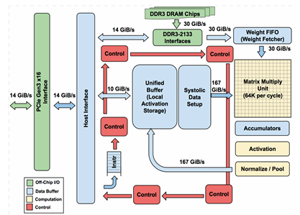
Literature Review: Google TPUv1 (2017)
Google coined the term “tensor processing unit” for their ASIC design accelerating ML requests on their servers (2017).
Key Features of TPUv1:
PCIe Interface to Host CPU.
DDR3 Interface to off-chip DRAM.
Weight-stationary systolic array with MAC processing elements.
CISC ISA with support for Matrix Multiplication, Convolution, and Non-Linear Activation Functions.
Figure 2. Block-level diagram of Google’s TPUv1.

Slide 5
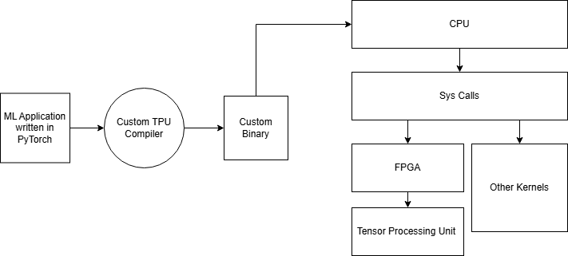
System-Level Context
ML application must be compiled into a mixed binary of CPU and TPU assembly.
A custom kernel (syscall) must be made to send the TPU instruction to the driving FPGA.
The driving FPGA simply asserts the correct signals to R/W instructions and data to the TPU.
Figure 3. System-level diagram TPU integration.

Slide 6
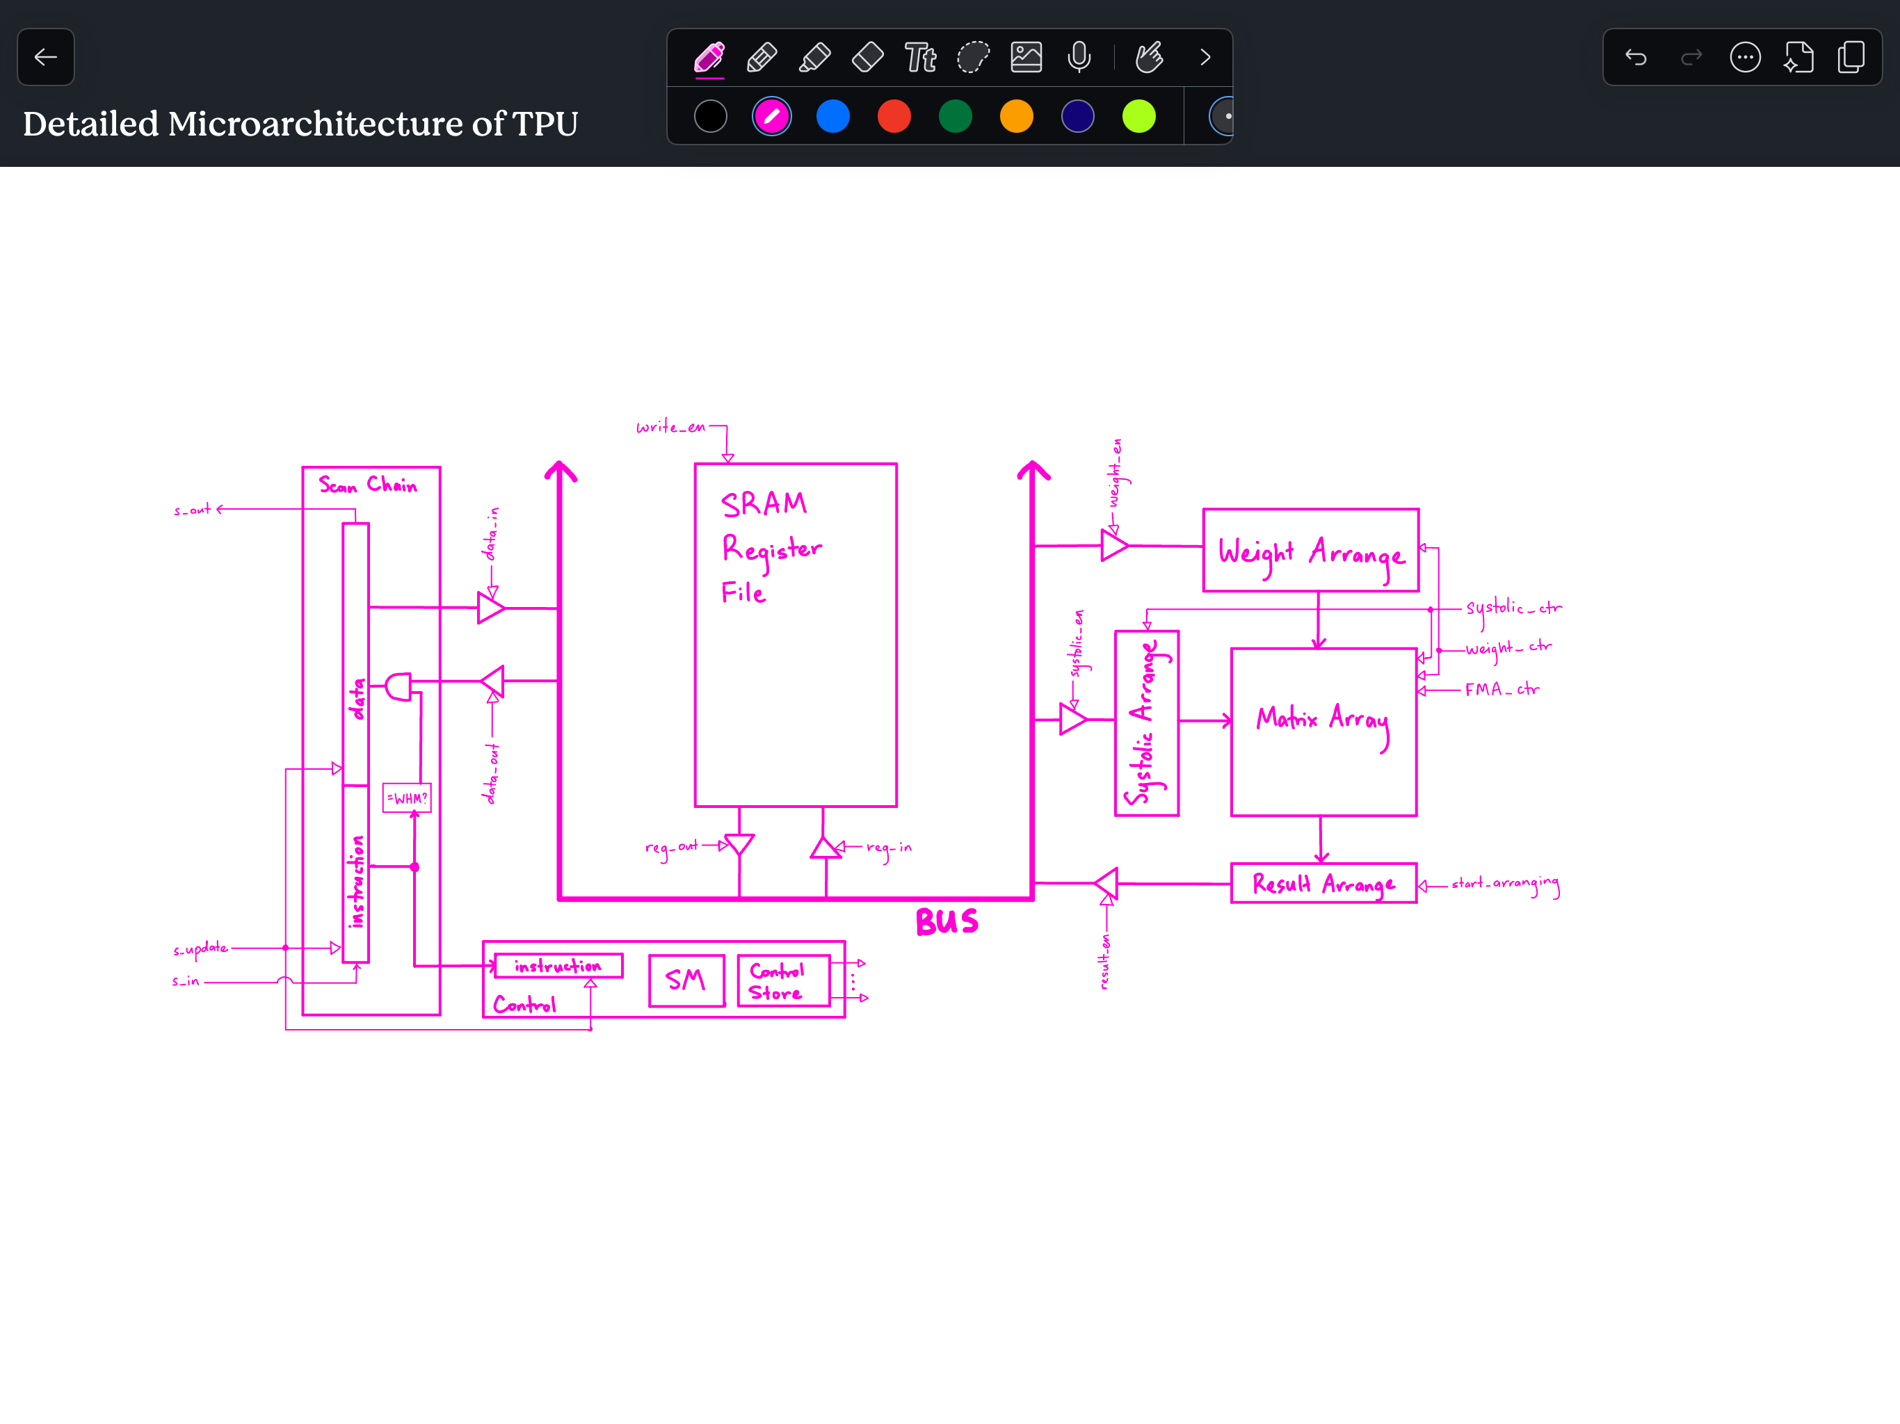
Microarchitecture: Overview
5 instruction CISC ISA.
Scan chain interface for R/W data and instructions.
NxN weight-stationary systolic array operating on 8-bit unsigned integers.
K-many registers, with each register being 8N² in size.
Global bus of width 8N².
Figure 4. TPU microarchitecture diagram.
Note: The final design uses N=4, K=8.

Slide 7
Microarchitecture: Deviations from Google
Supports MM, Conv, and Activation.
PCIe and DRAM interfaces.
Developed in 6 months by 100+ engineers.
Supports only MM.
Scan chain interface.
Developed in 3 months by 1 engineer.

Slide 8
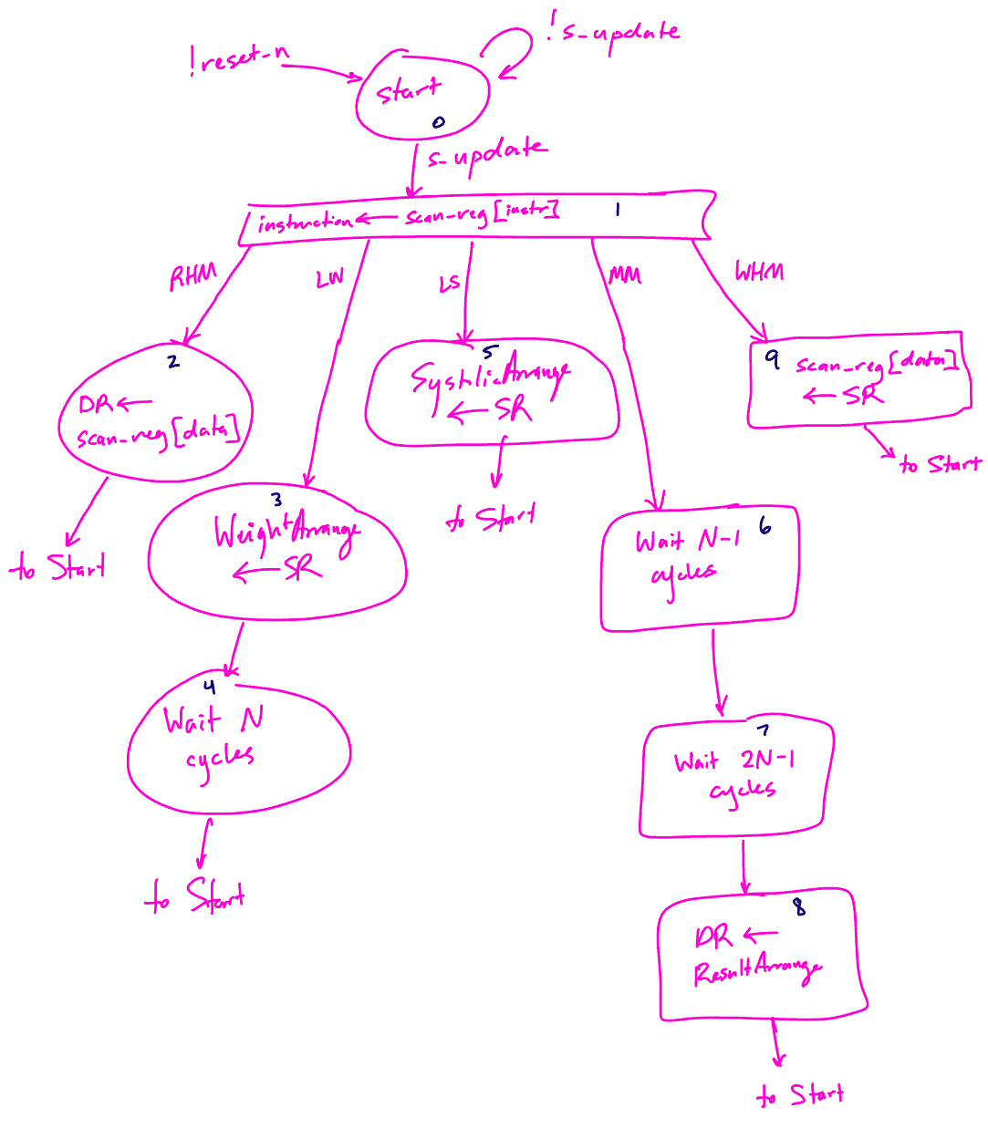
Microarchitecture: ISA
Read Host Memory (RHM)
Ex: RHM R3, MatrixA
Ex: RHM R4, MatrixB
Load Weights (LW)
Ex: LW R3
Load Systolic (LS)
Ex: LS R4
Matrix Multiply (MM)
Ex: MM R5
Write Host Memory (WHM)
Ex: WHM R5, MatrixC
Figure 5. State diagram for TPU control logic.

Slide 9
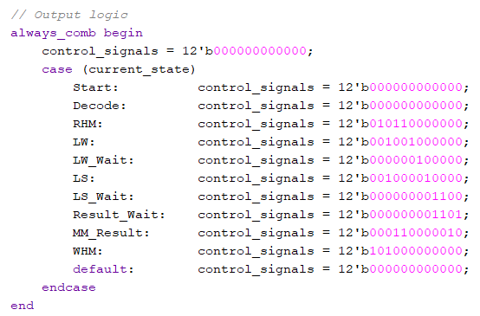
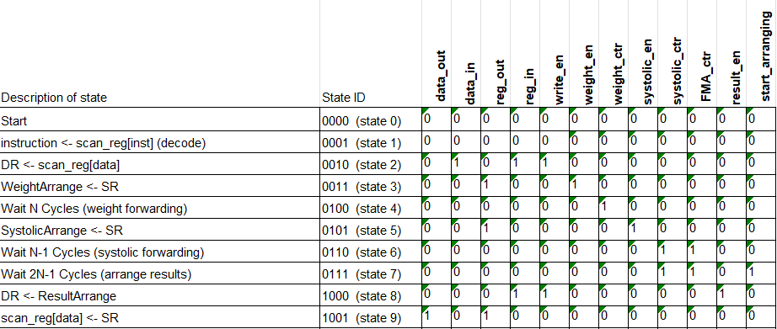
Microarchitecture: Microcoded Control
12 control signals all micro-coded in a Moore FSM.
Figure 6. Microcode planning document in Excel.
Figure 7. Microcode implementation in SystemVerilog.

Slide 10
Microarchitecture: Matrix Array
Weight-stationary systolic array of Fused Multiply-Add processing elements.
Performs the operation C=AB, where A,B,C are NxN matrices, and A is the “weight” matrix, and B is the “systolic” input.
Figure 8. Weight-stationary systolic array matrix multiplication animation.
Original Link HERE.

Slide 11
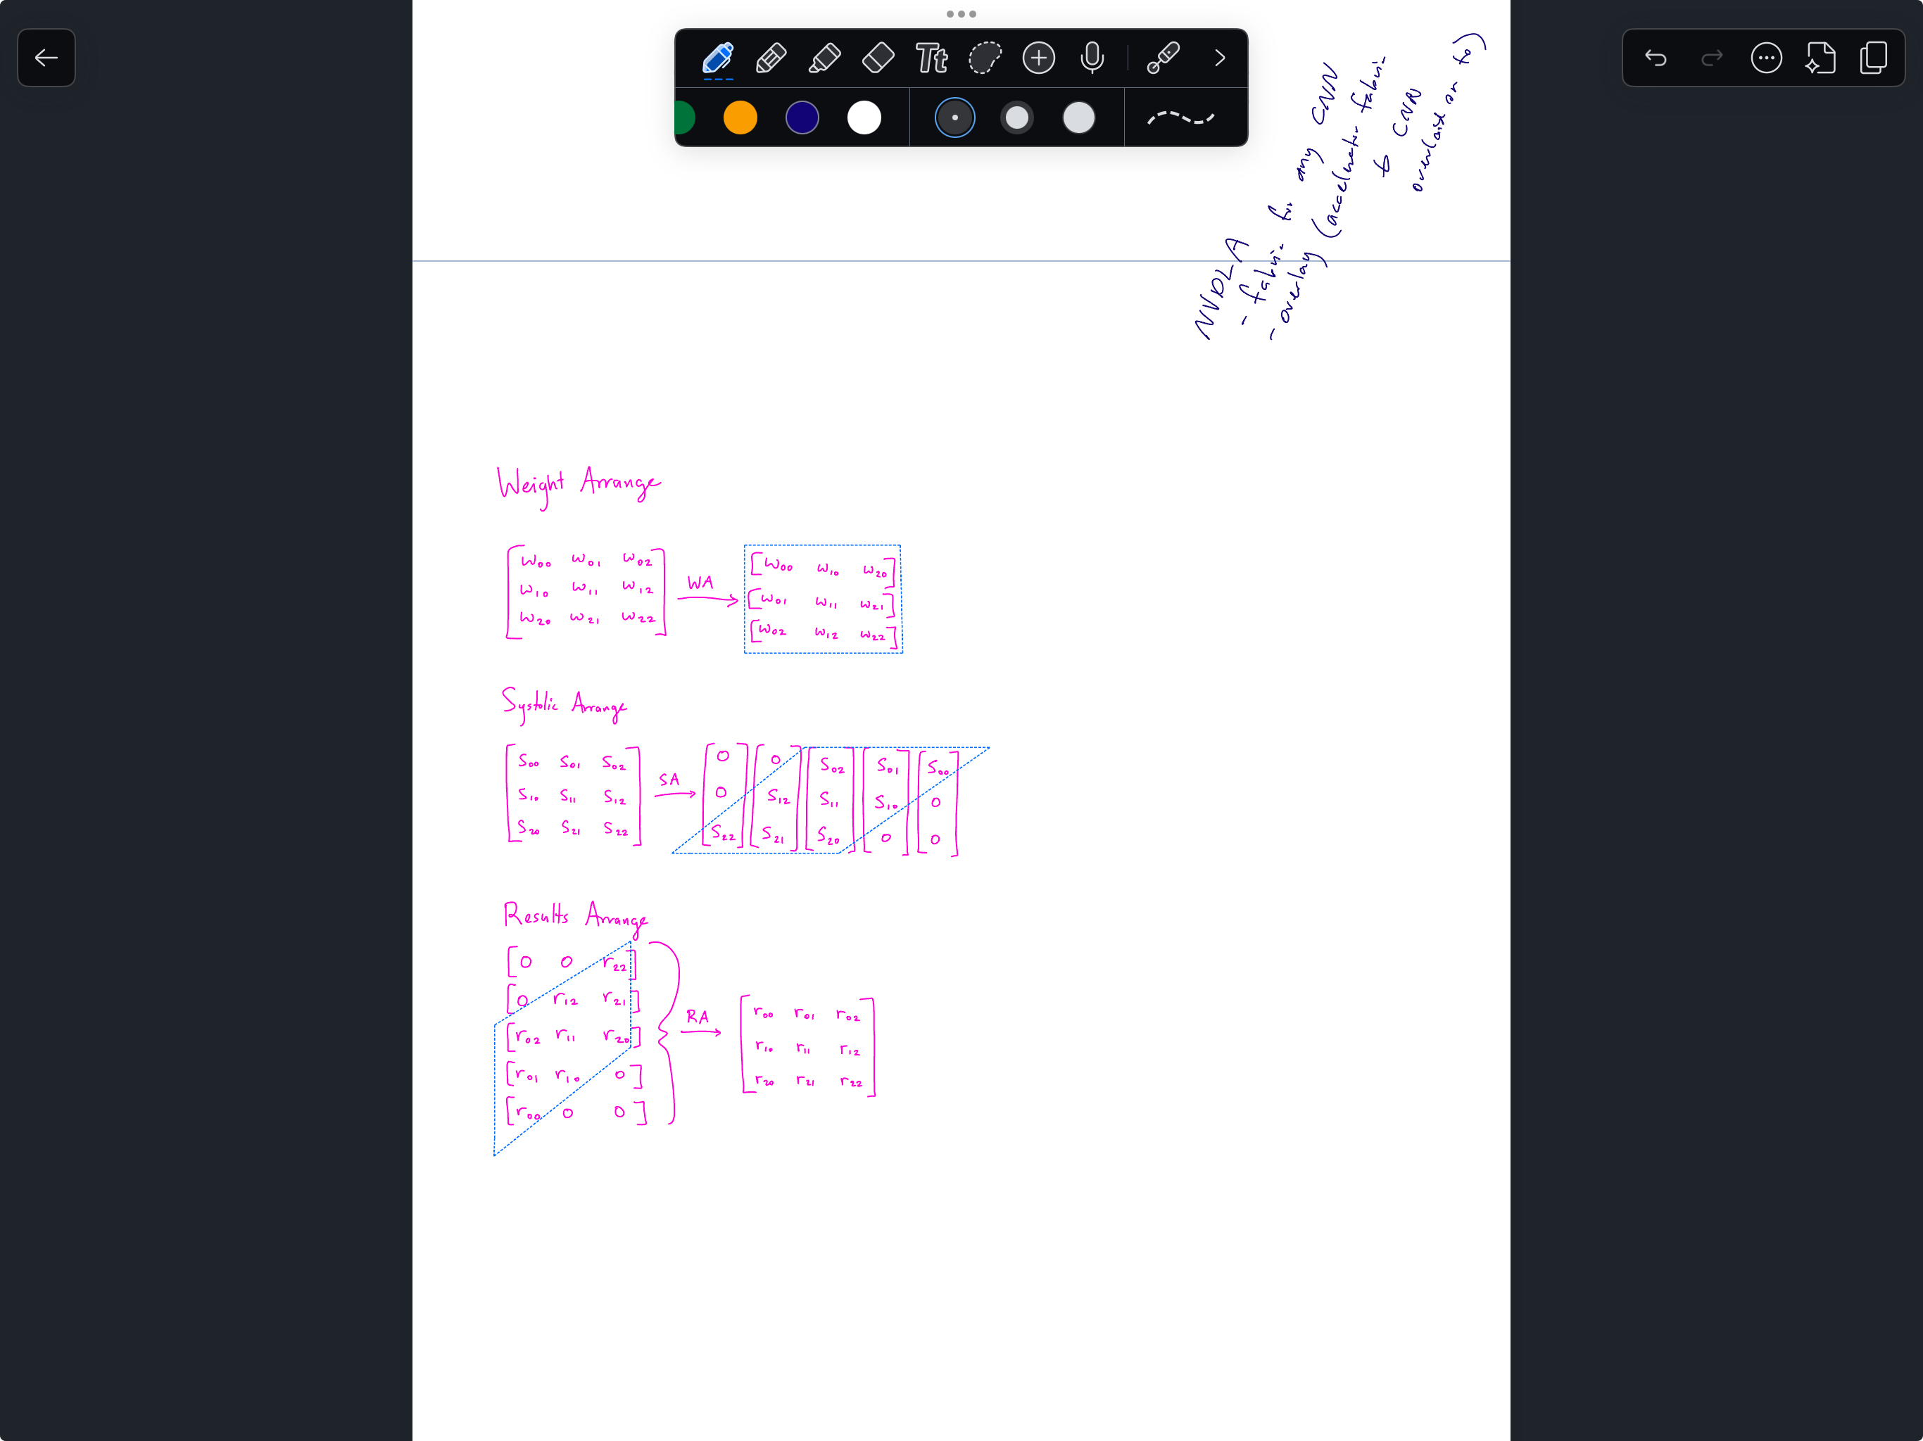
Microarchitecture: Arrange Blocks
Weight Arrange:
Square → Transposed row vectors
Systolic Arrange:
Square → Rhombus col vectors
Result Arrange:
Rhombus row vectors → Square
Figure 9. Breakdown of Arrange Blocks.

Slide 12
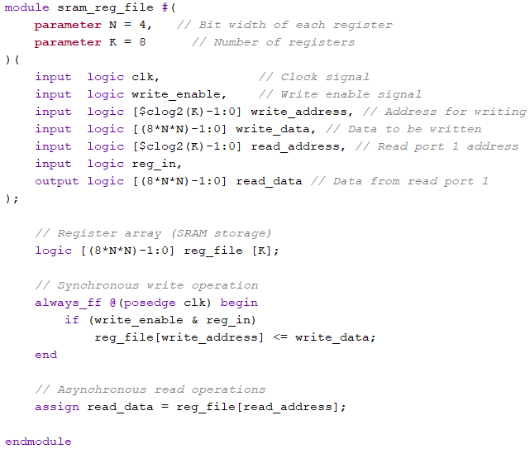
Microarchitecture: Register File
K-many registers.
Each register is 8N² in size.
Originally planned to compile Reg File in SRAM, but did not have time.
Figure 10. Register file implementation in SystemVerilog.

Slide 13
Microarchitecture: Scan Chain
scan_reg is partitioned into two sections: instruction and data.
Total size of scan_reg:
3 + clog2(K) + 8N².
Instruction is copied to control in decode state.
Figure 11. Scan chain architecture.

Slide 14
Microarchitecture: Bottlenecks
Scaling the design on N meant that the design grew quadratically, relative to the systolic array size.
There lacks control logic for Systolic cascaded systolic inputs into the Systolic Arrange block.
The scan chain interface makes the design memory bound, rather than computational bound.

Slide 15
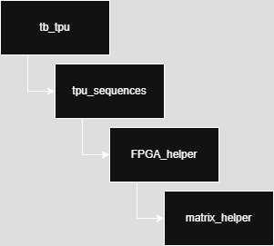
Testing Infrastructure
tb_tpu.sv
Call sequences and establish assertions.
tpu_sequences.sv
Contains basic and randomized sequences.
fpga_helper.sv
Emulates the FPGA driving data and instructions into the TPU.
matrix_helper.sv
Arranges 2D matrices into flattened matrices readable by the TPU.
Figure 12. Custom verification library dependency graph.

