Slide 1
Numerical ODE Accelerator
ECE382N Final Project
By Anthony Hermez
Supervised by Dr. Mark McDermott

Slide 2
Problem
Accelerator to solve differential equations and simulate dynamical systems in High Performance Computing
Applications in:
Protein interactions
Physics simulations
Mathematical modeling
Attempt to make a design that would work for any system of differential equations and then have user application input a system

Slide 3
Project Overview
Tailored the accelerator solves differential equations applied to particle movement
Chose an algorithm to improve simulation accuracy over longer time periods
Currently simulates movement of one particle
Simulated movement rendered through terminal window

Slide 4
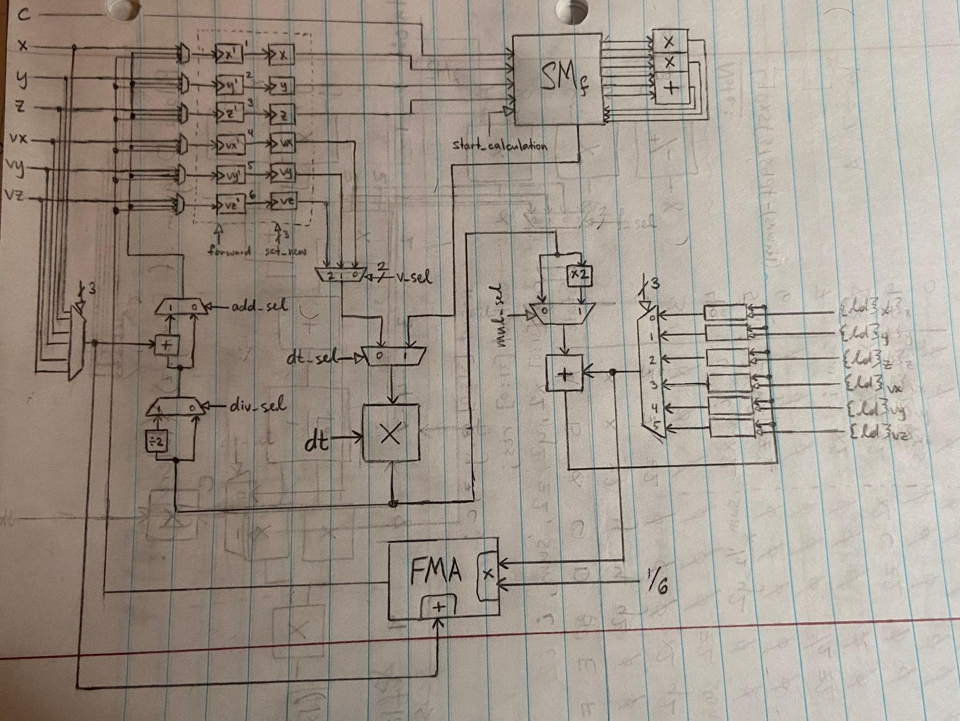
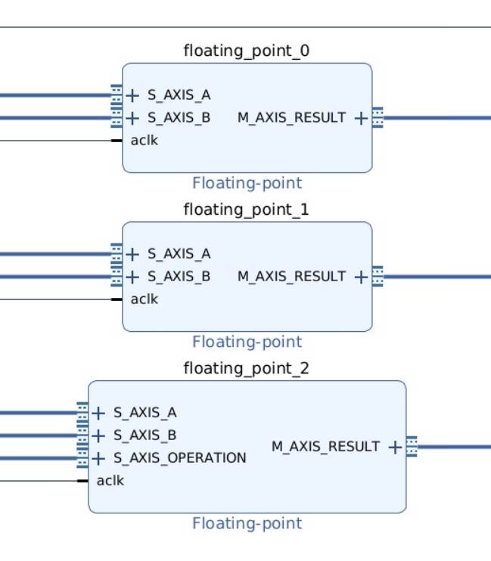
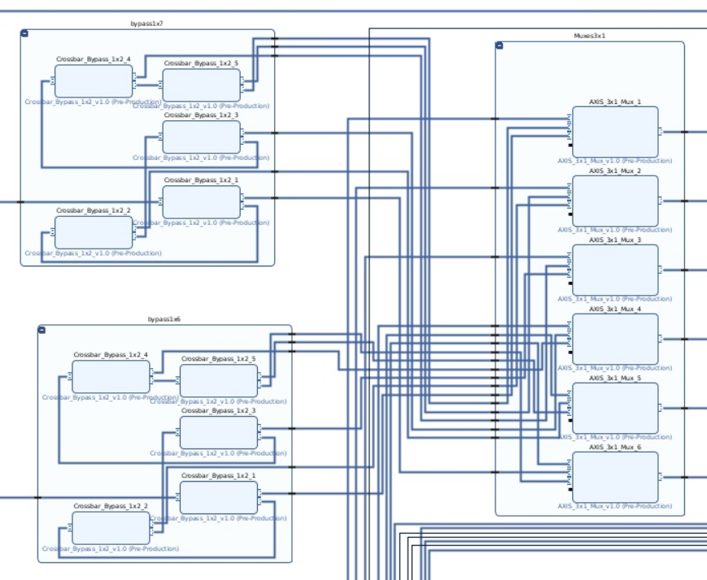
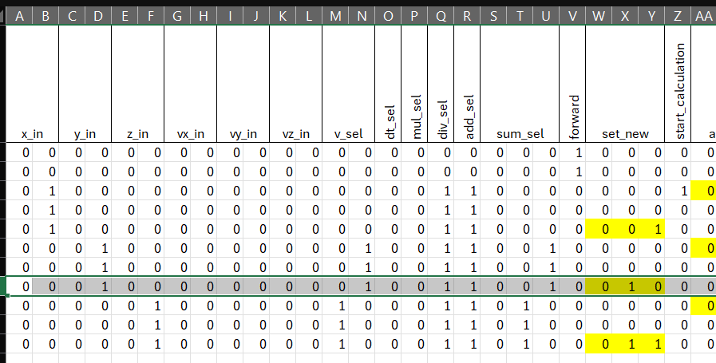
Verilog Overview
Used FP IP provided by Xilinx
IP uses AXI Stream protocol
Designed to minimize DSP Slice usage per diff. eq. Solver
Had to tailor to particle application

Slide 5
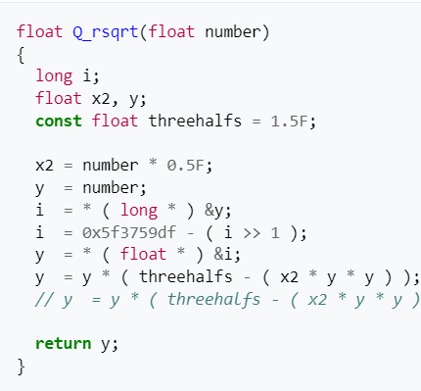
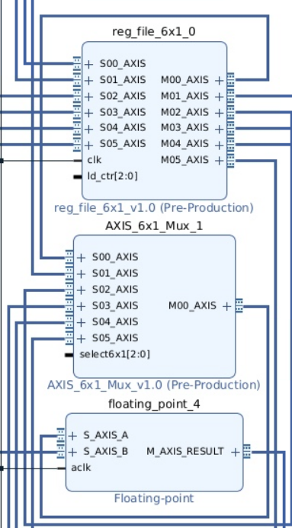
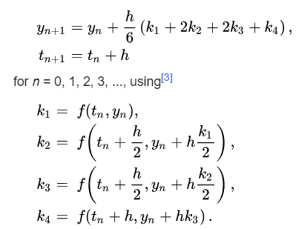
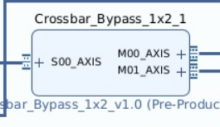
Optimizations
Fast Inverse Sqrt Algorithm
Used 4th order Runge-Kutta
Pipelined resources
Custom Logic

Slide 6

User Application Overview
It is very hard to see, but this is a particle
Application generates random initial states for the particle
Random initial x, y, z position
Random initial x, y, z velocity
Application reads output from accelerator at 30Hz and renders it on the terminal, showing the particle movement
To display Z axis movement
* signifies moving away from screen
~ signifies moving toward screen

Slide 7
Results - Overall
The verilog is written specifically for the particle motion simulator, so each different dynamical system would require different Verilog
Not very portable to other systems
Initially planned to do 40 particles
Took way too many LUTs and DSP slices
Stepped the number down to 15 particles
Why generate random initial conditions instead of letting the user define?
Did not want to have user manually enter 6 initial values for all 40 parameters, so making it random made the program run easier

Slide 8
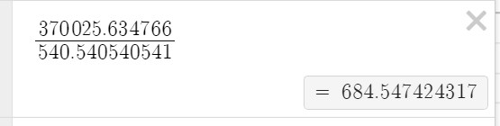
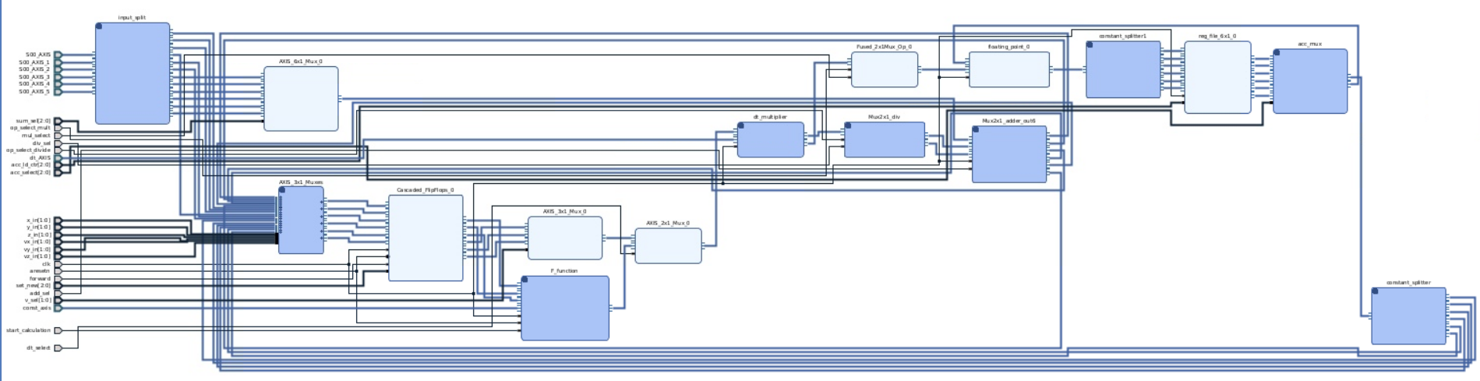
Results - Verilog
14 DSP Slices per solver (originally 45)
Found workarounds to minimize LUT usage
600x faster (theoretically) than software solution (for a single particle)
This is all custom logic!

Slide 9
Results - User Application
Initial plan was to host a web server on the Ultra96 board that read the output from the accelerator to have better rendering capability
FPGA -> Memory -> User Application -> Server
Not a very practical solution
Probably doable, but very unnecessary for the scope of the project
Data refresh rate determined by how fast the terminal could be refreshed
Anywhere between 15 to 33 Hz would render properly
Made parameters in the application such as particle numbers, minimum and maximum values, etc. with a #define, which made changes to the project much easier

Slide 10
Things to do Different
Modify to allow user-inputted initial conditions
Would affect speedup
Find a better way to display the z axis movement
Find a way to make this work with any dynamical system or system of differential equations
While still minimizing DSP usage
Take proper measurements

